Slide 1
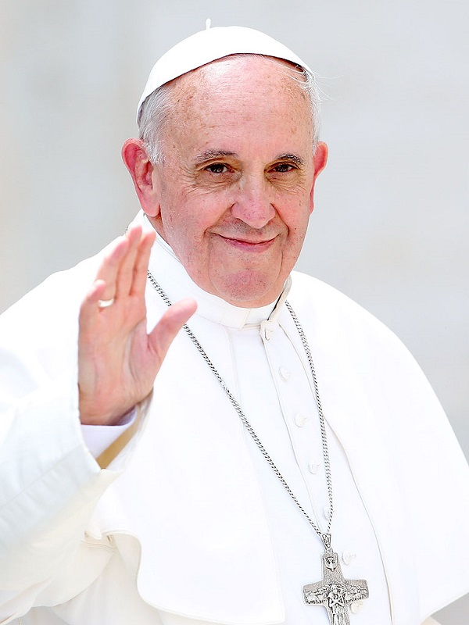
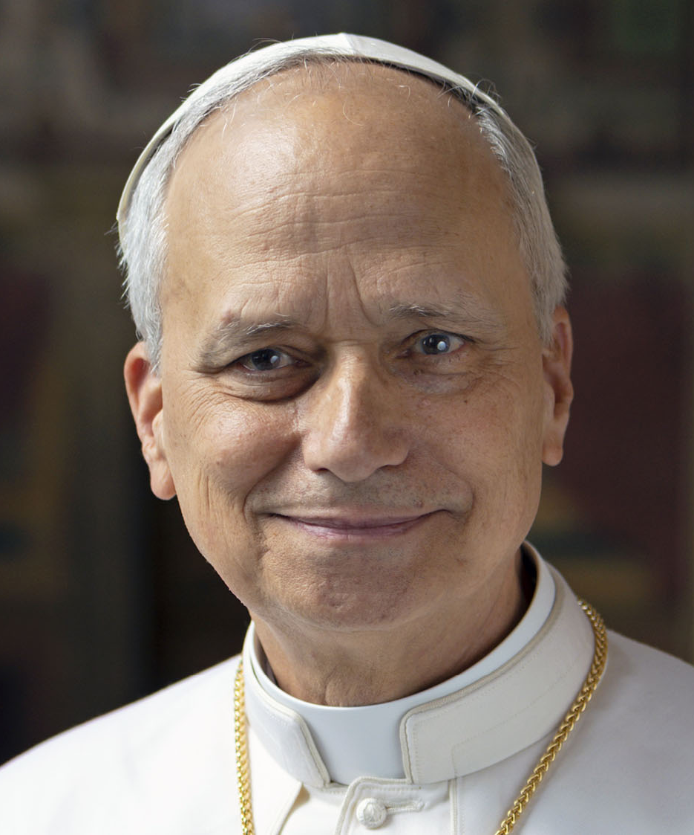
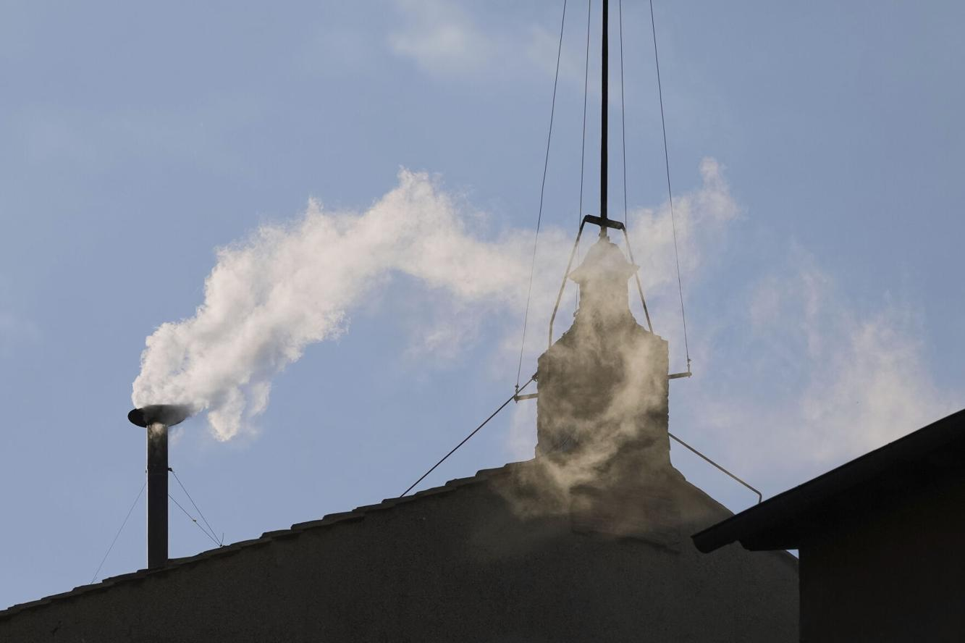
Pope Francis
Died
April 21, 2025
Pope Leo XIV
May 8, 2025

Slide 2
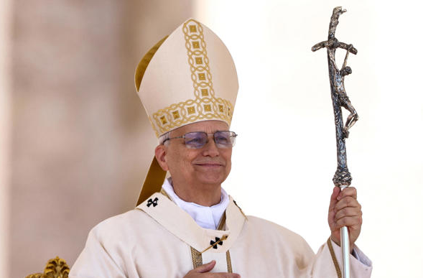
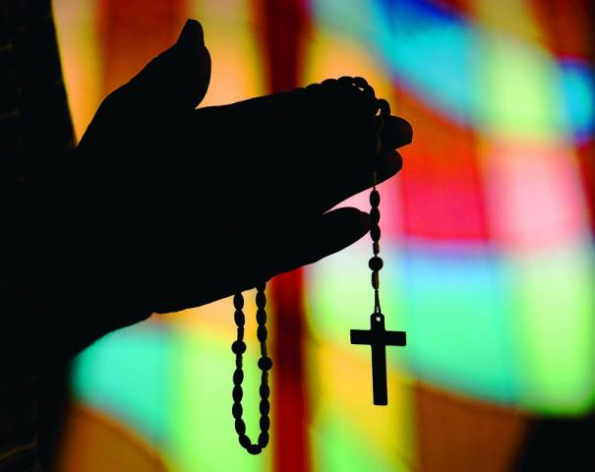
The Catholic Church

Slide 3
Catholic Church
What does the Catholic church believe & teach?
How and when did it begin?
What about their claim that Peter was first Pope?

Slide 4
Catholic Church
One of the first (perhaps the first) denomination
The largest “Christian” denomination (at least half “Christians”)
Powerful (religious, political & business)
“Catholic” = Universal

Slide 5
Catholic Church
Its Origin

Slide 6
Its Origin
Apostles warned of apostasy
  1 Tim. 4:1-3
  Acts 20:28-31 – from within the eldership
  2 Thess. 2:3-12 – a falling away

Slide 7
Its Origin
Apostles warned of apostasy
Departures within the organization of the church
  In NT: elders (plural) in every church (Acts 14:23), each having equal authority (Acts 20:28)
  Began to distinguish between elders (presbyters) and “presiding elders” – later called “bishops”
  Thought “bishops” in larger city churches had more authority
  Councils of bishops would meet – then select presiding bishop
  Now – have Archbishops – They meet – select presiding man –
  Now have Cardinals – Then finally the Pope

Slide 8

Gradually & Slowly
Heb. 2:1
Presiding Elder
(Bishop)
Presiding Cardinal
(POPE)
Elders
Elders
Cardinals
Bishops
Presiding Bishop
(Cardinal)

Slide 9
Hierarchy
of the
Roman
Catholic
Church
Pope
Head
Cardinals
251 worldwide
Archbishops
Over several dioceses
Bishops
Preside over one diocese, many parishes
Priests
Serve in Parish
Deacons
Aid the priest for Mass
The Laity
The People

Slide 10
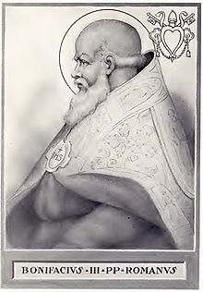
Its Origin
Apostles warned of apostasy
Departures within the organization of the church
Boniface, III
  Bishop of Rome
  Claimed to be “Universal Bishop” (“papa”)
  Declared Pope 607 AD by Roman Emperor

Slide 11
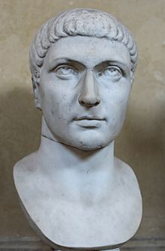
Its Origin
Apostles warned of apostasy
Departures within the organization of the church
Boniface, III
Constantine – Union of church & state
  Roman emperor (306-337)
  Recognized the Council of Nicea (325) as first church law making assembly
  Adopted the “Creed of Nicea”
  Made “Christianity” the national religion

Slide 12
Its Origin
Apostles warned of apostasy
Departures within the organization of the church
Boniface, III
Constantine – Union of church & state
Divisions within the Catholic Church
  In 1054 divided into Greek & Roman Catholic
  Difference in Bishop of Rome & Bishop of Constantinople
  Principally: over “Filioque” addition to the Nicene creed by Roman Catholics [over the Holy Spirit proceeding “from the Son”]

Slide 13
Catholic Church
Its Origin
Its Pope

Slide 14
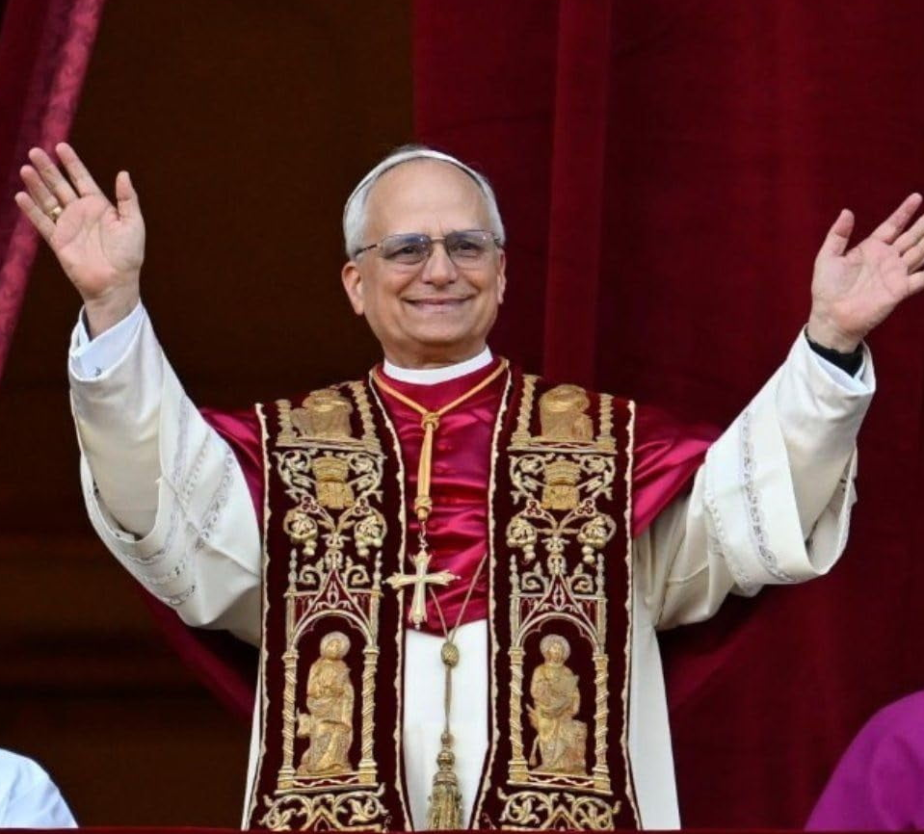
Its Pope
Was Peter the Pope?
  Argued from Matthew 16:16-18

Slide 15
Peter was “the first pope and bishop of Rome, prince of the Apostles, vicar of Jesus Christ, and human foundation of the church.”
- Donald Attwater, A Catholic Dictionary, 380

Slide 16
Peter
Rock
petros
petra
Masculine (form)
Small rock / Pebble
Feminine (form)
Boulder / Bedrock

Slide 17

“On this rock I will build my church…” (v. 18)
“You are the Christ, the Son of the living God” (v. 16)

Slide 18
Its Pope
Was Peter the Pope?
  Argued from Matthew 16:16-18
  Peter could not have been Pope
    Bible is silent about it (1 Pet. 4:11)
    Same authority given to all apostles (Matt. 18:18)
    Identified self as an apostle (1 Pet. 1:1) – never as Pope
    Peter was married (Matt. 8:14; 1 Cor. 9:5; 1 Pet. 5:1)
    Peter stopped Cornelius from bowing & worshipping him (Acts 10:25-26)
    Would expect some evidence in his writings (1 & 2 Peter) – None!
    Refers to himself as an apostle / servant (1 Pet. 1:1; 2 Pet. 1:1) and fellow elder (1 Pet. 5:1), but never as Pope.

Slide 19
Its Pope
Was Peter the Pope?
  Argued from Matthew 16:16-18
  Peter could not have been Pope
  No evidence that he was ever in Rome
    Paul’s letter to the Romans never mentions the “Holy Father” who sits in the Papal chair
    Paul spent two years in Rome – never mentioned any contact with the “Pontiff”

Slide 20
Peter’s Powers Did Not Cease at Death
“…whatever official prerogatives were conferred on Peter were not to cease at his death, but were handed down to his successors from generation to generation.”
Archbishop James Cardinal Gibbons, as cited in Church History, John D. Cox, 44)

Slide 21
Its Pope
Was Peter the Pope?
Pope thought to be infallible
  Declared in 1870
    Does that mean were fallible before 1870?
    Does that mean were infallible but didn’t know it?
  Not saying he is inspired (Faith of our Fathers, 99)
  Holy Spirit guides him – so that does not err
  Only when he speaks “ex Cathedra” (from the chair)

Slide 22
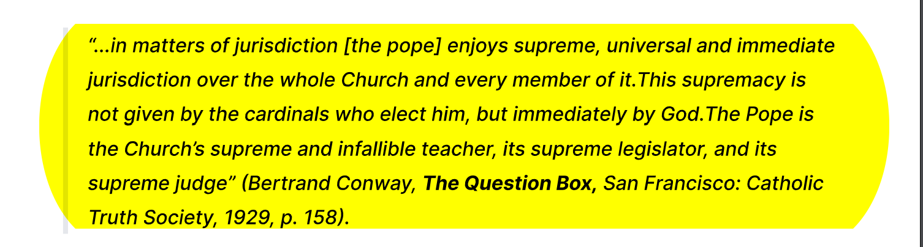
Pope is Infallible

Slide 23
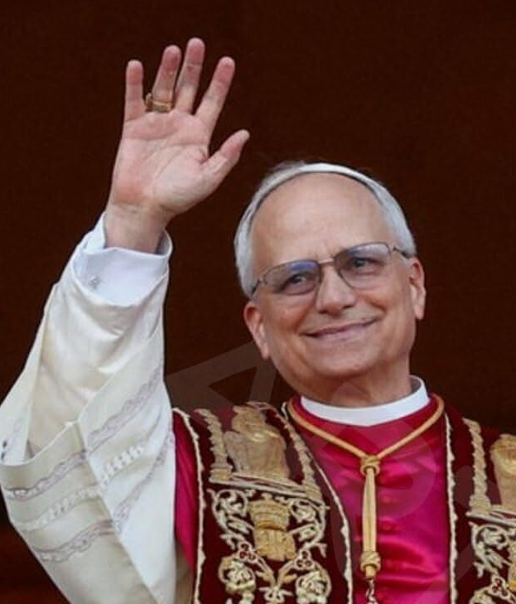
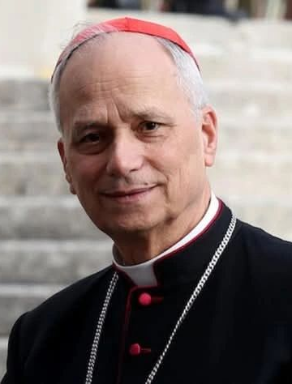
Pope is Infallible
May 7, 2025
May 8, 2025
God Changes Him
Fallible
Infallible
Robert Francis Prevost
Pope Leo XIV

Slide 24
The Pope is the “Vicor of Christ”
Means: he stands in the place of Christ on earth
He has “so great authority and power that he can modify, explain or interpret even divine laws” (The Converted Catholic Magazine, Jan 1946)
Means: his opinion overrules Scripture!
Compare: Gal. 1:8

Slide 25
Its Pope
Was Peter the Pope?
Pope thought to be infallible
Christ is the head of the church
  Matt. 28:18-19 – All authority
  Eph. 1:22-23
  Eph. 5:23
  Col. 1:18

Slide 26
Its Pope
Was Peter the Pope?
Pope thought to be infallible
Christ is the head of the church
Catholic head dies – or quits
  When Pope dies – head is dead (i.e. April 2005; April 2025)
  When Pope resigns – head quits (i.e. Feb. 2013)
  Our head doesn’t die or quit!

Slide 27
Catholic Church
Its Origin
Its Pope
Its Doctrine

Slide 28
Its Doctrine
Authority
  Catholic concept:
    Tradition, apocryphal writings, Pope’s words – par with Bible
    Bible cannot be understood by all
    Only Catholics have right to interpret the Bible
    Catholics are not encouraged to read & study their Bibles
  The Bible:
    Bible is our only guide (2 Tim. 3:16-17; Rev. 22:18-19)
    Can be understood (Eph. 3:3-5)
    Any who can read can interpret (Eph. 3:3-5; John 5:39)

Slide 29
Its Doctrine
Authority
Purgatory
  Says if one dies in sin / lost – can pray for him – saved after death
  Luke 16:19-31- great gulf fixed – cannot pass

Slide 30
Its Doctrine
Authority
Purgatory
Mary
  Catholic view of Mary:
    Immaculate: she was free from original sin
    She is to be worshipped – Mother of God
    Pray to Mary
  Bible:
    Mary was just a human being (John 2:3-4)
    Never worshipped in the Bible
    Mary tells people to follow Christ – not her (John 2:5)

Slide 31
Catholic Church
Its Origin
Its Pope
Its Doctrine
Its Sacraments

Slide 32
Its Sacraments
Sacrament of Baptism
Sacrament of Confirmation
Sacrament of Penance
Sacrament of Extreme Unction
Sacrament of Holy Orders
Sacrament of Matrimony
Sacrament of Mass / Holy Eucharist

Slide 33
Sacrament:
“A visible sign instituted by Christ by which grace is conveyed to our souls. Three things are necessary to constitute a Sacrament, viz. – a visible sign, invisible grace and the institution by our Lord Jesus Christ.”
(James Cardinal Gibbons, The Faith of Our Fathers, 218)

Slide 34
7 Sacraments
Sacrament of Baptism
Sacrament of Confirmation
Catholics Admit – Not in the Bible
Established by Council of Trent (1545-1563 AD)
Sacrament of Penance
Sacrament of Extreme Unction
Sacrament of Holy Orders
Sacrament of Matrimony
Sacrament of Mass / Holy Eucharist

Slide 35
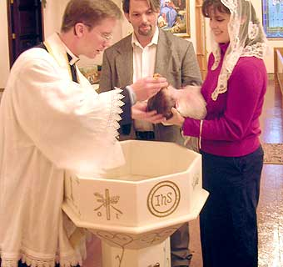
Sacrament of Baptism
Purpose: Cleanse from original sin
(Visible Church, 39)
Action: Sprinkling
Immersion never essential (Visible Church, 39)
Subjects: Infants included (Visible Church, 39)
  Not until the 9th Century was this practiced
  Baptize babies to save them from original sin
Power in the water

Slide 36
Power in the Water
“Though water of any kind was used for the administration of this Sacrament, the custom and blessing the water is of very great antiquity, and soon became universal in the Church. And very naturally so, because the water which is used in baptism is raised by the work of the Holy Spirit to the dignity of an instrumental cause of our regeneration, and as such is fittingly hallowed by a blessing. We find this custom frequently referred to by the Fathers….”
-The Teaching of the Catholic Church, V. II, 770ff

Slide 37

Sacrament of Baptism
Biblical Response
No original sin (Ezek. 18)
If take away original sin – why is the next generation guilty of Adam’s sin?
Baptism is immersion (Rom. 6:3-4)
Infants are not penitent believers (Acts 2:36-38)

Slide 38
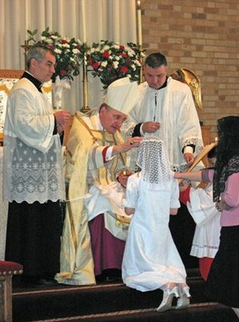
Sacrament of Confirmation
Purpose: Impart strength to live Christian life
“Confirmation is a Sacrament in which, through the imposition of the Bishops’ hands, unction and prayer, baptized persons receive the Holy Ghost, that they may steadfastly profess their faith and lead upright lives.”
(James Cardinal Gibbons, The Faith of Our Fathers, 230)

Slide 39
Sacrament of Confirmation
Purpose: Impart strength to live Christian life
Instituted by Lord – Yet not in the Bible (Visible Church, 47)
Administered:
  When child is about 7 years old (The Teachings of the Catholic Church)
  By the Bishop every five years (Visible Church, 48)

Slide 40
Sacrament of Confirmation
Purpose: Impart strength to live Christian life
Instituted by Lord – Yet not in the Bible (Visible Church, 47)
Administered:
The Ceremony:
  Anoint with oil
  Says words: “I sign thee with the sign of the cross and confirm thee with the chrism of salvation in the name of the Father, Son, and Holy Ghost.”
  Bishop blows on cheek of person being confirmed
  Bishop pronounces the Pax Tecum (“Peace be with you”)

Slide 41
Sacrament of Confirmation
Biblical Response
Nothing like it in NT (1 Pet. 4:11)
Strengthened through the word (Acts 20:32)
Any Christian has the strength to do what God demands (Phil. 4:13)

Slide 42
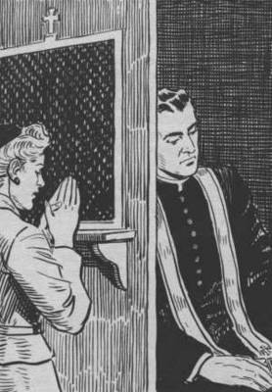
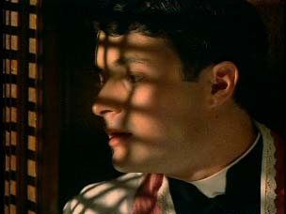
Sacrament of Penance
Confession & Prayer: at times for a professional fee
Jurisdiction: All priests have power to forgive sin, but they must have special permission to use that power (Visible Church, 51)
Confession:
  In secret (Confessional box, Visible Church, 52)
  Priest can cross question
  Allows the church to know the inner secrets
Satisfaction - Priest forgives the sin
Gave rise to Indulgences – exemption from punishment. Pardon sins intend to commit. (Selling)

Slide 43
Sacrament of Penance
Biblical Response
Nothing like it in NT (1 Pet. 4:11)
Christians who sin – repent & pray (Acts 8:22)
Confession to God (1 John 1:9)
Confession to one another (Jas. 5:16)
Every Christian = Priest (1 Pet. 2:5)

Slide 44
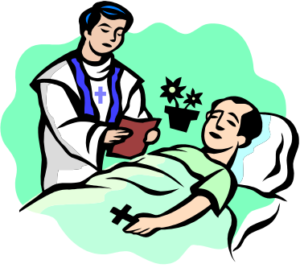
Sacrament of Extreme Unction
Last Anointing: Priest prays & anoints one who is in danger of dying. “Extreme” because it is the Last!
Origin: “Extreme unction, like all other sacraments was instituted by the blessed Lord, but there is no mention of it in the gospel.” (Visible Church, 55)
Items Used: Oil, table with white cloth, a crucifix, two candles, holy water, sprinkler, fresh water, spoon, napkins, balls of cotton
Ceremony: -

Slide 45
Ceremony – Extreme Unction
Sprinkle all persons in the room
Sprinkle sick person
Thumb of priest dipped in oil – makes sign of cross
  On eyes –for sins of sight
  On ears – for sins of hearing
  On nose – for sins of smelling
  On Lips – for sins of talking
  On feet – for sins of walking
Receives “Plenary Indulgence” = Full pardon

Slide 46
Sacrament of Extreme Unction
Last Anointing: Priest prays & anoints one who is in danger of dying. “Extreme” because it is the Last!
Origin: “Extreme unction, like all other sacraments was instituted by the blessed Lord, but there is no mention of it in the gospel.” (Visible Church, 55)
Items Used: Oil, table with white cloth, a crucifix, two candles, holy water, sprinkler, fresh water, spoon, napkins, balls of cotton
Ceremony: -
Timing of the Blessing – Only takes if patient dies

Slide 47
Sacrament of
Extreme Unction
Biblical Response
Nothing like it in NT (1 Pet. 4:11)
James 5 – call for elders who pray for the sick (not merely dying)
James 5 – Pray that they recover (not die)

Slide 48
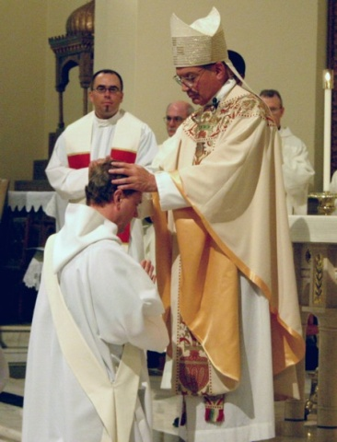
Sacrament of Holy Orders
Means by which priest are ordained
Tonsure: signify one taken from Laity to Clergy
  Cut some hair off – shaving circular spot – Top
  Bishop clips locks of hair
Minor Orders: Porter (Priest’s helper)
Deaconship (Required before Priesthood / Celibate)
Priesthood:
  Once a priest – always a priest
  Power to conduct mass, forgive sins, bless anyone or anything, rule the flock, administer sacraments.
  Power equal to Christ

Slide 49
Sacrament of Holy Orders
Means by which priest are ordained
Biblical Response
Nothing like it in NT (1 Pet. 4:11)
All Christian are priest (1 Pet. 2:5)
  Married men
  Women
NT Priest have no such power!

Slide 50
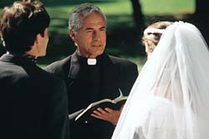
Sacrament of Matrimony
Lawful marriage = lawful according to Council of Trent
Pauline Privilege – Believer (Catholic) married to unbeliever (non-Catholic) can leave marriage and marry again
Indissolubility of Marriage – marriage dissolved only by death (not even fornication)
Limitations on Marriage -

Slide 51
Limitations On Marriage
Must be by Priest in own Parish
Vow of virginity cannot be withdrawn
Sponsor for baptism cannot marry one he sponsors (Visible Church, 78)
Cannot marry a non-Catholic without permission of Catholic church
Clandestiny – no marriage is to be kept secret from the priest

Slide 52
Sacrament
of Matrimony
Biblical Response
Nothing like it in NT (1 Pet. 4:11)
Christ has the law on marriage (Matt. 19:4-9)
Christ allowed divorce for fornication (Matt. 19:9)
Believer & unbeliever to stay together (1 Cor. 7)

Slide 53
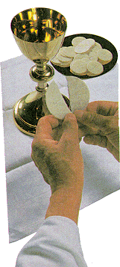
Sacrament of Mass / Holy Eucharist
Meaning of mass from Latin = to send away
Observance of sacrifice of Christ
Transubstantiation– Physical body & blood of Christ is transferred to bread & wine (literally!)
Many kinds of Mass
Sacrifice Christ over and over again (Matthews, 141)

Slide 54
Sacrament of Mass /
Holy Eucharist
Biblical Response
Nothing like it in NT (1 Pet. 4:11)
Matt. 26 – Jesus (while in his fleshly body & blood still in veins) gave bread and fruit of vine & said it was his body and blood.
Figurative language (i.e. he is “door”, “vine”, etc)
Matt. 26 – disciples were not shocked or baffled!
1 Cor. 10:17 – we are one bread (do we turn into bread as we eat?)
Christ suffered once (Heb. 9:25-28)

Slide 55
Catholic Church
Its Origin
Its Pope
Its Doctrine
Its Sacraments

