Slide 2
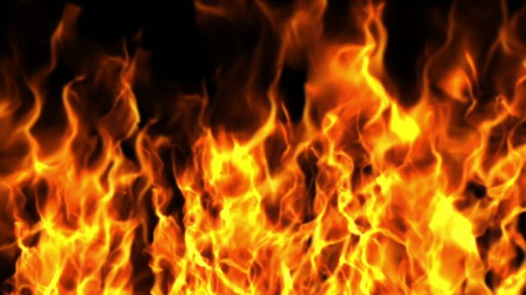
HELL
A Place Without Mercy

Slide 3

“Blessed are the merciful, for they shall obtain mercy” (Matt. 5:7).
“For judgment is without mercy to the one who has shown no mercy. Mercy triumphs over judgment” (James 2:13).

Slide 4
Why do we need mercy?
“For we must all appear before the judgment seat of Christ, that each one may receive the things done in the body…” (2 Cor. 5:10).

Slide 5
Why does Hell exist?
The punishment for rebellion against God.
“Then He will also say to those on the left hand, ‘Depart from Me, you cursed, into the everlasting fire prepared for the devil and
his angels’” (Matt. 25:41).

Slide 6

What is mercy?
“kind or compassionate treatment; relief from suffering” (Webster’s Dictionary).
Hell is a place completely
without mercy!

Slide 7
No Mercy in the Way Hell is Described
Fire - Mark 9:43-48; Rev. 20:14-15
Worm Doesn’t Die - Mark 9:43-48
Outer Darkness - Matt. 8:12; 22:13; 25:30
Weeping and Gnashing of Teeth
Torment - Rev. 20:10; Matt. 18:34

Slide 8
No Mercy in the Way Hell Begins
“Then He will also say to those on the left hand, ‘Depart from Me, you cursed, into the everlasting fire prepared for the devil and his angels’” (Matt. 25:41).

Slide 9
No Mercy in the Way Hell Begins
“But the sons of the kingdom will be cast out into outer darkness…” (Matt. 8:12).
“…will cast them into the furnace of fire. There will be wailing and gnashing of teeth” (13:42).
“Bind him hand and foot, take him away, and
cast him into outer darkness” (22:13).
“And cast the unprofitable servant into the outer darkness” (25:30).

Slide 10
No Mercy in the Way Hell is Experienced
He was in the flame - Luke 16:24
There was no relief from his suffering
There was no escape - v. 26
  No purgatory
  No annihilation - Matt. 25:46; Heb. 10:28-29

Slide 11
HELL
A Place Without Mercy

