Slide 2
This Week’s Sermons
Monday The Power Behind Pentecost
Tuesday The Requirements of Bible Baptism
Wednesday Who Pays When I Sin?
Thursday Hell - A Place Without Mercy
Friday Why I Long For Heaven

Slide 3

The Power Behind Pentecost
Acts 2

Slide 4
1. The Gospel Was Preached
“For I am not ashamed of the gospel of Christ, for it is the power of God to salvation for everyone who believes, for the Jew first and also for the Greek” (Romans 1:16).

Slide 5
1. The Gospel Was Preached
“whoever calls on the name of the Lord shall be saved” (v. 21)
They are convicted of their guilt (vs. 36-37)
They obey what they are told to do to be saved (vs. 38-41).

Slide 6
2. The Holy Spirit Was Poured Out
Acts 2:1-4
Caused the apostles to speak in tongues.
Produced a loud sound, drawing a multitude to the apostles.

Slide 7
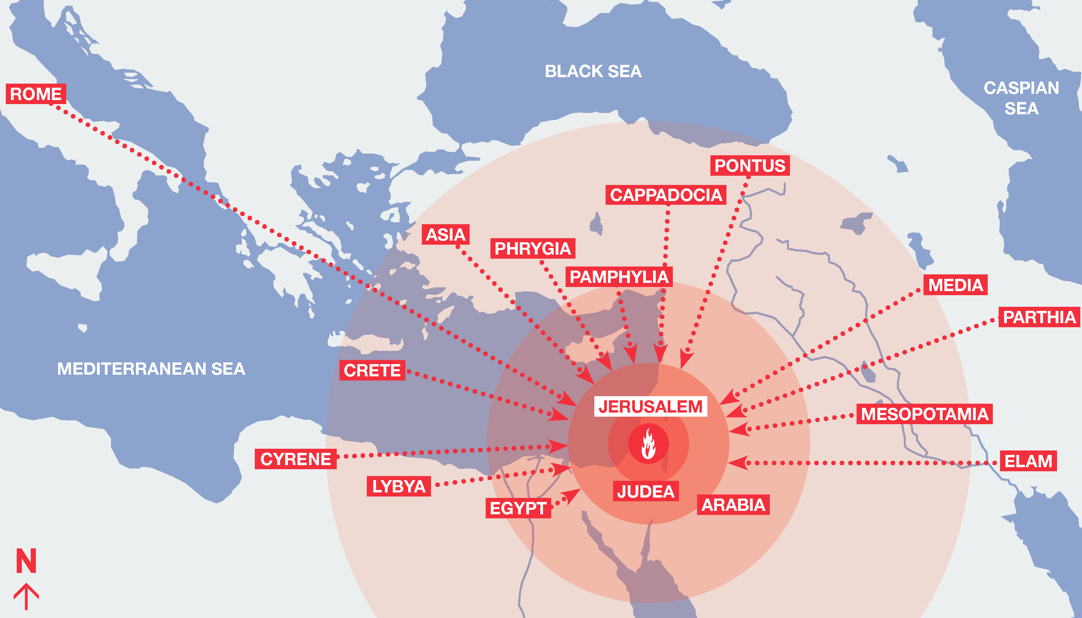
3. There Was a Unique Audience
“And there were dwelling in Jerusalem Jews, devout men, from every nation under heaven” (Acts 2:5).

Slide 8
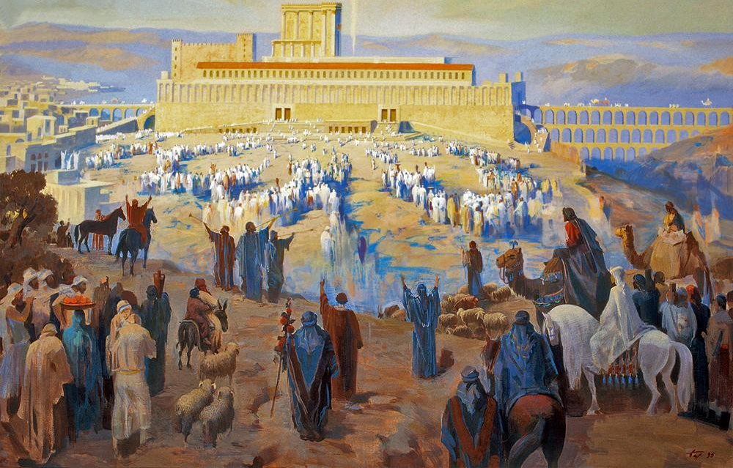
3. There Was a Unique Audience
“And there were dwelling in Jerusalem Jews, devout men, from every nation under heaven” (Acts 2:5).

Slide 9
4. They Had Witnessed Unique Events

Slide 10
4. They Had Witnessed Unique Events
And He said to them, “What kind of conversation is this that you have with one another as you walk and are sad?”
Then the one whose name was Cleopas answered and said to Him, “Are You the only stranger in Jerusalem, and have You not known the things which happened there in these days?”
Luke 24:17-18

Slide 11
4. They Had Witnessed Unique Events
Men of Israel, hear these words: Jesus of Nazareth, a Man attested by God to you by miracles, wonders, and signs which God did through Him in your midst, as you yourselves also know
Him, being delivered by the determined purpose and foreknowledge of God, you have taken by lawless hands, have crucified, and put to death;
whom God raised up, having loosed the pains of death, because it was not possible that He should be held by it.
Acts 2:22-24

Slide 12
4. They Had Witnessed Unique Events
3 hours of darkness - Matt. 27:45
Earthquake - Matt. 27:51
Veil of temple torn in two - Matt. 27:51
Many dead were raised - Matt. 27:52-53

Slide 13
4. They Had Witnessed Unique Events
Many dead were raised
Jesus crucified
3 hours of darkness
Earthquake
Veil of temple torn in two
Jesus raised from dead
Jesus triumphal entry

Slide 14
Peter’s Sermon Pieced it Together
vs. 22-24 Jesus, death, resurrection
vs. 25-28 Old Testament foretold this
vs. 29-31 David spoke of the Christ
v. 32 The apostles are eyewitnesses of the resurrected Christ
vs. 33-36 Outpouring of Holy Spirit is proof that Jesus is
the exalted Christ, whom they killed
v. 37 “they were cut to the heart”

Slide 15
The Power Behind Pentecost
The Gospel Was Preached
The Holy Spirit Was Poured Out
There Was a Unique Audience
They Had Witnessed Unique Events

