Slide 2
This Week’s Sermons
Sunday
9:00 am The Impact of Smart Devices and Social Media on the Family
9:50 am How to Live Like a King
5:30 pm Remove Not the Ancient Landmarks

Slide 3
This Week’s Sermons
Monday The Power Behind Pentecost
Tuesday The Requirements of Bible Baptism
Wednesday Who Pays When I Sin?
Thursday Hell - A Place Without Mercy
Friday Why I Long For Heaven

Slide 4
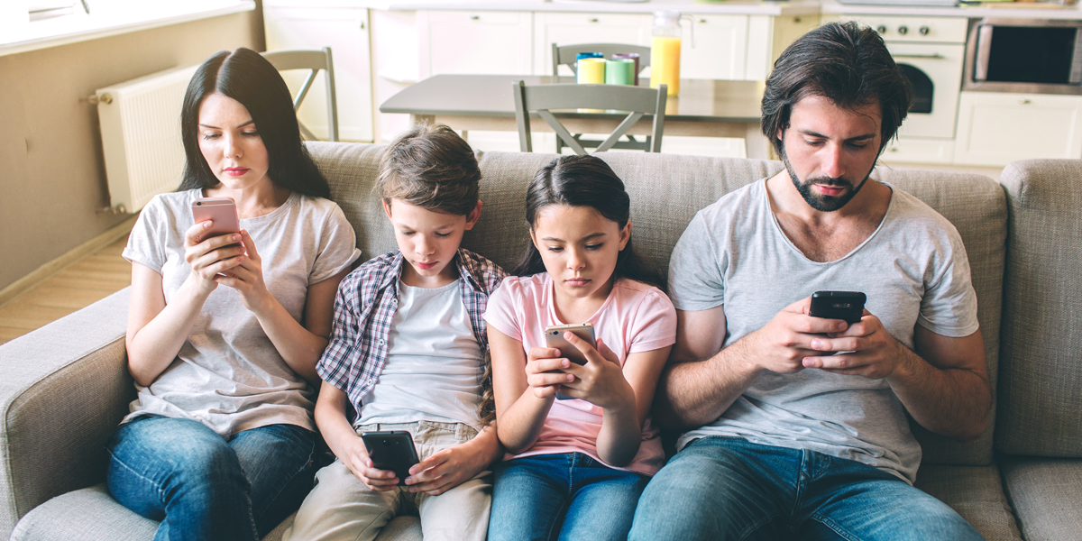
The Impact of Smart Devices and Social Media on the Family

Slide 5
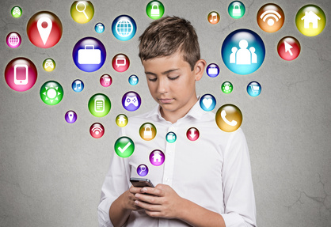
Smart Devices/Phones
Communication
Navigation
Media
Organization
Shopping
Gaming
Utilities
Virtual Assistant
Social Media

Slide 6
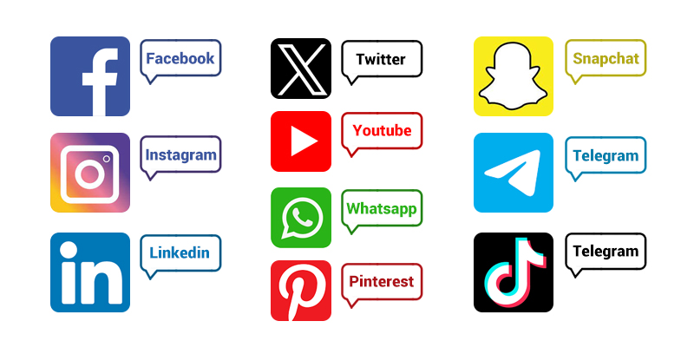
Media: “the transmission of information from a source to a recipient.
Social Media: “instantaneous electronic social communication (sharing of personal information) where a transfer of information takes place with two or more people.”

Slide 7

Benefits of Social Media
Maintaining Relationships
Creative Expression
Community Building
Information Sharing
Personal Branding
Business Opportunities
Networking
Advocacy and Activism
Learning and Education
Entertainment and Leisure

Slide 8
Negative Impact on Family
Wives, submit to your own husbands, as is fitting in the Lord.
Husbands, love your wives and do not be bitter toward them.
Children, obey your parents in all things, for this is well pleasing to the Lord.
Fathers, do not provoke your children, lest they become discouraged.
Colossians 3:18-21

Slide 9

1. Addiction
Platforms have been purposefully designed to become addictive to users.
They collect personal data and create algorithms to keep users engaged and scrolling.
Every “like,” comment, and share gives us a dose of dopamine, which causes users to share more content.
“Social-Validation Feedback Loop”

Slide 10
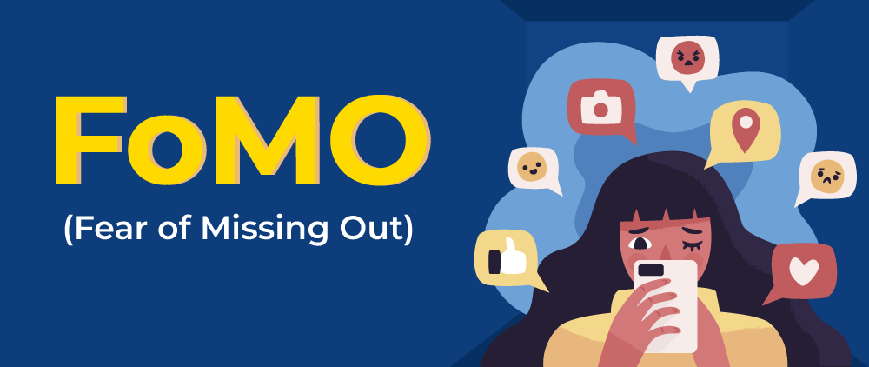
1. Addiction
“Fear of Missing Out”
When it feels like everyone else is on social media, we feel like we can’t log off or we will miss out on something important.
If we aren’t logged on and
participating, we become
“invisible.”

Slide 11
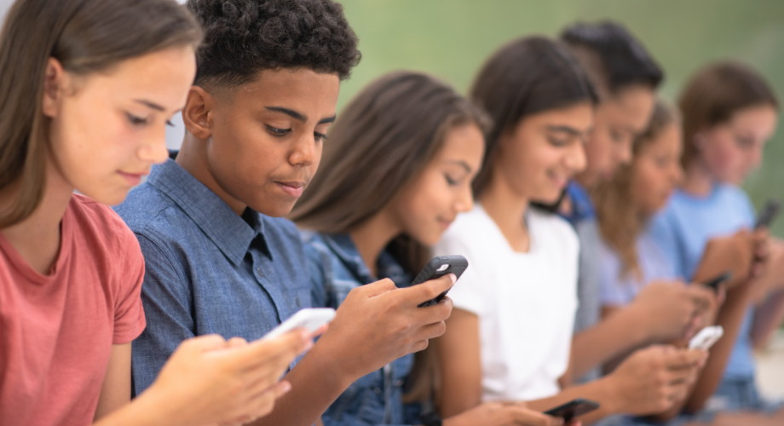
1. Addiction
96% of teens report using the internet daily.
46% of teens say they are online almost constantly.
44% of teens say they feel anxious without their phones.

Slide 12
1. Addiction
On average, people spend 5 hours a day on their smart phones.
47% of parents say they spend too much time on their smart phones.
46% of teens say their parent is at least sometimes distracted by their phone when they’re trying to talk to them.
Half of parents use their phone while driving with their children in their vehicles.

Slide 13
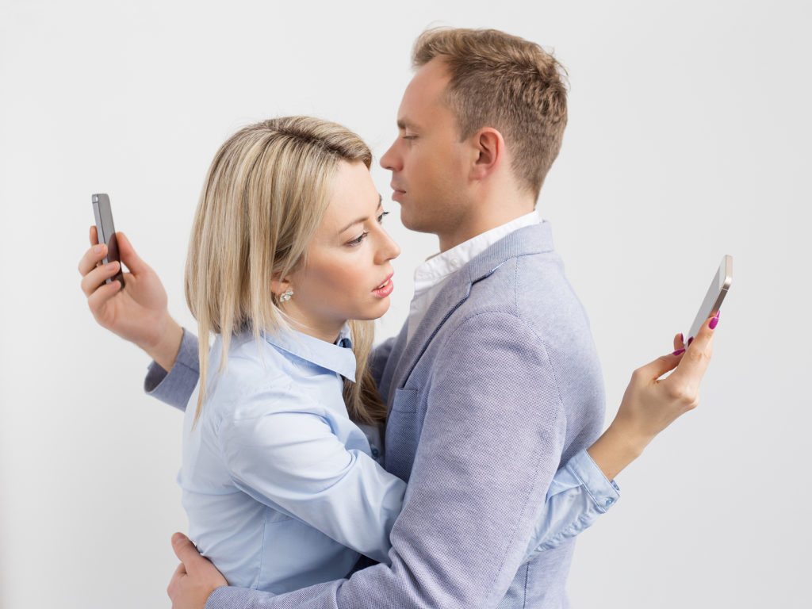
2. Decreased Face-to-Face Interaction
Nurturing the marriage relationship requires time spent together with one another.
1 Corinthians 7:2-5

Slide 14
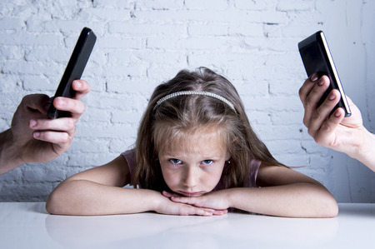
2. Decreased Face-to-Face Interaction
Parenting requires time and personal interaction.
“bring them up in the
training and admonition
of the Lord” (Eph. 6:4).

Slide 15

3. Conflict
4 in 10 parents say it’s hard to manage how much time their teen spends on their phone.
4 in 10 parents and teens
report regularly arguing with
one another about this subject.
Half of parents say they have
looked through their
teens’ phone.

Slide 16
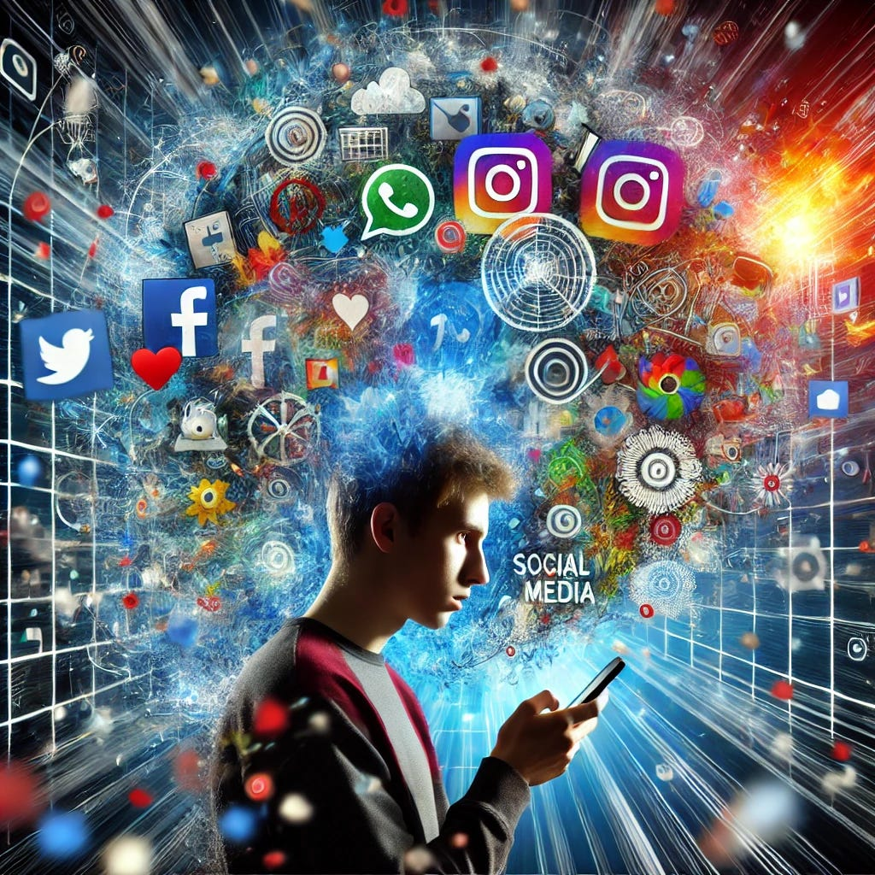
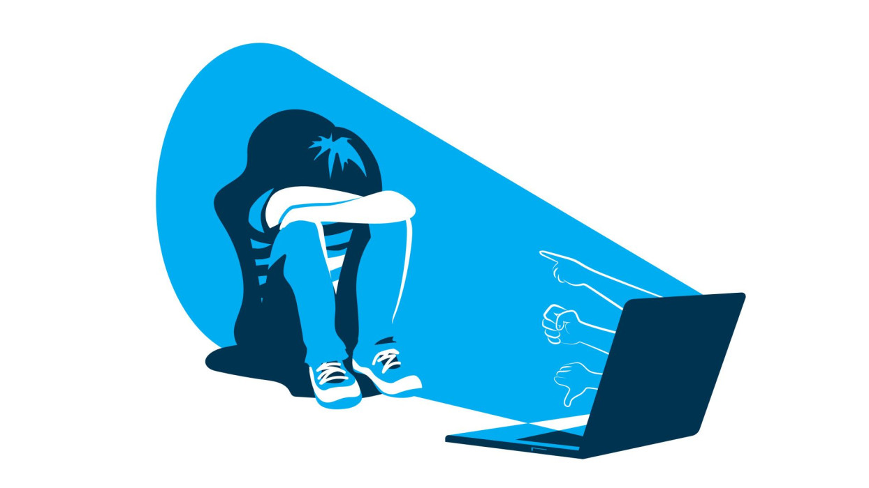
4. Mental Health
Increased Anxiety and Depression
Body Image Issues
Cyberbullying
Isolation

Slide 17
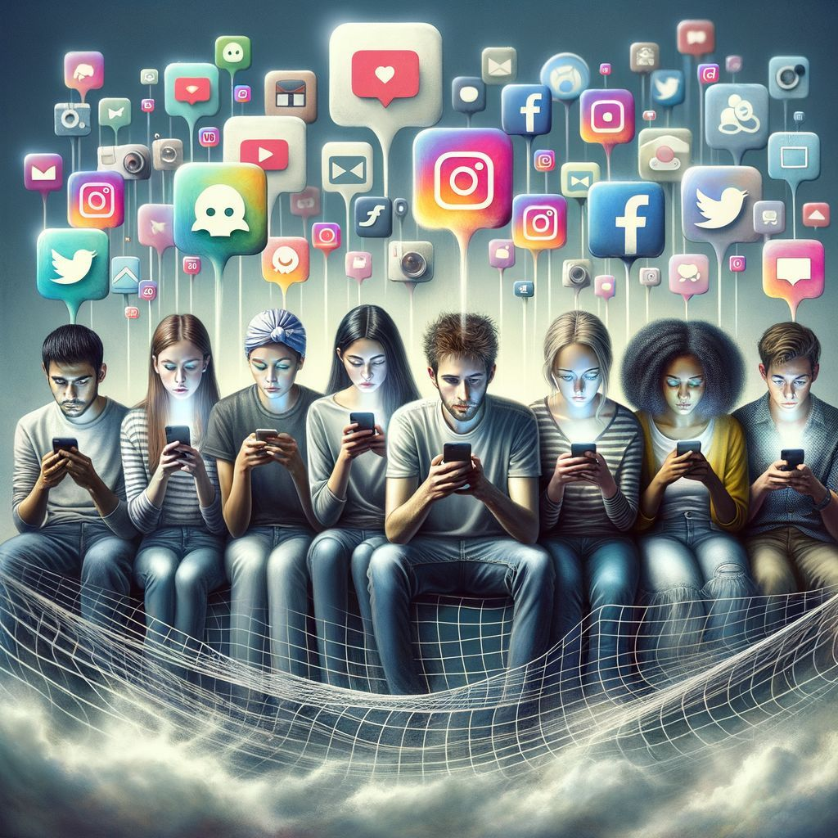
5. Exposure to Negative Influencers
“My son, if sinners entice you, do not consent… do not walk in the way with them, keep your foot from their path” (Prov. 1:10, 15).
“Do not be deceived: ‘Evil company corrupts good habits’” (1 Cor. 15:33).

Slide 18
The Impact of Smart Devices and Social Media on the Family
“Our use of any technological device should be funneled through the grid of whether the item in question is training us for righteousness or unrighteousness” (Walker, “What Do I Say When…” 110).
“Therefore, whether you eat or drink, or whatever you do, do all to the glory of God” (1 Cor. 10:31).

