Slide 2
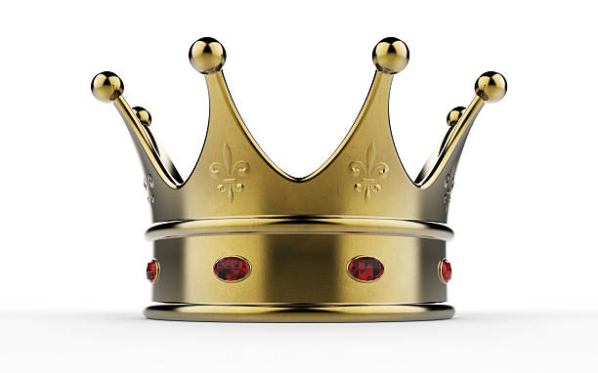
How to Live Like a King

Slide 3
Instructions for Kings Deut. 17:14-20
Shall Not Multiply Horses for Himself - v. 16
Shall Not Multiply Wives for Himself - v. 17
Shall Not Multiply Silver and Gold for Himself - v. 17

Slide 4
Instructions for Kings Deut. 17:14-20
The Law of God - vs. 18-20
Write a copy
Have it with him
Read from it all the days of his life
Careful to observe all of it

Slide 5
How to Live Like a King Today

Slide 6

How to Live Like a King Today
1. Trust in the Lord
Proverbs 3:5-6
Hebrews 11:6; 13:5-6
Genesis 22:7-8
James 1:6-8

Slide 7

How to Live Like a King Today
2. Honor Your Marriage Vows
Faithful eyes - Job 31:1
Faithful lips - Prov. 31:28-29
Faithful hands - 1 Cor. 7:1
Faithful feet - Prov. 6:28-29
Faithful heart - Prov. 4:23

Slide 8
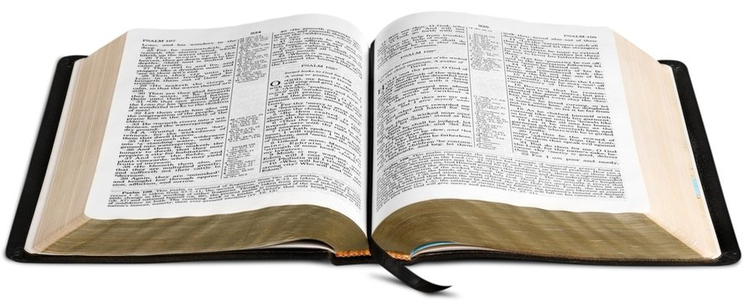
How to Live Like a King Today
Israel’s King had to…
Have his own copy.
Have it with him.
Read from it every day.
Observe all it said.

Slide 9
How to Live Like a King Today
Israel’s King had to…
Do you…
Have his own copy.
Have it with him.
Read from it every day.
Observe all it said.
Have your own copy?
Have it with you?
Read from it every day?
Observe all it says?

Slide 10
How to Live Like a King
We trust in God and not ourselves.
We are faithful to our wife.
We are men of the book.

