Slide 1
The Conversion of the Eunuch
Acts 8:26-40

Slide 2
26 Now an angel of the Lord spoke to Philip, saying, "Arise and go toward the south along the road which goes down from Jerusalem to Gaza." This is desert.
27 So he arose and went. And behold, a man of Ethiopia, a eunuch of great authority under Candace the queen of the Ethiopians, who had charge of all her treasury, and had come to Jerusalem to worship,
28 was returning. And sitting in his chariot, he was reading Isaiah the prophet.
29 Then the Spirit said to Philip, "Go near and overtake this chariot."

Slide 3
30 So Philip ran to him, and heard him reading the prophet Isaiah, and said, "Do you understand what you are reading?"
31 And he said, "How can I, unless someone guides me?" And he asked Philip to come up and sit with him.
32 The place in the Scripture which he read was this: "He was led as a sheep to the slaughter; And as a lamb before its shearer is silent, So He opened not His mouth.
33 In His humiliation His justice was taken away, And who will declare His generation? For His life is taken from the earth."
34 So the eunuch answered Philip and said, "I ask you, of whom does the prophet say this, of himself or of some other man?"

Slide 4
35 Then Philip opened his mouth, and beginning at this Scripture, preached Jesus to him.
36 Now as they went down the road, they came to some water. And the eunuch said, "See, here is water. What hinders me from being baptized?"
37 Then Philip said, "If you believe with all your heart, you may." And he answered and said, "I believe that Jesus Christ is the Son of God."
38 So he commanded the chariot to stand still. And both Philip and the eunuch went down into the water, and he baptized him.
39 Now when they came up out of the water, the Spirit of the Lord caught Philip away, so that the eunuch saw him no more; and he went on his way rejoicing.

Slide 5
40 But Philip was found at Azotus. And passing through, he preached in all the cities till he came to Caesarea.

Slide 6
A Simple Story
Acts 8:26-40
Lord sent Philip to the Eunuch (vv. 26-29)
Philip preached Jesus to him (vv. 30-35)
The Eunuch obeyed (vv. 36-40)

Slide 7
Acts 8:26-40
The
Conversion
of the
Eunuch

Slide 8
The Conversion of
the Eunuch
Acts 8:26-40
The Person

Slide 9
The Person
Queen’s Treasurer (v. 27)
  Man of great authority – great responsibility
  Under Candace (common name for queens i.e. “Pharoah”)
  Cabinet position (Secretary of Treasury)

Slide 10
The Person
Queen’s Treasurer (v. 27)
A Eunuch (vv. 27, 34, 36, 38)
  Some think merely a title for a Chamberlain or Palace official
  Likely means he was emasculated (rendered impotent)
  Eunuchs were not allowed to become Jews in the full sense (Deut. 23:1), but only proselytes of the gate

Slide 11
The Person
Queen’s Treasurer (v. 27)
A Eunuch (vv. 27, 34, 36, 38)
An Ethiopian (v. 27)
  From a great kingdom in Africa (south of Egypt)
  Had been to Jerusalem (to worship) and was returning

Slide 12
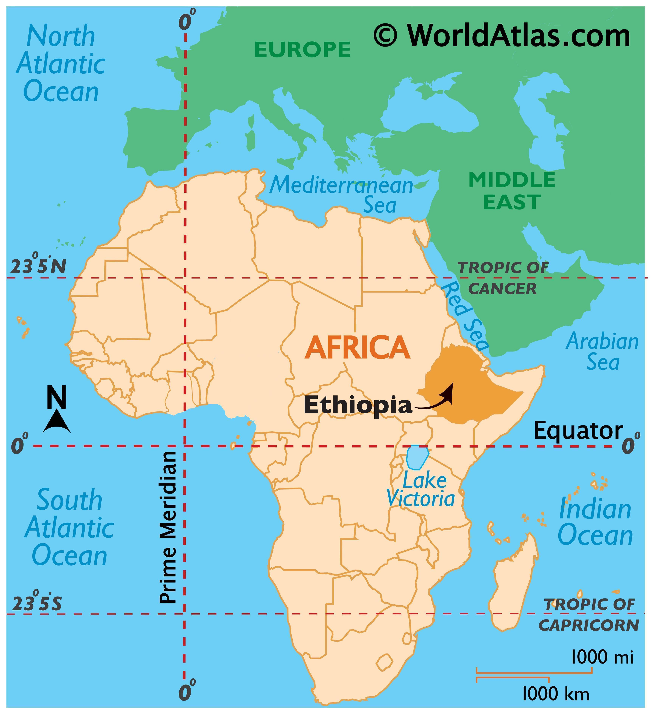
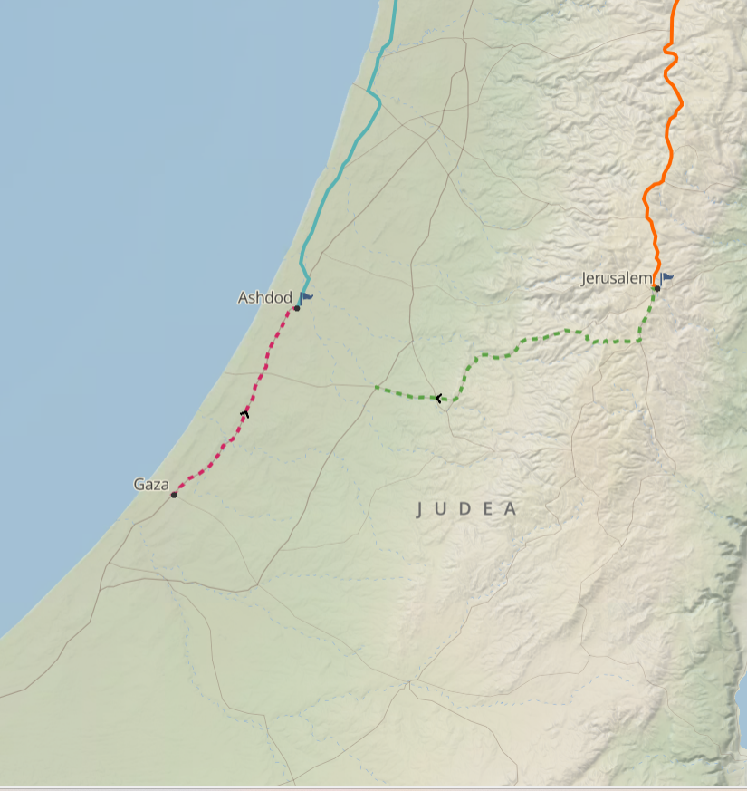

Slide 13
The Person
Queen’s Treasurer (v. 27)
A Eunuch (vv. 27, 34, 36, 38)
An Ethiopian (v. 27)
Everyone Needs Gospel

Slide 14
The Conversion of
the Eunuch
Acts 8:26-40
The Person
The Attitude

Slide 15
The Attitude
Reverence for God (v. 27)
  Went from Ethiopia to Jerusalem to worship (over 1500 miles one way)
  Devoted to make such a trip. [Would you have traveled to Jerusalem?]
  Sincere & thought he was right – else why make such a trip?
  Focused on spiritual matters (though he dealt daily with power and money)

Slide 16
The Attitude
Reverence for God (v. 27)
Desired to know (v. 28)
  Was reading the Scriptures (v. 28). [Would you have been found reading the text?]
  Wanted to understand (v. 31) [Would you have wanted to understand?]
  Asked a question (v. 34) [Would you have asked a question?]
  Wanted to know proper application (v. 34) [Would you have been concerned about proper application?]

Slide 17
The Attitude
Reverence for God (v. 27)
Desired to know (v. 28)
Humble (vv. 31, 34)
  Admitted his lack of understanding (v. 31)
  Asked a stranger for help (v. 31, 34)
  Man of power asking a man of no power to help

Slide 18
The Attitude
Reverence for God (v. 27)
Desired to know (v. 28)
Humble (vv. 31, 34)
Open mind (vv. 31-36)
  Had not predetermined what he would believe
  Did not already decide he was saved – no matter what Philip said
  Was willing to listen to the message preached

Slide 19
The Attitude
Reverence for God (v. 27)
Desired to know (v. 28)
Humble (vv. 31, 34)
Open mind (vv. 31-36)
Those with the right attitude
will obey the Gospel

Slide 20
The Conversion of
the Eunuch
Acts 8:26-40
The Person
The Attitude
The Message

Slide 21
The Message
From Isaiah 53 (vv. 32-33)
  Here is a divine interpretation of the prophecy
  Christ is the fulfillment of the Old Testament

Slide 22
  Rejected of men (vv. 1-3)
    His message was rejected (v. 1)
    He was not appealing to man (v. 2)
    He was despised and rejected (v. 3)
  The Reason for his Suffering: Sinful man (vv. 4-6)
    What he suffered (vv. 4-5)
    Why he suffered (vv. 4, 5, 6)
  Total Submission to suffering (vv. 7-9)
    He did not rebel or resist (v. 7)
    Submission to the point of death (v. 8)
    He was innocent, thus he had an honorable burial (v. 9)
  Victory and reward (vv. 10-12)
    He pleased the Lord – he was the offering for sin (vv. 10-11)
    His days will be prolonged (v. 10)
    Victory over Satan (v. 12)
Isaiah 53
“Victory Through
Suffering Servant”

Slide 23
The Message
From Isaiah 53 (vv. 32-33)
About Christ (v. 35)

Slide 24
Message About Christ
How he was rejected of men (Isa. 53)
How he was crucified for our sins (Isa. 53)
How he was raised (Isa. 53:10)
He is Deity – Son of God (v. 37)
He must be baptized (vv. 36, 38)

Slide 25
The Message
From Isaiah 53 (vv. 32-33)
About Christ (v. 35)
How God operates upon the sinner
  Not by an angel (vv. 26, 29, 39 – came to the preacher)
  Not by direct operation of the Spirit
  But by – message preached

Slide 26
The Message
From Isaiah 53 (vv. 32-33)
About Christ (v. 35)
How God operates upon the sinner
Message
Convinces about Christ
Convicts about sin

Slide 27
The Conversion of
the Eunuch
Acts 8:26-40
The Person
The Attitude
The Message
The Response

Slide 28
The Response
Made personal application (vv. 31, 36)
  Made application of the sermon to himself
  Saw that he needed to do something
  Do you make personal application to self?

Slide 29
The Response
Made personal application (vv. 31, 36)
Saw some urgency (vv. 36, 38)
  Immediately responded
  Wanted to remove any hindrance or obstacle to obedience
  As soon found water, he wanted to be baptized
  Do you see the urgency of getting right with God?

Slide 30
The Response
Made personal application (vv. 31, 36)
Saw some urgency (vv. 36, 38)
Asked, “What hinders me…” (v. 36)
  What’s stopping me from responding now?
  Implies: “I’m ready now”

Slide 31
What Hinders You?
Don’t know enough about the Bible?
Afraid of rejection?
Some sin don’t want to stop?
Think can’t live up to it?
Embarrassed to let your desire be known?
Don’t understand the plan of salvation?
Better time?

Slide 32
The Response
Made personal application (vv. 31, 36)
Saw some urgency (vv. 36, 38)
Asked, “What hinders me…” (v. 36)
Did what he was taught

Slide 33
What Did the Eunuch Do?
What Did the Eunuch Do?
Believed in Christ (v. 37)
Repented
  Commanded of all (Acts 17:30-31)
  Changing religious convictions
  Baptism for those who repent (Acts 2:38)

Slide 34
What Did the Eunuch Do?
What Did the Eunuch Do?
Believed in Christ (v. 37)
Repented
Confessed his faith (v. 37)
Baptized (vv. 38-39)

Slide 35
The Response
Made personal application (vv. 31, 36)
Saw some urgency (vv. 36, 38)
Asked, “What hinders me…” (v. 36)
Did what he was taught
Went on his way rejoicing (v. 40)
  Changed and was glad he did
  Believed he was forgiven

Slide 36
The Response
Made personal application (vv. 31, 36)
Saw some urgency (vv. 36, 38)
Asked, “What hinders me…” (v. 36)
Did what he was taught
Went on his way rejoicing (v. 40)
What hinders you?

Slide 37
The Conversion of
the Eunuch
Acts 8:26-40
The Person
The Attitude
The Message
The Response

