Slide 1
God Has Always Had A Standard for Men to Follow
In the garden of Eden (Gen. 2:16-17)
In building the ark (Gen. 6)
In building the tabernacle (Exo. 26; 36-38)
In building the temple (1 Kings 5-7)
In what the work of the priest was (Exo. 28)
In day of worship (Exo. 20:8-11)
In the sacrifices offered (Exo. 29)

Slide 2
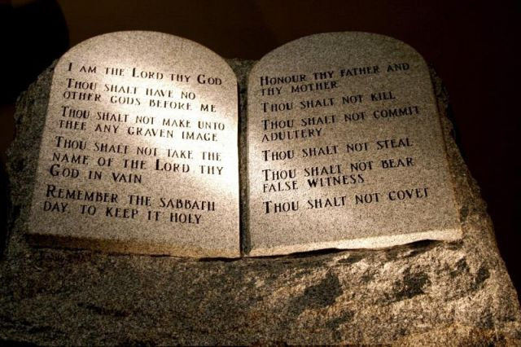
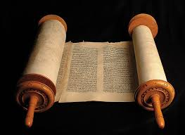
In the Old Testament Times
Standard = Law of Moses
Psa. 78:5-7
Deut. 6:1-3

Slide 3
What is Our Standard
In Religion Today?
If all churches are following the same standard – then why are they different?
If all who claim to be Christians are following the same standard – then why do they live different?
If we all are following the same standard – then why are their disagreements in religion?

Slide 4
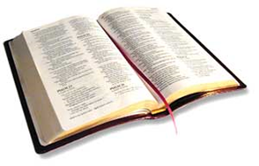
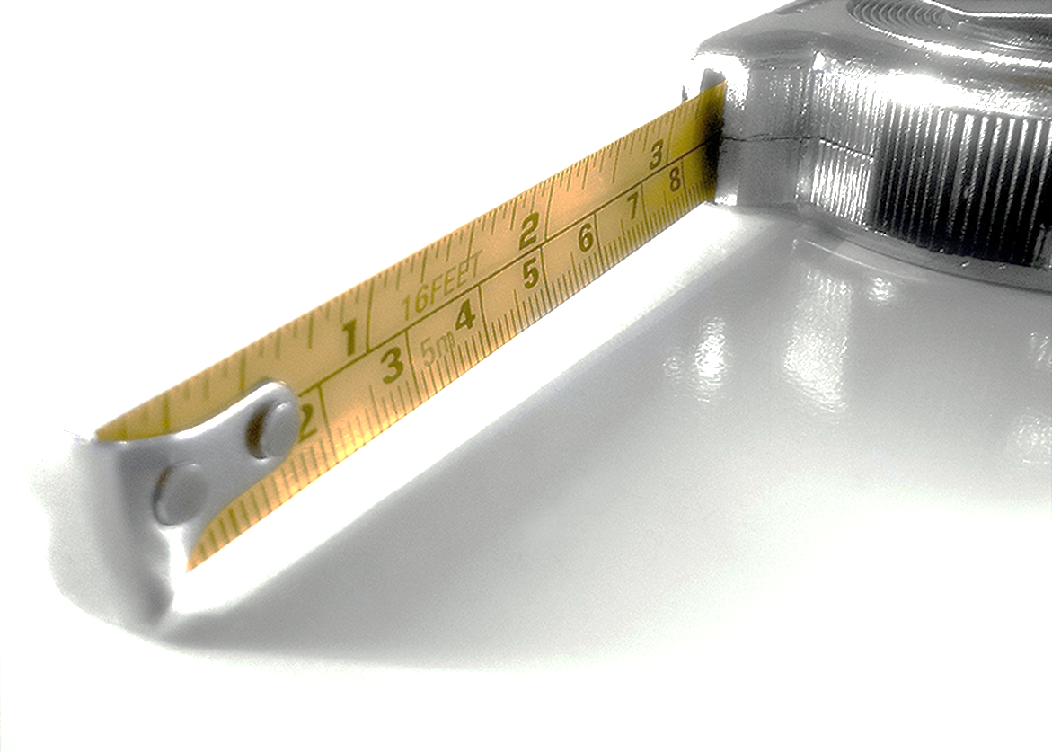
Our Standard In Religion

Slide 5
Our Standard In Religion
The Importance of a Standard

Slide 6
The Importance of a Standard
A Standard is Essential in All Areas of Life

Slide 7
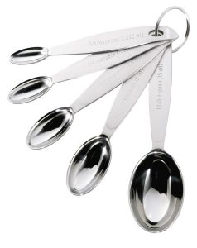
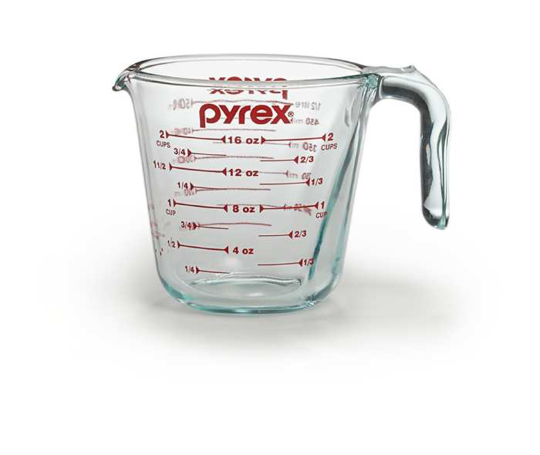
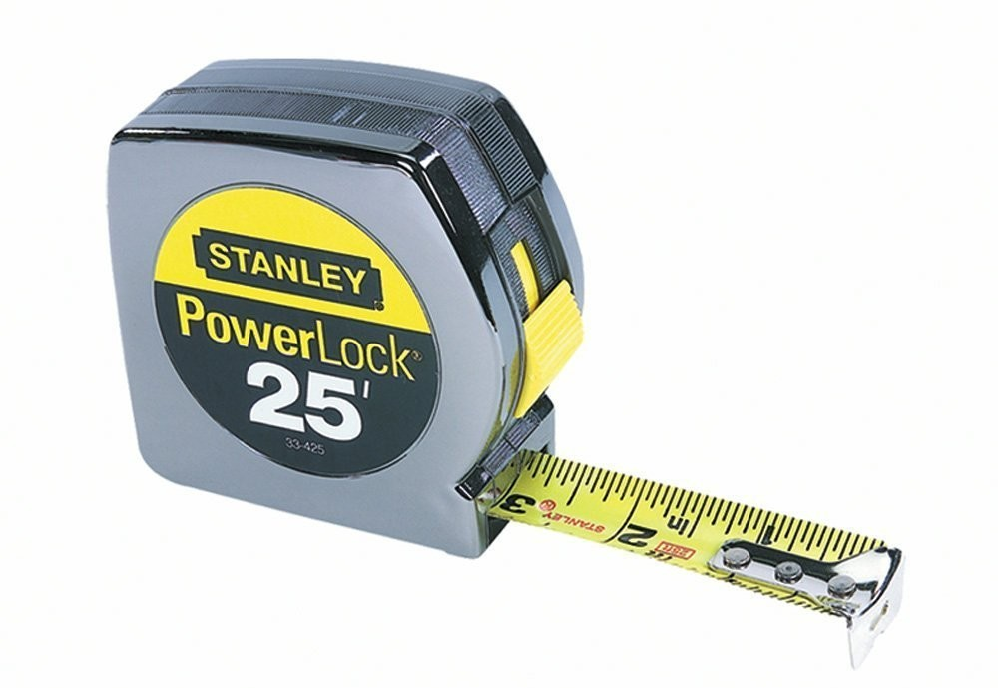
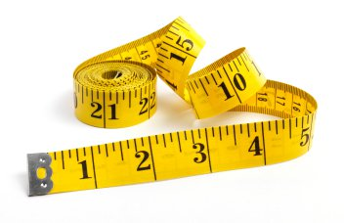
Standard of Measurement

Slide 8
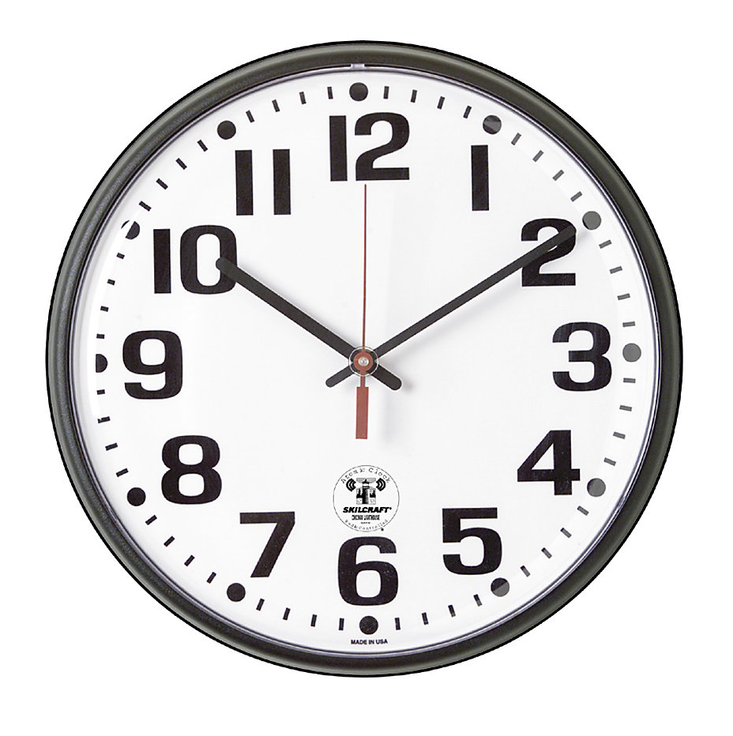
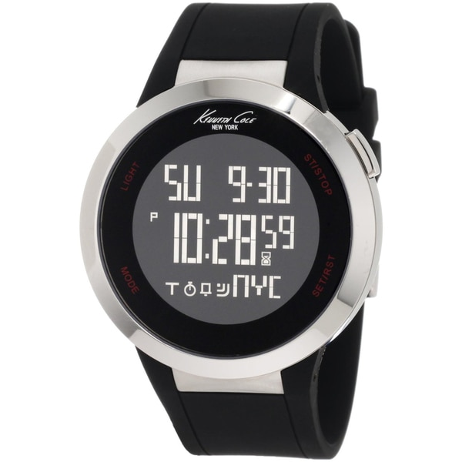
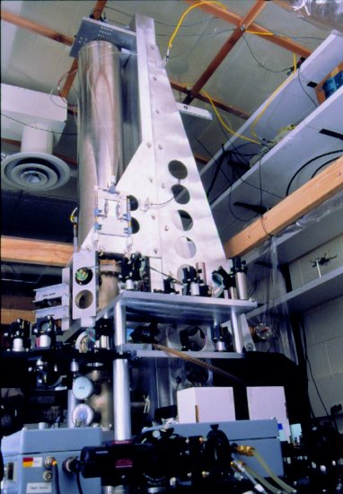
Standard of Time
Atomic Clock
Boulder, CO

Slide 9


Standard of Game

Slide 10
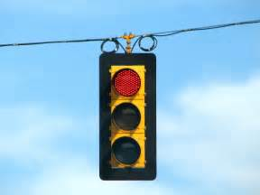
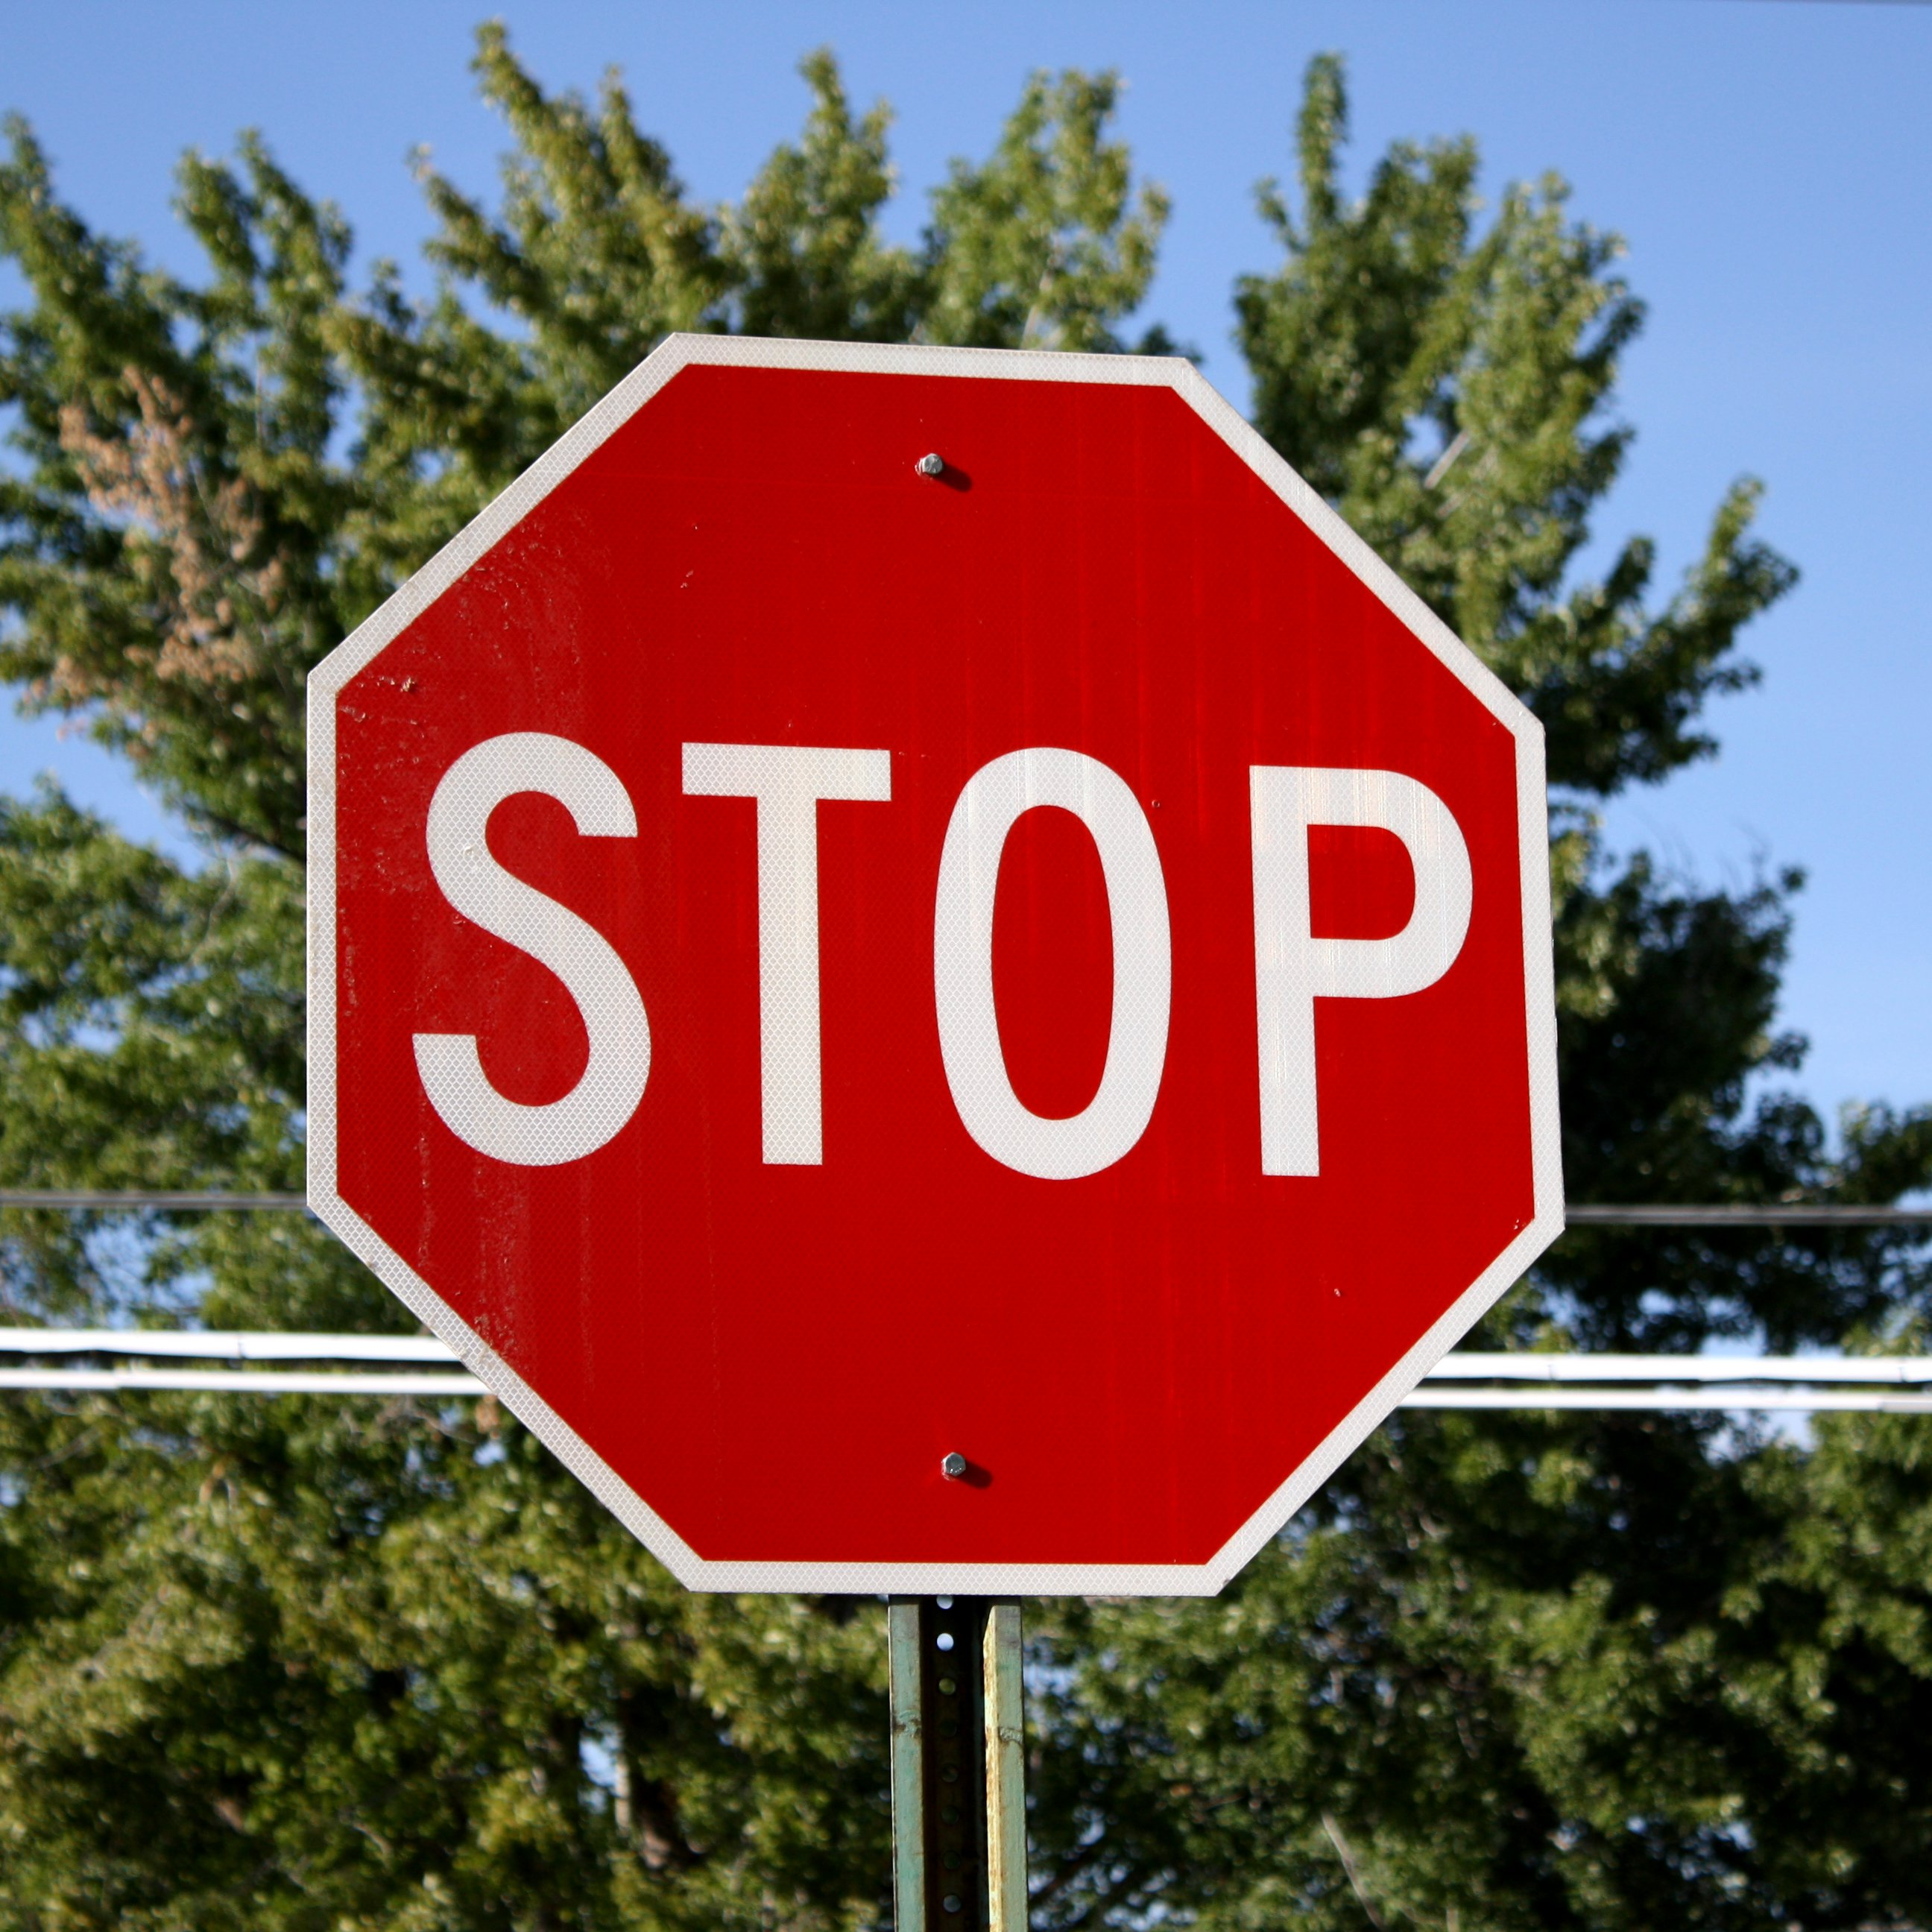
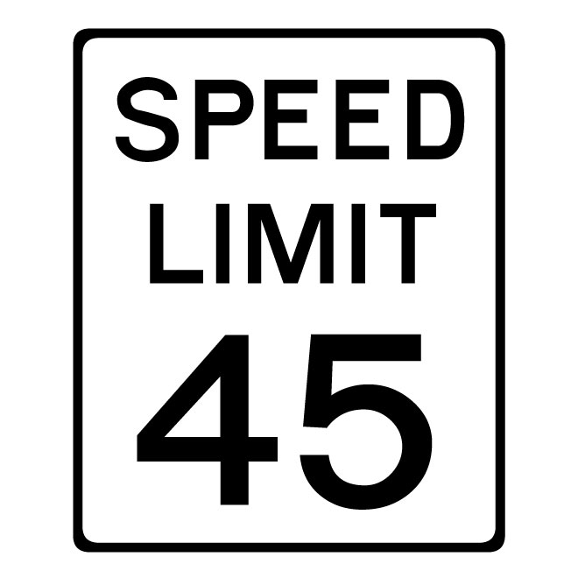
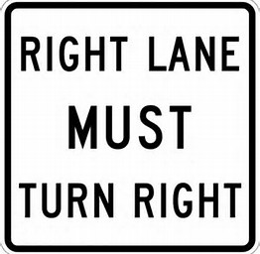
Standard of Traffic

Slide 11
The Importance of a Standard
A Standard is Essential in All Areas of Life
Without an Objective Standard:
  Everyone does what he wants (Judges 21:25)
  No one knows what is right (i.e. – time, measurement, how play game, etc.)
  No unity (John 17:20-21)
  Man cannot direct himself (Jer. 10:23; Rom. 11:34)
  Be no sin (Rom 4:15)

Slide 12
The Importance of a Standard
A Standard is Essential in All Areas of Life
Without an Objective Standard:
Even as Man Rebels – He Argues for a Standard
  “That’s not fair”
  “That’s not right”
  “Doesn’t seem like…”

Slide 13
Our Standard In Religion
The Importance of a Standard
False Standards (Subjective)
Subjective = Varying from person to person

Slide 14
False Standards (Subjective)
Emotion
  When we argue from what seems fair, makes sense, or seems right – we are appealing to emotions!
  Are some things that don’t seem fair and right:
    Requiring the married to separate (Ezra 10:11-ff)
    Requiring Abraham to sacrifice son (Gen. 22)
    Visiting consequences of sin on next generation (Exo. 34:7)
    Hold all Israel back because of Achan (Josh. 7)

Slide 15
False Standards (Subjective)
Emotion
  When we argue from what seems fair, makes sense, or seems right – we are appealing to emotions!
  Are some things that don’t seem fair and right:
  Are some things in God’s plan that don’t make sense:
    Dipping 7 times in Jordan to cure leprosy (2 Kings 5:10-14)
    Looking on a serpent on a pole to be cured of snake bite (Num. 21:4-9)
    Marching around city 7 times to capture the city (Josh. 6:1-7)
    Put clay on eyes of blind (John 9:6-7)

Slide 16
False Standards (Subjective)
Emotion
Family Situation
  Two ways:
    Family is the standard – by which decide right
    Choose our belief to justify family
  Must love the Lord more than family (Luke 14:26)
  What if family member was a homosexual? Atheist?
  Family situations differ.

Slide 17
False Standards (Subjective)
Emotion
Family Situation
Preacher / Esteemed Brethren
  Examples:
    “Brother ______ says that __________ is okay.”
    “Most preachers / brethren agree with ______”
    “If brother _______ says it is true, that’s good enough for me.”
  Must not think of men above what is written (1 Cor. 4:6)
  Preachers / men vary

Slide 18
False Standards (Subjective)
Emotion
Family Situation
Preacher / Esteemed Brethren
Human Wisdom
  Man is not at liberty to decide for self (Jer. 10:23)
  God’s ways are higher than man (Isa. 55:8-9)
  Way seems right, but wrong (Prov. 16:25)
  Lean not on own understanding (Prov. 3:5-6)
  Who is man to advise God (Rom. 11:34)?

Slide 19
False Standards (Subjective)
Emotion
Family Situation
Preacher / Esteemed Brethren
Human Wisdom
What We Have Always Believed / Done
  Make man the standard rather than God
  Means if doing wrong – justified because that what we’ve always done
  One raised in a cult, or extreme religion could say: “That is what we have always believed / done”

Slide 20
False Standards (Subjective)
Emotion
Family Situation
Preacher / Esteemed Brethren
Human Wisdom
What We Have Always Believed / Done

Slide 21
Our Standard In Religion
The Importance of a Standard
False Standards (Subjective)
The True Standard (Objective)
Objective = a fixed standard – does not vary

Slide 22
The True Standard (Objective)
An Objective Standard
  Means that what agrees with the standard is right and what doesn’t is wrong (Rom. 3:4)
  How we determine truth from error (1 John 4:6)
  Doesn’t change from person to person

Slide 23
The True Standard (Objective)
An Objective Standard
The Bible is the Standard
  Oracles of God (1 Pet. 4:11)
  Inspired Scriptures tells us what is right (2 Tim. 3:16-17)
  What is written determines what we believe (2 Cor. 4:13)
  The doctrine of Christ (2 John 9)

Slide 24
Our Standard In Religion
The Importance of a Standard
False Standards (Subjective)
The True Standard (Objective)
The Use of the True Standard

Slide 25
The Use of the True Standard
Could Misuse the Right Standard
  Could use the right standard – but careless reading of it [i.e. measuring tape, measuring cup, clock, etc.] (Matt. 19:4; 21:16, 42; 22:31; Luke 10:26)
  Could use the right standard – but ignore (Rom. 10:3, 17)
  Could use the right standard – but question how it applies (Luke 10:29)

Slide 26
The Use of the True Standard
Could Misuse the Right Standard
Right Standard – Used Properly
  Handle aright (2 Tim 2:15)
  Right conclusion (1 Cor. 1:10)
    All speak the same thing
    Same mind (cf. 2:16 – revelation of Christ)
    Same judgment (cf. Acts 20:3 – “decided”)

Slide 27
Our Standard In Religion
The Importance of a Standard
False Standards (Subjective)
The True Standard (Objective)
The Use of the True Standard

