Slide 1


Many Christians live as if they are imprisoned or tied to ball and chain
Not free
Drag a heavy burden with them
Sad part – When they are doing this to themselves
Self-imprisonment
Will not let themselves go free
Will not leave the ball and chain behind
Not willing to forgiven themselves for what God has forgiven!

Slide 2
Embracing
Forgiveness
Learning to Forgive Yourself

Slide 3
Embracing Forgiveness
God’s Forgiveness
The Basis for All Others

Slide 4
God’s Forgiveness
The Basis for All Others
God is a forgiving God
  Psalm 86:5 – “…ready to forgive, And abundant in mercy…”
  Psalm 130:7 – “…with Him is abundant redemption…”
  Nehemiah 9:17 – “…ready to pardon, Gracious and merciful…”
  Micah 7:18 – “…Pardoning iniquity And passing over the transgressions…does not retain His anger forever…”
  Isaiah 55:7 – “…He will abundantly pardon…”
  Luke 23:34 – “Father, forgiven them, for they do not know what they are doing…”
  1 John 1:7, 9 – “cleanses us from all sin….cleanses us from all unrighteousness…”

Slide 5
God’s Forgiveness
The Basis for All Others
God is a forgiving God
What God does in forgiveness
  Means: release – lets go of the sin (Psa. 103:12)

Slide 6
Aphiemi- used in Mt. 6:12; 18:27,35; 1 John 1:9
Vine’s: “To send forth, send away...signifies the remission of punishment due to sinful conduct...secondly it involves complete removal of the cause of offense...” (Vol. 2, p. 122)
Forgiveness
Defined
  Thayer: “to send away...to let go..let alone, let be...to leave, not to discuss now.” (p. 89)
  Englishmans’ - p. 87 - shows it is translated:
    “leave” - Matt. 5:24
    “Sent away” - Matt. 13:36
    “have omitted” - Matt. 23:23
    “let go” - Jno. 11:44

Slide 7
God’s Forgiveness
The Basis for All Others
God is a forgiving God
What God does in forgiveness
  Means: release – lets go of the sin (Psa. 103:12)
  Removes the guilt (Acts 3:19; Isa. 44:22)
  Remembers the sin no more (Jer. 31:31-34; Heb. 8:12)
  Removes the shame of being a sinner (Isa. 43:25; Micah 7:18-19)
  Creates a new person (Rom. 6:3-4; 2 Cor. 5:17)

Slide 8
God’s Forgiveness
The Basis for All Others
God is a forgiving God
What God does in forgiveness
Forgiveness toward others & self is based on God forgiving
  If God is not forgiving – how could we even talk about forgiveness toward others – much less forgiving self?
  Parallel: Matt. 6:12, 14-15; 18:23-35; Eph. 4:32
  Thus, God’s forgiveness is a reason for forgiving others (including self)

Slide 9
Embracing Forgiveness
God’s Forgiveness
The Basis for All Others
Bible Characters
Who Embraced Forgiveness

Slide 10
Bible Characters
Who Embraced Forgiveness
David
  His sin (Adultery and murder – 2 Sam. 11)
  Embraced forgiveness
    Psa. 32
    Psa. 51

Slide 11
Bible Characters
Who Embraced Forgiveness
David
Saul (Paul)
  His sin (Persecution, encouraged prison and death – Acts 7, 8, 9)
  Embraced forgiveness
    2 Tim. 4:6-8 – rejoiced in hope he had
    Titus 3:3-7 – changed by the grace of God – now have hope
    1 Tim. 1:12-17 – the chief of sinners yet forgiven
    Phil. 3:13 – could forget the things which are behind

Slide 12
Bible Characters
Who Embraced Forgiveness
David
Saul (Paul)
Peter
  His sin
    Denied the Lord (Matt. 26:69-75)
    Was a hypocrite (Gal. 2:11-14)
  Embraced forgiveness
    1 Pet. 1:3-9 – “we” have hope
    2 Pet. 3:13-14 – “we” look forward to new heavens… blameless

Slide 13
Bible Characters
Who Embraced Forgiveness
David
Saul (Paul)
Peter
Simon
  His sin (offered to buy the Spirit – Acts 8:18-21)
  Embraced forgiveness
    Acts 8:22 – was told he could be forgiven
    Acts 8:24 – believe it and asked Peter to pray that be forgiven

Slide 14
Bible Characters
Who Embraced Forgiveness
David
Saul (Paul)
Peter
Simon
Corinthians
  Their sin (very immoral – 1 Cor. 6:9-11)
  Embraced forgiveness
    1 Cor. 6:11 – washed, sanctified, and justified
    1 Cor. 1:4-9 – eagerly waiting for coming of Christ

Slide 15
Embracing Forgiveness
God’s Forgiveness
The Basis for All Others
Bible Characters
Who Embraced Forgiveness
Distinctions Clarified
Keep Things Straight

Slide 16
Distinctions Clarified
Keep Things Straight
Difference in guilt and consequences

Slide 17
Guilt of Sin
Individual
Not Passed on
Ezek. 18:4, 20
Forgiven
Completely Removed
(Heb. 8:12)
Conseq. of Sin
Shared
Is Passed on
Exo. 34:7
Num. 14:18
Not Removed
(Prov. 6:33; 13:15)

Slide 18
Distinctions Clarified
Keep Things Straight
Difference in guilt and consequences
Forgiveness & forgetting (history)
  Should “forget” in sense – don’t hold person accountable for the guilt (Heb. 8:12 – remember no more)
  Forgetting in sense – not a matter of historical memory – not the same
    God remembers sin of David (2 Sam. 11)
    God remembers the sin of Saul (Acts 7, 8, 9)
    God remembers the sin of Peter (Matt. 26; Gal. 2)
    God remembers the sin of the Corinthians (1 Cor. 6)

Slide 19
Distinctions Clarified
Keep Things Straight
Difference in guilt and consequences
Forgiveness & forgetting (history)
Forgiveness & excusing
  Forgiving does not overlook – and excuse (ignore or justify) the sin [God is not excusing]
  Repentance is demanded (Acts 8:22; Luke 17:3)
  If you forgive self (embrace forgiveness) – no way saying “What I did was no big deal.”

Slide 20
Embracing Forgiveness
God’s Forgiveness
The Basis for All Others
Bible Characters
Who Embraced Forgiveness
Distinctions Clarified
Keep Things Straight
Biblical Principles
That Help Us to Embrace Forgiveness

Slide 21
Biblical Principles
That Help Us to Embrace Forgiveness
Not based on deserving (Titus 3:3-7)
Focus more on God’s forgiveness than relationship with man
Truly change (repentance – Acts 8:22)
Quit trying to pay a cancelled debt (if God already forgiven)
Quit trying to have a higher standard than God!
Remember – there is no reason for bearing shame of guilt – that has been removed!
Forgiving self does not mean – didn’t do it, were justified or shouldn’t face some consequence

Slide 22
Embracing Forgiveness
God’s Forgiveness
The Basis for All Others
Bible Characters
Who Embraced Forgiveness
Distinctions Clarified
Keep Things Straight
Biblical Principles
That Help Us to Embrace Forgiveness

Slide 23
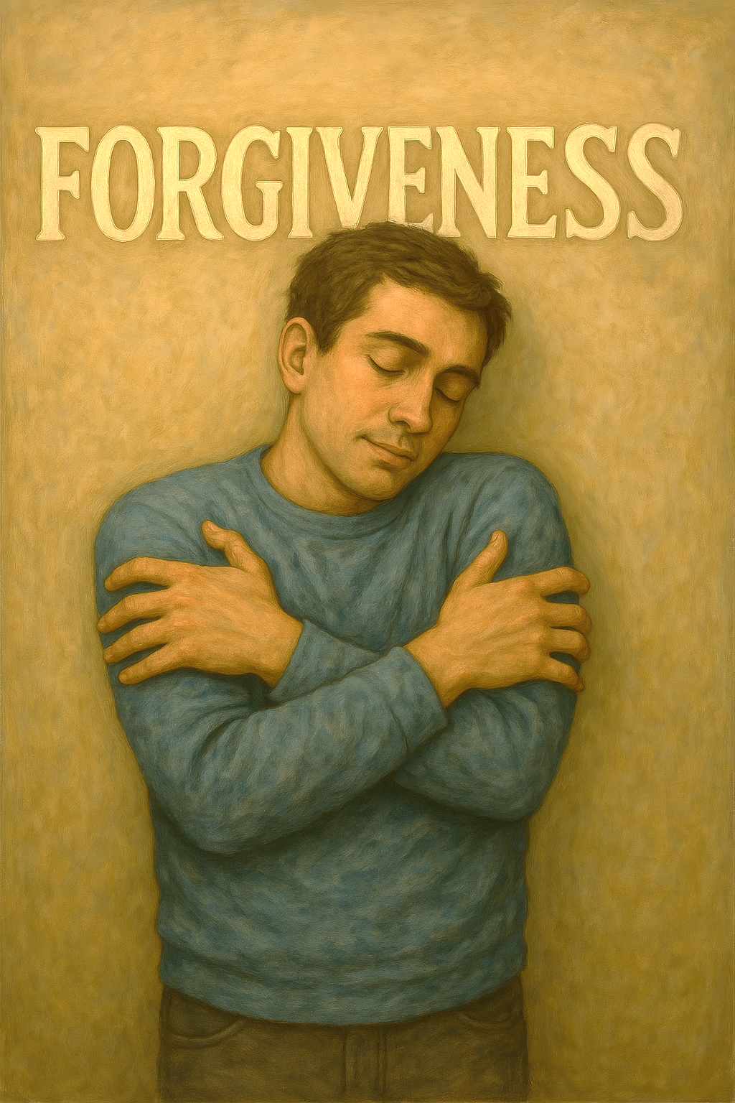
When Your Embrace Forgiveness
Act like you have been forgiven (i.e. Paul)
Have joy (Psa. 51:8, 12)
Have gladness (Psa. 51:8)
Rejoice (Psa. 51: 8)
Believe you have hope (2 Tim. 4:16-18)

