Slide 1
Second Missionary Journey
(Acts 16-18)

Slide 2
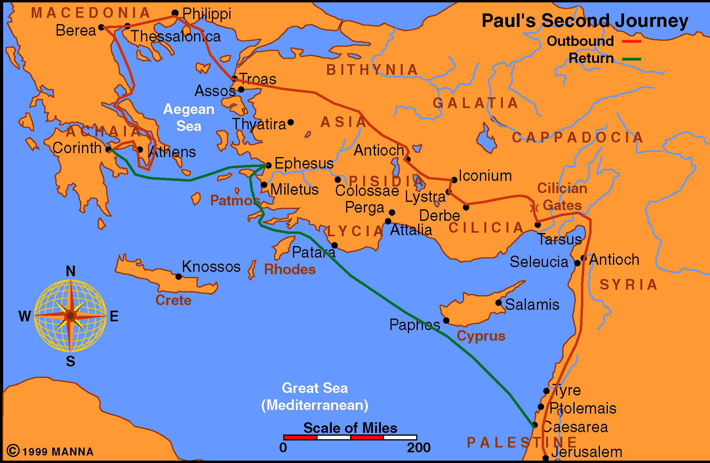
Acts 16-18

Slide 3
Second Missionary Journey
(Acts 16-18)
Macedonian Call (16:6-10)
Came to Philippi (16:11-40)
  Conversion of Lydia (vv. 13-15)
  Damsel with spirit of Divination (vv. 16-18)
  Paul & Silas imprisoned (vv. 19-24)
  Conversion of Jailer (vv. 25-34)
  Released from Jail and departed (vv. 35-40)

Slide 4
Second Missionary Journey
(Acts 16-18)
Macedonian Call (16:6-10)
Came to Philippi (16:11-40)
Conversion of Lydia (vv. 14, 15, 40)
  All information we have – three verses
  Many facts – stated with briefest mention
From whence she came
The work she did
Her religious character
The heart she had
The influence she bore
The obedience she gave

Slide 5
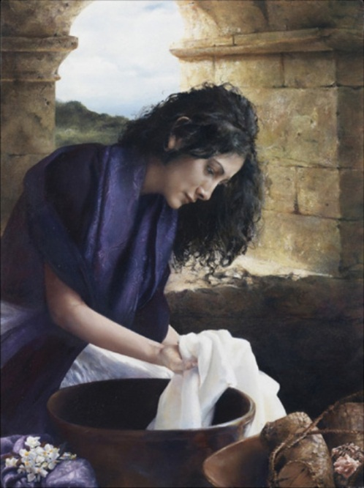
The Conversion of Lydia
Acts 16:14-15, 40

Slide 6

The Conversion
Of Lydia
The Prospect: Lydia

Slide 7
The Prospect: Lydia
Of Thyatira (v. 14)
  In Asia (Rev. 1:11)
  300 Miles away

Slide 8
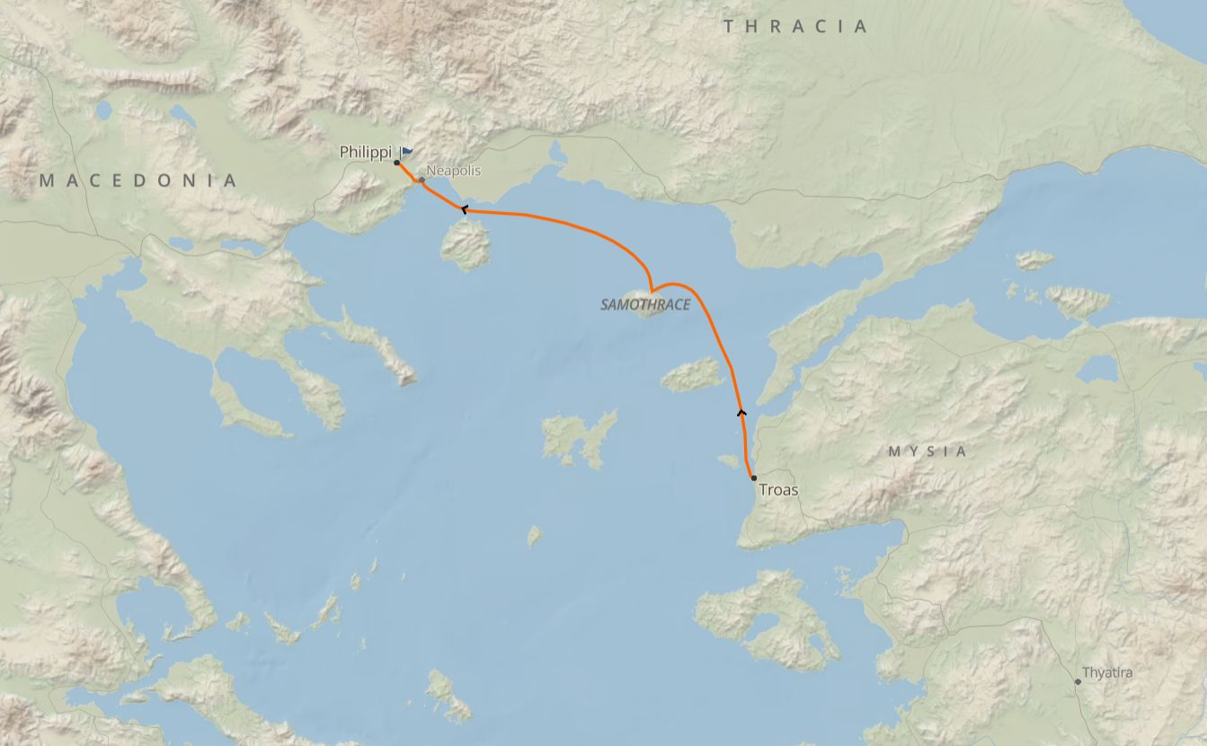

Slide 9
The Prospect: Lydia
Of Thyatira (v. 14)
  In Asia (Rev. 1:11)
  300 Miles away
  What brings her here? Assume business
  Seems that she is living in Philippi – not just visiting (house)
  From province where Paul forbidden to go
  Makes her first European convert

Slide 10
The Prospect: Lydia
Of Thyatira (v. 14)
Seller of Purple (v. 14)
  Either cloth or dye
    Likely dye – region was known for manufacturing dye
    One source: juice of Madder Root – used in Thyatira (Hemer)
    Very expensive (wear name of dye – not cloth)
    Rich kings wore it (Luke 16:19)

Slide 11

The Prospect: Lydia
Of Thyatira (v. 14)
Seller of Purple (v. 14)
  Either cloth or dye
  Successful businesswoman
    Such a business would require some capital
    Success & spirituality are not enemies
    Business / Work & spirituality are not enemies

Slide 12
The Prospect: Lydia
Of Thyatira (v. 14)
Seller of Purple (v. 14)
  Either cloth or dye
  Successful businesswoman
  Financially well off (if owned business)

Slide 13
The Prospect: Lydia
Of Thyatira (v. 14)
Seller of Purple (v. 14)
Religious (v. 14)
  Worshiped God
    God fearing (Acts. 13:16)
    May suggest – Gentile with an attitude like Cornelius
    May even suggest - was a convert to Jew’s religion

Slide 14
The Prospect: Lydia
Of Thyatira (v. 14)
Seller of Purple (v. 14)
Religious (v. 14)
  Worshiped God
  Prayed

Slide 15
The Prospect: Lydia
Of Thyatira (v. 14)
Seller of Purple (v. 14)
Religious (v. 14)
Hospitable (v. 15)
  Note the manner of invitation “if you have…”
  Insisted – constrained them

Slide 16
The Conversion
Of Lydia
The Prospect: Lydia
Her Heart: Opened

Slide 17

Her Heart: Opened
How Does The Lord Operate on Heart?
  Gospel is power to salvation (Rom. 1:16)
  Gospel preached pricks the heart (Acts 2:37)
  Preaching of Paul was to open the hearts of Gentiles (Acts 26:17-18)

Slide 18
Her Heart: Opened
How Does The Lord Operate on Heart?
Context Tells Us How
  “Heard us”(v. 14a) – before heart opened
  “Lord opened heart” (v. 14b)
  Gave “heed…” (v. 14c)

Slide 19
Acts 16:14-15
14 Now a certain woman named Lydia heard us. She was a seller of purple from the city of Thyatira, who worshiped God. The Lord opened her heart to heed the things spoken by Paul.
15 And when she and her household were baptized, she begged us, saying, "If you have judged me to be faithful to the Lord, come to my house and stay." So she persuaded us.
1
2
3

Slide 20
Her Heart: Opened
How Does The Lord Operate on Heart?
Context Tells Us How
  “Heard us” (v. 14a) – before heart opened
  “Lord opened heart” (v. 14b)
  “Gave heed…” (v. 14c)
Not opened so she would listen – already heard!
Means: Gospel pricked her heart – so she willingly obeyed

Slide 21
Her Heart: Opened
How Does The Lord Operate on Heart?
Context Tells Us How
Hardening & Opening of Heart – Depends upon the Heart
  Hardened –
    Pharaoh (Exo. 4:21 cf. Exo. 8:32)
    Heb. 3:7
  Opened – (Acts 2:37, 41)
  Same Sun:
    Hardens clay
    Melts butter

Slide 22
Her Heart: Opened
How Does The Lord Operate on Heart?
Context Tells Us How
Hardening & Opening of Heart – Depends upon the Heart
Consequences of Arbitrary Opening One Heart & Not Another
  Respecter of persons (Rom. 2:11)
  Gospel powerless (Rom. 1:16)
  Christ didn’t die for all (Heb. 2:9)
  No free will (Rom. 6)
  If heart not opened – God’s fault!

Slide 23
The Conversion
Of Lydia
The Prospect: Lydia
Her Heart: Opened
Her Response: Obedience

Slide 24
Her Response: Obedience
Heard (v. 14)
Believed (v. 14)
Baptized (v. 15)

Slide 25
The Rule of Conversion
Matthew | Teach |  |  | Baptize | In Name
Mark | Preach | Believe |  | Baptized | Saved
Luke | Preached |  | Repentance |  | Remission
Summary | Preach | Believe | Repent | Baptized | Saved

Slide 26
The Conversion
Of Lydia
The Prospect: Lydia
Her Heart: Opened
Her Response: Obedience
Her Household: Influenced

Slide 27
Her Household: Influenced
Influence on her Family
Infants included?
  Assumes a lot:
    She was married
    She had children
    Her children were small
    She had them with her
    That they were baptized

Slide 28
Her Household: Influenced
Influence on her Family
Infants included?
  Assumes a lot:
  Those who are to be baptized:
    Believers (Mk. 16:16)
    Repent (Acts 2:38)
    Sinners (Acts 22:16)

Slide 29
Her Household: Influenced
Influence on her Family
Infants included?
  Assumes a lot:
  Those who are to be baptized:
  If she had a husband – totally ignored by Luke
    Makes no mention of him
    She talks about herself & her house (vv. 15, 40)

Slide 30
Her Household: Influenced
Influence on her Family
Infants included?
  Assumes a lot:
  Those who are to be baptized:
  If she had a husband – totally ignored by Luke
  Those baptized were not babies:
    Spoke to women & were baptized (vv. 13-ff)
    In Lydia’s house comforted the brethren (v. 40)

Slide 31
The Conversion
Of Lydia
The Prospect: Lydia
Her Heart: Opened
Her Response: Obedience
Her Household: Influenced

