Slide 1
When God Has A Special Work
Done By Chosen People
He Always Gave Them A Pattern / Rule To Follow
Noah
Ark
(Gen. 6)
What to build
Material
Size
What put in it
Moses
Tabernacle
(Exo. 36-38)
What to build
Material
Compartments
Vessels
David
Temple
(1 Kings 5-7)
What to build
Where to build
When to build
Materials
Dimensions

Slide 2
The Rule of Conversion
A Study of the Great Commission

Slide 3
Limited
Great
Jews Only
Matt. 10:5-6
Whole World
Matt. 28:19-20

Slide 4
Records the
Great Commission
Matt. 28:19-20
Mark 16:15-20
Luke 24:47-48
John 20:21-23

Slide 5
None of the Four Gospels
Give The Entire Commission
Two Different Sessions
  First – (three parts)
  Second – Some 2-3 weeks later - on Mt. in Galilee (fourth part)

Slide 6
What The Four Gospels Accounts Tell Us
1st Part: John & Luke (Mark mentions)
2nd Part: Luke
3rd Part: Mark
4th Part: Matthew

Slide 7
Commission Given In Different Places
Matthew - From a Mountain in Galilee
Mark - From Jerusalem
Luke - From Jerusalem
John - From Jerusalem

Slide 8
Each Account Gives Different Emphasis
Matthew - Duty of the preacher - “go”
Mark - Duty of the hearer
Luke - When the message began
John - Forgiveness pronounced by God

Slide 9
The Rule of Conversion
A Study of the Great Commission

Slide 10
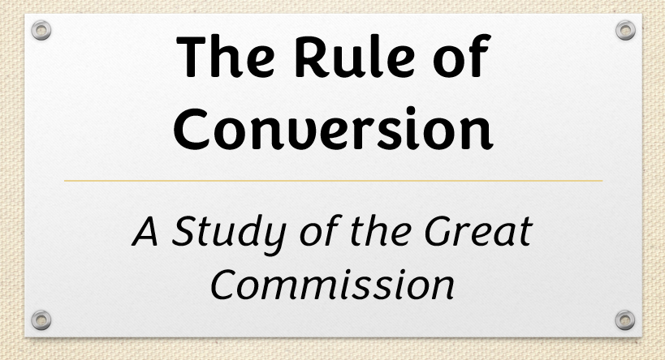
The First Session
  Accounts

Slide 11
The First Session
The same day that he was raised from the dead
John 20:19-23 – First part of the discussion
Luke 24:36-49 – First & second part of discussion
Mark 16:14-18 – First & third part of discussion

Slide 12
The First Session
  Accounts
  Summary

Slide 13
The First Session
Salutation – “peace be unto you”
  Recorded by Luke (24:36) & John (20:19, 21)
  First words to disciples who were struck with fear
  Thus, he dispels their fears
  The peace they would offer (in their preaching) must first be realized

Slide 14
The First Session
Salutation – “peace be unto you”
Reality of Christ’s Bodily Appearance
  John: He showed his hands & side (20:20-ff)
  Luke gives more details (24:37-40)
  While beholding him & wondering if they could trust their senses – he called for food and ate before them (Lk. 24:41-43)
  Indeed, there was a bodily resurrection!

Slide 15
The First Session
Salutation – “peace be unto you”
Reality of Christ’s Bodily Appearance
Divine Mission of Apostles
  John mentions (all others omit) – “As the Father has sent me, even so send I you.” (20:21)
  Lord was sent to seek & save the Lost (Lk. 19:10) – thus, so were they.

Slide 16
The First Session
Salutation – “peace be unto you”
Reality of Christ’s Bodily Appearance
Divine Mission of Apostles
Promise of the Holy Spirit
  “Breathed on them…receive ye the Holy Spirit.” (John 20:22)
  John is only writer to report this.
  Same promise made before death (Jno. 14, 15, 16)
  Fulfilled on day of Pentecost

Slide 17
The First Session
Salutation – “peace be unto you”
Reality of Christ’s Bodily Appearance
Divine Mission of Apostles
Promise of the Holy Spirit
Power to Forgive & Retain Sins
  John’s record (20:23)
  Not power of a priest to absolve men of their sin (Catholic)
  Simply: authority to make known to men God’s plan
  Power to declare whose sins are forgiven & whose are not (by inspiration)
  Rest of commission & history of Apostles help us to understand
1st Part

Slide 18
The First Session
Salutation – “peace be unto you”
Reality of Christ’s Bodily Appearance
Divine Mission of Apostles
Promise of the Holy Spirit
Power to Forgive & Retain Sins
Necessity of Death & Resurrection of Christ
  Luke’s record (24:44-46)
  Disciples still didn’t have an understanding of the necessity of his death….
  Explains that this is what I told you & the prophets said.

Slide 19
The First Session
Salutation – “peace be unto you”
Reality of Christ’s Bodily Appearance
Divine Mission of Apostles
Promise of the Holy Spirit
Power to Forgive & Retain Sins
Necessity of Death & Resurrection of Christ
Things to be Preached (Luke)

Slide 20
Repentance & Remission of sins (Luke 24:47)
  Repentance – duty to be performed
  Remission – blessing to be enjoyed
In His Name (Luke 24:47)
  For through him salvation comes
  For by his authority
    Salvation offered
    Repentance is demanded
Start in Jerusalem (Luke 24:47; Acts 1:8)

Slide 21
The First Session
Salutation – “peace be unto you”
Reality of Christ’s Bodily Appearance
Divine Mission of Apostles
Promise of the Holy Spirit
Power to Forgive & Retain Sins
Necessity of Death & Resurrection of Christ
Things to be Preached (Luke)
Apostles are Witnesses (Luke)

Slide 22
This is why they were chosen, commissioned & given power (Luke 24:48)
Witness: seen with eyes (no witnesses or witnessing today)
  2 Pet. 1:16-ff
  1 John 1:1-ff
  Acts 1:21-22
Luke ends his report here

Slide 23
The First Session
Salutation – “peace be unto you”
Reality of Christ’s Bodily Appearance
Divine Mission of Apostles
Promise of the Holy Spirit
Power to Forgive & Retain Sins
Necessity of Death & Resurrection of Christ
Things to be Preached (Luke)
Apostles are Witnesses (Luke)
2nd Part

Slide 24
The First Session
Salutation – “peace be unto you”
Reality of Christ’s Bodily Appearance
Divine Mission of Apostles
Promise of the Holy Spirit
Power to Forgive & Retain Sins
Necessity of Death & Resurrection of Christ
Things to be Preached (Luke)
Apostles are Witnesses (Luke)
Their Field & Work (Mark)

Slide 25
Field: all world – every creature (Mark 16:15)
Work: Preach the gospel – means of converting man (Mark 16:15)
Appropriately follows Luke’s account: when receive power – then GO!

Slide 26
The First Session
Salutation – “peace be unto you”
Reality of Christ’s Bodily Appearance
Divine Mission of Apostles
Promise of the Holy Spirit
Power to Forgive & Retain Sins
Necessity of Death & Resurrection of Christ
Things to be Preached (Luke)
Apostles are Witnesses (Luke)
Their Field & Work (Mark)
Conditions of Salvation

Slide 27
Mark 16:16
Saved = remission of sins (parallel to Luke)
Believe & is Baptized

Slide 28
The First Session
Salutation – “peace be unto you”
Reality of Christ’s Bodily Appearance
Divine Mission of Apostles
Promise of the Holy Spirit
Power to Forgive & Retain Sins
Necessity of Death & Resurrection of Christ
Things to be Preached (Luke)
Apostles are Witnesses (Luke)
Their Field & Work (Mark)
Conditions of Salvation
Confirmation of Their Testimony

Slide 29
“These signs shall follow those that believe”
(Mark 16:17-20)
Purpose of miracles – confirm the word
Why? Without complete revelation
Word has been confirmed (Heb. 2:3-4)
1 Cor. 13:8-10 – miracles have ceased

Slide 30
The First Session
Salutation – “peace be unto you”
Reality of Christ’s Bodily Appearance
Divine Mission of Apostles
Promise of the Holy Spirit
Power to Forgive & Retain Sins
Necessity of Death & Resurrection of Christ
Things to be Preached (Luke)
Apostles are Witnesses (Luke)
Their Field & Work (Mark)
Conditions of Salvation
Confirmation of Their Testimony
3rd Part

Slide 31
The First Session
Salutation – “peace be unto you”
Reality of Christ’s Bodily Appearance
Divine Mission of Apostles
Promise of the Holy Spirit
Power to Forgive & Retain Sins
Necessity of Death & Resurrection of Christ
Things to be Preached (Luke)
Apostles are Witnesses (Luke)
Their Field & Work (Mark)
Conditions of Salvation
Confirmation of Their Testimony
All of this
on the same day
of resurrection!

Slide 32
Lord’s Meetings With His Disciples
Met with disciples – on same day was raised from dead (Thomas was not there).- John 20:19-24
Eight days later met again (Thomas there). – John 20:25-29
Met them again at Sea of Tiberias (John 21) – “Third time” (v. 14)
Met again in Galilee (appointed before his death) – (Matt. 26:32; 28:7, 10, 16).

Slide 33
The First Session
The Second Session
  Account

Slide 34
The Second Session
Perhaps 2-3 weeks after first session
On a mountain in Galilee
Only Matthew records this
Matthew 28:16-20 – Fourth part of the [total] discussion

Slide 35
The First Session
The Second Session
  Account
  Summary

Slide 36
The Second Session
Supreme Lordship of Jesus - “All authority” (v. 18)
Work of Apostles to World & church (vv. 19-20)
  World: make disciples & baptize them (Conversion of sinners) (v. 19)
  Church: teaching them to observe all things (Edification of saints) (v. 20)

Slide 37
The Second Session
Supreme Lordship of Jesus - “All authority” (v. 19)
Work of Apostles to World & church (vv. 19-20)
Continued Presence of Jesus (v. 20)
  “Lo I am with you always…”
  With them through the Spirit
4th Part

Slide 38
The First Session
The Second Session

Slide 39
The First Session
Salutation – “peace be unto you”
Reality of Christ’s Bodily Appearance
Divine Mission of Apostles
Promise of the Holy Spirit
Power to Forgive & Retain Sins
Necessity of Death & Resurrection of Christ
Things to be Preached (Luke)
Apostles are Witnesses (Luke)
Their Field & Work (Mark)
Conditions of Salvation
Confirmation of Their Testimony
1st Part
2nd Part
3rd Part

Slide 40
The Second Session
Supreme Lordship of Jesus - “All authority”
Work of Apostles to World & church
Continued Presence of Jesus
4th Part

Slide 41
The Rule of Conversion
Matthew | Teach |  |  | Baptize | In Name
Mark | Preach | Believe |  | Baptized | Saved
Luke | Preached |  | Repentance |  | Remission
Summary | Preach | Believe | Repent | Baptized | Saved

Slide 42
Lessons From The
Great Commission
The Gospel Is To Be Preached To All
The Gospel Message Is Confirmed
What To Do To Be Saved
Those Who Obey Are In A Relationship With God
Those Who Obey Must Be Taught More

