Slide 1
Jesus instituted the Lord’s Supper just before his death
  Matt. 26:26-29
  Mark 14:22-25
  Luke 22:19,20
  1 Cor. 11:23-26

Slide 2
Jesus instituted the Lord’s Supper just before his death
Background: Observing the Passover

Slide 3
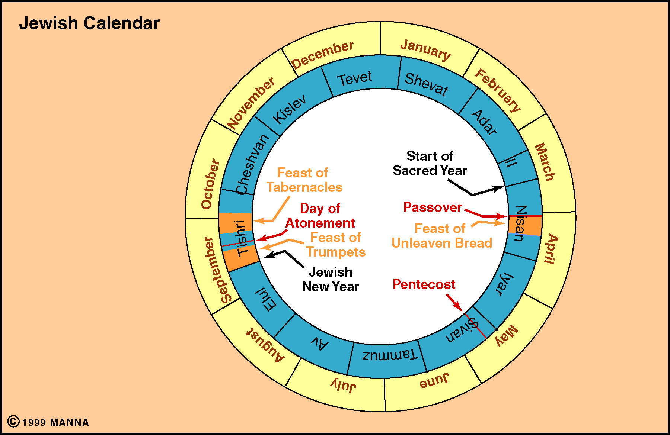

Slide 4
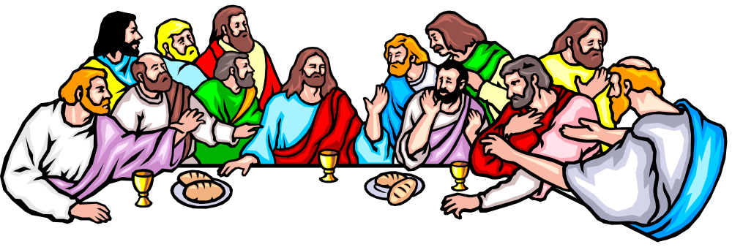
Passover
Jesus & disciples observing the Passover (Matt. 26:17-20)
Passover instituted (Exo. 12)
  10th plague - killing of firstborn
  Kill a lamb - sprinkle blood on doorpost (v. 7)
  Eat a feast with unleavened bread (v. 8)
  God will “pass over” (v. 13)

Slide 5
Passover
Jesus & disciples observing the Passover
Passover instituted
Ate Feast of Unleavened Bread as a memorial (Exo.12:14-28)
Elements / Emblems used:
  Unleavened bread (Mark 14:12)
  Fruit of the vine (Mark 14:25)

Slide 6
Jesus instituted the Lord’s Supper just before his death
Background: Observing the Passover
Called:
  “Lord’s Supper” (1 Cor. 11:20)
  “Break bread” (Acts 2:42; 20:7)
  “Communion” (1 Cor. 10:16)

Slide 7
Jesus instituted the Lord’s Supper just before his death
Background: Observing the Passover
Called:
Lord’s Supper is a Serious Thing
  If partake in unworthy manner – guilty of body and blood of Christ (1 Cor. 11:27)
  How we partake could bring judgement on us (1 Cor. 11:29)

Slide 8





The
Lord’s Supper
The
Lord’s Supper

Slide 9
The Lord’s Supper
The Lord’s Supper
Looks Back – to the cross

Slide 10

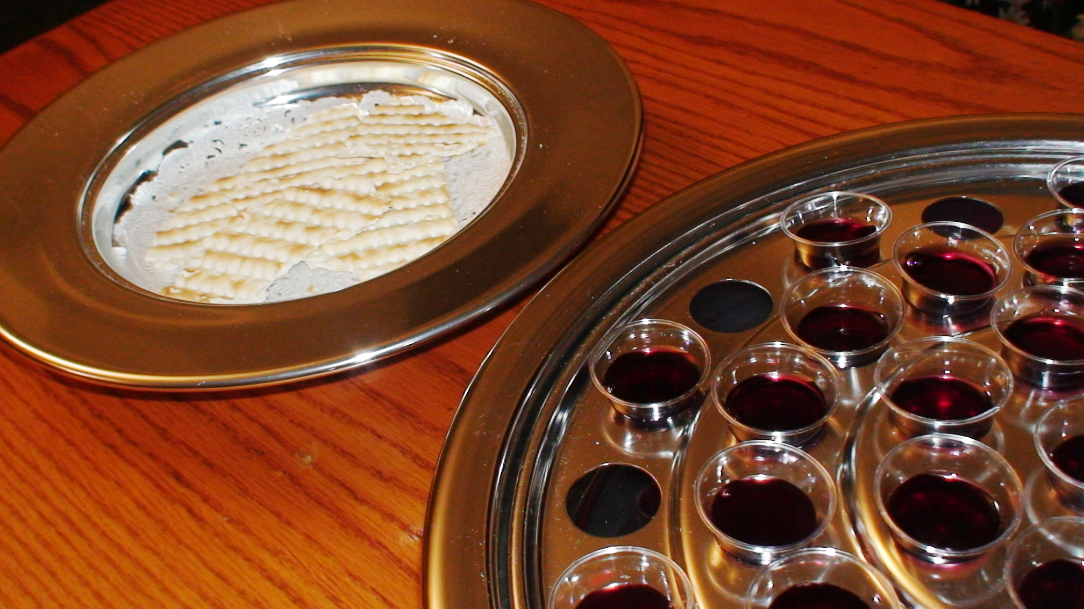
Looks Back – to the cross
Do this in remembrance of Christ (Luke 22:19; 1 Cor. 11:24-25)
Each of the elements point to the sacrifice on the cross:
Unleavened Bread
Mark 14:12
Represents:
Body of Jesus
(Mark 14:22)
Fruit of Vine
Mark 14:25
Represents:
Blood of Jesus
(Mark 14:24)

Slide 11
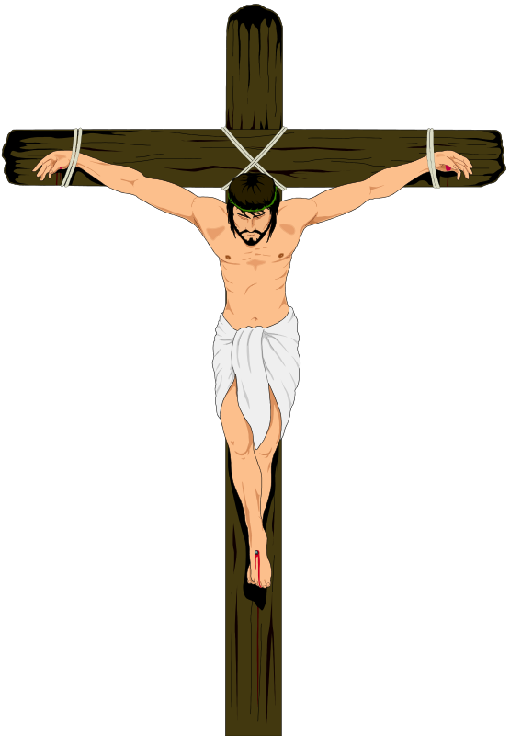
Looks Back – to the cross
Do this in remembrance of Christ (Luke 22:19; 1 Cor. 11:24-25)
Each of the elements point to the sacrifice on the cross:
Thus, while we observe the Lord’s Supper we should see:
Body
Matt. 26:26
1 Cor. 11:24
Pain, Agony
Died by suffication
Blood
Matt. 26:27-28
1 Cor. 11:25
Spear pierced side
Blood was shed for me

Slide 12
The Lord’s Supper
The Lord’s Supper
Looks Back – to the cross
Looks Forward – to his coming

Slide 13
Looks Forward – to his coming
Points to his second coming (1 Cor. 11:26)
Observance affirms our belief in a resurrected Jesus who is alive and is coming again!
The second coming is a great day:
  Don’t know when (Matt. 24:35-ff)
  Come in clouds (Acts 1:9-11)
  With the sound of trumpet & visible to all (1 Cor. 15:52; 1 Thess. 4:16; Rev. 1:7)
  Face judgment (2 Thess. 1:7-10)
  Ushered into eternity (1 Thess. 4:13-ff)
  Long for it (1 Thess. 1:9-10)

Slide 14
Looks Forward – to his coming
Points to his second coming (1 Cor. 11:26)
Observance affirms our belief in a resurrected Jesus who is alive and is coming again!
The second coming is a great day:
As we observe the Lord’s Supper should see: the Lord’s second coming!

Slide 15
The Lord’s Supper
The Lord’s Supper
Looks Back – to the cross
Looks Forward – to his coming
Looks Within – to examine self

Slide 16

Looks Within – to examine self
Examine ourselves to see if the manner of observance is proper (1 Cor. 11:27-29)
Text is often misapplied – “Worthy to partake”
Look to see if the “manner” (vv. 27, 29) of partaking is worthy
  Discern means to “evaluate” (BDAG); translated “judge” (11:31).
  Word “discern” means to discriminate or distinguish (Vincent) –
    Lord’s body from common food (cf. context vv. 20-21)
    Understand that partaking is designed remember the body and blood
  Manner: how we view what we are doing – what we are reflecting upon

Slide 17
Looks Within – to examine self
Examine ourselves to see if the manner of observance is proper (1 Cor. 11:27-29)
Text is often misapplied – “Worthy to partake”
Look to see if the “manner” (vv. 27, 29) of partaking is worthy
  Discern means to “evaluate” (BDAG); translated “judge” (11:31).
  Word “discern” means to discriminate or distinguish (Vincent) -
  “because all who eat the bread and drink the cup without recognizing the body…” (v. 29, NCV)
  “…eats and drinks judgment to himself if he does not judge the body rightly” (v. 29, NASB95)

Slide 18
Looks Within – to examine self
Examine ourselves to see if the manner of observance is proper (1 Cor. 11:27-29)
Text is often misapplied – “Worthy to partake”
Look to see if the “manner” (vv. 27, 29) of partaking is worthy
As we partake, need to look within – to see how we view the Lord’s Supper – what we are thinking

Slide 19
The Lord’s Supper
The Lord’s Supper
Looks Back – to the cross
Looks Forward – to his coming
Looks Within – to examine self
Looks Without – to show his death

Slide 20

Looks Without – to show his death
Our partaking tells others of his death (1 Cor. 11:26)
Word “proclaim” means to “announce” (BDAG) – most often translated “preach” (i.e. Acts 4:2; 17:13; 1 Cor. 9:14)
Preaching a “silent” sermon to the world around us that Jesus died for us!
Telling those around us that Jesus shed his blood for the remission of sins (Matt. 26:28)
Proclaiming that he tasted death for every man (Heb. 2:9)
When we partake, we look to others and the effect that our observance may have on them

Slide 21
Things We Tell the World in the Lord’s Supper:
Jesus died for our sins (Matt. 26:28)
That the law of Moses is no longer in effect (Heb. 9:14-15)
That we are under a new testament (Matt. 26:28)
That the kingdom has come (Matt 16:29; Luke 22:18)

Slide 22
The Lord’s Supper
The Lord’s Supper
Looks Back – to the cross
Looks Forward – to his coming
Looks Within – to examine self
Looks Without – to show his death
Looks Upward – to communion with God

Slide 23

Looks Upward – to communion with God
We have communion with our Lord and brethren (1 Cor. 10:16)
Word for communion (koinōnia) – word for fellowship
  Translated “participation” (ESV)
  Translated “sharing” (NASB95)
Context: eating meat sacrificed to idols
  To partake in a meal (intended to honor idols) would include communing with the being (idol) that is honored
  To partake means also have fellowship with idolaters
Same true of Lord’s Supper – when we partake:
  We have fellowship with one another
  We have fellowship with the one honored in our worship - God

Slide 24
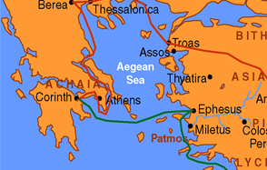
1 Cor 10:16-17
16 The cup of blessing which we bless, is it not the communion of the blood of Christ? The bread which we break, is it not the communion of the body of Christ?
17 For we, though many, are one bread and one body; for we all partake of that one bread.
We Commune With Other Christians Even Though We Are Separated

Slide 25
The Lord’s Supper
The Lord’s Supper
Looks Back – to the cross
Looks Forward – to his coming
Looks Within – to examine self
Looks Without – to show his death
Looks Upward – to communion with God

