Slide 1
Mark 15:43 (NASB95)
Joseph of Arimathea came, a prominent member of the Council, who himself was waiting for the kingdom of God; and he gathered up courage and went in before Pilate, and asked for the body of Jesus.
ASV: “bodly went in”
NCV: “brave enough to go”
Lexham: “came acting courageously”
Phillips: “Went with great courage”
Weymouth: “summoned up courage”

Slide 2
“Courage”
(tolmaō)
BDAG: “to show boldness or resolution in the fae of danger, opposition, or a problem, dare, bring oneself to (do someth.)”
Louw-Nida: “to dare”
M.R. Vincent: “Lit., having dared went in. Daring all possible consequences.”
Translated: “Bold” (2 Cor. 10:2; 11:21; Phil. 1:14) and “Dare” (Matt. 22:46; Mk. 12:34)
Suggests: possible fear

Slide 3

“The quality of mind or spirit that enables a person to face difficulty, danger, pain, etc,. without fear; bravery.”
- Dictionary.com

Slide 4

Courage Is Standing Alone in the Crowd

Slide 5
Courage must be “Gathered”
Lenski: “cast all his fears to the wind”
Pulpit: “exposes himself to danger of death”
Barnes: “It needed no small measure of courage to do this”
Point: Courage doesn’t just happen – we must muster / gather courage
We must try hard to have the needed quality!

Slide 6
Do You Have Courage?
Daring?
Bold?
Cast fears to the wind?
Expose yourself to danger?
Perhaps, like Timothy, we could use a little more courage (2 Tim. 1:7)
If we have courage – must gather it up: Must work for it!

Slide 7
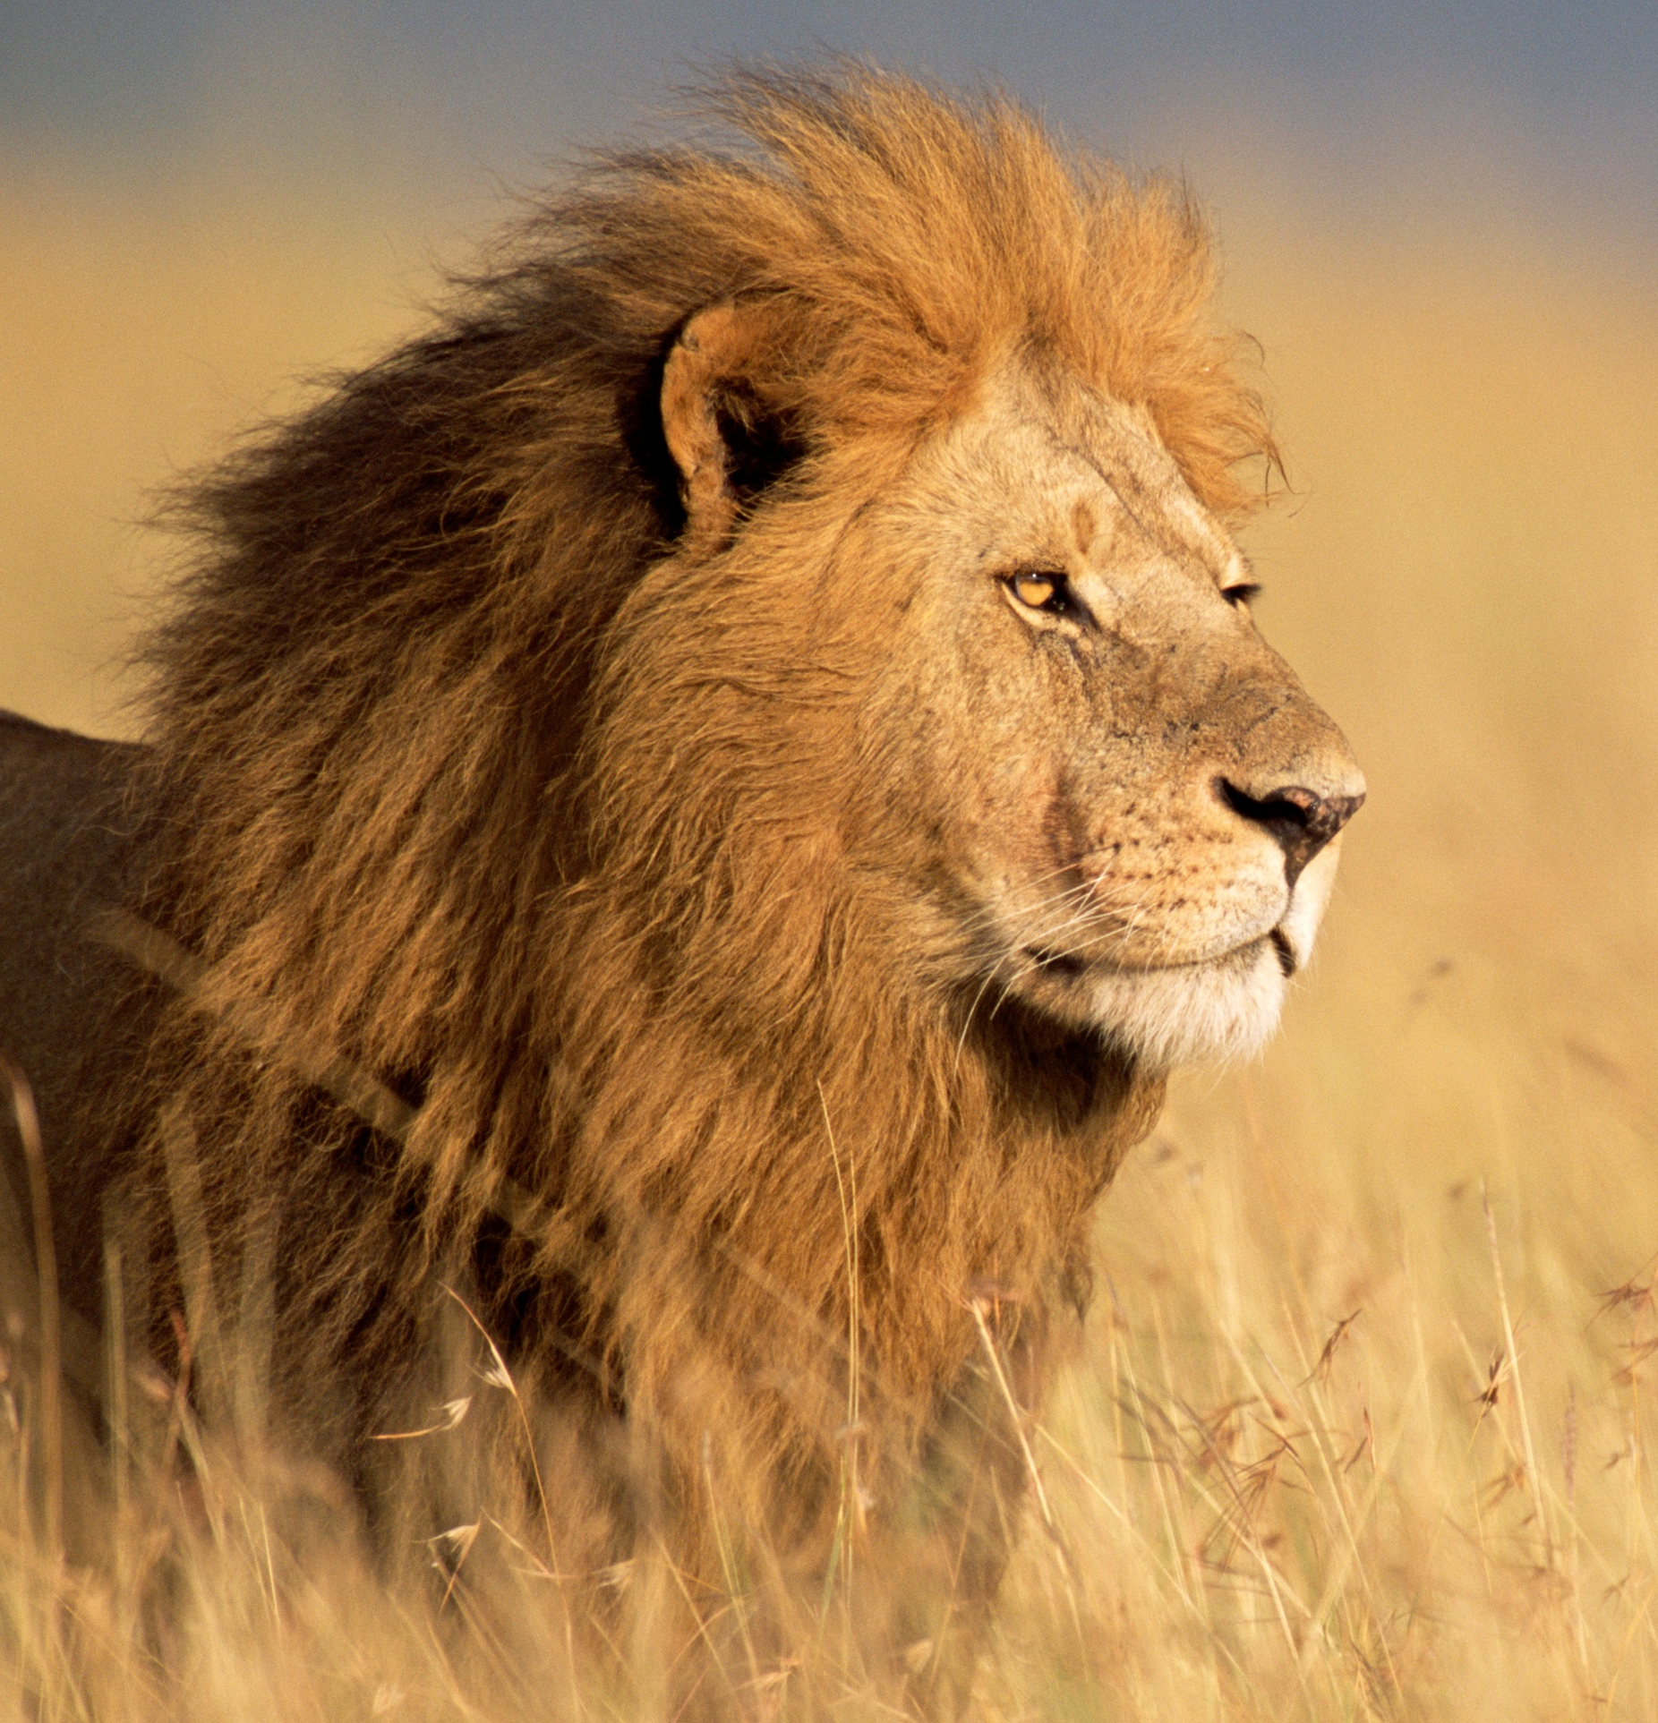
Gathering
Courage
Mark 15:43

Slide 8
Gathering Courage
Why We Need to Gather Courage

Slide 9
Why We Need to Gather Courage
Fear can overpower and manipulate us (Matt. 25:25)
Without courage, we pull back from responsibility (Deut. 1:19-46)
Fear what others say or think and act accordingly
  Gal. 2:11-14
  Luke 12:4-7
  John 12:42
  John 19:38

Slide 10
Gathering Courage
Why We Need to Gather Courage
When We Need to Gather Courage

Slide 11
When We Need to Gather Courage
To speak truth (Phil. 1:14)
To stand against opposition to the Lord (2 Cor. 10:2)
To lead family (Eph. 5:22-24; 6:1-4)
To obey the Lord when family doesn’t (1 Pet. 3:1-2)
To exercise discipline (Prov. 22:15; Matt. 18:15-17)
To forgive (Matt. 18:21-35; Luke 17:1-5)
To face difficult circumstances (Phil. 4:11-13)
To resist temptation (1 Cor. 10:13)

Slide 12
Gathering Courage
Why We Need to Gather Courage
When We Need to Gather Courage
How We Need to Gather Courage

Slide 13
How We Need to Gather Courage
Understand God is with us (Josh. 1:9; Deut. 31:6; 1 Chron. 28:20)
Surround self with fellow believers (Heb. 10:24-25; Acts 28:15)
Realize that a situation depends on you (Mark 15:43; cf. Jn. 19:38)
Stronger faith overcomes fear (2 Tim. 1:12; Isa. 26:3)
Understand that you face an ultimatum (Acts 4:17-20)
Pray earnestly (Acts 4:23-30)

Slide 14
Gathering Courage
Why We Need to Gather Courage
When We Need to Gather Courage
How We Need to Gather Courage

