Slide 1
God warned his people not to marry the pagans of the land
  Exo. 34:11-16
  Deut. 7:1-4
Yet, his people did that anyway
  Solomon married pagan women (1 Kings 11:1-4)
  This led to idolatry – ultimately captivity (Psa. 106:34-42)
  When came back – did it again (Ezra 9:1-2; 10)
  Later (25 yrs) either had a relapse or failed to repent (Neh. 13:23-27)
This association with pagans had a corrupting effect – even corrupted their language (Neh. 13:24)

Slide 2
“The Language of Ashdod”
Our language can easily be corrupted from the influence of the world around us
God revealed his message in words (1 Cor. 2:12-13)
Thus, the words (Bible terms) are important
We are to speak as the oracles of God (1 Pet. 4:11)
  That has a connection to glorifying God (v. 11)
  Our speech is to be “sound” (Titus. 2:8)
Often, our speech betrays us (Matt. 26:69-73)

Slide 3
“The Language of Ashdod”
(Using Bible Terms in Bible Ways)
Consider some Bible terms that are often misused / misapplied
May we learn to speak the language of Scripture

Slide 4
“The Language of Ashdod”
(Using Bible Terms in Bible Ways)
“Christian”

Slide 5
“Christian”
How the term in used in the Bible
  Acts 11:26 – one who believes & turns (v. 21), is a disciple (v. 26) and in the church (v. 26)
  Acts 26:28 – One can believe and not be a Christian
  Describes an individual who obeys the gospel & is in the church

Slide 6
“Christian”
How the term in used in the Bible
The language of Ashdod (misused)
  Used to describe anyone who believes in Christ
  Applied to anyone who has good morals
  Applied to people in churches that don’t follow the Scriptures
  Applied to the church (as well as the individual)
  Applied to a school, nation or business

Slide 7
“The Language of Ashdod”
(Using Bible Terms in Bible Ways)
“Christian”
“Pastor”

Slide 8
“Pastor”
How the term in used in the Bible
  Eph. 4:11 – God placed pastors in the church (Greek poiman)
  Same word for “shepherd” or “feed” flock (Acts 20:28) which referred to elders (v. 17)
  Same term used in 1 Pet. 5:1-2 where elders are to feed (poiman) the flock
  Always a plurality in the church (Acts 14:23; Phil. 1:1)
  Qualifications to be a pastor or elder (1 Tim. 3; Titus 1)

Slide 9
“Pastor”
How the term in used in the Bible
The language of Ashdod (misused)
  Applied to the man who preaches (may not even meet qualifications of 1 Tim. 3 or Titus 1)
  Denominational language that suggest that the preacher is the “pastor” has the oversight of the congregation

Slide 10
“The Language of Ashdod”
(Using Bible Terms in Bible Ways)
“Christian”
“Pastor”
“Reverend”

Slide 11
“Reverend”
How the term in used in the Bible
  Term used in Psa. 111:9 (KJV/ASV) refers to God
  NKJV – “awesome”
  Means: fear as fear of God; honored; awesome
  Not used to refer to man
  Not a name of God, but describes Him as one to be revered, honored, feared - awesome

Slide 12
“Reverend”
How the term in used in the Bible
The language of Ashdod (misused)
  Used as a title for one who preaches
  Clergy – Laity distinction
    One in the pulpit (“ordained”)
    One in the pew (not “ordained”)

Slide 13
“The Language of Ashdod”
(Using Bible Terms in Bible Ways)
“Christian”
“Pastor”
“Reverend”
“Father”

Slide 14
“Father”
How the term in used in the Bible
  Many passages used to refer to our human fathers (Gen. 2:24; Matt. 4:22; Heb. 12:7, 9)
  God is our Father (Matt. 5:16; 18:35; John 17:1, 5)
  Never used as a religious title (Matt. 23:8-11)

Slide 15
“Father”
How the term in used in the Bible
The language of Ashdod (misused)
  Used as a religious title (particularly in the Catholic church)
  Raises one man above another
  Men in the New Testament times refused such honor
    Acts 10:25-26
    Acts 14:11-18

Slide 16
“The Language of Ashdod”
(Using Bible Terms in Bible Ways)
“Christian”
“Pastor”
“Reverend”
“Father”
“Sabbath”

Slide 17
“Sabbath”
How the term in used in the Bible
  Sabbath = 7th day of the week (Exo. 20:10-11; 31:15)
  1st Day is not the Sabbath (Matt. 28:1)
  We are to worship on the 1st day of the week (Acts 20:7; 1 Cor. 16:1-2)
  We are not governed by the Sabbath law (Col. 2:14, 16)

Slide 18
“Sabbath”
How the term in used in the Bible
The language of Ashdod (misused)
  Refer to Sunday (1st day of week) as the “Sabbath”
  Apply the laws of the Sabbath to our Sunday
  Called Sunday (1st day of the week) as the “Christian Sabbath”

Slide 19
“The Language of Ashdod”
(Using Bible Terms in Bible Ways)
“Christian”
“Pastor”
“Reverend”
“Father”
“Sabbath”
“Fellowship”

Slide 20
“Fellowship”
How the term in used in the Bible
  Joint action in spiritual work

Slide 21
2 Corinthians 6:14–17
¹⁴ Do not be unequally yoked together with unbelievers. For what fellowship has righteousness with lawlessness? And what communion has light with darkness?
¹⁵ And what accord has Christ with Belial? Or what part has a believer with an unbeliever?
¹⁶ And what agreement has the temple of God with idols? For you are the temple of the living God. As God has said: “I will dwell in them And walk among them. I will be their God, And they shall be My people.”
¹⁷ Therefore “Come out from among them And be separate, says the Lord. Do not touch what is unclean, And I will receive you.”
Common Work
Share in Action
koinonia
Harmony of thought
A part together with
others
A union of purpose
Thus:
Agreement in principle
leading to joint or common action in spiritual work

Slide 22
“Fellowship”
How the term in used in the Bible
  Joint action in spiritual work
  How the term is used / translated in NT

Slide 23
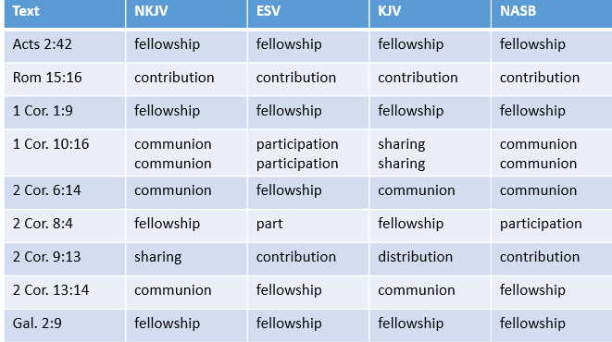

Slide 24
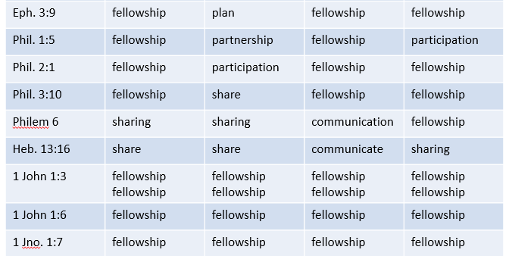

Slide 25
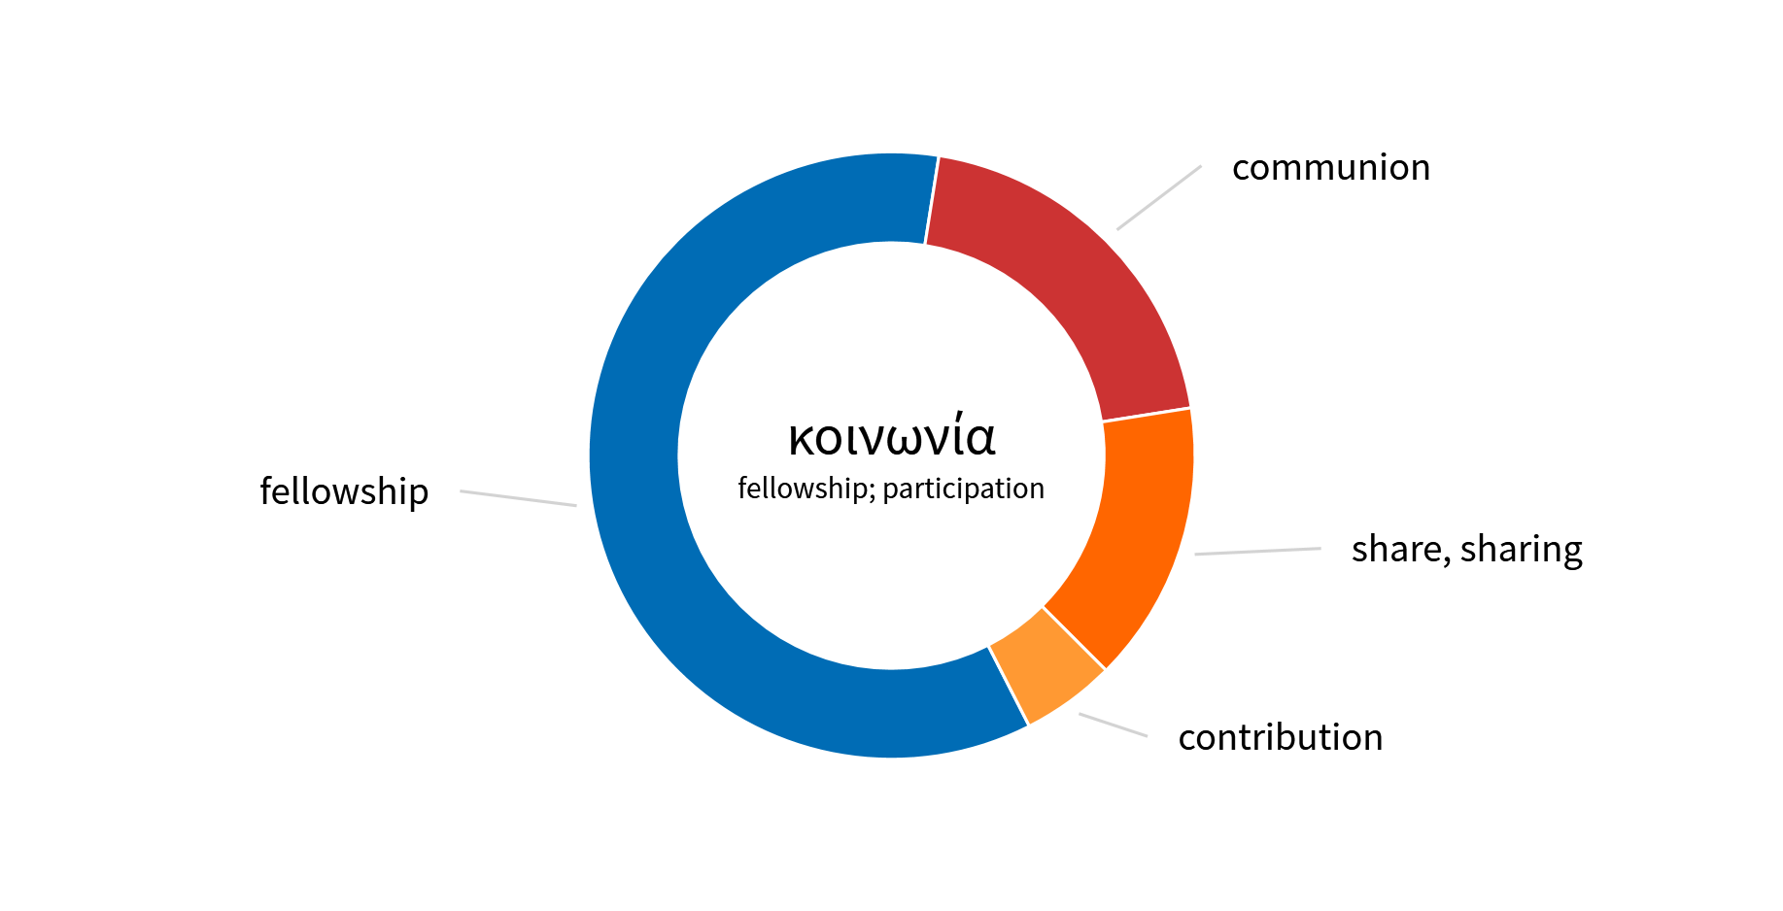
NKJV

Slide 26
Fellowship
Contribution
Communion
Part
Participation
Sharing
Partnership
Distribution
Communicate
KJV
NKJV
ESV
NASB

Slide 27
Fellowship
(Koinonia)
COMMUNION – Lord’s Supper (1 Cor. 10:16)
COMMUNITY - Sharing of goods (Acts 2:42)
CONTRIBUTION – For poor saints (Rom. 15:26)
COOPERATION – Extending right hand of fellowship (Gal. 2:9)

Slide 28
“Fellowship”
How the term in used in the Bible
  Joint action in spiritual work
  How the term is used / translated in NT
  Always a spiritual endeavor

Slide 29
“Fellowship”
How the term in used in the Bible
The language of Ashdod (misused)
  Fun, food, games, and sports
  Multipurpose buildings (kitchens, gyms, etc.) are referred to as “fellowship halls”
  Never used in that way in the NT

Slide 30
“The Language of Ashdod”
(Using Bible Terms in Bible Ways)
“Christian”
“Pastor”
“Reverend”
“Father”
“Sabbath”
“Fellowship”
“Witness”

Slide 31
“Witness”
How the term in used in the Bible
  Described those who actually saw (witnessed) the things of which they spoke (Acts 1:8; 2:32; 3:15)
  Apostles could be witnesses since they had been with the Lord (John 15:27)

Slide 32
“Witness”
How the term in used in the Bible
The language of Ashdod (misused)
  Used to describe one who teaches or shares the gospel with others
  The Bible never uses the term that way
  No one today is a witness to Christ

Slide 33
“The Language of Ashdod”
(Using Bible Terms in Bible Ways)
“Christian”
“Pastor”
“Reverend”
“Father”
“Sabbath”
“Fellowship”
“Witness”

