Slide 1
Matthew 14:22–33
Jesus Walks on the Water
²² Immediately Jesus made His disciples get into the boat and go before Him to the other side, while He sent the multitudes away.
²³ And when He had sent the multitudes away, He went up on the mountain by Himself to pray. Now when evening came, He was alone there.
²⁴ But the boat was now in the middle of the sea, tossed by the waves, for the wind was contrary.
²⁵ Now in the fourth watch of the night Jesus went to them, walking on the sea.
²⁶ And when the disciples saw Him walking on the sea, they were troubled, saying, “It is a ghost!” And they cried out for fear.
²⁷ But immediately Jesus spoke to them, saying, “Be of good cheer! It is I; do not be afraid

Slide 2
²⁸ And Peter answered Him and said, “Lord, if it is You, command me to come to You on the water.”
²⁹ So He said, “Come.” And when Peter had come down out of the boat, he walked on the water to go to Jesus.
³⁰ But when he saw that the wind was boisterous, he was afraid; and beginning to sink he cried out, saying, “Lord, save me!”
³¹ And immediately Jesus stretched out His hand and caught him, and said to him, “O you of little faith, why did you doubt?”
³² And when they got into the boat, the wind ceased.
³³ Then those who were in the boat came and worshiped Him, saying, “Truly You are the Son of God.”
Parallel Accounts
Mark 6:45-52
John 6:15-21

Slide 3
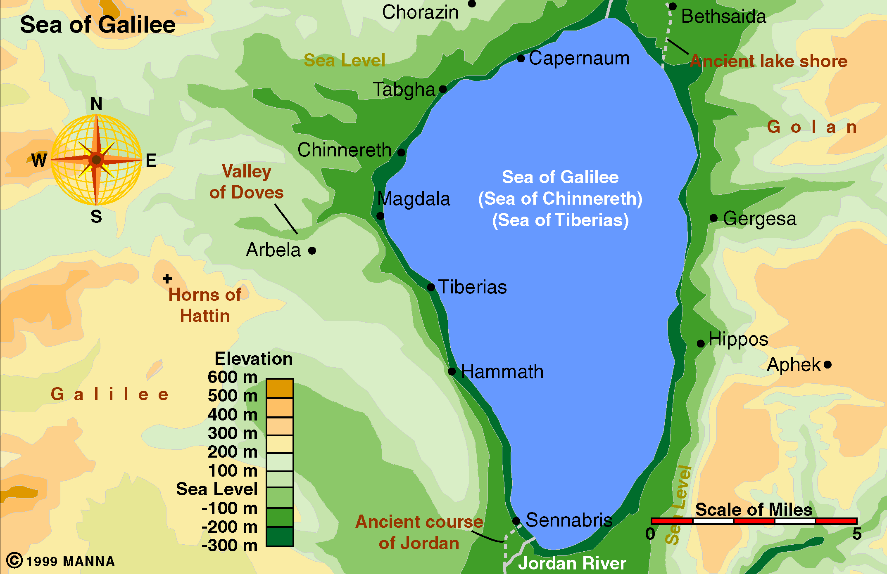
Sea of Galilee
Bethsaida (Galilee)
Sent to “other side” (Bethsaida, Mk. 6:45; Capernaum, Jn. 6:17)
3 - 4 miles out in sea (Jn. 6:19)
In four watch: 3am – 6am (Mt. 14:25)

Slide 4
Matthew 14:22–33
Jesus Walks on the Water
“This section pictures separation, storm and stress (verses 22-24), fright (verses 25, 26), reassurance (verse 27), wavering (verses 28-32), and worship (verses 32, 33)” (William Hendrickson, 598).
Disciples were sent away – apparently expecting Jesus to come in another boat (John 6:17)
Two things that captured their attention & ours:
  Storm – strong winds (v. 24); boisterous (v. 30)
  Jesus walking on water (v. 25)
Peter asked to come to Jesus on the water (vv. 29-30)

Slide 5
Matthew 14:22–33
Jesus Walks on the Water
²⁸ And Peter answered Him and said, “Lord, if it is You, command me to come to You on the water.”
²⁹ So He said, “Come.” And when Peter had come down out of the boat, he walked on the water to go to Jesus.
³⁰ But when he saw that the wind was boisterous, he was afraid; and beginning to sink he cried out, saying, “Lord, save me!”
Doesn’t tell us that Peter sank or went completely under
Simply marks the beginning of the process

Slide 6
Are you beginning to sink?
Peter Began to Sink
Peter Began to Sink
Focus is not on the one who has sunk into the depths,
But on the one who is beginning to sink

Slide 7
Peter Began to Sink
Peter Began to Sink
The Temperament that Contributed

Slide 8
The Temperament that Contributed
Peter was not a wicked man – just being Peter
Peter was impulsive, impetuous & at times reckless
  Always the first to speak – quickest to act
    Matt. 15:15
    Matt. 16:13-18
    Matt. 16:22-23
    Matt. 17:4
    John 13:8-9
    John 18:10-11

Slide 9
The Temperament that Contributed
Peter was not a wicked man – just being Peter
Peter was impulsive, impetuous & at times reckless
  Always the first to speak – quickest to act
  “A most interesting person, this Peter. He seems to do nothing in halves” (Hendrickson, 602)
  “Impulsive Peter is immediately ready for action” (601)
  He is the only one of the disciples to ask & walk on water – and the only one to begin to sink!
  Willing to do what no one else would think of doing – yet can easily work to his ruin!

Slide 10
The Temperament that Contributed
Peter was not a wicked man – just being Peter
Peter was impulsive, impetuous & at times reckless
Peter focused too much on self
  When took notice of the wind – was thinking of himself (v. 30)
  “As long as he concentrated his attention on Jesus all went well. But the moment he took notice of the boisterous winds and the surging waters he became frightened” (Hendrickson, 602)

Slide 11
The Temperament that Contributed
Headstrong
Follower – not a leader
Laid back – easy going
Impulsive
Cautious
Quick to speak – talk a lot
Negative
Gullible
Your temperament may contribute to your beginning to sink:

Slide 12
Peter Began to Sink
Peter Began to Sink
The Temperament that Contributed
The Faith that Weakened

Slide 13
The Faith that Weakened
Peter’s Faith Weakened for the Moment
³⁰ But when he saw that the wind was boisterous, he was afraid; and beginning to sink he cried out, saying, “Lord, save me!”
³¹ And immediately Jesus stretched out His hand and caught him, and said to him, “O you of little faith, why did you doubt?”

Slide 14
The Faith that Weakened
Peter Began to Sink in Familiar Waters
  Peter was in home territory
    Raised & lived on the shores of the lake (John 1:44)
    Fisherman – who knew every inch of the waters (Matt. 4:18)
    Among those who loved him and knew him
  When away from home & support group – may begin…
  Could be some even in our midst beginning to sink
    Even though – in a strong church – that know well
    Even though – have a godly family – that love dearly
    Even though – surrounded by close friends

Slide 15
The Faith that Weakened
Peter Began to Sink in Familiar Waters
Peter Began to Sink after Loyal Discipleship
  Peter was no beginner – not inexperienced
    Called much earlier – understood Jesus is the Messiah (John 1:41-42)
    Listened to his teaching (Matt. 5-7)
    Witnessed the miracles (Matt. 8-9)
    Named an apostle (Matt. 10)
    Saw the 5,000 & 4,000 fed (John 6)
  Learn: One can be faithful, loyal & dedicated – does not guarantee that will not begin to sink! (cf. 1 Cor. 10:12)

Slide 16
The Faith that Weakened
Peter Began to Sink in Familiar Waters
Peter Began to Sink after Loyal Discipleship
Peter Began to Sink on a Permitted Path
  Had the Lord forbidden Peter – we could well understand his beginning to sink
    He would be doing what he shouldn’t do!
    Many paths the Lord has forbidden (i.e. Gal. 5)
  Here – was going where the Lord permitted him to go!
    He was not rebelling
    He was not disobeying

Slide 17
Sinking on a Permitted Path
Worship – lose our focus (1 Cor. 11:27)
Using liberties – abuse (Rom. 14:19-21)
Teaching others – shift our motive (Phil. 1:15)
May do something (not sinful or encouraged)
  Date / Marry a non-Christian
  Where go to school
  Type of employment
  Miss a lot because of own or family member’s sickness

Slide 18
The Faith that Weakened
Peter Began to Sink in Familiar Waters
Peter Began to Sink after Loyal Discipleship
Peter Began to Sink on a Permitted Path
Peter Began to Sink when he Began to Fear
  There is no evidence that the wind had grown more fierce while Peter was walking on the water.
  Problem: took his eyes off the Lord – onto the wind (v. 30)
    Now he is afraid (v. 30)
    He now is no different that any other – now the wind and the waves are a terrible threat!

Slide 19
The Faith that Weakened
Peter Began to Sink in Familiar Waters
Peter Began to Sink after Loyal Discipleship
Peter Began to Sink on a Permitted Path
Peter Began to Sink when he Began to Fear
  There is no evidence that the wind had grown more fierce while Peter was walking on the water.
  Problem: took his eyes off the Lord – onto the wind (v. 30)
  We can easily do the same
    When question Lord’s provisions (Matt. 6:25-ff)
    When fail to cast our burdens on him (1 Pet. 5:7)
    When think we have a better way (Prov. 14:12)

Slide 20
Peter Began to Sink
Peter Began to Sink
The Temperament that Contributed
The Faith that Weakened
The People that were Near

Slide 21
The People that were Near
Disciples – His Friends (in the boat)
  Have to wonder if they even noticed anything before Peter cries, “Lord save me!”
    In the early hours of morning (v. 25)
    Had trouble recognizing Jesus (v. 26)
    If they notice – no record of any reaction.
  A disciple today could begin to sink with little notice
    Because have not reached point of going under
    Brethren, friends & even family may not realize the change going on within
    Outward impressions say all is well…

Slide 22
The People that were Near
Disciples – His Friends (in the boat)
Jesus – His Lord (on the water)
  As Peter began to sink his Lord was not far away
    Peter knew where to cry for help (v. 30)
    While he begins to sink – not lost faith in his Lord!
    Lord was close enough to stretch out is hand and save him (v. 31)
  When you realize that you are beginning to sink – remember the Lord is close by:
    Promised he will never leave (Heb. 13:5)
    Time to cry for help, “Lord save me!” (v. 30)

Slide 23
Are You
Beginning to Sink?
Not read / study as much as used to?
Praying less?
Pulling away from godly friends?
Associating more with people of world?
Losing focus during worship?
Spirituality means less?
Becoming more absorbed in work / material?

Slide 24
Peter Began to Sink
Peter Began to Sink
The Temperament that Contributed
The Faith that Weakened
The People that were Near

