Slide 1
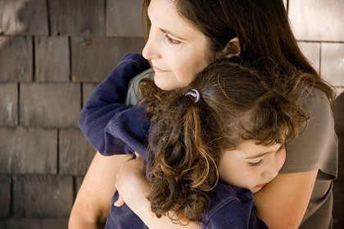
Maintaining Biblical Faith in a
Humanistic Society
(Protecting Our Children from
Secular Influences)

Slide 2
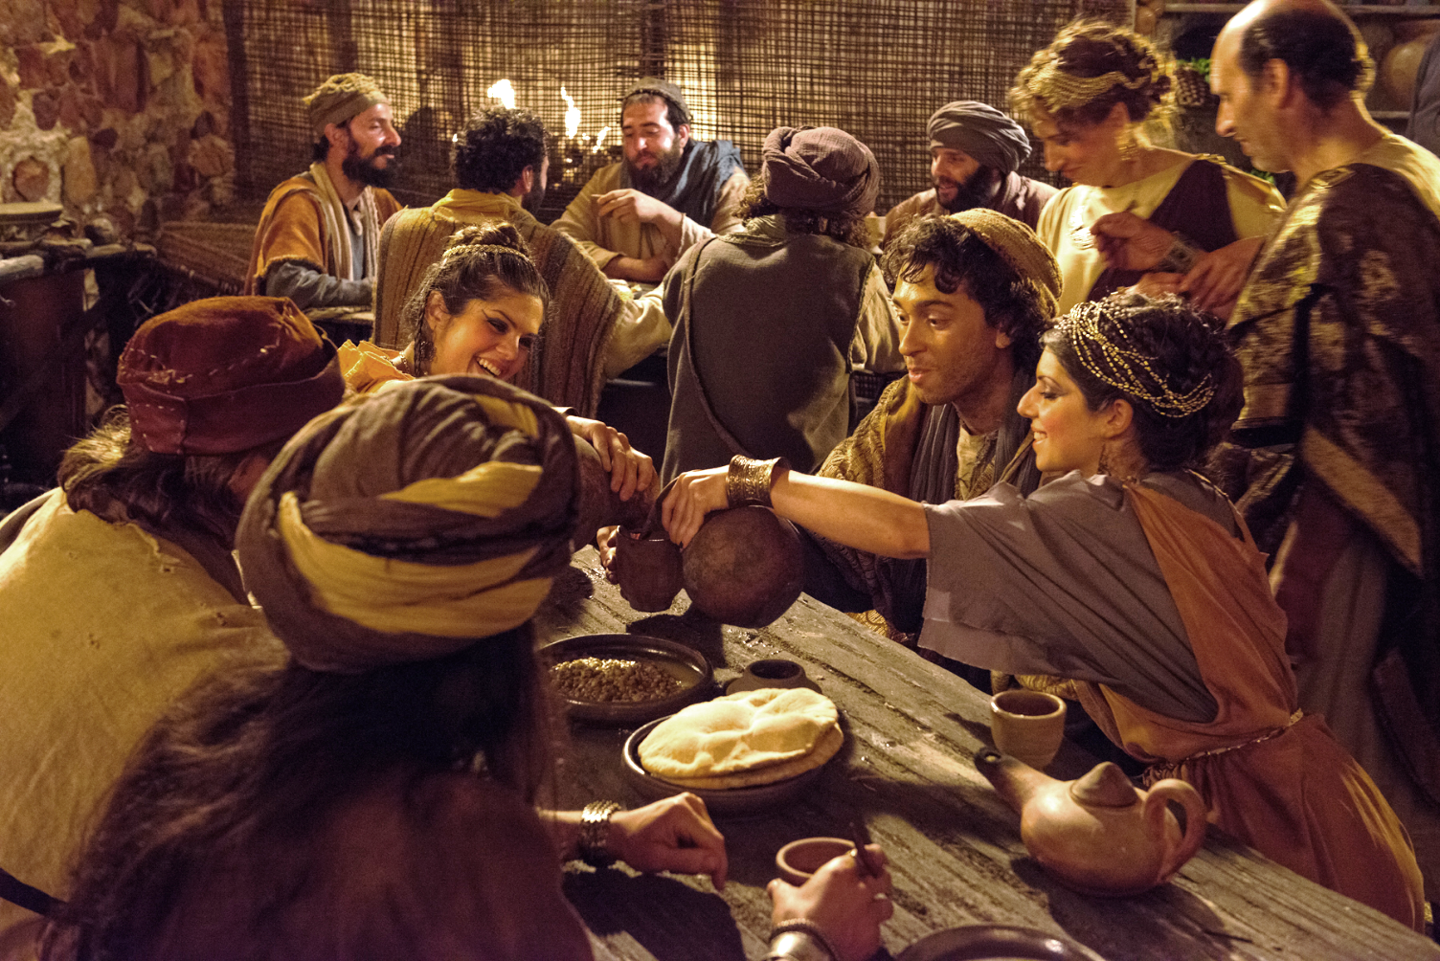
Judges 2:10
“All that generation also were gathered to their fathers; and there arose another generation after them who did not know the LORD, nor yet the work which He had done. Then the sons of Israel did evil in the sight of the LORD and served the Baals.”
2
Notes:
2

Slide 3
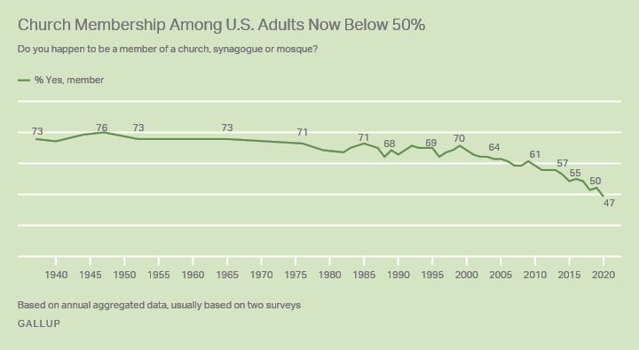
2020 Church Membership Gallup Poll
67%
3
Notes:
3

Slide 4

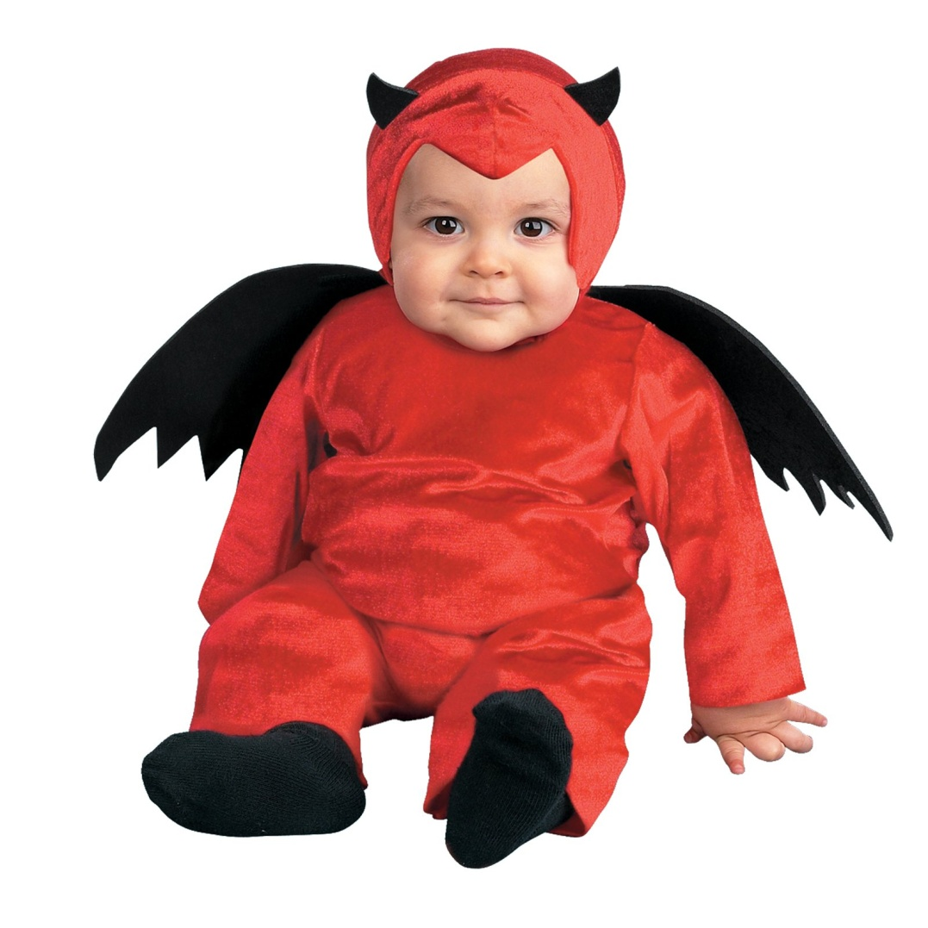


Slide 5
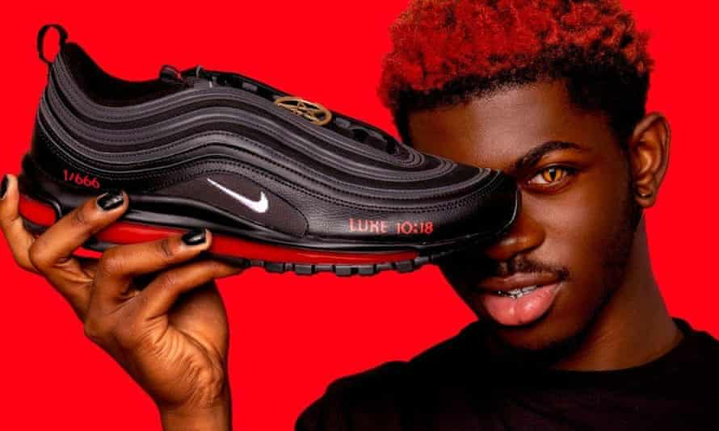

Slide 6


Slide 7
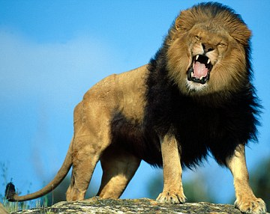
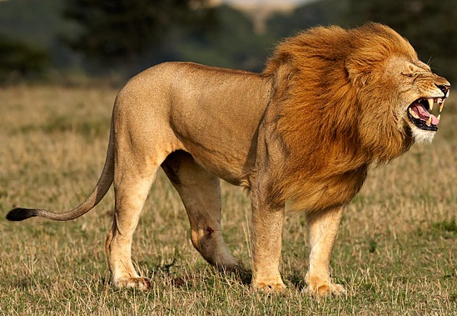
“Be of sober spirit, be on the alert Your adversary, the devil, prowls around like a roaring lion, seeking someone to devour.”
I Pet. 5:8
7
Notes:
7

Slide 8
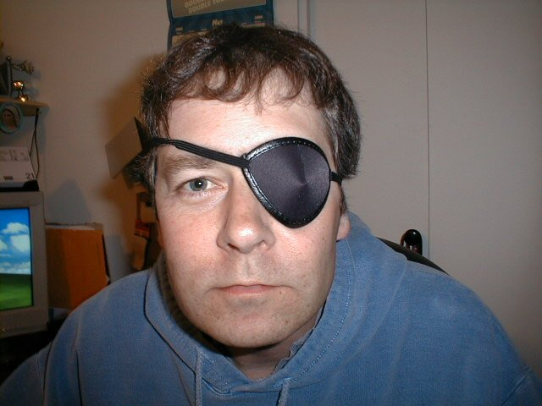
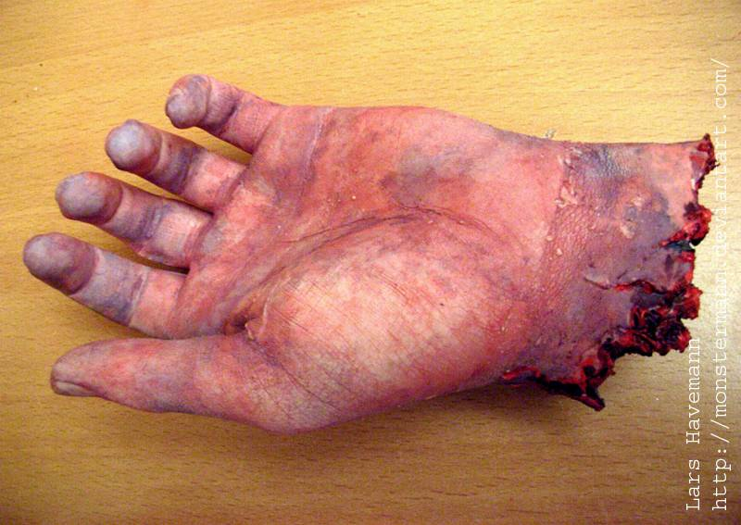
“If your right eye causes you to sin, tear it out and throw it away. For it is better that you lose one of your members than that your whole body be thrown into hell. 30And if your right hand causes you to sin, cut it off and throw it away. For it is better that you lose one of your members than that your whole body go into hell.”
Mt. 5:29-30
Not Real

Slide 9
We and our Children are Threatened by Enumerable Doctrines and Philosophies
Humanism, Secularism, Racism, Hedonism, Asceticism, Stoicism, Relativism, Materialism, Egoism, Deism, Paganism, Pantheism, Eastern Religions and the New Age Movement, Agnosticism, Atheism, the Progressive Agenda, Neo-Darwinism, Fatalism, Anarchism, Annihilationism, Nihilism, Male Chauvinism, Feminism, Naturalism, Empiricism, Rationalism, Fascism, Totalitarianism, Marxism, Socialism, Sadism
- Immorality, Carnality, Sensuality, Homosexuality

Slide 10


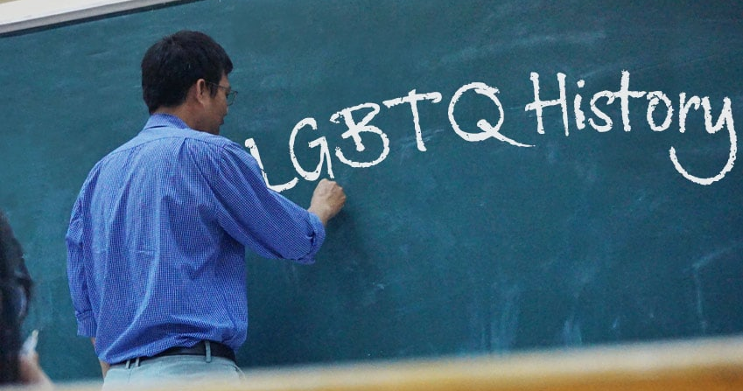
1. Social Policy (School, education)
2. Family
3. 5 forms of media!
George Barna Survey Says 3 Major Influences in American Child’s Life
George Barna, The 7 Faith Tribes,. 2014
Notes:
10

Slide 11
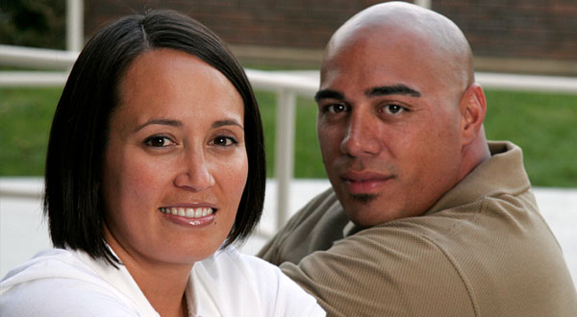
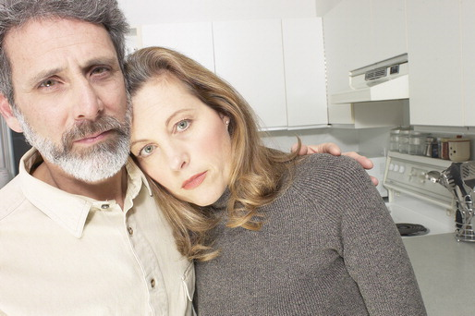
So, What’s The Solution for Concerned Parents?!
Notes:
11

Slide 12
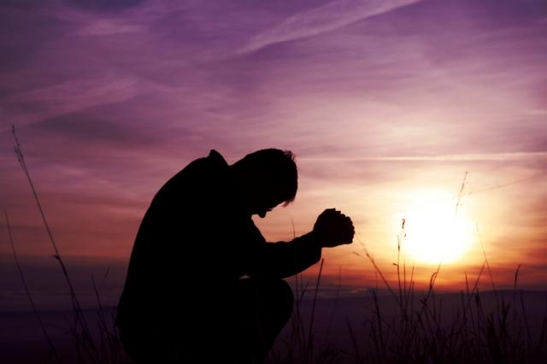
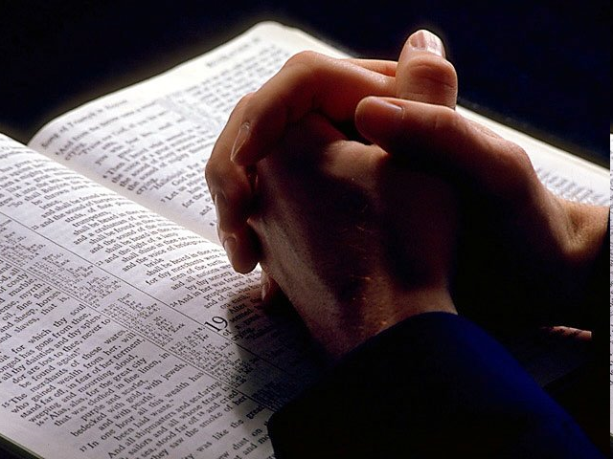

Solution: Teach Them to Love the Lord Jesus
(Mk. 12:28-30)
Do You Want to Protect Your Children (and Yourself) from This World?
Notes:
12

Slide 13
Teach Them to Love the Lord Jesus
Mk. 12:28-30
Do You Want to Protect Your Children (and Yourself) from This World?
Notes:
13

Slide 14
Psa. 11:3
“If the foundations are destroyed, what can the righteous do?”
14
Notes:
14

Slide 15


I. Train Your Children to Love Jesus
Eph. 6:4; II Tim. 1:5; 3:14,15; Lu. 2:46-52
Notes:
15

Slide 16

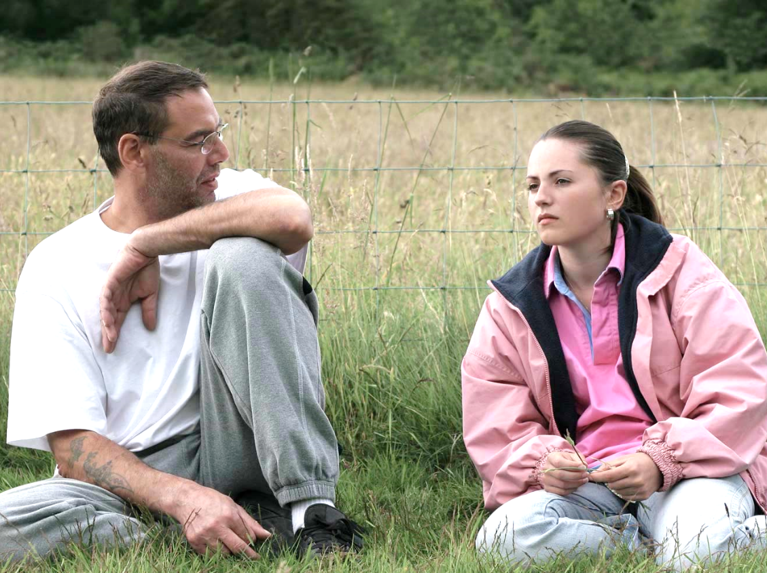
I. Train Your Children to Love Jesus
Deut. 6:6-7; 11:18-19; Psa. 78:1-7; Prov. 22:6
We Need to Include Casual Day-to-Day Spiritual Conversations With our Children
Notes:
16

Slide 17
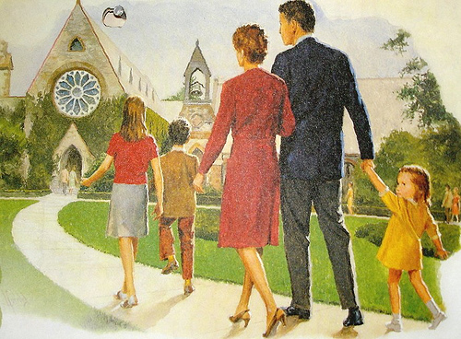
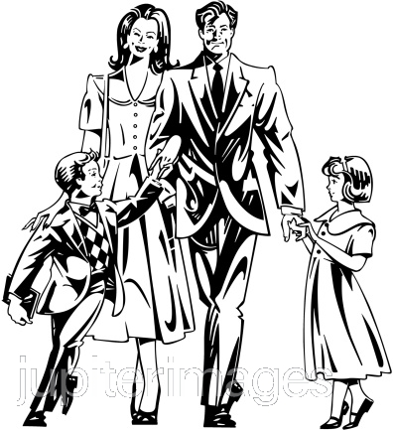
II. What Parents Can Do and Still Have Unfaithful Children
1. Can be loving, caring parents
2. Can take them to all the church assemblies
Notes:
17

Slide 18
III. What Else Can Parents Do to Promote Faithfulness in Children
Notes:
18

Slide 19
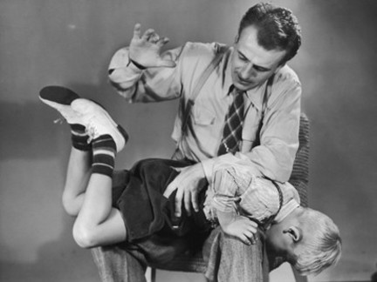

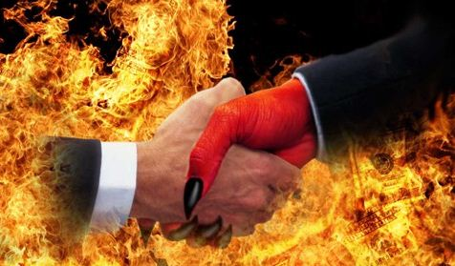
III. What Else Can Parents Do to Promote Faithfulness in Children
A. Discipline Them
Notes:
19

Slide 20
III. What Else Can Parents Do to Promote Faithfulness in Children
A. Discipline Them
I Cor. 5; II Thess. 3:6,14; Mt. 19:29
Notes:
20

Slide 21
III. What Else Can Parents Do to Promote Faithfulness in Children
A. Discipline Them
I Cor. 5; II Thess. 3:6,14; Mt. 19:29
Emphasize the Things of God Over the
Things of the World
Notes:
21

Slide 22




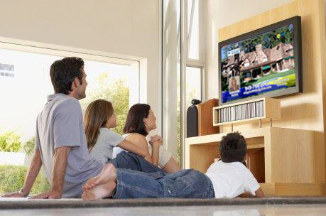
Christians Often Place the Greatest Priority on Their Children Excelling in Secular Activities Above the Kingdom of God
School athletics, NFL, NBA, MLB, NASCar, hunting, fishing, ATVs, 4H, band, voice lessons, beauty, fitness, fashion, entertainment, pop culture and music, social prowess, popularity, business, earthly possessions, excelling in academics, attending the best college, having the best career, making the most $$, vacation, hobbies, entertainment . .

Slide 23
And a Parent Might Respond, “But we bring him to church every week”
Yes, but all the time, money, energy, and emphasis you place on worldly things should go into teaching them to Love the Lord*

Slide 24
Instructor at Auburn University
“If christians really believed that people were going to an eternal Hell, they would be willing to crawl across broken shards of glass in order to teach others not to go there”

Slide 25
Parents
If we really believe that our children could end up in eternal punishment, would we be willing to crawl across broken shards of glass to prevent them from going there?

Slide 26
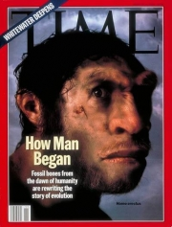
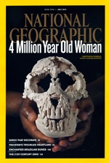







We Need More Emphasis on God’s Word and Less on the World

Slide 27
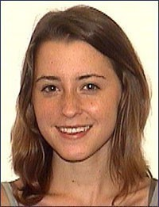
Whitney Hendricksen
Died March 17, 2009
Colorado Springs, CO

Slide 28
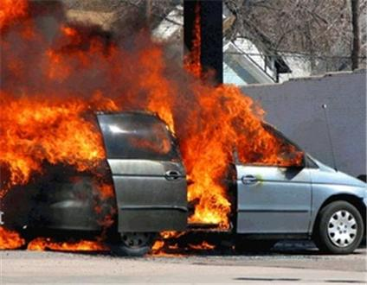

Slide 29
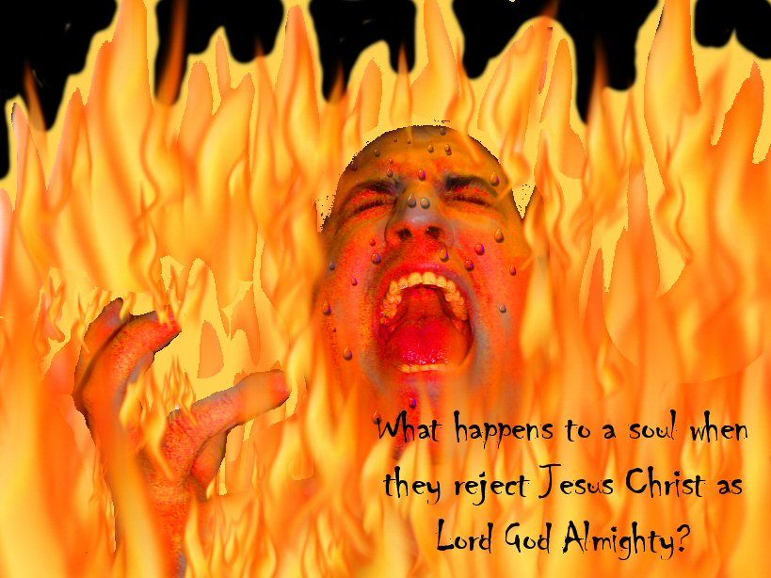
The Problem is a Lack of Faith
We Don’t Really Believe our Kids Could go to Hell

Slide 30
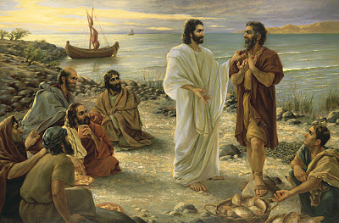
John 21:15-17 (NKJV)
Notes:
30

Slide 31
John 21:15-17 (NKJV)
“So when they had eaten breakfast, Jesus said to Simon Peter, “Simon, son of Jonah, do you love Me more than these?” He said to Him, “Yes, Lord; You know that I love You.” He said to him, “Feed My lambs.”
Notes:
31

Slide 32
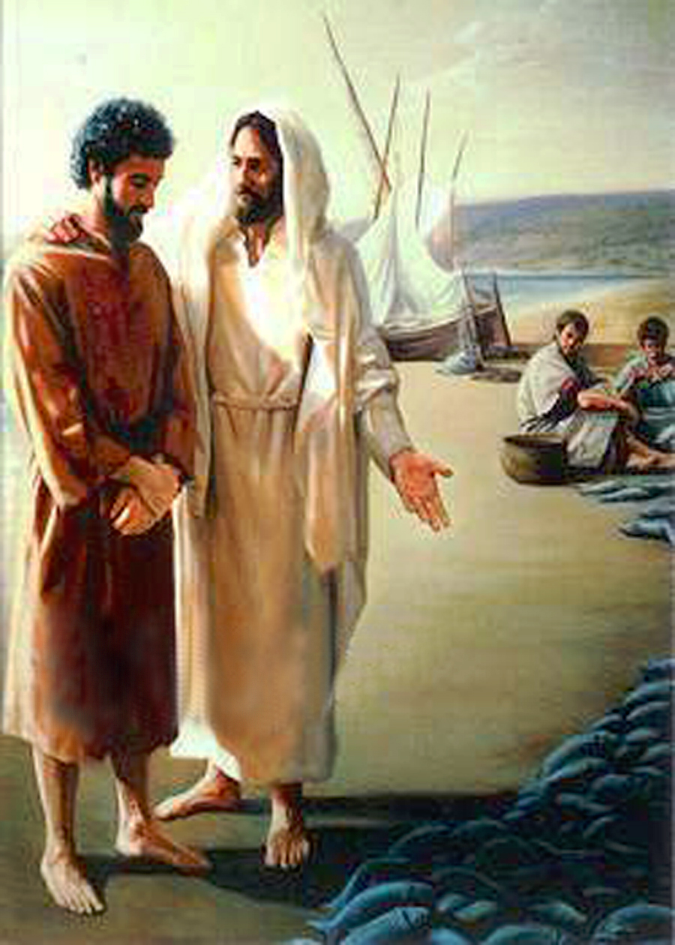
John 21:15-17
“He said to him again a second time, “Simon, son of Jonah, do you love Me?” He said to Him, “Yes, Lord; You know that I love You.” He said to him, “Tend My sheep.”
Notes:
32

Slide 33
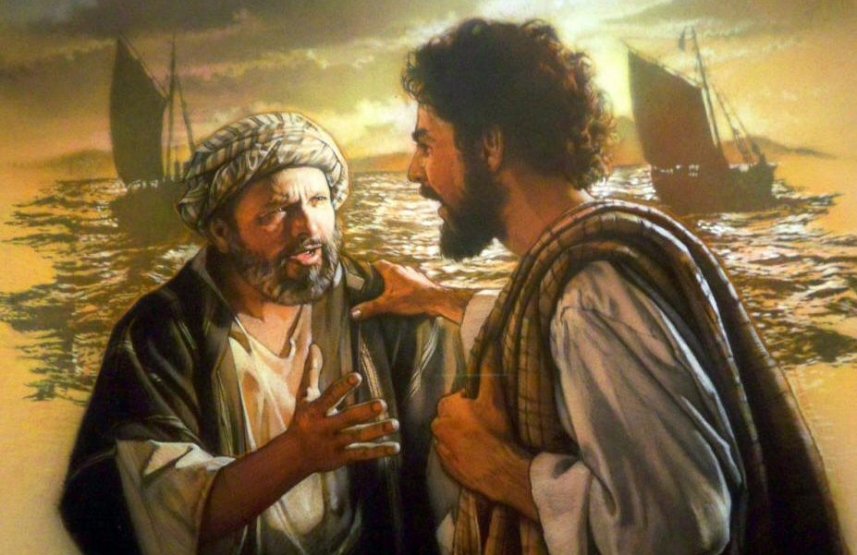
“He said to him the third time, “Simon, son of Jonah, do you love Me?” Peter was grieved because He said to him the third time, “Do you love Me?” And he said to Him, “Lord, You know all things; You know that I love you.” Jesus said to him, “Feed my sheep.”
John 21:15-17 (NKJV)
Notes:
33

Slide 34
What Might Jesus Say to Us Here Today?
Notes:
34

Slide 35
What Might Jesus Say to Us Here Today?
Jesus might say to the El Bethel Christians, “Christians, do you love Me more than these things of the world?’” You might say to Him, ‘Yes, Lord; You know that we love You.” He might say to you, “Feed My lambs.’” He might say to you a second time, “El Bethel Christians, do you love Me?” You might say to Him, “Yes, Lord; You know that we love You.” He might say to you, “Tend My sheep.” He might say to you a third time, “El Bethel Christians, do you love Me?” And you might say to Him, “Lord, You know all things; You know that we love you.” Jesus might say to you, “Feed my sheep.”
Notes:
35

Slide 36
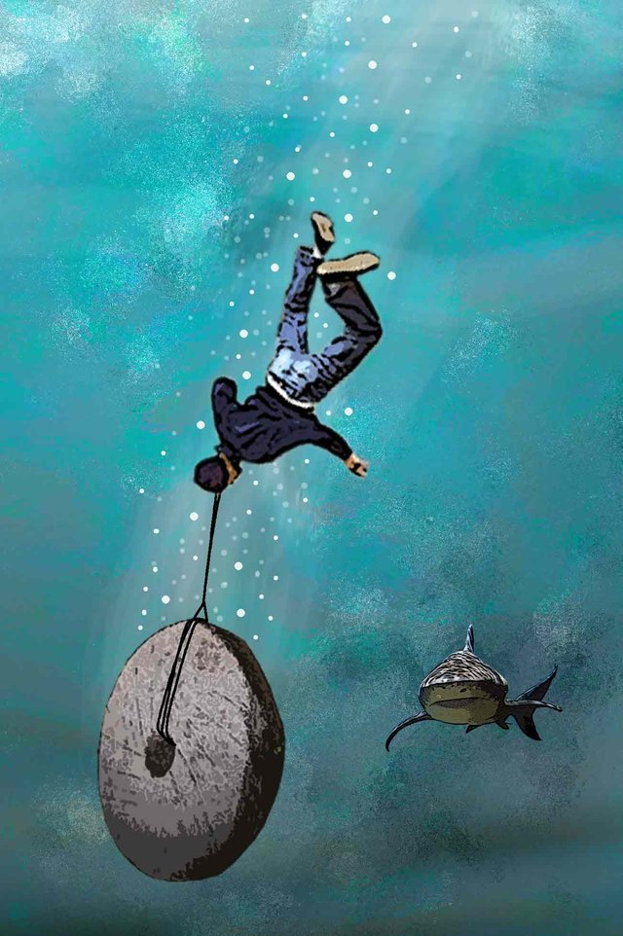
Matt. 18:6 (NASB)
“whoever causes one of these little ones who believe in Me to stumble, it would be better for him to have a heavy millstone hung around his neck, and to be drowned in the depth of the sea.”
Notes:
36

Slide 37
Joshua 24:14-16 (NKJV)
“‘Now therefore, fear the LORD, serve Him in sincerity and in truth, and put away the gods which your fathers served . . . Serve the LORD! 15 And if it seems evil to you to serve the LORD, choose for yourselves this day whom you will serve, whether the gods which your fathers served. . . or the gods of the Amorites. . . But as for me and my house, we will serve the LORD.’ 16So the people answered and said: ‘Far be it from us that we should forsake the LORD to serve other gods.’”
Notes:
37

Slide 38
What Might Joshua Say to Us Today?
Notes:
38

Slide 39
What Might Joshua Say to Us Today?
Joshua might say, “Now therefore, El Bethel Christians, fear the LORD, serve Him in sincerity and in truth, and put away the gods of worldly possessions, career, entertainment, idleness, and spiritual disinterest, which your brethren served in the past. Serve the LORD! And if it seems boring to you to serve the LORD, choose for yourselves this day whom you will serve, the gods of hobbies, sports, wealth, and worldly pleasure. But as for me and my house, we will serve the LORD.” So the El Bethel Christians answered and said. . . (To be determined)
Notes:
39

Slide 40
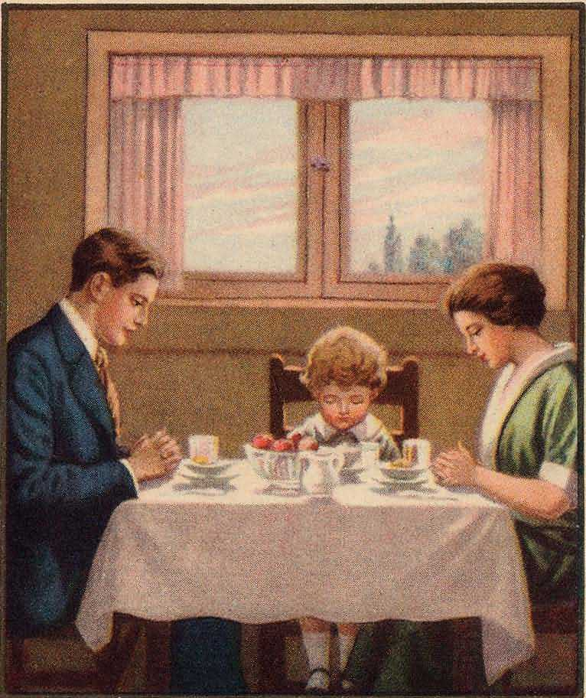
Some Potential Applications For Training Children
Have regular times of Bible study and devotion with your family every week
Let your children see you studying and praying
Live so that when you die, your child will say, “My mom loved the Lord”
Put scriptures up on your wall, refrigerator, bathroom mirror
Turn off ungodly commercials (alcohol, immodesty, fornication)
Don’t laugh or make jokes about sin
Pray with your family every day

Slide 41
Twelve Additional Ideas For Spiritual Growth/Dedication
1. Ask your children what they learned in Bible class
2. Use news events to teach your children Biblical principles
3. Give your children instructions from a Biblical perspective
4. Visit nursing homes and shut-ins
5. Take your family to gospel meetings and bring others
6. Volunteer for projects to help other members of the church
7. Turn off secular music sometimes when traveling, and turn on acapella hymns, sermons or Bible podcasts
Notes:
41

Slide 42
Twelve Additional Ideas For Spiritual Growth/Dedication
8. Pray that the Lord will make your children instruments for righteousness and the praise of God, even if it means going through hardships
9. Make your home a haven of hospitality, as much as you are able
10. Begin memorizing the scripture with your family
11. Become evangelistic and show an interest in saving the souls of others
12. LIVE THE LOVE OF JESUS - Mt. 25:31-46
Notes:
42

Slide 43

Let us Pray That Our Meat Will Be to Do the Will of Our Father in Heaven

Slide 44
“Therefore said the disciples one to another, Hath any man brought Him ought to eat? Jesus saith unto them, My meat is to do the will of Him that sent me, and to finish His work.” - Jn. 4:33,34 (KJV)
Let us Pray That Our Meat Will Be to Do the Will of Our Father in Heaven

Slide 45
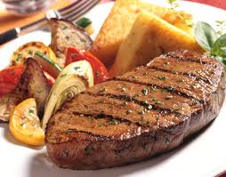
“Therefore said the disciples one to another, Hath any man brought Him ought to eat? Jesus saith unto them, My meat is to do the will of Him that sent me, and to finish His work.” - Jn. 4:33,34 (KJV)
Let us Pray That Our Meat Will Be to Do the Will of Our Father in Heaven

Slide 46
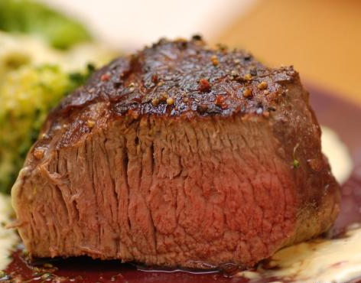
“Therefore said the disciples one to another, Hath any man brought Him ought to eat? Jesus saith unto them, My meat is to do the will of Him that sent me, and to finish His work.” - Jn. 4:33,34 (KJV)
Let us Pray That Our Meat Will Be to Do the Will of Our Father in Heaven

Slide 47
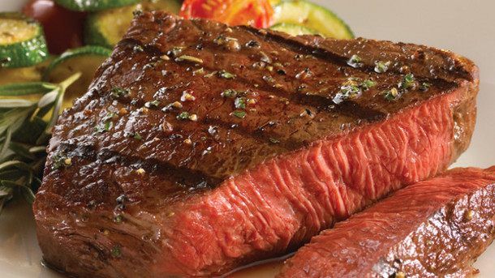
“Therefore said the disciples one to another, Hath any man brought Him ought to eat? Jesus saith unto them, My meat is to do the will of Him that sent me, and to finish His work.” - Jn. 4:33,34 (KJV)
Let us Pray That Our Meat Will Be to Do the Will of Our Father in Heaven

Slide 48
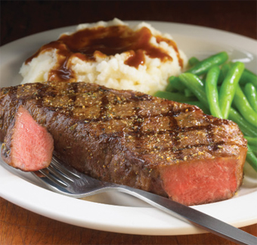
“Therefore said the disciples one to another, Hath any man brought Him ought to eat? Jesus saith unto them, My meat is to do the will of Him that sent me, and to finish His work.” - Jn. 4:33,34 (KJV)
Let us Pray That Our Meat Will Be to Do the Will of Our Father in Heaven

Slide 49
“Your words were found and I ate them.”
- Jer. 15:16
Let us Pray That Our Meat Will Be to Do the Will of Our Father in Heaven

Slide 50
