Slide 1
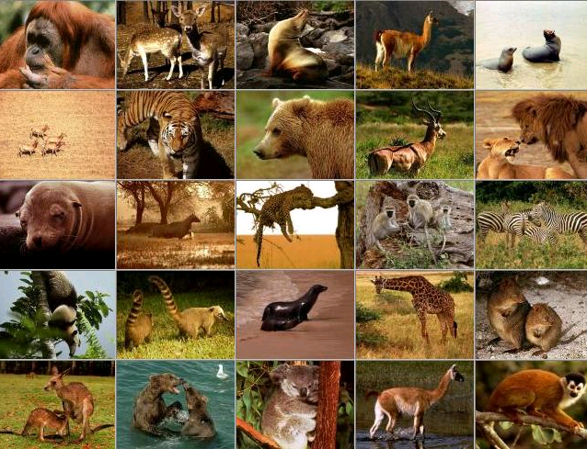
Background to Neo-Darwinian Evolution
Microevolution vs. Macroevolution and Animal Kinds

Slide 2
I Pet. 3:15
“always being ready to make a defense to everyone who asks you to give an account for the hope that is in you, yet with gentleness and reverence”
Notes:
2

Slide 3
I Pet. 3:15
“always being ready to make a defense to everyone who asks you to give an account for the hope that is in you, yet with gentleness and reverence”
Gal. 6:1
“Brethren, even if anyone is caught in any trespass, you who are spiritual, restore such a one in a spirit of gentleness; each one looking to yourself, so that you too will not be tempted.”
Notes:
3

Slide 4
I Pet. 3:15
“always being ready to make a defense to everyone who asks you to give an account for the hope that is in you, yet with gentleness and reverence”
Gal. 6:1
“Brethren, even if anyone is caught in any trespass, you who are spiritual, restore such a one in a spirit of gentleness; each one looking to yourself, so that you too will not be tempted.”
II Tim. 2:24-26
“The Lord’s bond-servant must not be quarrelsome, but be kind to all, able to teach, patient when wronged, 25with gentleness correcting those who are in opposition, if perhaps God may grant them repentance leading to the knowledge of the truth, 26and they may come to their senses and escape from the snare of the devil, having been held captive by him to do his will.”
Notes:
4

Slide 5
What We Will Learn about Animal Kinds in This Lesson
Fixity (discontinuity) of Animal Kinds Disproves Neo-Darwinian Evolution
Animals Can Vary/Change Within Their own Kind (Microevolution), But Not Outside Their own Kind (Macroevolution)

Slide 6
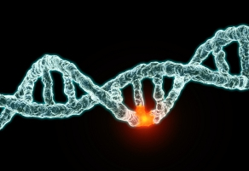
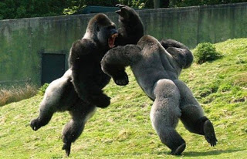
The philosophy that all life on earth gradually evolved from a single-celled organism by means of (1) random mutations (purely accidental) and (2) natural selection (i.e., survival of the fittest). AKA, “particles to people” or “molecules to man.”
What is Evolution?
(AKA, Macroevolution, Neo-Darwinism or The General Theory of Evolution)

Slide 7



The Philosophy of Macroevolution is Not New
It has been a strongly held philosophical conviction of faith for thousands of years before man ever tried to make it scientific
“a priori” Philosophy, (the conclusion precedes the experiments) versus
2. “a posteriori” Science, (the conclusion is drawn
only AFTER the experiments)

Slide 8
Macroevolution Was Believed, Accepted, and Taught Before It Was Scientifically Tested
How Do We Know?

Slide 9
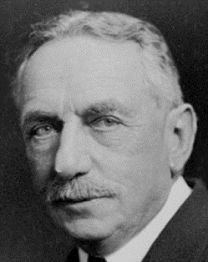
“from the earliest stages of Greek thought man has been eager to discover some natural cause of evolution, and to abandon the idea of supernatural intervention in the order of nature”
- Dr. H.F. Osborn, The Origin and Evolution of Life, 1918, p. ix. (Harvard Paleontologist, President of American Museum of Natural History)
9
Notes:
9

Slide 10
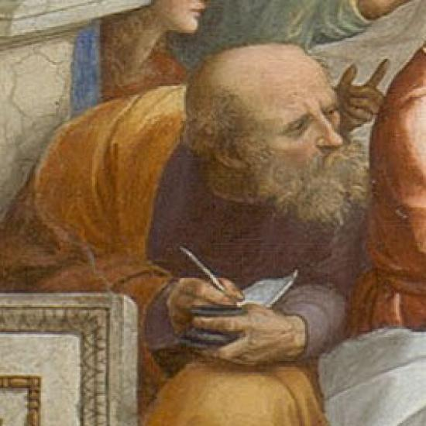
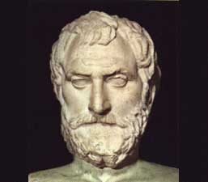
Man Has Been Trying to Explain God Away for over 3,000 Years
1) Psalms 14:1; 53:1- “The fool has said in his heart, ‘there is no God.’”
2) Evolution proposed by Ancient Greeks: Thales (588 B.C.) Anaximander (570 B.C.); Empedocles (455 B.C.); Democritus (420 B.C.); Strato (288 B.C.)
10
Thales, 588 B.C.
Anaximander, 570 B.C.
Notes:
10

Slide 11
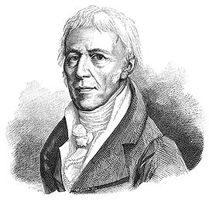
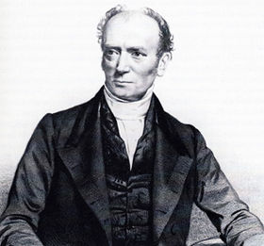
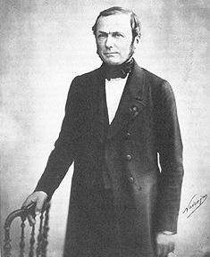
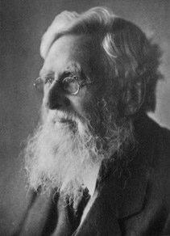
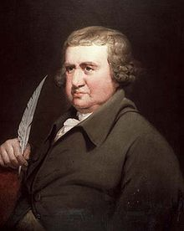
Evolution Proposed Prior to Charles Darwin
Jean-Baptiste Lamarck (1744-1829)
Robert Grant (1793-1874)
Geoffroy Saint-Hilaire (1772-1844)
Alfred Russel Wallace (1823-1913)
11
Erasmus Darwin (1731-1802)
Notes:
11

Slide 12
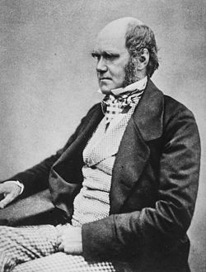
What Is the Significance of Charles Darwin?
Charles Darwin used a logical fallacy called “The Fallacy of Equivication” (AKA, “Bait and Switch”) to say, if animals can vary within their kind then they can evolve into different kinds (i.e., across phylogentic boundaries)
Notes:
12

Slide 13

What Is the Significance of Charles Darwin?
Charles Darwin used a logical fallacy called “The Fallacy of Equivication” (AKA, “Bait and Switch”) to say, if animals can vary within their kind then they can evolve into different kinds (i.e., across phylogentic boundaries)
Notes:
13

Slide 14
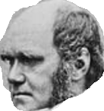
What Is the Significance of Charles Darwin?
Charles Darwin used a logical fallacy called “The Fallacy of Equivication” (AKA, “Bait and Switch”) to say, if animals can vary within their kind then they can evolve into different kinds (i.e., across phylogentic boundaries)
Notes:
14

Slide 15
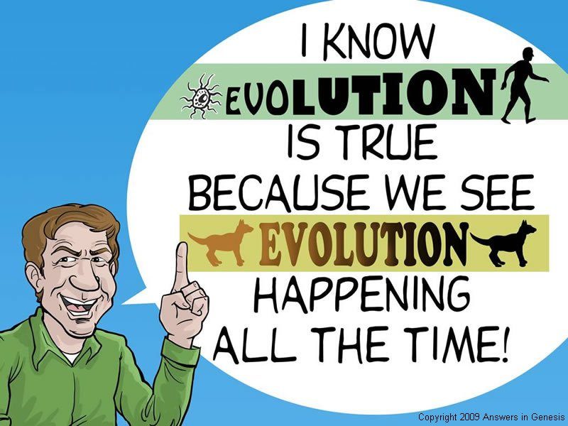

Slide 16
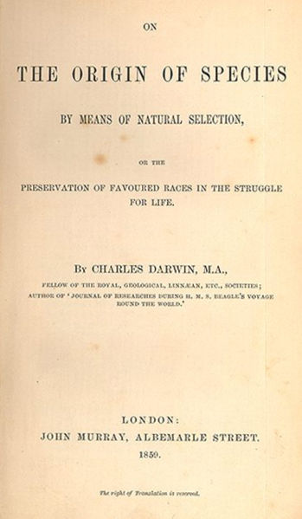
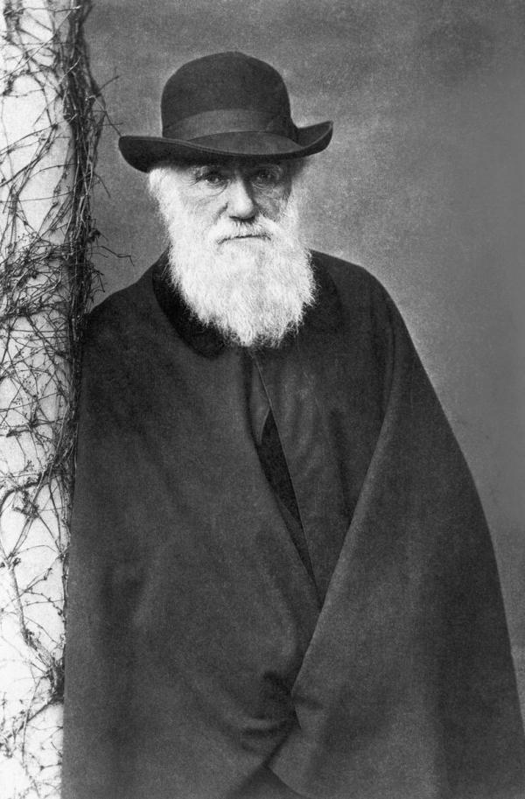
Darwin proved “survival of the fittest.” However, in order to prove macro- evolution, he had to establish, “arrival of the fittest”

Slide 17
Animals can vary within their kind, (microevolution) but cannot change outside their kind (macroevolution)
The Microevolution Maxim

Slide 18
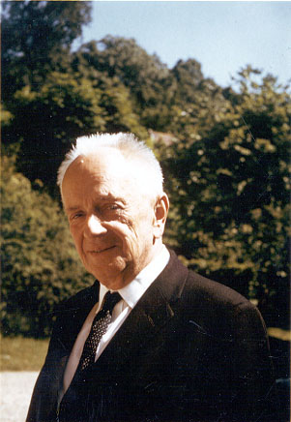
“On the other hand, it is manifestly impossible to reproduce in the laboratory the evolution of man . . . Experimental evolution deals of necessity with only the simplest levels of the evolutionary process, sometimes called microevolution.”
- Dr. Theodosius Dobzhansky, “On Methods of Evolutionary Biology and Anthropology” (Part I—Biology), American Scientist (December 1957), pp. 381-392. –Pioneered Modern Evolutionary Synthesis of biology with fruit flies.

Slide 19
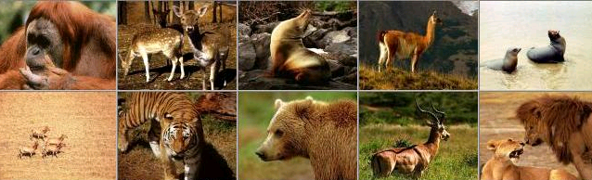
Gen. 1:21
“21So God created great sea creatures and every living thing that moves, with which the waters abounded, according to their kind, and every winged bird according to its kind.”
“Then God said, "Let the earth bring forth the living creature according to its kind: cattle and creeping things and beast of the earth, each according to its kind; and it was so. And God made the beast of the earth according to its kind, cattle according to its kind, and everything that creeps on the earth according to its kind. And God saw that it was good.”

Slide 20
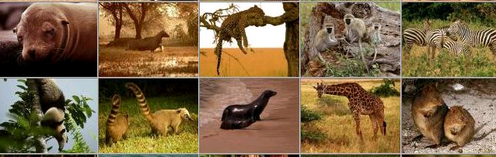
Gen. 1:24-25
“24Then God said, "Let the earth bring forth the living creature according to its kind: cattle and creeping things and beast of the earth, each according to its kind; and it was so. 25And God made the beast of the earth according to its kind, cattle according to its kind, and everything that creeps on the earth according to its kind.”
DEFINITON: The Hebrew word “Min” is the English equivalent for the word “kind.”

Slide 21
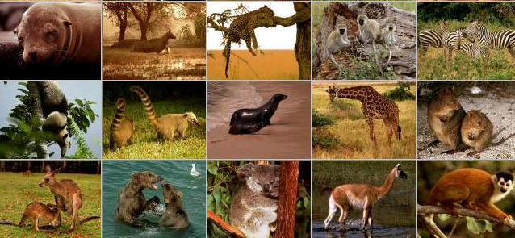
Baraminology
Our Old Testament word “KIND,” in Genesis, comes from the Hebrew word “Min,” from which is derived the study of “BARAMINOLOGY”

Slide 22
Baraminology
“Baraminology is a creationist taxonomic system that classifies animals into groups called "created kinds" or "baramins” according to creation in the book of Genesis. It claims that (1) differing kinds cannot interbreed, and (2) have no evolutionary relationship to one another.”
First Proposed by Frank Marsh in 1941

Slide 23
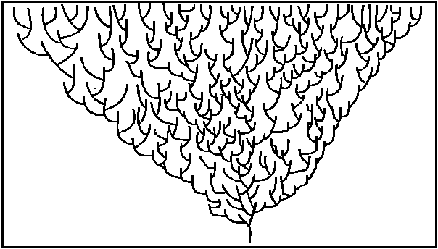
Baraminology
“Baraminology is a creationist taxonomic system that classifies animals into groups called "created kinds" or "baramins” according to creation in the book of Genesis. It claims that (1) differing kinds cannot interbreed, and (2) have no evolutionary relationship to one another.”
First Proposed by Frank Marsh in 1941

Slide 24
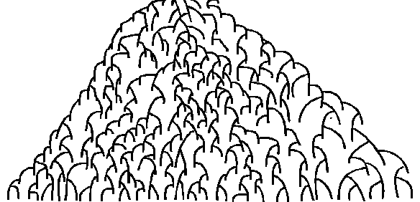
Baraminology
“Baraminology is a creationist taxonomic system that classifies animals into groups called "created kinds" or "baramins” according to the account of creation in the book of Genesis. It claims that (1) differing kinds cannot interbreed, and (2) have no evolutionary relationship to one another.”
First Proposed by Frank Marsh in 1941.

Slide 25

Baraminology
“Baraminology is a creationist taxonomic system that classifies animals into groups called "created kinds" or "baramins” according to the account of creation in the book of Genesis. It claims that (1) differing kinds cannot interbreed, and (2) have no evolutionary relationship to one another.”
First Proposed by Frank Marsh in 1941.

Slide 26
Baraminology
“Baraminology is a creationist taxonomic system that classifies animals into groups called "created kinds" or "baramins” according to the account of creation in the book of Genesis. It claims that (1) differing kinds cannot interbreed, and (2) have no evolutionary relationship to one another.”
First Proposed by Frank Marsh in 1941.

Slide 27


> 1,300 Varieties of Roses
www.mr-roses.com

Slide 28
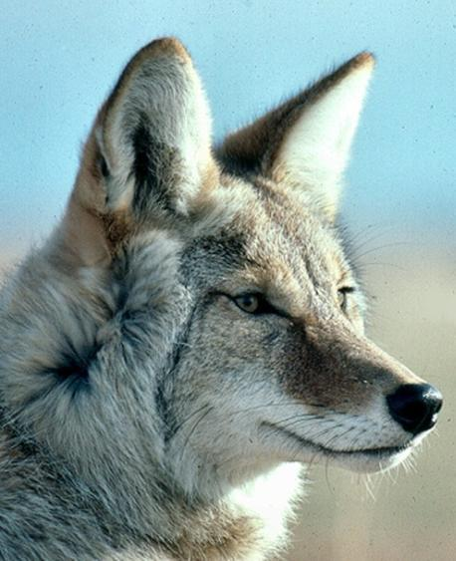
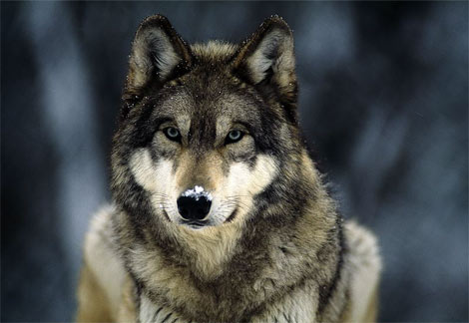
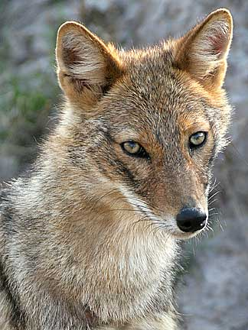

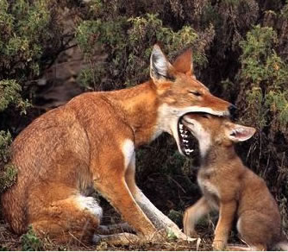
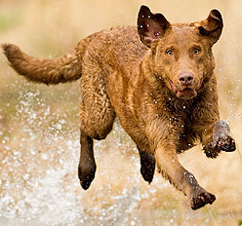
Canidae Canis
Sdsnake.com
animals.nationalgeographic.com
daveparsons.com
Gray Wolf
Golden Jackal
Coyote
360 Recognized Breeds
Dingo
Ethiopian Wolf
Domesticated Dog

Slide 29
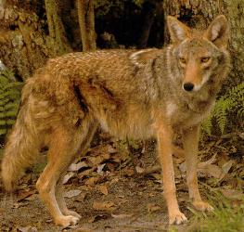
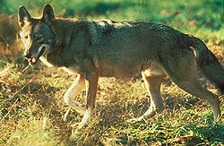
Canidae Canis
Wikipedia.com
Sciencetrio.wordpress.com
Coywolf

Slide 30
Canidae Canis
Sdsnake.com
animals.nationalgeographic.com
daveparsons.com
Gray Wolf
Golden Jackal
Coyote
360 Recognized Breeds
Dingo
Ethiopian Wolf
Domesticated Dog

Slide 31
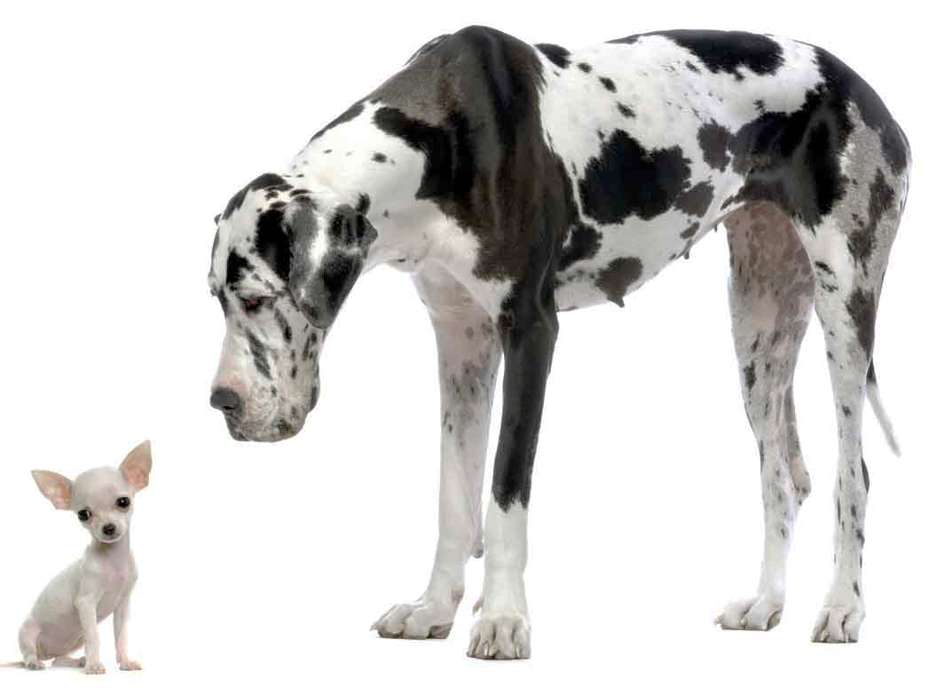

Great Dane and Chihuahua
Canidae canis familiaris
360 Recognized Breeds
http://chweetpics.com/wp-content/uploads/2009/07/Great-Dane-and-Chihuahua-small.jpg

Slide 32
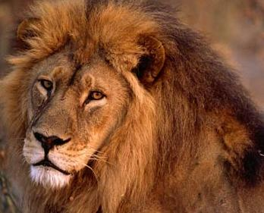
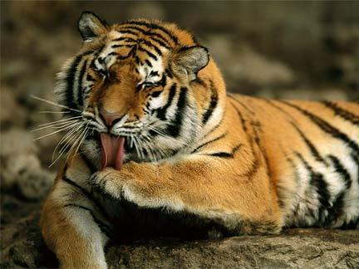
Felidae Panthera
animals.nationalgeographic.com
animals.nationalgeographic.com
Lion
Tiger

Slide 33
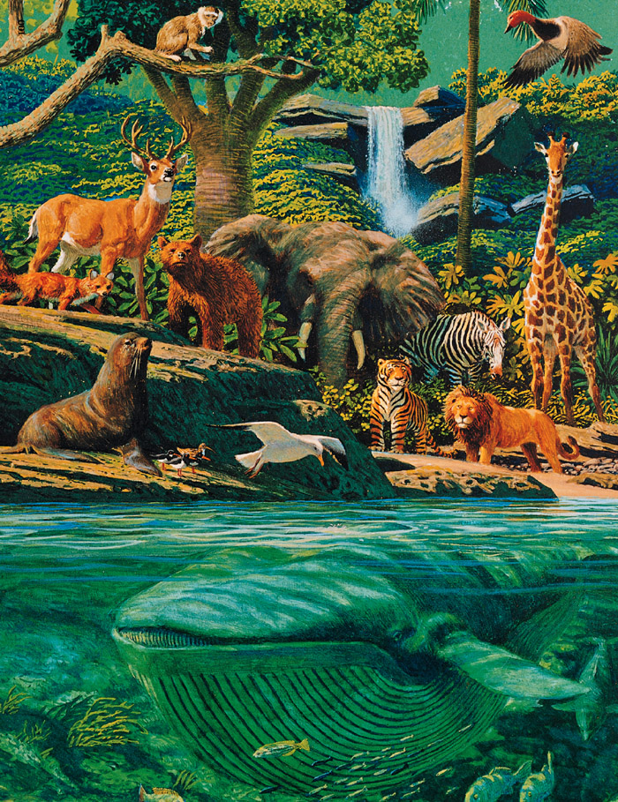

Slide 34
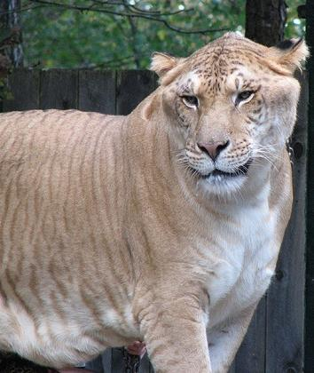
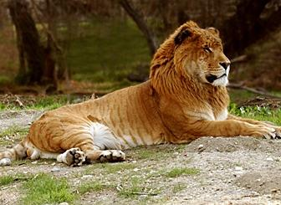
Liger
news.nationalgeographic.com
Tigon
Liger.com

Slide 35
Each Has Lost Some Genetic Information from the Original Ancestor
animals.nationalgeographic.com
animals.nationalgeographic.com
Lion
Tiger

Slide 36
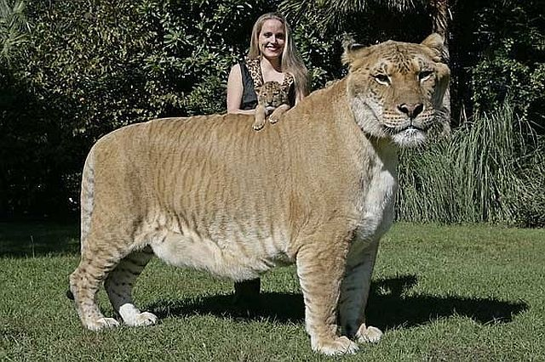
Liger – Up to 920 lbs.

Slide 37
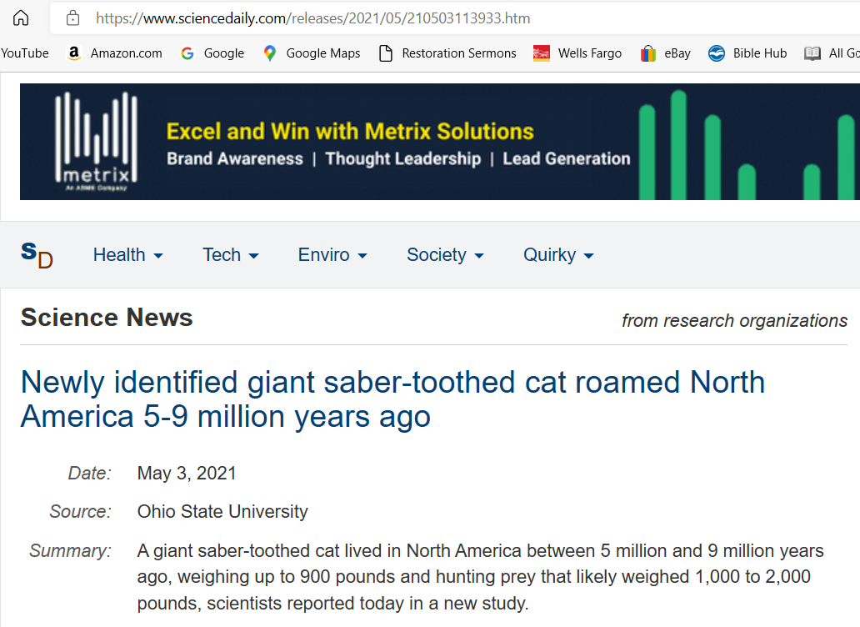

Slide 38
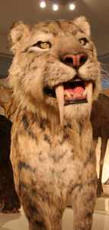
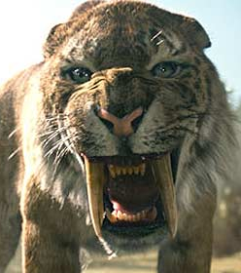
Liger – Up to 920 lbs.

Slide 39
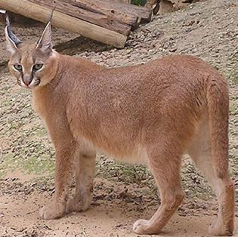
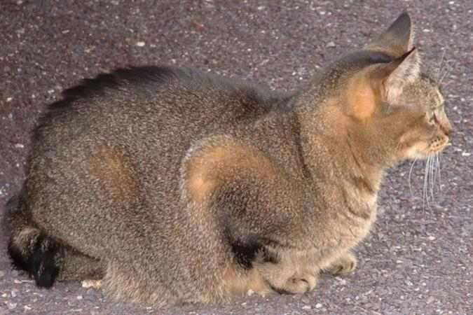
www.zooinstitutes.com/animals/1385.jpg
Domestic Cat
www.petpeoplesplace.com/resources/gallery/images/uploads/Abyssinian_802904131.jpg
Caracal

Slide 40
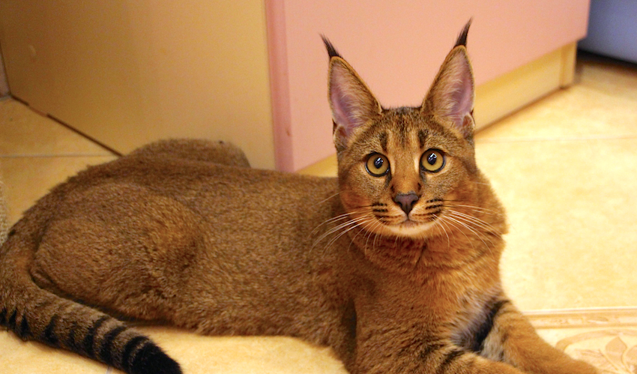
Caracat

Slide 41
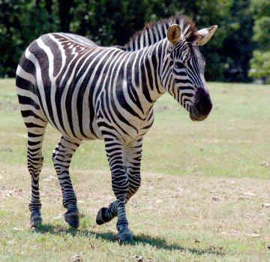
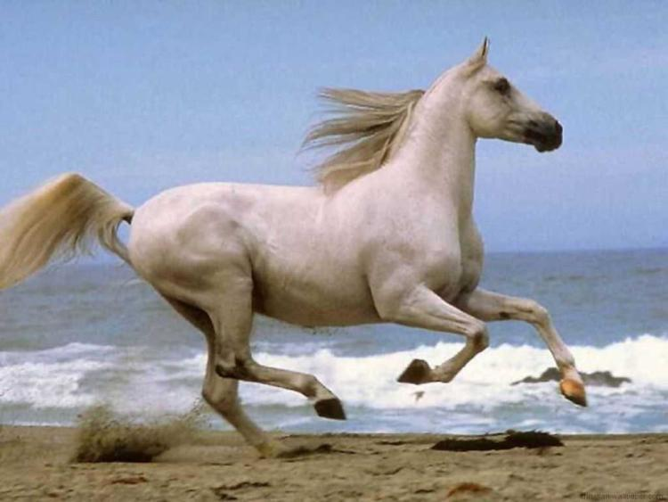
Equidae Equus zebra Equidae Equus ferus
http://thequickanddirtydirty.com/wp-content/uploads/2010/02/zebra.jpg
www.filebrothers.com/screenshot/horse-running-beach.jpg

Slide 42
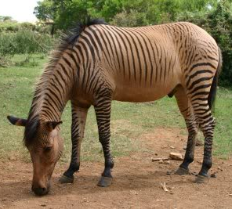
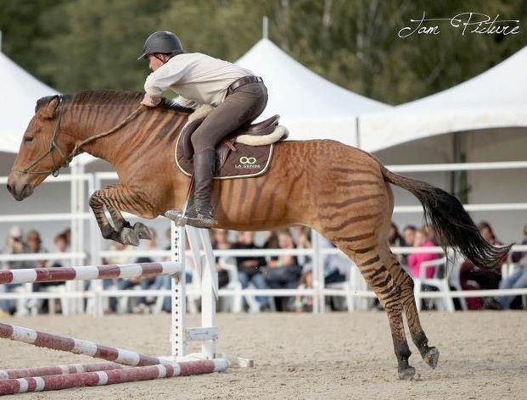
Zorse

Slide 43
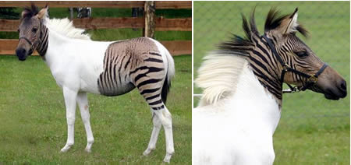
Zebroid
www.oddee.com/item_96640.aspx

Slide 44
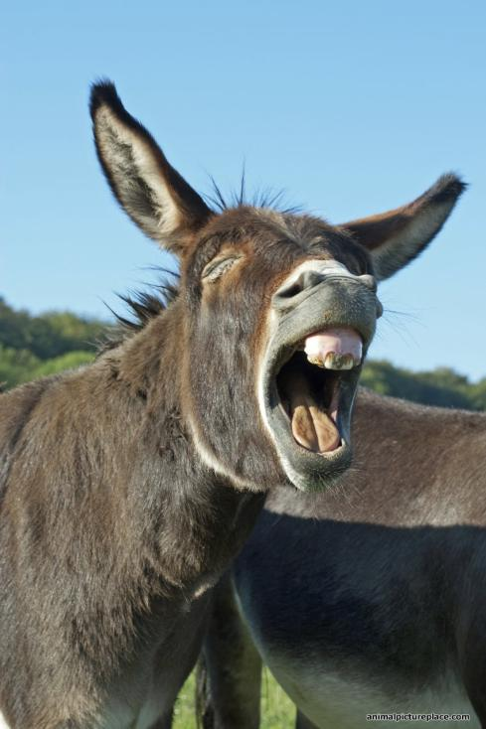
Equidae Equus zebra Equidae Equus africanus
http://thequickanddirtydirty.com/wp-content/uploads/2010/02/zebra.jpg

Slide 45
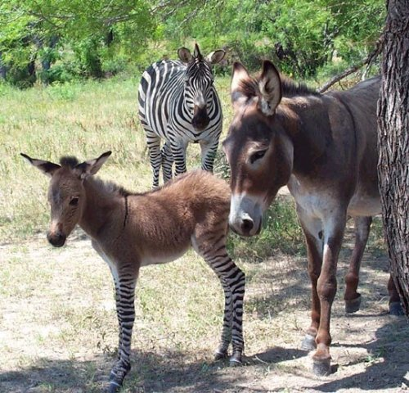
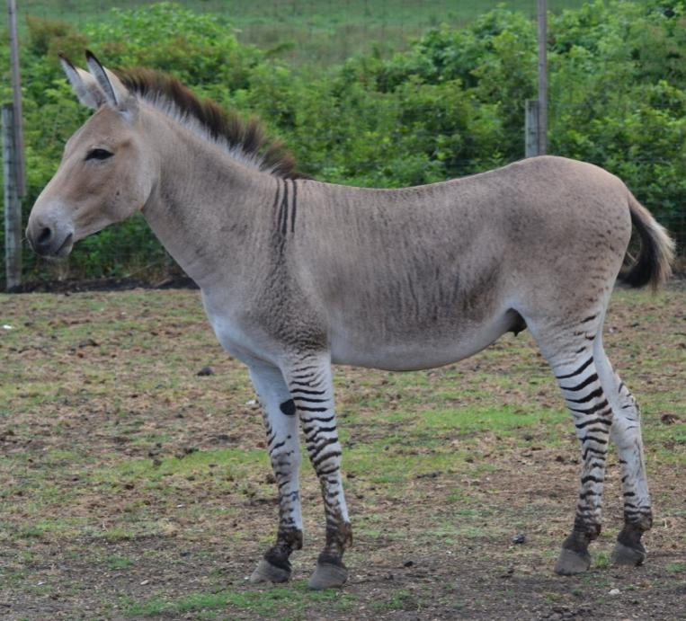
Equidae Equus zebra + Equidae Equus africanus =
Zedonk

Slide 46


Equidae Equus zebra + Equidae Equus africanus =
Donkzee

Slide 47





Slide 48


Ursus arctos
Ursidae Ursus maritimus
animals.nationalgeographic.com
Polar Bear
Grizzly Bear

Slide 49



Grolar Bear
or Pizzly

Slide 50

Equidae Equus zebra Rhinoceros
Dinoanimals.com
thequickanddirtydirty.com/wp-content/uploads/2010/02/zebra.jpg

Slide 51

What We Don’t See: A Rhinebra
www.worth1000.com/hosted/tutorials/151216_copy_57200524520PM_1c_finished.jpg

Slide 52

What We Don’t See: A Bird Dog
www.worth1000.com/hosted/tutorials/151216_copy_57200524520PM_1c_finished.jpg

Slide 53

What We Don’t See: A Fox Bird

Slide 54

What We Don’t See: Giraffe Turtle

Slide 55

What We Don’t See: Gorillacrow

Slide 56

What We Don’t See: Leopardsquirrel

Slide 57

What We Don’t See: Pughorse

Slide 58

What We Don’t See: Bunnybird

Slide 59

What We Don’t See: Pugmonkey

Slide 60
Evolutionists Say This is a Ridiculous Unrealistic Interpretation of What They Believe
Really??
www.worth1000.com/hosted/tutorials/151216_copy_57200524520PM_1c_finished.jpg

Slide 61

Dinosaur-Bird
(“Feathered Dinosaur”)
Natural History Museum of Utah

Slide 62






62
Dinosaurs Through Time by Rupert Matthews and published by McRae Books (copyright: McRae Books Srl 2005, Revised Edition 2007, p. 117).
Dinosaurs Through Time by Rupert Matthews and published by McRae Books (copyright: McRae Books Srl 2005, Revised Edition 2007, p. 117).

Slide 63

63
Dinosaurs Through Time by Rupert Matthews and published by McRae Books (copyright: McRae Books Srl 2005, Revised Edition 2007, p. 117).
Dinosaurs Through Time by Rupert Matthews and published by McRae Books (copyright: McRae Books Srl 2005, Revised Edition 2007, p. 117).

Slide 64
Pure Science Fiction Peddled as Truth
64
Dinosaurs Through Time by Rupert Matthews and published by McRae Books (copyright: McRae Books Srl 2005, Revised Edition 2007, p. 117).

Slide 65
II Tim. 3:13
“But evil men and impostors will proceed from bad to worse, deceiving and being deceived.”
II Tim. 3:7
“always learning and never able to come to the knowledge of the truth.”

Slide 66


Bovidae Bos taurus
(aka, Domesticated Cattle) Bovidae Bison bison (>800 breeds)
www.livingwilderness.com/wildlife/bison-standing.html
http://kenfuchs42.net/lonestar2008_01.html

Slide 67


Beefalo
http://americanmonsters.com/site/2009/12/beefalo-usa
http://www.texasheroes.net/Cattalo.jpg

Slide 68
Beefalo
Beefalo
http://americanmonsters.com/site/2009/12/beefalo-usa
http://www.texasheroes.net/Cattalo.jpg

Slide 69
14 Members of The Cattle Kind

Slide 70


The Cattle Kind
1. American Bison 2. Domesticated Cattle

Slide 71

The Cattle Kind
3. Musk Ox

Slide 72

The Cattle Kind
4. Cape Buffalo

Slide 73

The Cattle Kind
4. Cape Buffalo

Slide 74

The Cattle Kind
5. Auroch
(Progenitor to Domesticated Cattle - Last Female Died in 1627)

Slide 75


Slide 76

The Cattle Kind
6. Wild Yak (Himalayans)

Slide 77


Bovidae Bos grunniens + Bovidae Bos taurus =

Slide 78

Bovidae Bos grunniens+ Bovidae Bos primigenius =
Yattle

Slide 79
Bovidae Bos grunniens+ Bovidae Bison bison=

Slide 80


Bovidae Bos grunniens+ Bovidae Bison bison Yakalo

Slide 81

The Cattle Kind
7. Asian Banteng

Slide 82

The Cattle Kind
8. Kouprey (SE Asian Grey Ox)

Slide 83

The Cattle Kind
9. Gaur (Indian Bison)

Slide 84

The Cattle Kind
10. European Bison

Slide 85
Compare to American Bison

Slide 86
The Cattle Kind
10. European Bison

Slide 87

11. Wild Water Buffalo (Asian Buffalo)
The Cattle Kind

Slide 88

The Cattle Kind
12. Tamaraw (Mindoro Dwarf Buffalo- Philippines)

Slide 89

13. Indonesian Lowland Anoa (“Midget Buffalo” < 500 Left)
The Cattle Kind

Slide 90


13. Indonesian Mountain Anoa (“Midget Buffalo” < 500 Left)
The Cattle Kind

Slide 91
The Cattle Kind
5. Auroch
(Progenitor to Domesticated Cattle - Last Female Died in 1627)

Slide 93

14 Members of The Cattle Kind
All Descended from a Common Ancestor Because. . . They’re All the Same KIND
Dutch Back-Breeding Project to Produce an Auroch From Various Cattle Genes
direwolfproject.com/breeding-back.html

Slide 94

14 Members of The Cattle Kind
All Descended from a Common Ancestor Because. . . They’re All the Same KIND
Dutch Back-Breeding Project to Produce an Auroch From Various Cattle Genes
direwolfproject.com/breeding-back.html

Slide 95
14 Members of The Cattle Kind
All Descended from a Common Ancestor Because. . . They’re All the Same KIND
Dutch Back-Breeding Project to Produce an Auroch From Various Cattle Genes
direwolfproject.com/breeding-back.html

Slide 96
14 Members of The Cattle Kind
All Descended from a Common Ancestor Because. . . They’re All the Same KIND
Dutch Back-Breeding Project to Produce an Auroch From Various Cattle Genes
direwolfproject.com/breeding-back.html

Slide 97
14 Members of The Cattle Kind
All Descended from a Common Ancestor Because. . . They’re All the Same KIND
Dutch Back-Breeding Project to Produce an Auroch From Various Cattle Genes
direwolfproject.com/breeding-back.html

Slide 98


Camelidae Camelus bactrianus Camelidae Lama glama
cdmi.cesr.fr/pub/Sandbox/ANewCamel/camel.jpg
commons.wikimedia.org/wiki/File:Domestic_Lama.jpg

Slide 99



Camel and Lama Separated Across Two Continents >7,500 Miles Apart, Supposedly 11-25 Million Years Ago
Yet. . .

Slide 100


They Can Still Interbreed
Cama
www.hemmy.net/2006/06/19/top-10-hybrid-animals/

Slide 101
This Says that The Camel and Lama Have NOT Been Geographically-Isolated for 11-25 Million Years

Slide 102
Gen. 1:24
“24Then God said, "Let the earth bring forth the living creature according to its kind: cattle and creeping things and beast of the earth, each according to its kind; and it was so.”
102
Notes:
102

Slide 103











Finch Snake Turtle
≠ ≠ ≠
Bat Rat Cat
≠ ≠ ≠
Dog Pig Monkey
≠ ≠ ≠
Man

Slide 104
What Have You Learned about Animal Kinds in This Lesson?
Fixity (discontinuity) of Animal Kinds Disproves neo-Darwinian Evolution
Animals Can Vary/Change Within Their own Kind (Microevolution), But Not Outside Their own Kind (Macroevolution)

Slide 105
Four Final FAQs
#1. So, How Did Noah Fit All Those Animals in the Ark?
105
Notes:
105

Slide 106
Gen. 6:11-22
“Now the earth was corrupt in the sight of God, and the earth was filled with violence. 12God looked on the earth, and behold, it was corrupt; for all flesh had corrupted their way upon the earth.
13Then God said to Noah, “The end of all flesh has come before Me; for the earth is filled with violence because of them; and behold, I am about to destroy them with the earth. 14“Make for yourself an ark of gopher wood; you shall make the ark with rooms, and shall cover it inside and out with pitch. 15“This is how you shall make it: the length of the ark three hundred cubits, its breadth fifty cubits, and its height thirty cubits. 16“You shall make a window for the ark, and finish it to a cubit from the top; and set the door of the ark in the side of it; you shall make it with lower, second, and third decks. 17“Behold, I, even I am bringing the flood of water upon the earth, to destroy all flesh in which is the breath of life, from under heaven; everything that is on the earth shall perish. 18“But I will establish My covenant with you; and you shall enter the ark—you and your sons and your wife, and your sons’ wives with you. 19“And of every living thing of all flesh, you shall bring two of every kind into the ark, to keep them alive with you; they shall be male and female. 20“Of the birds after their kind, and of the animals after their kind, of every creeping thing of the ground after its kind, two of every kind will come to you to keep them alive. 21“As for you, take for yourself some of all food which is edible, and gather it to yourself; and it shall be for food for you and for them.” 22Thus Noah did; according to all that God had commanded him, so he did.”
106
Notes:
106

Slide 107



#1. So, How Did Noah Fit All Those Animals in the Ark?
1. 506,000 feet³ of space on each deck x 3 = >1.5 million feet³ of space (equivalent to 627 freight carriers or 500 semi trailers)
500 Tractor Trailers or a line of trucks 117 football fields long
627 Standard Freight Carriers
107
Notes:
107

Slide 108

#1. So, How Did Noah Fit All Those Animals in the Ark?
1. 506,000 feet³ of space on each deck x 3 = >1.5 million feet³ of space (equivalent to 627 freight carriers or 500 semi trailers)
500 Tractor Trailers or = line of trucks 117 football fields long
108
Notes:
108

Slide 109

#1. So, How Did Noah Fit All Those Animals in the Ark?
1. 506,000 feet³ of space on each deck x 3 = >1.5 million feet³ of space (equivalent to 627 freight carriers or 500 semi trailers)
2. Only ca. 1,400 animal kinds (including dinosaurs)
109
Notes:
109

Slide 110

Infraorder of Related Dinosaurs

Slide 111




Slide 112
#1. So, How Did Noah Fit All Those Animals in the Ark?
1. 506,000 feet³ of space on each deck x 3 = >1.5 million feet³ of space (equivalent to 627 freight carriers or 500 semi trailers)
2. Only ca. 1,400 animal kinds (including dinosaurs)
3. Could have taken juveniles or eggs
112
Notes:
112

Slide 113
FAQ #2. What Do Similarities in Human and Chimpanzee DNA Indicate?

Slide 114
FAQ #2. What Do Similarities in Human and Chimpanzee DNA Indicate?
Evolutionists argue that chimpanzees may be our closest living “relative” sharing 98.5-99.4% homologous DNA.
The Journal Nature, in 2005, had a special issue dedicated to the chimp genome and chimp/human relatedness. Some called it “the most dramatic confirmation yet.” One headline stated, “Charles Darwin was Right and Chimp Gene Map Proves It.”
What did they find? There was 300% greater difference between chimp and human DNA than previously thought (i.e., 96%)
This seems highly similar, but human genome has 3 billion base pairs, so this amounts to 120 million differences
Note: sickle cell anemia is only a single base pair difference) Plus, there are 40-45 million genes in humans missing from chimps and vice versa

Slide 115
FAQ #2. What Do Similarities in Human and Chimpanzee DNA Indicate?
What’s the Point? If Humans evolved from chimp-like creatures, it would require at least 116 million persistent (accumulating), beneficial point mutations. . . . But we can’t find one! (PBS Principle)
Furthermore, this evolutionary process supposedly occurred in only 300,000 generations (i.e., 6 million years)

Slide 116
FAQ #2. What Do Similarities in Human and Chimpanzee DNA Indicate?
What’s the Point? If Humans evolved from chimp-like creatures, it would require at least 116 million persistent (accumulating), beneficial point mutations. . . . But we can’t find one! (PBS Principle)
Furthermore, this evolutionary process supposedly occurred in only 300,000 generations (i.e., 6 million years)
A bacterium with a 20 min. generation in only 14 years goes through 368,320 generations and, yet we don’t see one PBS (persistent, beneficial, structural) mutation, much less 120 million
In 25 years, a bacterium goes through 657,000 generations = 13.1 million years in supposed human evolutionary time
Finally, although chimps and humans are supposed to be more closely related, sharing a common ancestor that came after the gorillas, guess what was found when comparing their three genomes?. . . . 18-29% of human genetic markers are more similar to gorillas than to chimps – (which disproves evolution) reflects an intelligent designer making mix-and-match mosaics in creation (cf. duck billed platypus, red panda, human and octopus eyes, etc.).

Slide 117

FAQ #3. What About the Dinosaurs?

Slide 118
Dinosaurs Have Been One of the Most Powerful Tools to Convince Children of Evolution

Slide 119
Where Do Dinosaurs Fit into the Bible?

Slide 120

"Then God said, “Let the earth bring forth living creatures after their kind: cattle and creeping things and beasts of the earth after their kind”; and it was so.” - Gen. 1:24
redgen50.blogspot.com/2012/
120
Notes:
120

Slide 121
"Then God said, “Let the earth bring forth living creatures after their kind: cattle and creeping things and beasts of the earth after their kind”; and it was so.” - Gen. 1:24
The Bible Teaches that All Land Creatures Were Created on the 6th Day of Creation
redgen50.blogspot.com/2012/
121
Notes:
121

Slide 122
Why Doesn’t the Bible Mention Dinosaurs?

Slide 123
Why Doesn’t the Bible Mention Dinosaurs?
1. Dinosaur Fossils Not Known to Be Discovered until 1822 by Dr. Gideon Mantell

Slide 124
Why Doesn’t the Bible Mention Dinosaurs?
1. Dinosaur Fossils Not Known to Be Discovered until 1822 by Dr. Gideon Mantell
2. The Word Dinosaur Not Invented Until 1841 by Richard Owen

Slide 125
Why Doesn’t the Bible Mention Dinosaurs?
1. Dinosaur Fossils Not Known to Be Discovered until 1822 by Dr. Gideon Mantell
2. The Word Dinosaur Not Invented Until 1841 by Richard Owen
3. Suggest Dinosaurs May Have Previously Been Known by the Name “Dragon”

Slide 126
Why Do All Major Cultures in the World Have Dragon Legends?

Slide 127

Dragons or Dinosaurs
With added imagination
Credit: Dr. John Lepera

Slide 128

Dragons or Dinosaurs
Without added imagination
Credit: Dr. John Lepera

Slide 129

Dragons or Dinosaurs
Without added imagination
Credit: Dr. John Lepera

Slide 130


Slide 131
Why Do All Major Cultures in the World Have Dragon Legends?
Scientists Have Speculated. . .

Slide 132


Carl Sagan Said. . .
“The pervasiveness of dragon myths in the folk legends of many cultures is probably no accident. . . But it is not a western anomaly. It is a worldwide phenomenon. . . Could the pervasive dreams and common fears of "monsters," which children develop shortly, after they are able to talk, be evolutionary vestiges of quite adaptive-baboonlike-responses to dragons. . . We are descended from reptiles and mammals both.. . . in the nighttime stirring of the dream dragons, we may each of us be replaying the hundred-million-year-old warfare between the reptiles and the mammals.”
- Carl Sagan, The Dragons of Eden, New York: Random House, 1977, pp. 95, 104, 105.

Slide 134
Job 40:15-18
"Look now at the behemoth, which I made along with you; he eats grass like an ox. See now, his strength is in his hips, and his power is in his stomach muscles. He moves his tail like a cedar; the sinews of his thighs are tightly knit. His bones are like beams of bronze, his ribs like bars of iron."

Slide 135



Slide 136


Slide 137



Slide 138
So What Is the Significance of Dinosaurs in the Evolution Controversy?
Evolutionist Dr. Derek Ager Responds. . .

Slide 139


“Always it comes back to the extinction of the dinosaurs. I must admit to being a little tired of those stupid great beasts, though they are the best recruiting sergeants for our subject among young people (including myself). Their importance, in my view, is grossly exaggerated.”
- Derek V. Ager, The New Catastrophism (Cambridge, U.K.: Cambridge University Press, 1993), p. 186
Dinosaur-Facts.com

Slide 140

FAQ #4. What About the “Ice Age”

Slide 141
FAQ #4. What About the “Ice Age”
Recommendation:
Go to www.creation.com and do a search for “ice age”
It will turn up >60 articles + videos and podcasts on the ice age

Slide 142


Slide 143
There may be references to the ice age in the ancient book of Job (37:9–10, 38:22–23, 29–30), who perhaps lived in its waning years.
- Job lived in the land of Uz (Uz being a descendant of Shem [Gen. 10:23]), and most conservative Bible scholars agree that Job probably lived some time between the Tower of Babel and Abraham
New Answers Book

Slide 144
Job 38:29,30
‘Out of whose womb came the ice? And the frost of the heavens, who fathered it? The waters are hidden like stone, and the face of the deep is frozen’

Slide 145
Job 38:29,30
‘Out of whose womb came the ice? And the frost of the heavens, who fathered it? The waters are hidden like stone, and the face of the deep is frozen’
Job 37:9-10
“From the chamber of the south comes the whirlwind,
And cold from the scattering winds of the north. By the breath of God ice is given, and the broad waters are frozen.”
Job 38:22-23
“Have you entered the treasury of snow,
have you seen the treasury of hail,
Which I have reserved for the time of trouble,
For the day of battle and war?”

Slide 146

Such questions may indicate Elihu and Job knew, either firsthand or by historical/ family accounts, about an ice age. These are probably in reference to the climatic effects of the Ice Age—effects not now seen in the Middle East.
New Answers Book

Slide 147

"For in six days the LORD made the heavens and the earth, and on the seventh day He rested. -Exo. 31:17
147
Notes:
147

