Slide 1
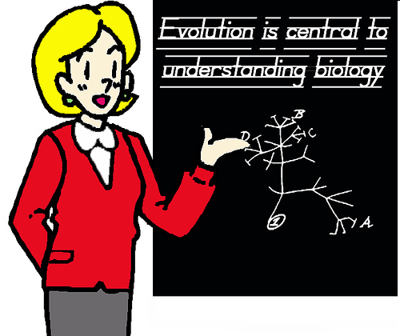
Nine Macroevolution Myths Still Taught in Public Schools
Debunked
Notes:
1

Slide 2

Darwinian Evolution Debunked
Nine Frauds Still Taught in Public Schools
Animal Homology
Embryology
The Peppered Moth
Alleged Horse Evolution
Darwin’s Finches
“Neanderthal Man”
Was Lucy Our Ancestor?
Alleged Fruit Fly Evolution
Vestigial Organs
Emphasis:
• Macroevolution requires new genes (New Information)
Notes:
2

Slide 3
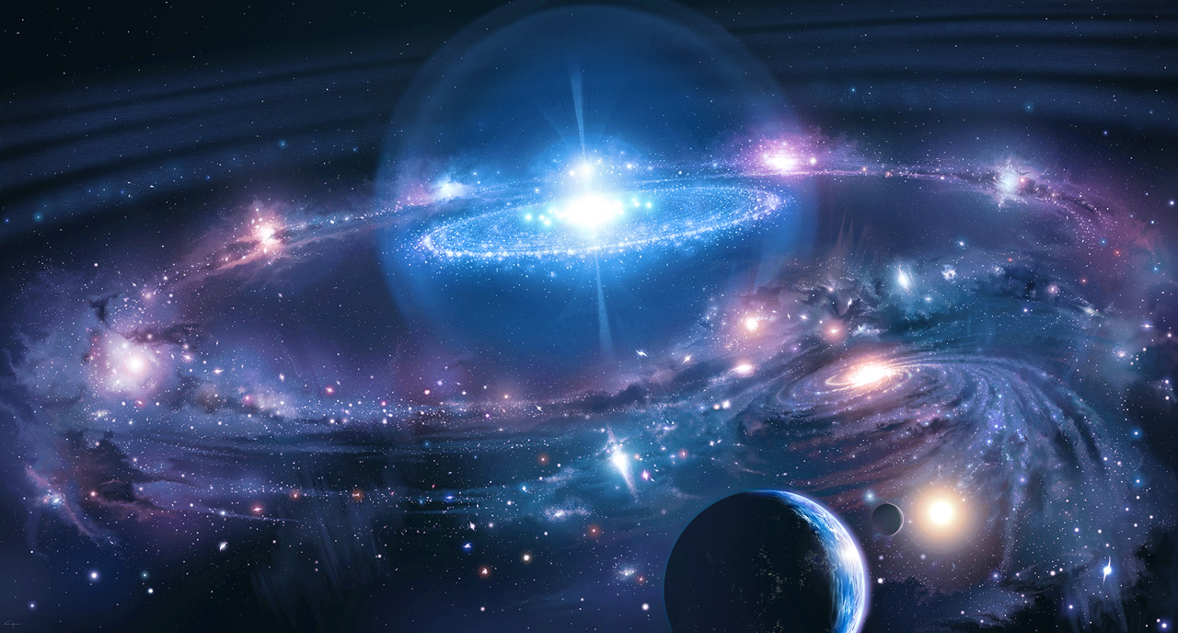
“For by Him all things were created, both in the heavens and on earth, visible and invisible, whether thrones or dominions or rulers or authorities—all things have been created by Him and for Him. He [Jesus] is before all things and in Him [Jesus] all things hold together.”
- Col. 1:17
3
Notes:
3

Slide 4
So, Where is Truth??
- Ultimate eternal truth can only be obtained through an ultimate and eternal mind: the mind of the creator. [Metaphysical]
“My goal is that they may be encouraged in heart and united in love, so that they may have the full riches of complete understanding, in order that they may know the mystery of God, namely, Christ, in whom are hidden all the treasures of wisdom and knowledge.” -Col. 2:3 (TNIV)
- Then why study science in the origins debate? Because it’s God’s natural revelation to point us BACK to God’s divine revelation – The Bible
– History, geology, archaeology, paleontology, anthropology, psychology, sociology, microbiology, biochemistry, anatomy, astronomy, mathematics, physics, astronomy all point back to an eternal creator- - - - GEN. 1:1-31

Slide 5
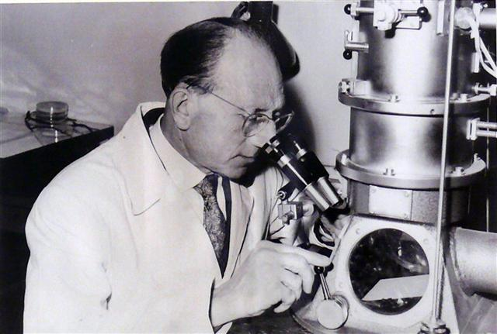
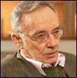
"Today our duty is to destroy the myth of evolution, considered as a simple, understood, and explained phenomenon which keeps rapidly unfolding before us. Biologists must be encouraged to think about the weaknesses and extrapolations that theoreticians put forward or lay down as established truths. The deceit is sometimes unconscious, but not always, since some people, owing to their sectarianism, purposely overlook reality and refuse to acknowledge the inadequacies and falsity of their beliefs."
- Dr. Pierre-Paul Grasse. 1977, The Evolution of Living Organisms, p. 8 (French zoologist, past president of the French Academy of Sciences. Dobzhansky said that Grasse’s “knowledge of the living world is encyclopedic.”)
5
Notes:
5

Slide 6

“But we have renounced the hidden things of shame, not walking in craftiness nor handling the word of God deceitfully, but by manifestation of the truth commending ourselves to every man's conscience in the sight of God.” - II Cor. 4:2
Christians Must Be Different

Slide 7
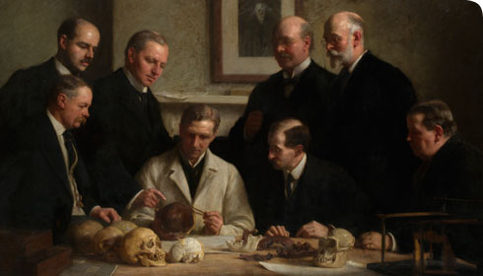
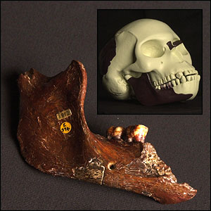
Examples of Hoaxes by Evolutionists Have Been Perpetrated for Over 130 Year
1912, Piltdown Man Hoax

Slide 8
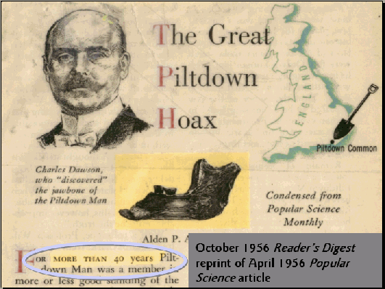

Slide 9
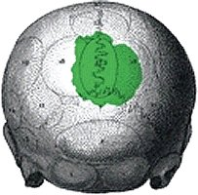
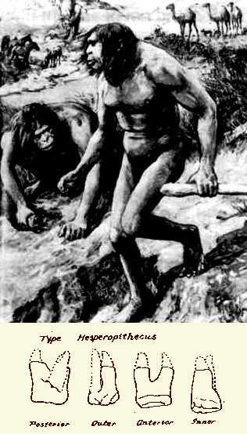
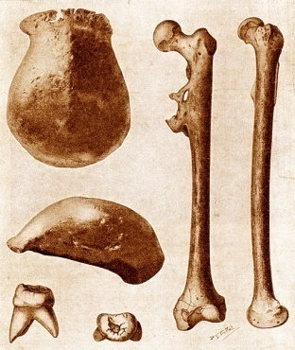
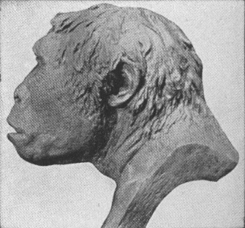
Examples of Scientific Misrepresentations by Evolutionists
1922, Nebraska Man – Found to be the tooth of a pig
1892, Orce Man – Found to be the skull of a donkey
1891, Java Man – Found to be the skullcap, three teeth and femur of human
The hypothesis that life arose from non-life taught as a fact in public schools

Slide 10
The Bible tells us there will be deceivers who peddle lies and propaganda to supplant divine truth with lies
We Shouldn’t Be Surprised at the Deceit. In Fact, We Should Be Prepared for It

Slide 11
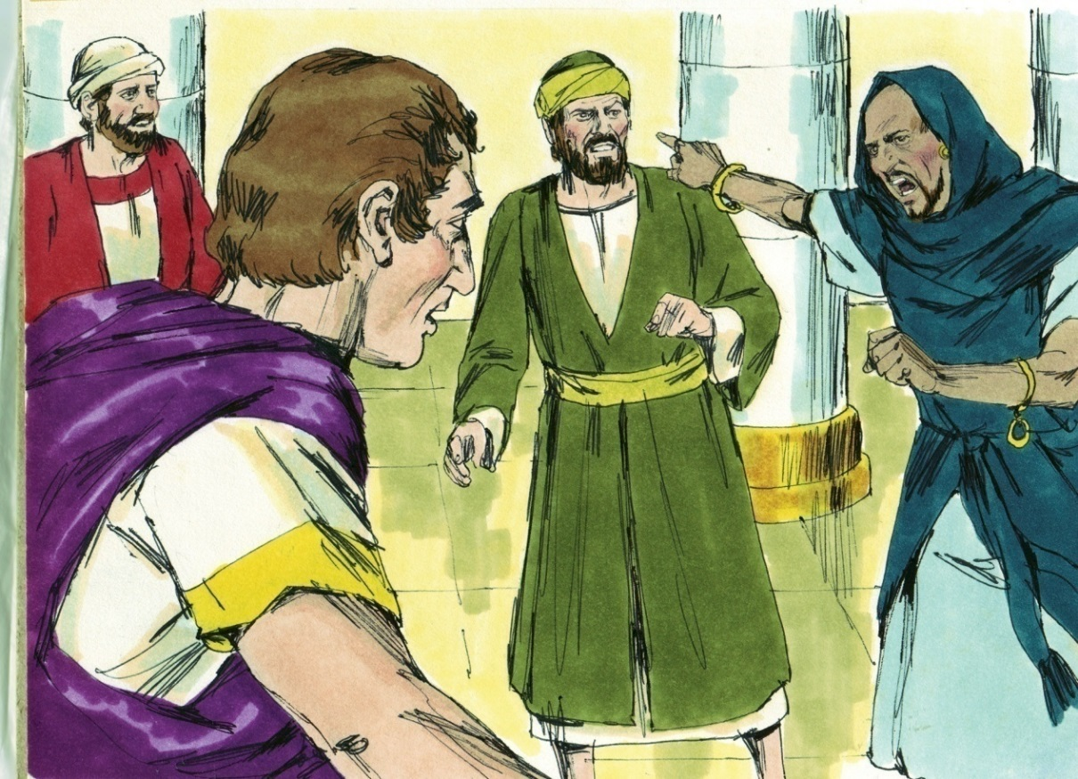
“Then Saul, who also is called Paul, filled with the Holy Spirit, looked intently at him and said, ‘O full of all deceit and all fraud, you son of the devil, you enemy of all righteousness, will you not cease perverting the straight ways of the Lord? And now, indeed, the hand of the Lord is upon you, and you shall be blind, not seeing the sun for a time.’ And immediately a dark mist fell on him, and he went around seeking someone to lead him by the hand.”
Acts 13:9-11
Elymas (Bar-Jesus)

Slide 12

“Beware lest anyone cheat you through philosophy and empty deceit, according to the tradition of men, according to the basic principles of the world, and not according to Christ.”
- Col. 2:8
Beware

Slide 13
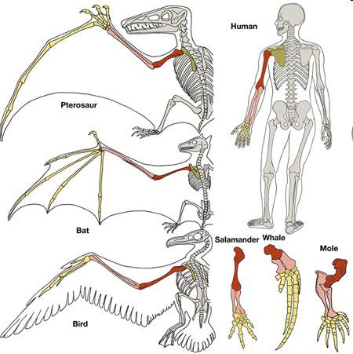
I. Animal Homology
(Similarities in Animals, Comparative Anatomy)
Regarding homology, Charles Darwin Said:
"is it not powerfully suggestive of true relationship, of inheritance from a common ancestor?”
- The Origin of Species, 1872 ed., p. 382

Slide 14
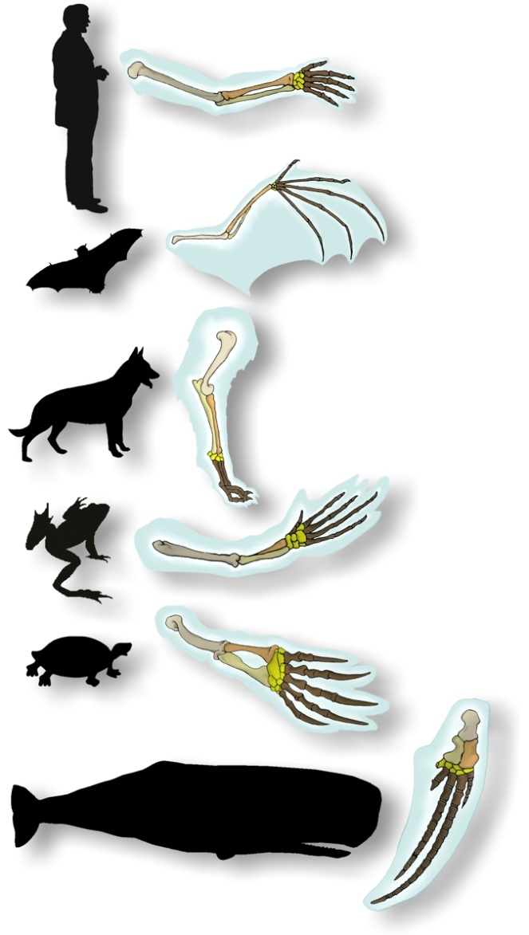
Homologous Limbs
Rob Baker, Apologetics Press

Slide 15
Common Ancestor
Or
COMMON DESIGNER?

Slide 16
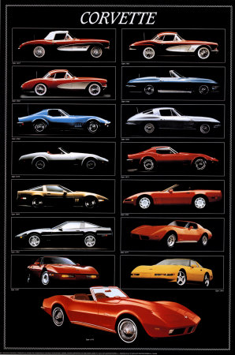
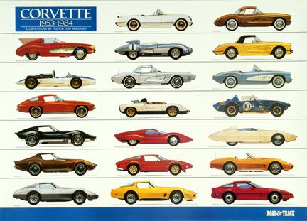
Common Ancestor
Or
COMMON DESIGNER?

Slide 17
Common Designer

Slide 18
What Would Discredit the Darwinian Evolutionary Model of Homology?

Slide 19
What Would Discredit the Darwinian Evolutionary Model of Homology?
Answer: Identical (homologous) anatomical structures in animals that appear in different evolutionary lines (i.e., the same organs in animals that did not evolve from one another).
Or
“Non-inherited similarities”

Slide 20
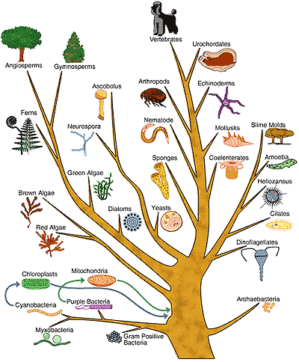

Slide 21
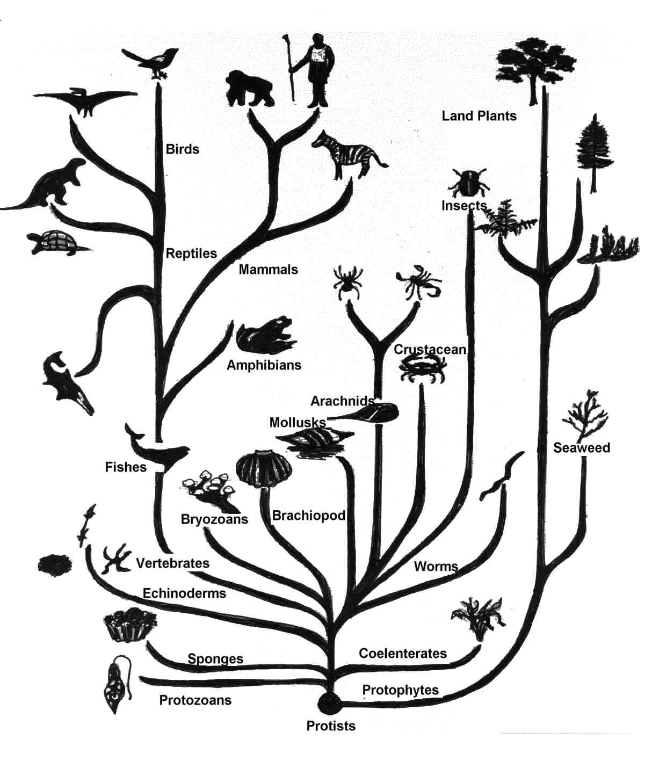
Library.thinkquest.org
Notes:
21

Slide 22
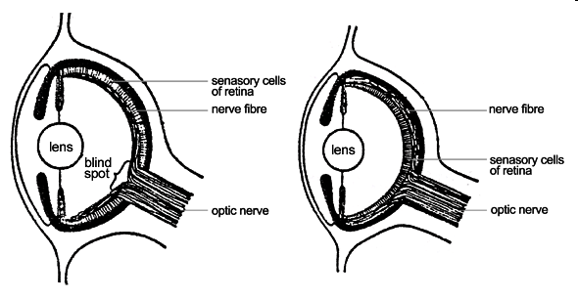
No Common Ancestor With the Same Feature, But Identical Organizational and Structural Evolution
Human Eye
Octopus Eye Eye
http://commons.wikimedia.org/wiki/File:Evolution_eye_numbered.png

Slide 23
No Common Ancestor for Eye, But Identical Organizational and Structural Evolution?
Code Word: “Convergent Evolution”
Human Eye
Octopus Eye

Slide 24
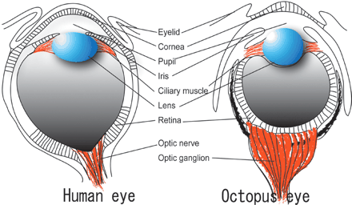
No Common Ancestor for Eye, But Identical Organizational and Structural Evolution?
Code Word: “Convergent Evolution”
Human Eye
Octopus Eye
http://genome.cshlp.org/content/14/8/1555/F1.expansion

Slide 25
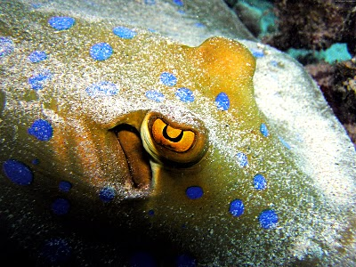
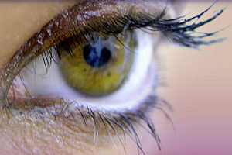
No Common Ancestor for Eye, But Identical Organizational and Structural Evolution?
Code Word: “Convergent Evolution”
Octopus Eye
Human Eye
http://tangledwing.wordpress.com/2007/11/11/nason-creek-autumn-wallpaper-world-energy-needs-may-increase-by-50-octopus-eye/
http://www.topnews.in/human-eyeinspired-solution-provides-
10-times-better-vision-computers-2179347/

Slide 26
Consider This: If Similarities Indicate Common Ancestry, Then What Should We Find That Proves They Were Coded (Blueprinted) the Same?

Slide 27
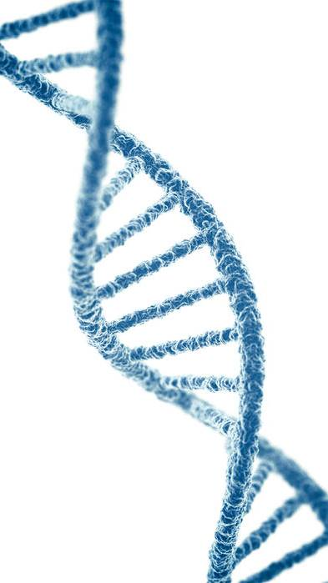
We Should Find the Corresponding Homologous GENES (or “BLUEPRINTS”) in the DNA That Code For These Similar Structures. Do we find them?
NO

Slide 28
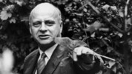
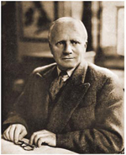
“What mechanism can it be that results in the production of homologous organs, the same 'patterns', in spite of their not being controlled by the same genes? I asked this question in 1938, and it has not been answered.”
Dr. Gavin De Beer, Homology: An Unsolved Problem, Oxford University Press, London, 1971, p. 16 .
(Director, British Museum of Natural History, President of Linnaean Society, Winner of the Royal Society’s “Darwin Medal.”)

Slide 29
“What mechanism can it be that results in the production of homologous organs, the same 'patterns', in spite of their not being controlled by the same genes? I asked this question in 1938, and it has not been answered.”
Dr. Gavin De Beer, Homology: An Unsolved Problem, Oxford University Press, London, 1971, p. 16 .
(Director, British Museum of Natural History, President of Linnaean Society, Winner of the Royal Society’s “Darwin Medal.”)

Slide 30
“What mechanism can it be that results in the production of homologous organs, the same 'patterns', in spite of their not being controlled by the same genes? I asked this question in 1938, and it has not been answered.”
Dr. Gavin De Beer, Homology: An Unsolved Problem, Oxford University Press, London, 1971, p. 16 .
(Director, British Museum of Natural History, President of Linnaean Society, Winner of the Royal Society’s “Darwin Medal.”)
Answer?
Common Designer

Slide 31
Point I Take Home Message
Similarities Suggest a Common Designer And Not A Common Ancestor

Slide 32
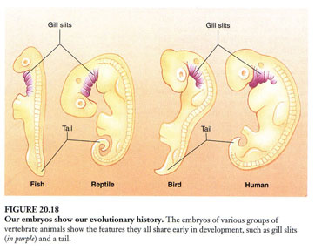
II. Embryology
(Haeckel’s Embryos)
"Embryology is to me by far the strongest single class of facts in favor of change of forms"
- Charles Darwin, letter to Asa Gray, Sept. 10, 1860
Textbook: Biology. By Peter H. Raven & George B. Johnson. Fifth edition (customized). McGraw-Hill, 1999. Page 416.

Slide 33
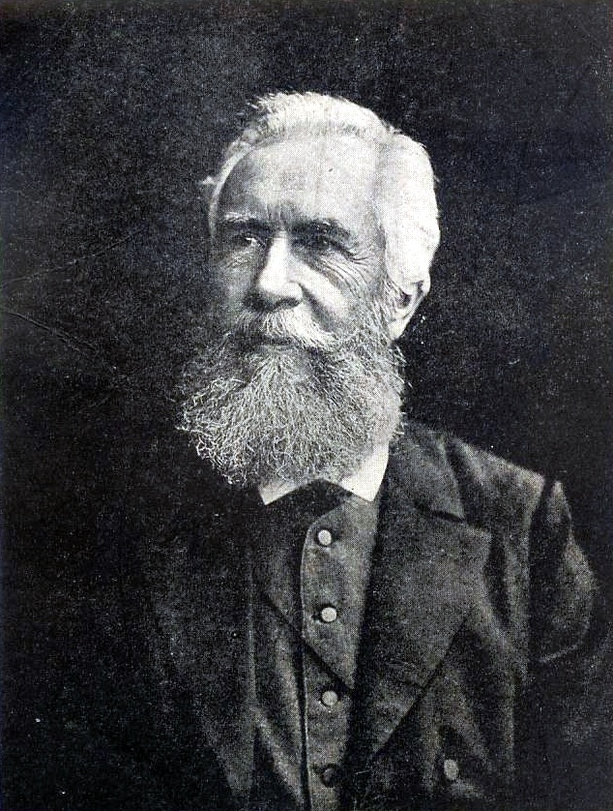
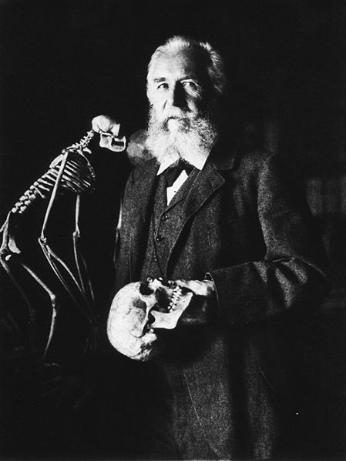
II. Embryology
(Haeckel’s Embryos)
Ernst Heinrich Haeckel, ca. 1874

Slide 34
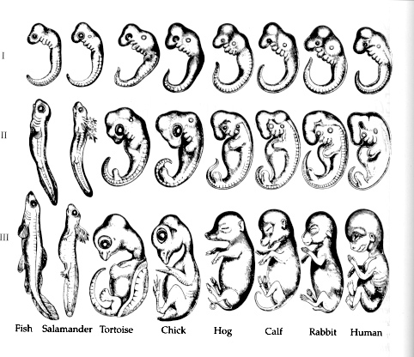

Slide 35
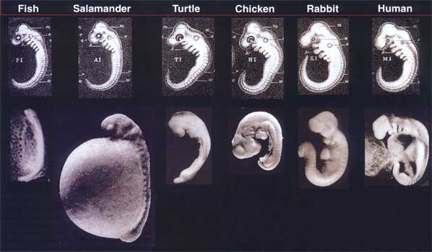

Slide 37
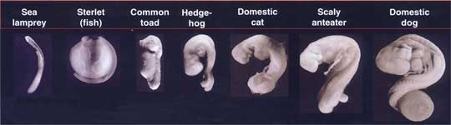

Slide 38
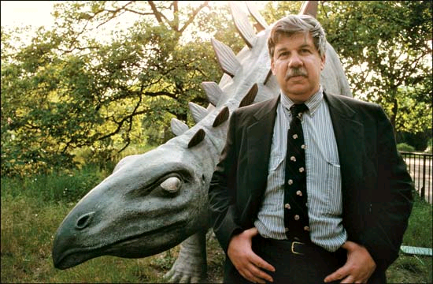
“Haeckel had exaggerated the similarities. . . in a procedure that can only be called fraudulent—simply copied the same figure over and over again. . . we do, I think, have the right to be both astonished and ashamed by the century of mindless recycling that has led to the persistence of these drawings in a large number, if not a majority, of modern textbooks”
Stephen J. Gould, 2000, Natural History, 86:42-48. (Reprinted in the New York Times)

Slide 39
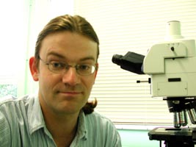
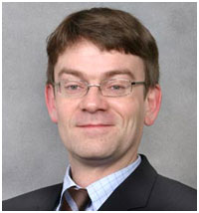

“It looks like it’s turning out to be one of the most famous fakes in biology”
- Michael Richardson, 2000, Science, 277:1435
(Evolutionary Embryologist, Leiden University, Netherlands: Richardson along with an international team of experts re-examined Haeckel’s carvings and found them to be fraudulent.)

Slide 40
Point II Take Home Message
Darwinists admit Haeckel’s Embryo’s are Frauds
Embryology Proves Nothing about our Origin

Slide 41
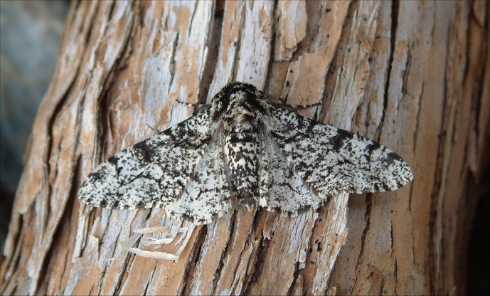
III. The English Peppered Moth
Photo courtesy of Roy Cripps

Slide 42
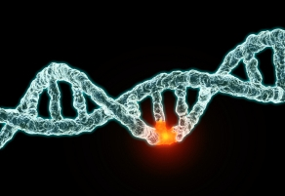
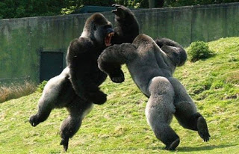
The philosophy that all life on earth gradually evolved from a single-celled organism by means of (1) random mutations (purely accidental) and (2) natural selection (i.e., survival of the fittest). AKA, “particles to people” or “molecules to man.”
What is Evolution?
(AKA, Macroevolution, Neo-Darwinism or The General Theory of Evolution)

Slide 43
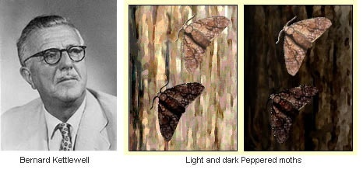
Birmingham, Manchester, Liverpool

Slide 44
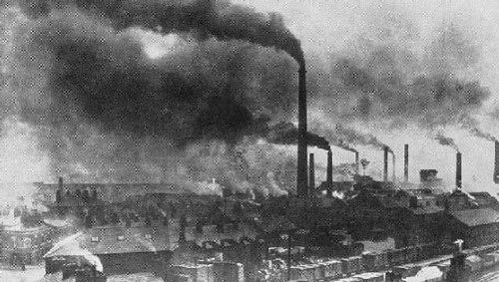
Birmingham, Manchester, Liverpool
Birmingham, Manchester, Liverpool

Slide 45
Problems with the Moth Hypothesis
#1: Only Proves Variation Within a Kind
(aka “Microevolution”)
No New Genetic Information is Being Added
Photo courtesy of Roy Cripps

Slide 46


What You Should Ask Your Teacher about Peppered Moth “Evolution?”
If the peppered moth demonstrates macroevolution, then what new genes have been added to the moth genome?

Slide 47
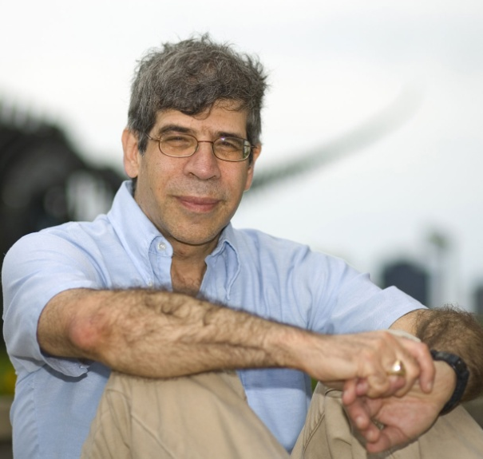
“these examples represent the loss of traits, rather than the origin of evolutionary novelties”
- Coyne, J.A., Switching on evolution—how does evo-devo explain the huge diversity of life on Earth? Nature 435(7045):1029–1030, 2005.

Slide 48
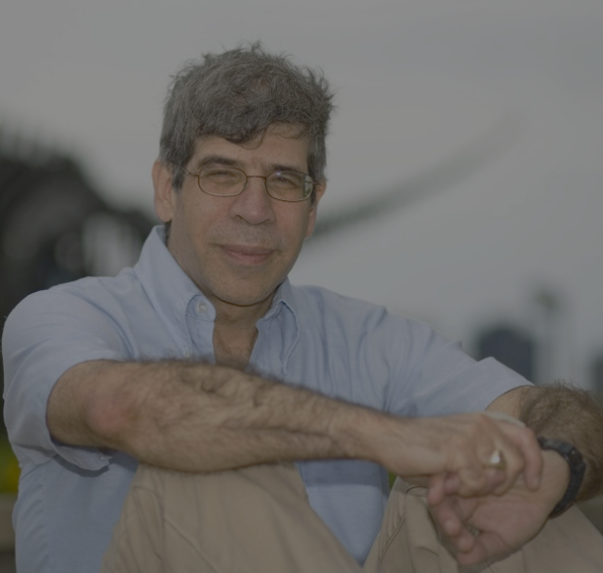
Devolution
“these examples represent the loss of traits, rather than the origin of evolutionary novelties”
- Coyne, J.A., Switching on evolution—how does evo-devo explain the huge diversity of life on Earth? Nature 435(7045):1029–1030, 2005.

Slide 49
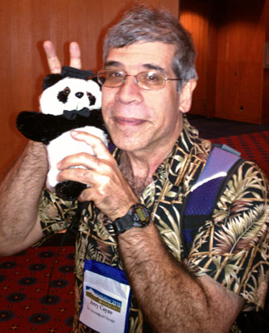
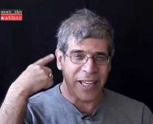
“these examples represent the loss of traits, rather than the origin of evolutionary novelties”
- Coyne, J.A., Switching on evolution—how does evo-devo explain the huge diversity of life on Earth? Nature 435(7045):1029–1030, 2005.

Slide 50
Problems with the Moth Hypothesis
#3: Discrepancies in the moth studies
Dark moths in unpolluted areas increased just as in polluted areas.
Dark moths continued to increase after light colored camouflage returned to the trees.
In one area, light colored moths began to increase in proportion before the light colored lichen returned to the trees.
Staged photographs

Slide 51
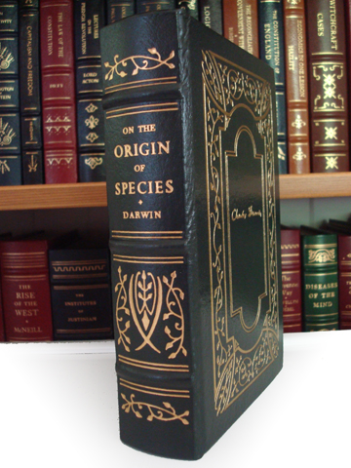
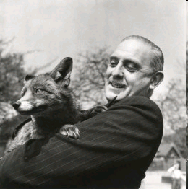
54 YEARS AGO
“The peppered moth experiments [show] survival of the fittest. But they do not show evolution in progress.”
- L. Harrison Matthews, (Professor, Bristol University; Scientific Director of the Zoological Society of London, Fellow of the Royal Society), Forward to On The Origin of Species, (London: J. M. Dent & Sons, Ltd., 1971).

Slide 52
Then Why Is the Peppered Moth Myth Still Used in Evolutionary Textbooks in 2025?

Slide 53
Then Why Is the Peppered Moth Myth Still Used in Evolutionary Textbooks in 2025?
Because They Have Nothing Better to Present

Slide 54
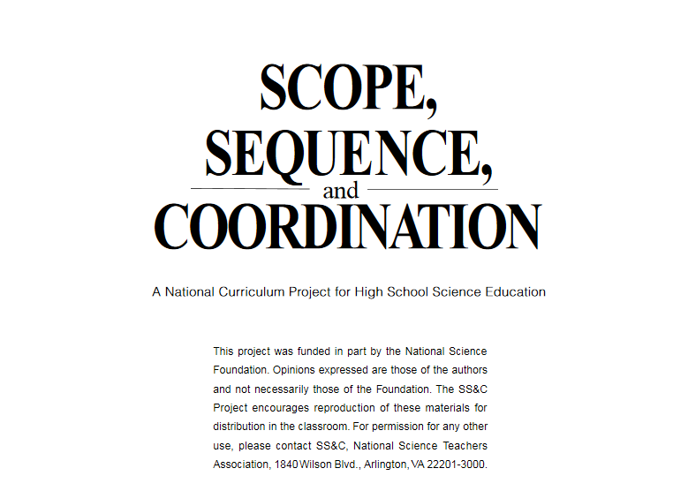


Slide 55
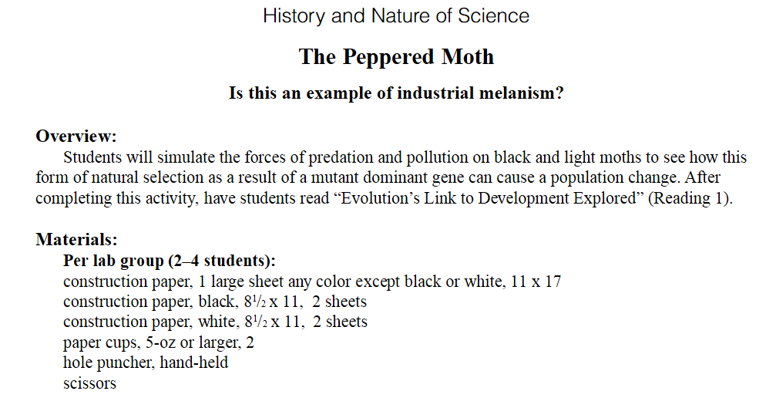

Slide 56
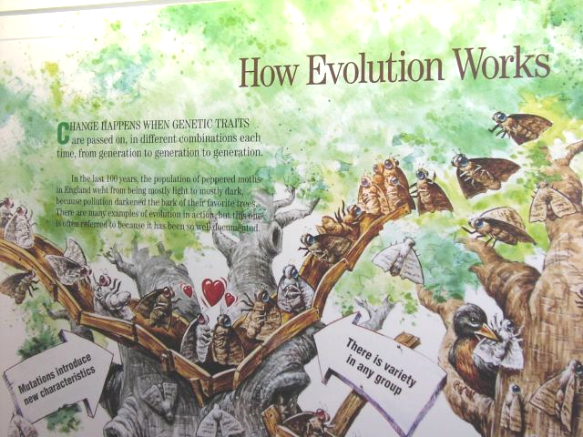
Denver Museum of Nature and Science
Wrong

Slide 57
Point III Take Home Message
The Peppered Moth Demonstrates Microevolution, Not Macroevolution

Slide 58
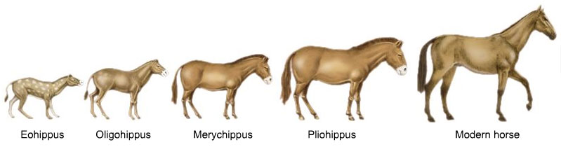
IV. Alleged Horse Evolution
http://horsejumper.edublogs.org

Slide 59
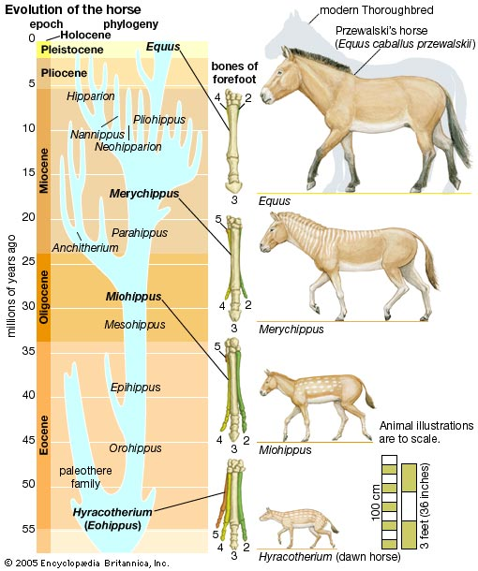
Evolutionists admit the horse history is better represented as a “bush” rather than a “tree”
WHY?

Slide 60
Evolutionists admit that all but Hyracotherium were contemporaries
- If all three lived contemporaneously, then they did not evolve from one another

Slide 61


32 Years Ago
“Prothero and Shubin conclude: ‘Throughout the history of horses, the species are well-marked and static over millions of years. At high resolution, the gradualistic picture of horse evolution becomes a complex bush of overlapping, closely related species.’”
-Stephen Jay Gould and Niles Eldredge, “Punctuated Equilibrium Comes of Age,” Nature, Vol. 336 (18 November 1993), p. 226

Slide 62

39 Years Ago
“The horse is…the classic story of one genus turning into another, turning into another. Now it’s becoming apparent that there’s an overlap of these genera, and that there were many species belonging to each one. It’s a very bushy sort of pattern that is, I think, much more in line with the punctuational model; there isn’t just a simple, gradual transition from one horse to another. This is now becoming fairly well known.”
- Steven Stanley, “Resetting the Evolutionary Timetable,” Interview by Neil A. Campbell, Bioscience, vol. 36 (December 1986) p. 726

Slide 63

71 Years Ago
“The family tree of the horse is beautiful and continuous only in the textbooks. . . . The construction of the horse is therefore a very artificial one, since it is put together from non-equivalent parts, and cannot therefore be a continuous transformation series.”
-Dr. Nils Heribert Nilsson, Synthetische Artbildung, Verlag CWE Gleerup, Sweden, 1954, pp. 551-552. (Swedish geneticist, University of Lund)

Slide 64


72 Years Ago
"The uniform, continuous transformation of Hyracotherium into Equus, so dear to the hearts of generations of textbook writers never happened in nature.”
- George Gaylord Simpson, Life of the Past, 1953, p. 119.

Slide 65
Point IV Take Home Message
Horse Evolution Never Occurred

Slide 66

V. Darwin’s Finches

Slide 67


Slide 68


Slide 69

Charles Darwin Discovered Nine Species of Finches on the Galapagos Islands

Slide 70


Slide 71

Darwin’s Original Finch Drawings
What did Darwin prove? Variation within a KIND

Slide 72

Chestofbooks.com

Slide 73


Slide 74

Imageshack.US

Slide 75

Great Dane vs. Chihuahua
No New Genetic Information Added. Information is Actually LOST
There are fewer differences in Darwin’s finches than in the 360 breeds of dogs in the world, yet no one says these dogs are different species. And the dogs aren’t changing into anything other than dogs.
What’s Really Going on Here?
http://chweetpics.com/wp-content/uploads/2009/07/Great-Dane-and-Chihuahua-small.jpg

Slide 76
What You Should Ask Your Teacher about Darwin’s Finches
If Darwin’s finches demonstrate macroevolution, then what new genes have been added to the finch genome?

Slide 77
Point V Take Home Message
Darwin’s Finches Demonstrate Microevolution, not Macroevolution

Slide 78

VI. Were the Neanderthals Humans or Unevolved Ape-Like Creatures?

Slide 79

Neanderthal 20th Century Human

Slide 80
Clues That Neanderthal Was Human
Neanderthal Peoples (Homo neanderthalensis) Are Known to Have:

Slide 81


Clues That Neanderthal Was Human
Neanderthal Peoples (Homo neanderthalensis) Are Known to Have:
Created and hunted with weapons
Created artwork
Set broken bones
Created musical instruments

Slide 82
Clues That Neanderthal Was Human
Neanderthal Peoples (Homo neanderthalensis) Are Known to Have:
Created and hunted with weapons
Created artwork
Set broken bones
Created musical instruments
Made tools and jewelry
Built and rode in ocean-sailing vessels
Observed religious practices
Buried their dead with honors
Spoken an intelligible language

Slide 83



Clues That Neanderthal Was Human
Neanderthal Peoples (Homo neanderthalensis) Are Known to Have:
Cultivated and used pigments
Cooked their food (vegetables)

Slide 84
Clues That Neanderthal Was Human
Neanderthal Peoples (Homo neanderthalensis) Are Known to Have:
Cultivated and used pigments
Cooked their food (vegetables)
Since the 1950’s, secular scientists have admitted that their anatomy falls within the range of human beings living today (Even their cranial capacity [brain size]).

Slide 85
Clues That Neanderthal Was Human
Neanderthal Peoples (Homo neanderthalensis) Are Known to Have:
Cultivated and used pigments
Cooked their food (vegetables)
Since the 1950’s, secular scientists have admitted that their anatomy falls within the range of human beings living today (Even their cranial capacity [brain size].
Even secular scientists admit, they (1) lived at the same time as humans (Homo sapiens), (2) walked like humans, (3) acted like humans, even (4) interbred with humans

Slide 86




Neanderthal Man? Really??
Neanderthal-museum, Mettmann Germany by Thomas Ihle
Wikipedia.com

Slide 87
Point VI Take Home Message
Neanderthals Were Humans

Slide 88


VII. Was Lucy Our Ancestor?

Slide 89

http://earlyhumans.mrdonn.org/lessonplans.html

Slide 90


Slide 91


Slide 92



Lucy (Australopithecus aferensis)
Laetoli HUMAN Footprints
Mary Leakey Team Footprints Found in Tanzania in 1976
Supposedly 3.7 Million years old
But Homo sapiens are “Only 100K years old”
PBS said, “The footprints also look remarkably like a human's. In fact, they looked so human-like, some scientists had a hard time believing that they were made by Australopithecus afarensis (Lucy's species), the only human ancestor known to have lived at the time.” (PBS.org)

Slide 93

Slide Credit: Mike Riddle

Slide 94

Human Fossil Footprints in Rock Dated Before Humans were Supposed to Have Evolved

Slide 95

Slide Credit: Mike Riddle

Slide 96

Slide Credit: Mike Riddle

Slide 97

Slide Credit: Mike Riddle

Slide 98

Slide Credit: Mike Riddle

Slide 99



Slide 100


Point VII Take Home Message
Evolutionists Admit, Lucy Is Not Our Ancestor

Slide 101

VIII. Fruit Fly Evolution
Fruit Fly (Drosophila melanogaster)

Slide 102
The philosophy that all life on earth gradually evolved from a single-celled organism by means of (1) random mutations (purely accidental) and (2) natural selection (i.e., survival of the fittest). AKA, “particles to people” or “molecules to man.”
What is Evolution?
(AKA, Macroevolution, Neo-Darwinism or The General Theory of Evolution)

Slide 103

Morphological Mutations

Slide 104

Morphological Mutations
Fruit Fly (Drosophila melanogaster)

Slide 105

The “PBS” Principle

Slide 106
The “PBS” Principle
For Neo-Darwinian evolution to be true, mutations must be (1) Persistent, (2) Beneficial, and (3) Structural
Translation: Favorable structural changes must be passed down to progeny.

Slide 107

The “PBS” Principle
For Neo-Darwinian evolution to be true, mutations must be (1) Persistent, (2) Beneficial, and (3) Structural
Translation: Favorable structural changes must be passed down to progeny.

Slide 108
What You Should Ask Your Teacher about Fruit fly
“Evolution”
If fruit fly mutations demonstrate macroevolution, then what new beneficial genes have been added to the fruit fly genome?

Slide 109
Point VIII Take Home Message
Fruit Flies Mutations Demonstrate Microevolution and not Macroevolution

Slide 110



IX. Vestigial Organs
The Usual Suspects
Tonsils
Appendix
Tailbone (coccyx)
In 1931, the German Scientist Alfred Wiedersheim, in a book entitled, The Science Of Life, listed 180 “useless” vestigial organs in the human body alone

Slide 111



Slide 112

44 Years Ago
- S.R. Scadding, 1981, Evolutionary Theory. 5:173-176

Slide 113
44 Years Ago
“vestigial organs provide no evidence for evolutionary theory”
- S.R. Scadding, 1981, Evolutionary Theory. 5:173-176

Slide 114
16 Years Later. . .
“The appendix does not serve any useful purpose as a digestive organ in humans, and it is believed to be gradually disappearing in the human species over evolutionary time” – Encyclopedia Britannica, 1997, p. 491
Still taught in public schools

Slide 115


1. Appendix
(33 Years Ago)
In a standard medical textbook, Dr. Keith L. Moore describes the appendix as “a well-developed lymphoid organ.”
- 1992, Clinically Oriented Anatomy, p. 205

Slide 116


1. Appendix
(48 Years Ago)
“The appendix is not generally credited with significant function; however, current evidence tends to involve it in the immunologic mechanism”
– G. McHardy,1976 Gastroenterology, 2:1135

Slide 117
2. The Tonsils
“Like other organs of the lymphatic system, the tonsils act as part of the immune system to help protect against infection. In particular, they are believed to be involved in helping fight off pharyngeal and upper respiratory tract infections.”
- Wikipedia, 2008

Slide 118

3. The Coccyx

Slide 119




4. The Wings of Flightless Birds

Slide 120

5. Supposed “Hipbones” in Whales

Slide 121
What You Should Ask Your Teacher about Vestigial Organs
If vestigial organs demonstrate macroevolution, then what new genes have been added to the animal’s genome?
Devolution

Slide 122
Point IX Take Home Message
Vestigial Organs Are: (1) Not Vestigial, and
(2) Prove Nothing Regarding Evolution

Slide 123


Proponents of Naturalistic Darwinism Do Not Always Deal in an Above-Board Manner
"In fact, evolution became in a sense a scientific religion; almost all scientists have accepted it and many are prepared to ‘bend' their observations to fit with it."
- Dr. H.S. Lipson, 1980, "A Physicist Looks at Evolution," Physics Bulletin, 31:138 (University of Manchester, Head Dept. of Physics, Fellow of the Royal Society)
Consequently, we should not be surprised when falsehoods concerning origins are peddled as truth
Dr. Henry Lipson
1988
Dr. Bb Gould

Slide 124

“But there were also false prophets among the people, even as there will be false teachers among you, who will secretly bring in destructive heresies, even denying the Lord who bought them, and bring on themselves swift destruction. And many will follow their destructive ways, because of whom the way of truth will be blasphemed.” - II Pet. 2:1,2

Slide 125

“Indeed, let God be true but every man a liar” (Rom. 3:4). “When you received the word of God which you heard from us, you welcomed it not as the word of men, but as it is in truth, the word of God” (I Thess. 2:13). “Every word of God is pure. . . Do not add to His words, lest He rebuke you, and you be found a liar” (Prov. 30:5,6).

Slide 126
The “Intelligent Design Verse”
“For since the creation of the world His invisible attributes are clearly seen, being understood by the things that are made, even His eternal power and Godhead, so that they are without excuse.” - Rom. 1:20

