Slide 1
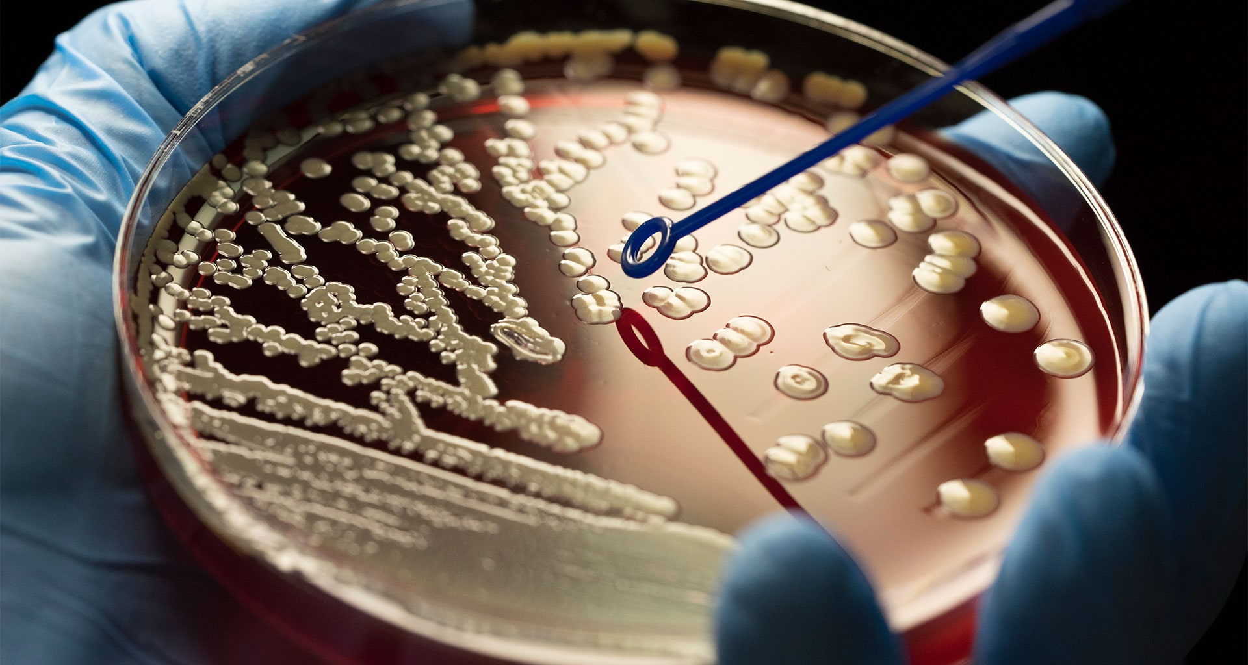
Neo-Darwinian Evolution is Unscientific

Slide 2

“In the beginning God created the heavens and the earth.”
- Gen. 1:1
2
Notes:
2

Slide 3
“For by Him [Jesus] all things were created, both in the heavens and on earth, visible and invisible, whether thrones or dominions or rulers or authorities—all things have been created by Him and for Him. He [Jesus] is before all things and in Him [Jesus] all things hold together.” - Col. 1:16,17
3
Notes:
3

Slide 4
.

Slide 5
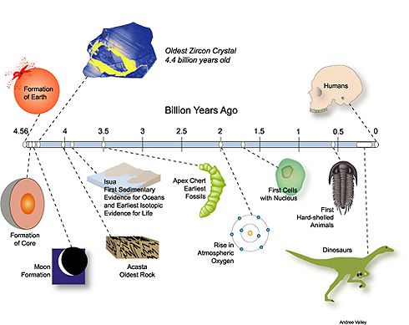
Evolutionary Timeline

Slide 6

Objection to Texas Bible Class Teaching Intelligent Design

Slide 7
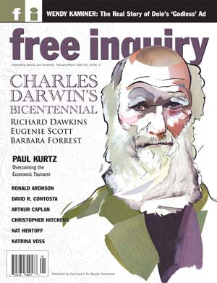
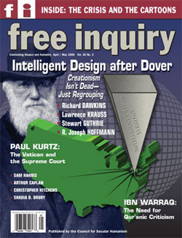
“Evolution thus becomes the most potent weapon for destroying the Christian faith.”
- A.J. Mattill Jr., “Three Cheers for the Creationists,” Free Inquiry, vol. 2 (Spring 1982)

Slide 8

Young Adults Who Lost Their Faith Because of Macroevolution
Young couple in South
(+ 2 more children: JW and W sons)
Christian Girl at Auburn University
Young preacher
Christian. College student in Oregon
Home-schooled child in Indiana
Man in South Carolina’s three children
Two young Christians at NJ University
Neighbor in Pennsylvania
Notes:
8

Slide 9
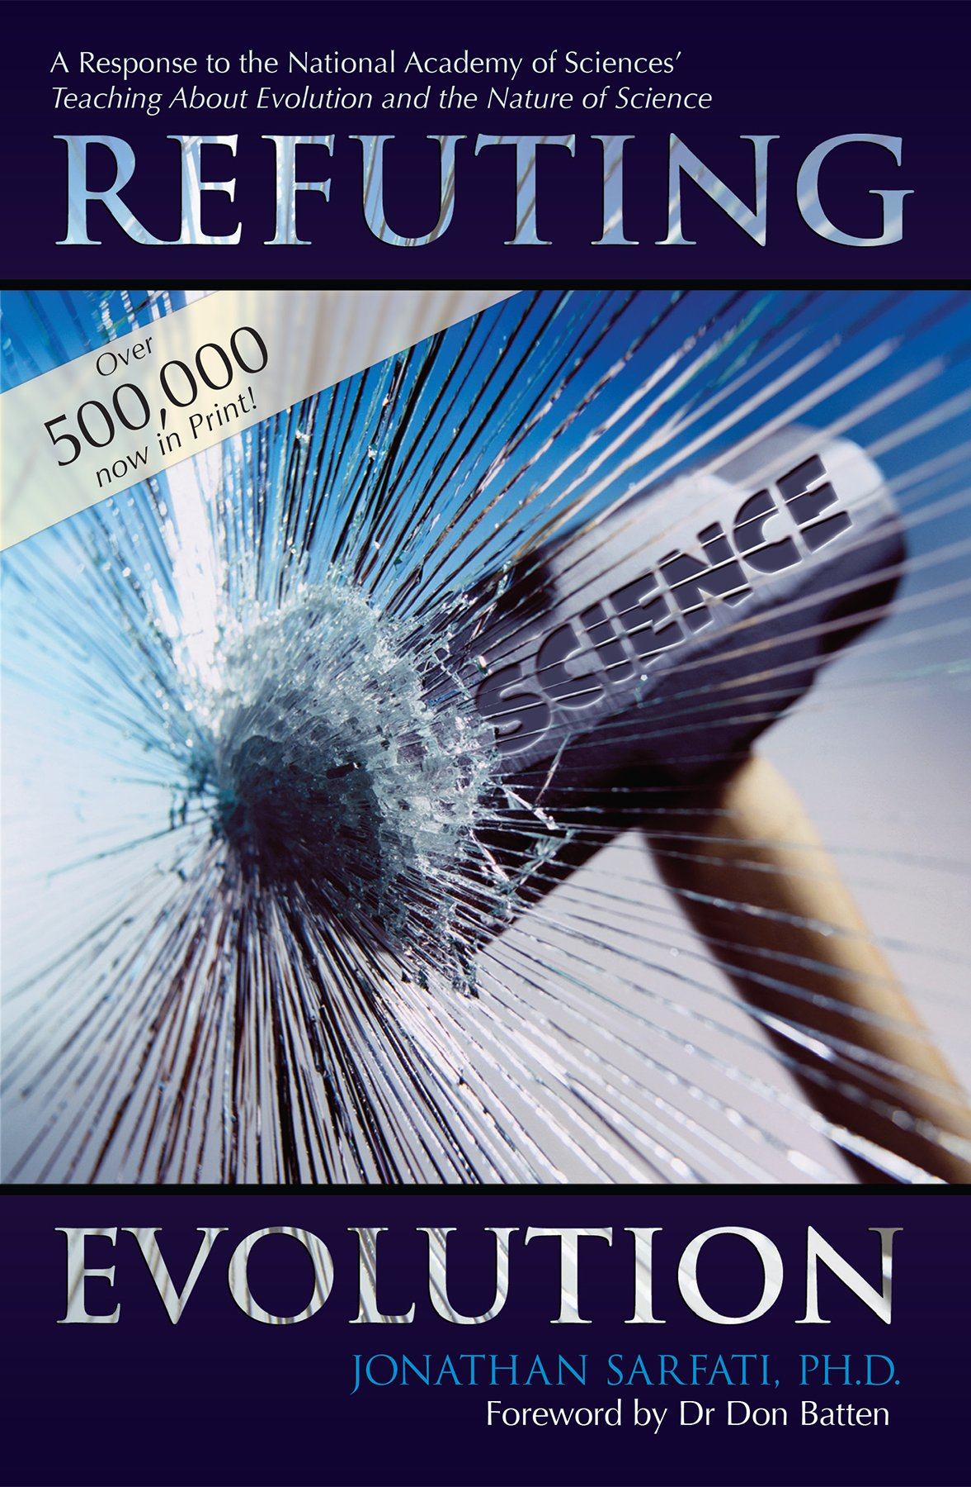
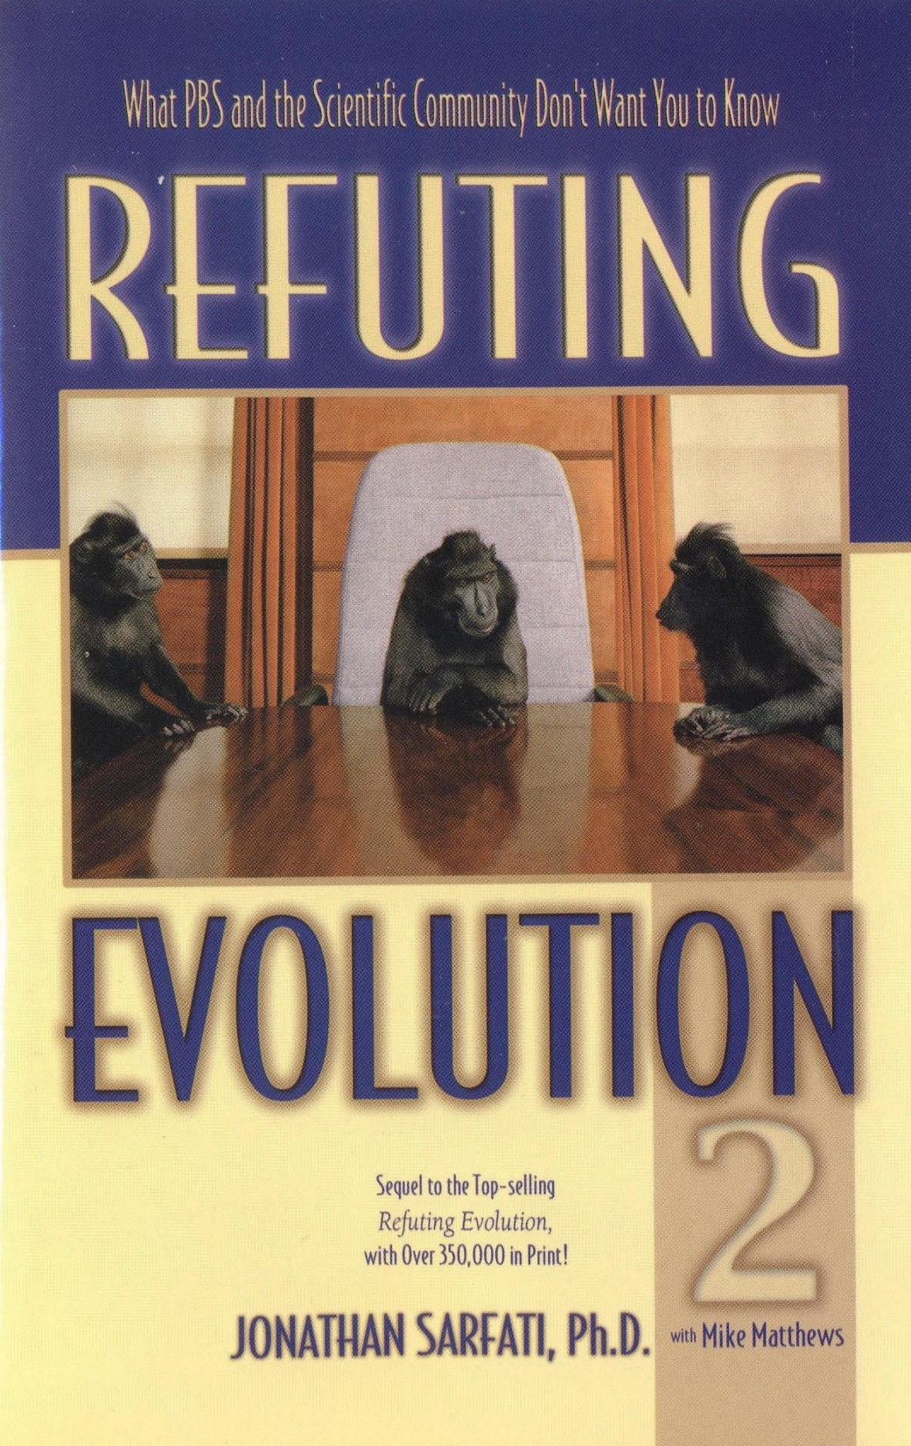

Slide 10
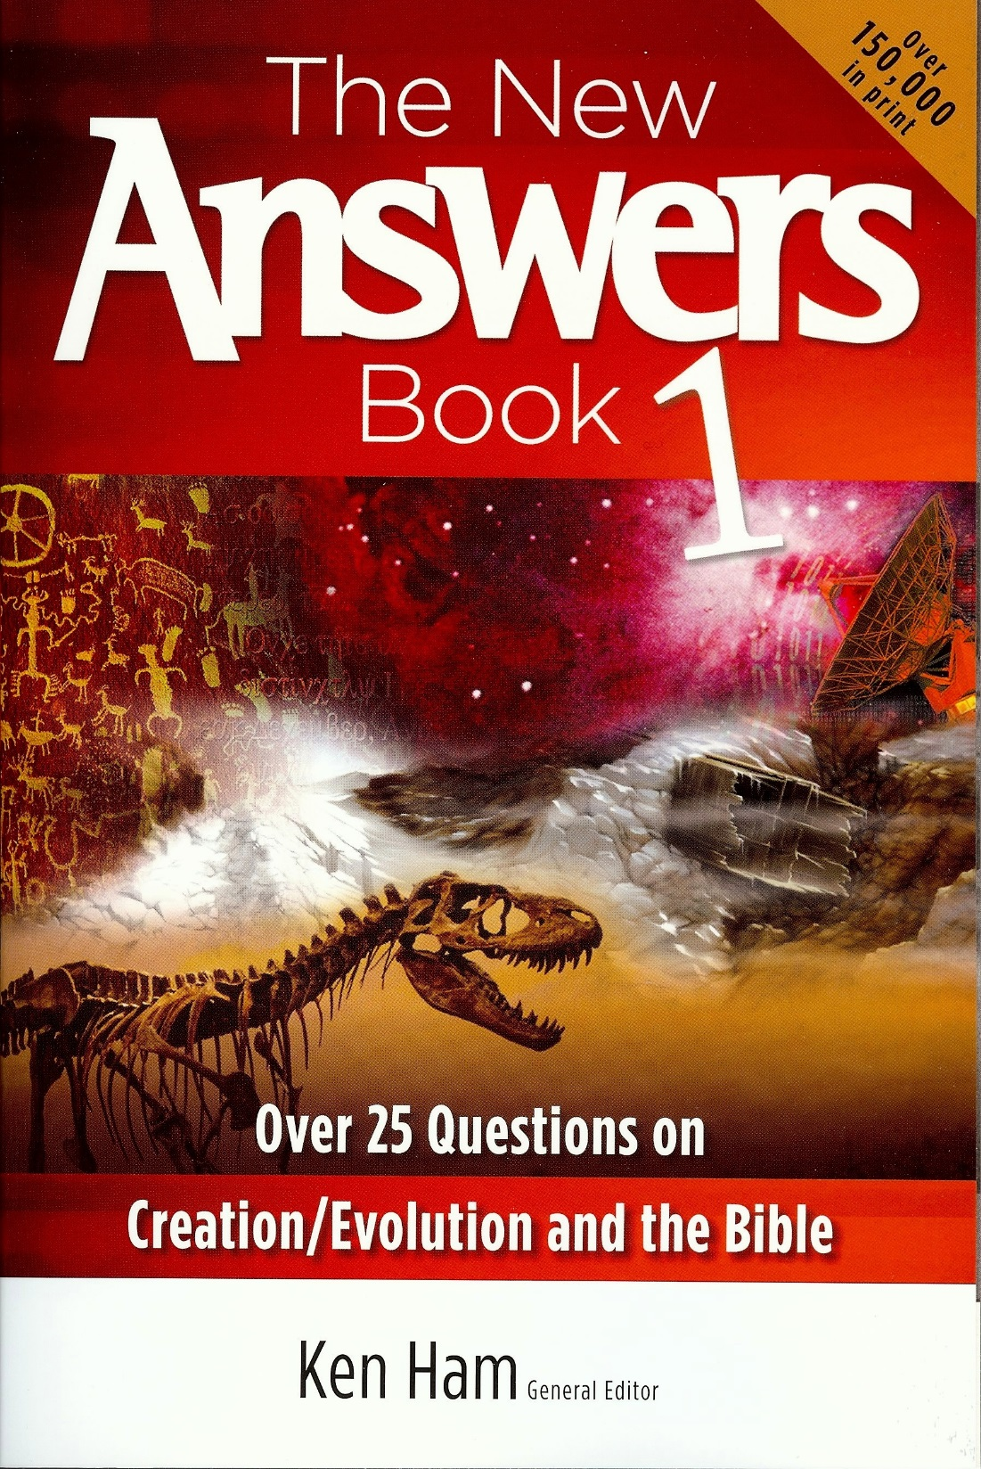

Slide 11
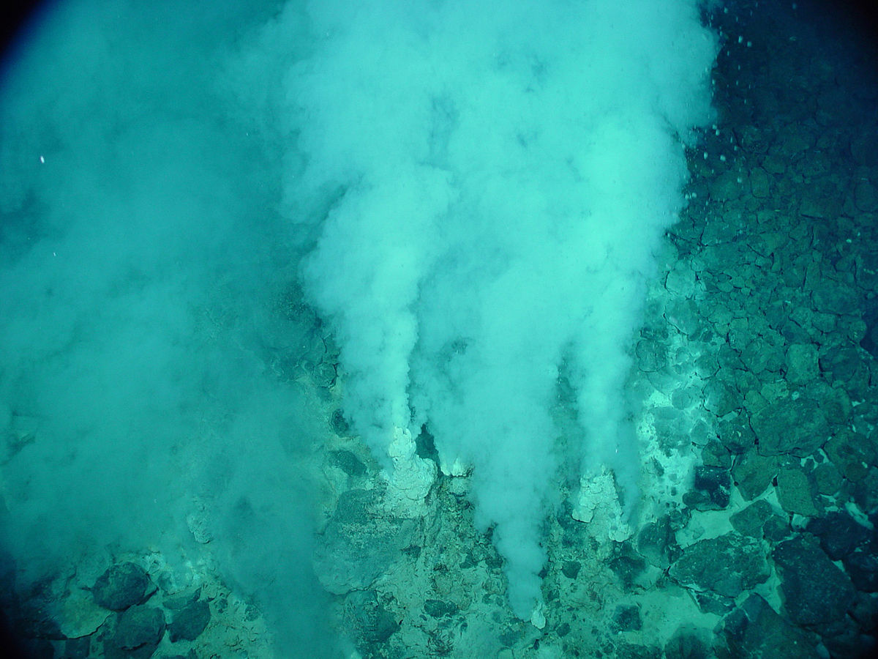
I. The Doctrine of Abiogenesis is Unscientific
(Spontaneous Generation
Life Arising from Non-life)

Slide 12

What Are the Chances of Spontaneous Generation?

Slide 13
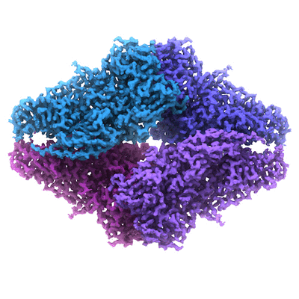
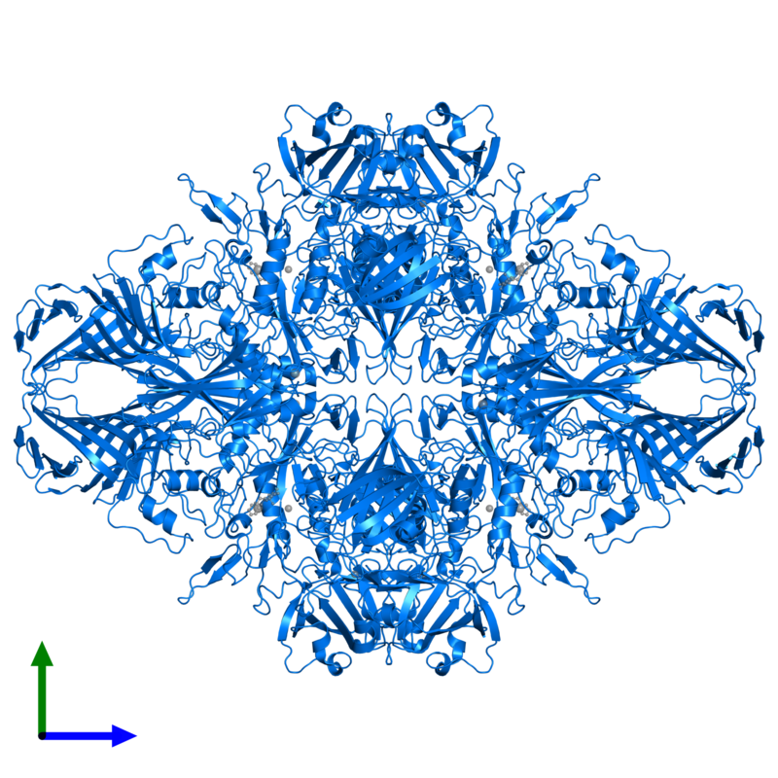
What Are the Chances of Spontaneous Generation?
Consider - PROTEINS

Slide 14
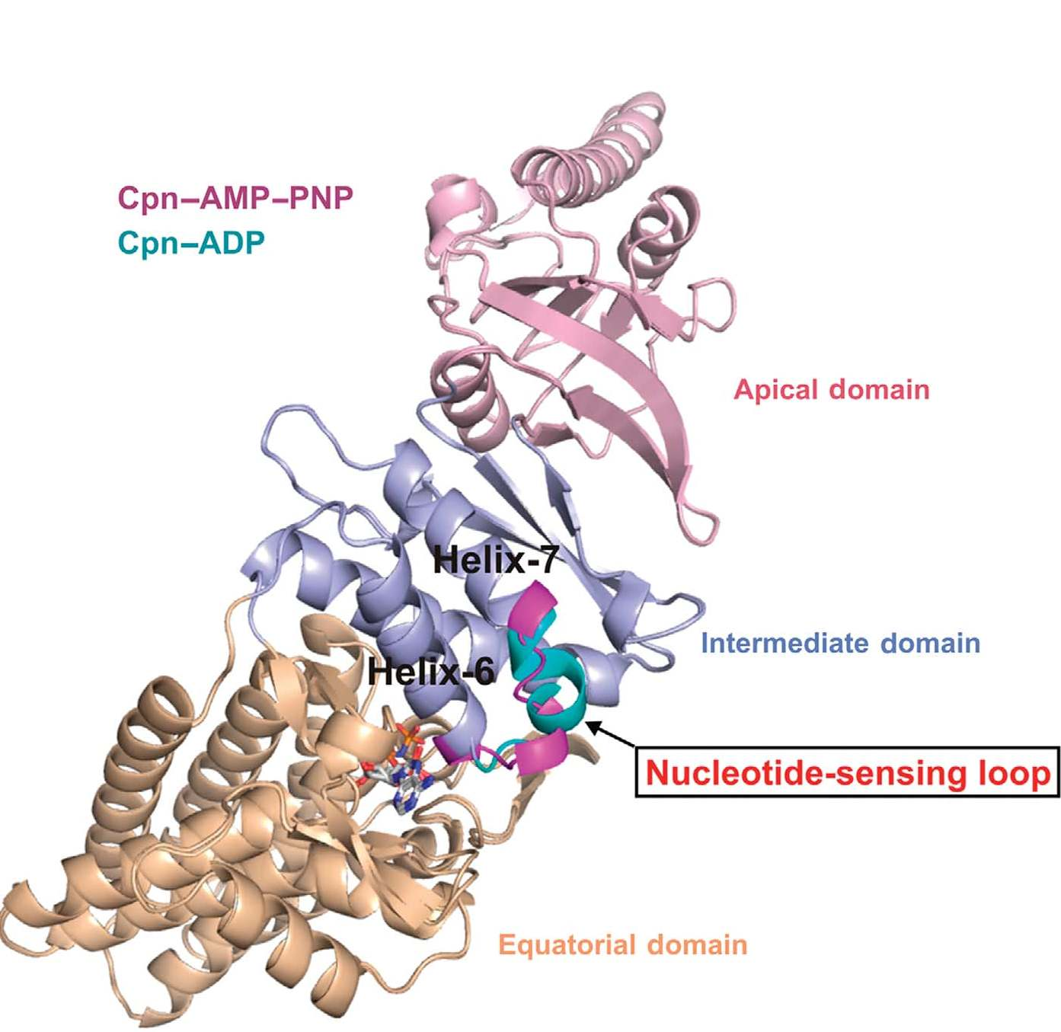
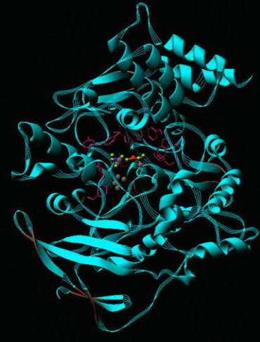
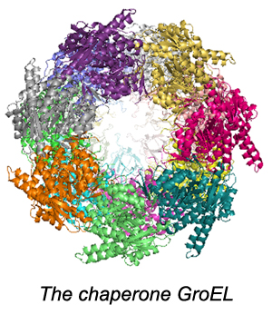
11 Reasons Why Proteins Are
Proof of a Creator

Slide 15
1. The First Single-Celled Organism Would Require 300 Proteins for Life
(per pro. Abiogenesis)

Slide 16
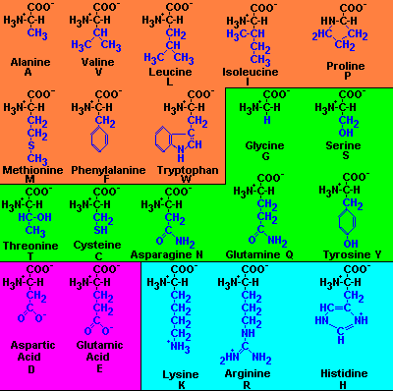
2. To Create JUST ONE (1) Protein, All 20 Amino Acids Would First Have to Evolve
16
Notes:
16

Slide 17

Living
Organism

Slide 18

Proteins
Living
Organism

Slide 19

Amino Acids
Proteins
Living
Organism

Slide 20
3. Even if all 20 amino acids could have spontaneously appeared, they would be oxidized in the presence of oxygen. . . AND theorists now contend the early atmosphere would have contained oxygen.
(Note: This oxidizing atmosphere would have actually precluded amino acid synthesis in the first place).
20
Notes:
20

Slide 21
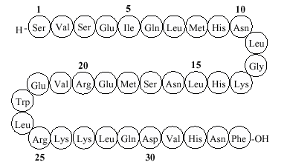
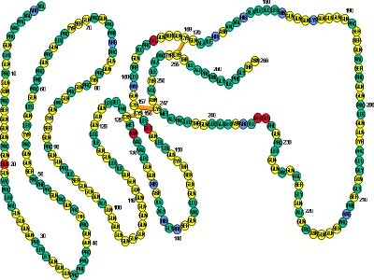
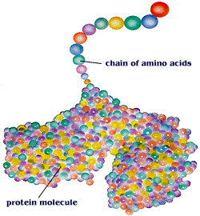
4. The First Protein Would Have to be Created by an Enormous String of at Least 267 Properly Ordered Amino Acids
(Nucleic Acids Res. 2005; 33(10):3390–3400)
21
Notes:
21

Slide 22
5. The Simplest Bacterium Would Require a Minimum of 300 of These Proteins for Life
300 proteins x 267 amino acids =
22
Notes:
22

Slide 23

5. The Simplest Bacterium Would Require a Minimum of 300 of These Proteins for Life
300 proteins x 267 amino acids = 80,100 PROPERLY ORDERED amino acids needed
23
Notes:
23

Slide 24
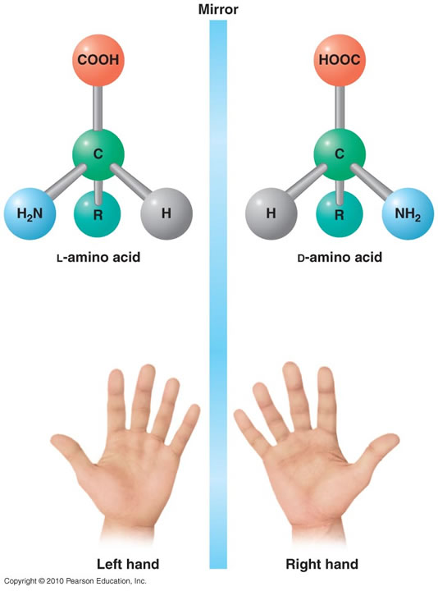
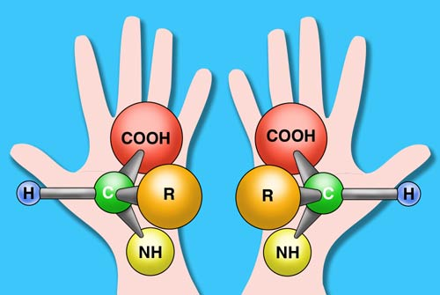
6. The Chirality of the 80,100 Amino Acids Must All Be Left-Handed (L) and Not Right Handed (D) In Order for a Cell to Live
24
Notes:
24

Slide 25
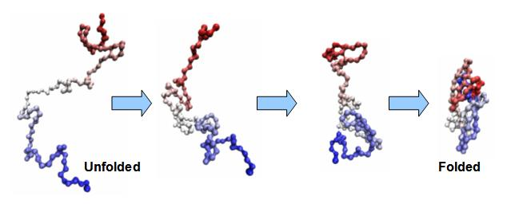
7. Before Being Functional, All Proteins Have to Be Folded Into a Precise 3-D Structure
25
Notes:
25

Slide 26
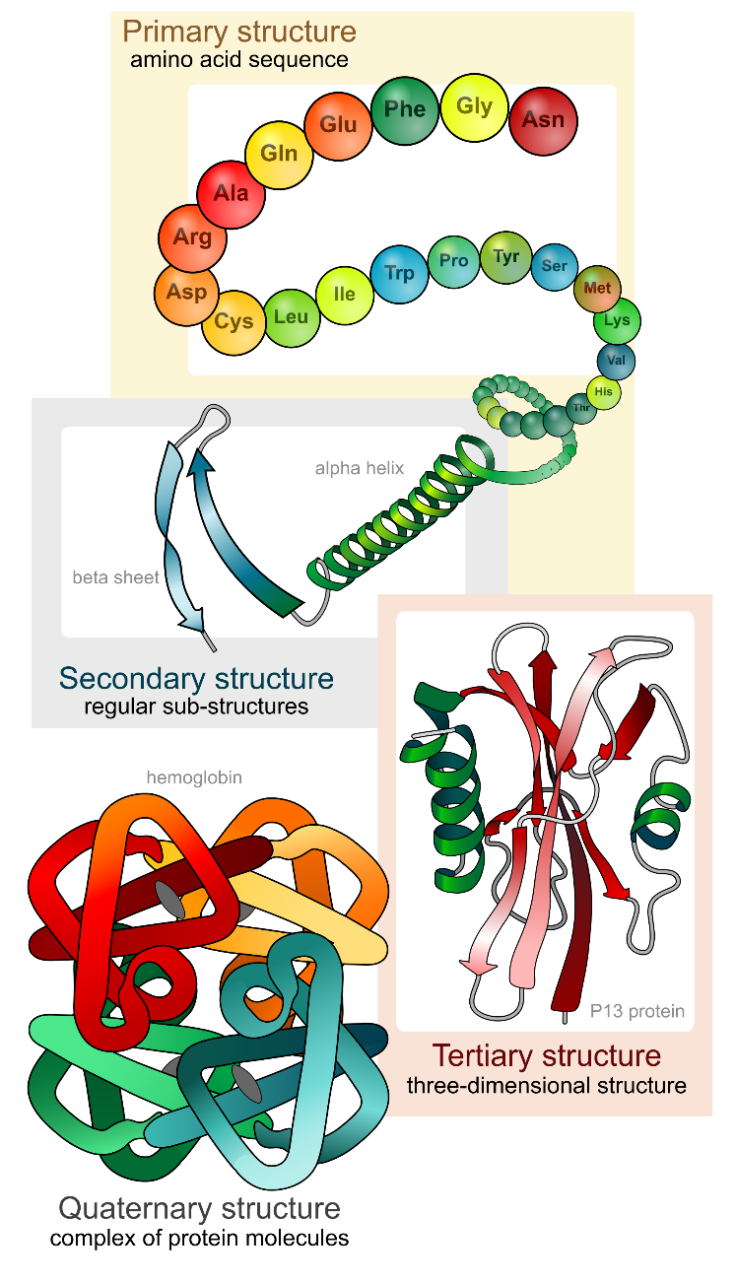
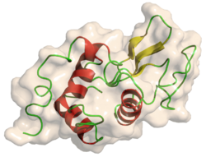
8. Before a Protein Can Fold, it Has to be Coded With a Tail That Instructs the Chain How it Should Fold in Upon Itself
Lysozyme
26
Notes:
26

Slide 27
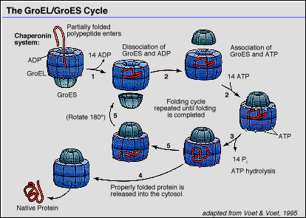
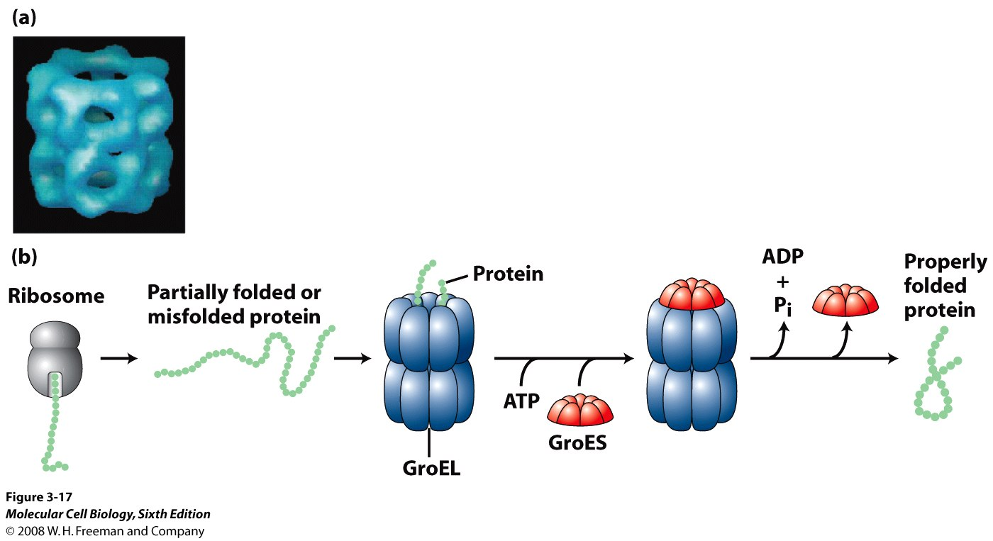
9. Protein Folding Requires Chaperones and Chaperonins for Precise Folding to Occur (NOTE: There are rare exceptions where proteins can fold without chaperones, but to manufacture all proteins in the first bacterium would require chaperones.)
27
Notes:
27

Slide 28
10. Time Fails Us To Describe all the Other Intricate Biological Mechanisms Truly Required To Create all the Proteins Within the Cell, Including the genetic blueprint (DNA), required to arrange the amino acids into their precise sequence. Other systems required in the cell to create all bacterial proteins are Initiator tRNA, Initiation Factors - IF1, IF2 (GTP) and IF3, mRNA, rRNA, RNA Polymerase, Transcription, Translation, etc.
*Note: A total of more than 50 molecular components are required to translate proteins
The following Animated Instructional Lecture May Help:
https://www.youtube.com/watch?v=erOP76_qLWA&list=LLzEVf7JDxuntsxLqgh47jlA&index=2

Slide 29
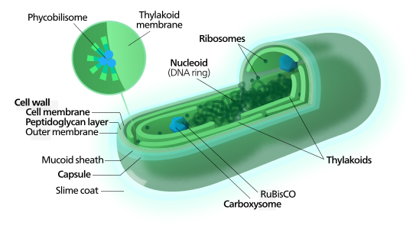
11. In addition to the minimum of 300 precisely coded and folded proteins for the first bacterial cell to live, the cell has to be. . .

Slide 30
11. In addition to the minimum of 300 precisely coded and folded proteins for the first bacterial cell to live the cell has to be “self replicating” or it will disappear without a trace. Hundreds of other components are also needed for the viable bacterium (e.g., Cyanobacterium) (e.g., cell membrane or wall, thylakoids, thylakoid membrane, phycobilisomes, carotenoids and phycoerythrins, RuBisCO, etc., etc.)

Slide 31
Hence, Nobel Prize-winner, Jacques Monod, argued that the probability of life emerging by random processes is so small that it might be considered to be “zero.”
Popper, K.R., Scientific Reduction and the Essential Incompleteness of all Science; in Ayala, F.J., and Dobzhansky, T., eds, Studies in the Philosophy of Biology, Macmillan Press, London, p. 270, 1974.
Beta-galactosidase

Slide 32
Thus, Francis Crick Advocates for
“Directed Panspermia”
Now, Who Are the Ones Relying on Faith and not “Science?”

Slide 33
Point I Summary
Abiogenesis is Out of the Realm of Possibility

Slide 34
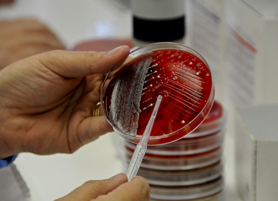
II. Macroevolution Is Not Scientifically Testable
(Falsifiable)

Slide 35
Valid Science Must be Falsifiable
Meaning you have to be able to test it to determine whether it is false
If there is no way to determine whether it is false, then it is simply assumed to be true, regardless of what variables are changed in the experiment – Thus it is unscientific
Macroevolution is a rigged PHILOSOPHY designed to prevent it from ever being disproven – a shell game

Slide 36
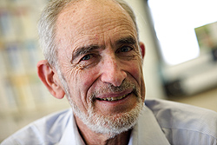
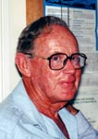
“Our theory of evolution has become … one which cannot be refuted by any possible observations. . . It is thus ‘outside of empirical science’ but not necessarily false. No one can think of ways in which to test it."
- Drs. Paul R. Ehrlich, and L. C. Birch, “Evolutionary History and Population Biology,” Nature, vol. 214 (April 22, 1967), pp. 349-352.
Notes:
36

Slide 37
Point II Summary
Macroevolution is Not Scientific Because it is Not Falsifiable

Slide 38

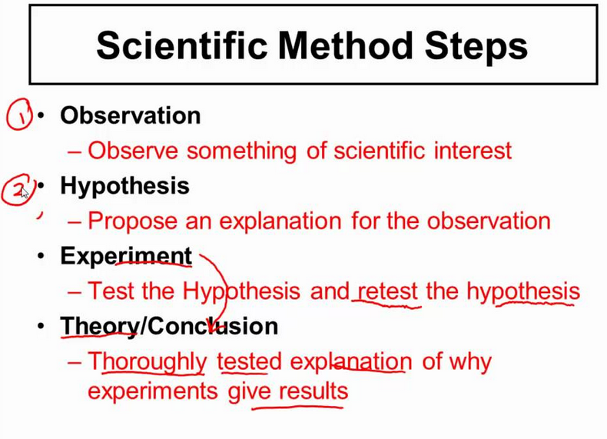
III. Neo-Darwinian Evolution Does Not Adhere to the Four-Tiered Scientific Method
The Four-Tiered Scientific Method
An observation of some event in the universe
Development of a hypothesis to explain this event
Utilization of the hypothesis to design experiments that will confirm or falsify the hypothesis
Conducting repeatable experiments to validate the hypothesis and compose a theory
Credit: Sciencepost - www.youtube.com/watch?v=nEtneU9o-C8

Slide 39
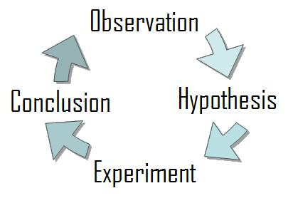

Correct Application of the Scientific Method
a posteriori

Slide 40
Neo-Darwinian Corruption of the Scientific Method
a priori
Mlk
Mkl
Nmk
Mlk
Mkl
Nmk
post hoc
S to follow

Slide 41
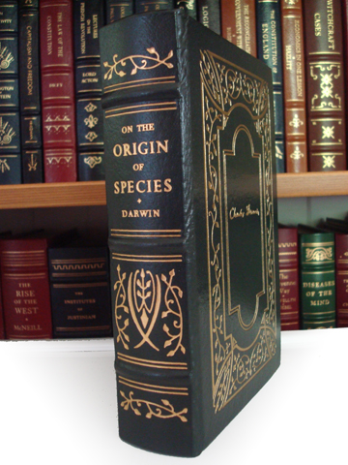
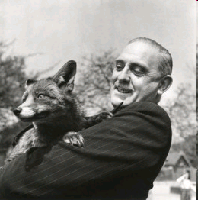
"In accepting evolution as a fact, how many biologists have paused to reflect that science is built upon theories that have been proved by experiment[s] to be correct, or remember that the theory of animal evolution has never been thus proved? … is it then a science or a faith?"
- Dr. L. Harrison Matthews, (Professor, Bristol University; Scientific Director of the Zoological Society of London, Fellow of the Royal Society), Forward to On The Origin of Species, (London: J. M. Dent & Sons, Ltd., 1971).
41
Notes:
41

Slide 42
Now, Who Are the Ones Relying on Faith and not “Science?”

Slide 43
Point III Summary
Macroevolution is Not Scientific Because it Does Not Adhere to the Scientific Method

Slide 44
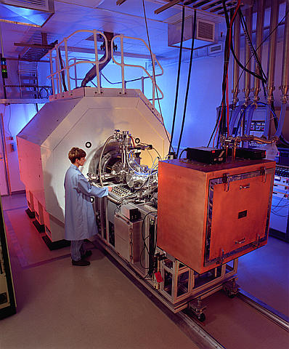
IV. What About Radiometric Dating?
Radiometric Techniques Only Measure the Chemical Composition of the Rock, NOT THE AGE. Ages are Subjectively Extrapolated

Slide 45


Radioisotopic Decay
(Radiometric Dating)
Parent
Daughter
Uranium-238
Lead-206

Slide 46
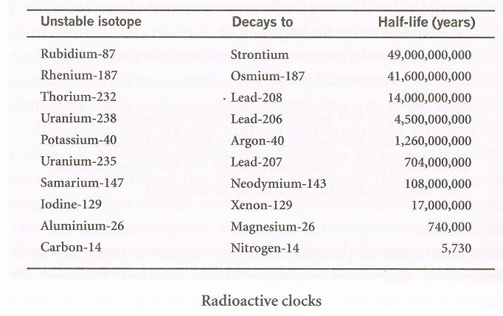
Particle Emitted
β
β
α
α
Electron Capture
α
α
108,000,000,000
β, γ
β+, Electron Capture
β
α = 2 protons + 2 neutrons,
β = electron,
β+ = positron
Electron Capture = a proton-rich nuclide absorbs an inner atomic electron, thereby changing a nuclear proton to a neutron and simultaneously causing the emission of an electron neutrino.

Slide 47
Particle Emitted
β
β
α
α
Electron Capture
α
α
108,000,000,000
β, γ
β+, Electron Capture
β
α = 2 protons + 2 neutrons,
β = electron,
β+ = positron
Electron Capture = a proton-rich nuclide absorbs an inner atomic electron, thereby changing a nuclear proton to a neutron and simultaneously causing the emission of an electron neutrino.

Slide 48

Radiometric Dating Is An Exercise of Faith
Based on 9 Unprovable Assumptions

Slide 49

Assumption #1
By faith, evolutionists believe they know how much parent element was in the rock when it was formed
This Cannot be Known
Uranium-238

Slide 50
Assumption #2
By faith, materialists believe they know how much daughter element was in the rock when it was formed
This Cannot be Known
Lead-206

Slide 51
Assumption #3
By faith, evolutionists believe they know that no parent element leaked into the rock during millions of years
This Cannot be Known
Uranium-238

Slide 52
Assumption #4
By faith, evolutionists believe they know that no parent element leaked out of the rock during millions of years
This Cannot be Known
Uranium-238

Slide 53
Assumption #5
By faith, evolutionists believe they know that no daughter element leaked into the rock during millions of years
This Cannot be Known
Lead-206

Slide 54
Assumption #6
By faith, evolutionists believe they know that no daughter element leaked out of the rock during millions of years
This Cannot be Known
Lead-206

Slide 55
Assumption #7
By faith, evolutionists believe the rate of radioactive decay has been constant over a period of over 4 billion years
We Know This is False

Slide 56
Assumption #8
By faith, evolutionists believe that radiometric clocks are “reset” and all of the daughter element is purged from rock when it is molten
We Know This is False
Argon-40

Slide 57
Assumption #9
By faith, evolutionists believe that all eight common radiometric methods return the same ages (the methods converge) for the same rocks. . . .
We Know This is False

Slide 58



Slide 59
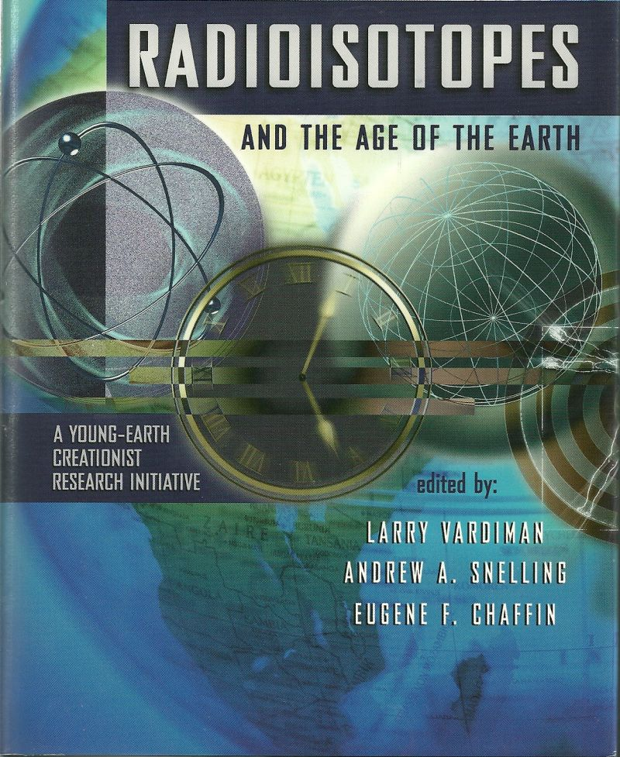

Slide 60
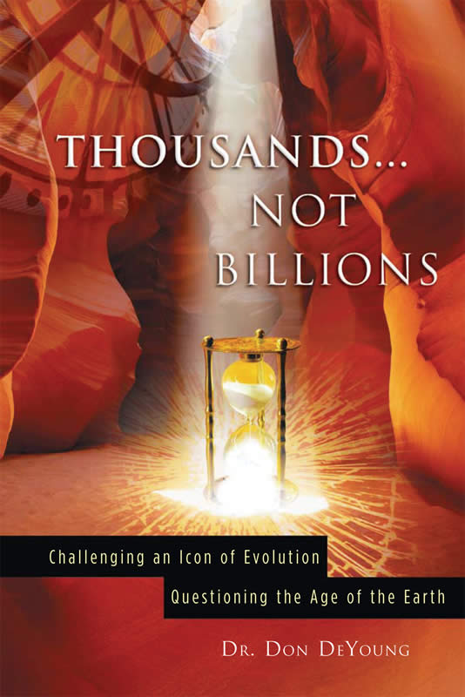

Slide 61
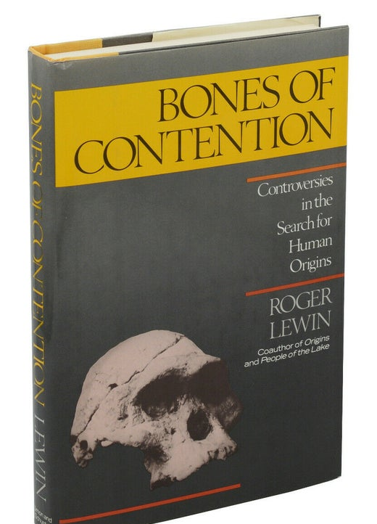
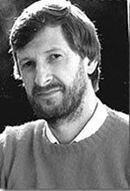

Slide 62
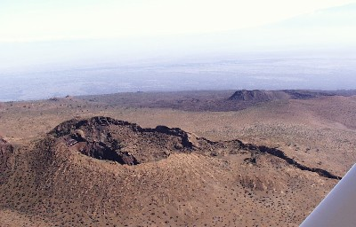
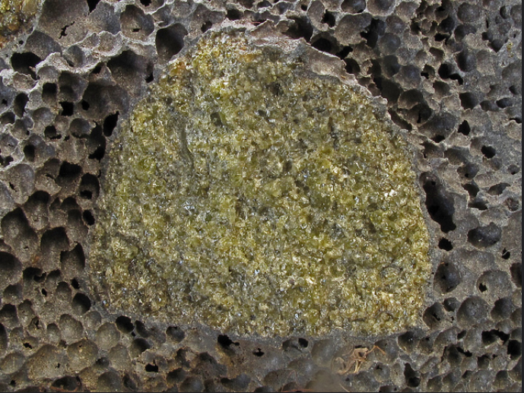
Old Dates for Young Rocks
Hualalai Basalt, Hawaii – Erupted in 1801
Radiometric Age: 22.7 million years

Slide 63

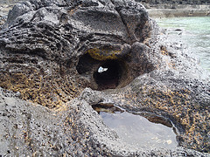
Old Dates for Young Rocks
Rangitoto Basalt – Actual Age: < 800 years
Radiometric Age: 15 million years

Slide 64


Old Dates for Young Rocks
Mt. Etna Basalt – Erupted in 1972
Radiometric Age: 700,000 years

Slide 65


Old Dates for Young Rocks
Mt. Erebus Basalt – Actual Age: 17 years
Radiometric Age: 1.6 million years

Slide 66
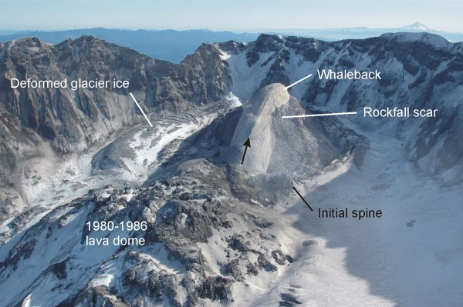
Old Dates for Young Rocks
Mt. St. Helens Lava Dome – Actual Age: 11 years
Radiometric Age: 2 million years

Slide 67
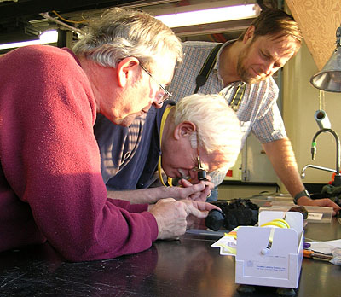
NOTE: 90% of Tests Used to Determine the Age of the Earth Return a Young Age
(i.e., all the tests used in the 19th century, and many in the 20th century)
Evolutionists Only Accept the ca. 10% of Tests They Believe Return an Old Age (based on their unproven assumptions)
www.mbari.org/.../ridges2005/august_23.htm

Slide 68
11 Scientific Evidences of a Young Earth
Notes:
68

Slide 69
11 Scientific Evidences of a Young Earth
Not enough sediment buildup in the oceans (20+ BT/year deposited, -1 BT subducted) – Only ca. 1,500 ft. thick sediment in the oceans, compared to ca. 1 mile thick on the continents
Notes:
69

Slide 70
11 Scientific Evidences of a Young Earth
Not enough sediment buildup in the oceans (20+ BT/year deposited, -1 BT subducted) – Only ca. 1,500 ft. thick sediment in the oceans, compared to ca. 1 mile thick on the continents
Not enough salt in the ocean (If oceans formed 4 BYA, would be saturated @ 26%, currently @ only 3.5%)
Notes:
70

Slide 71

www.oceanexplorer.noaa.gov

Slide 72
11 Scientific Evidences of a Young Earth
Not enough sediment buildup in the oceans (20+ BT/year deposited, -1 BT subducted) – Only ca. 1,500 ft. thick sediment in the oceans, compared to ca. 1 mile thick on the continents
Not enough salt in the ocean (If oceans formed 4 BYA – still not saturated @ 26%, currently @ only 3.5%)
Not enough helium in the atmosphere – 0.0005% (generated from uranium decay)
Notes:
72

Slide 73
11 Scientific Evidences of a Young Earth
Not enough sediment buildup in the oceans (20+ BT/year deposited, -1 BT subducted) – Only ca. 1,500 ft. thick sediment in the oceans, compared to ca. 1 mile thick on the continents
Not enough salt in the ocean (If oceans formed 4 BYA – still not saturated @ 26%, currently @ only 3.5%)
Not enough helium in the atmosphere – 0.0005% (generated from uranium decay)
Earth’s magnetic field is decaying too fast (2x 1,400 YA)
Notes:
73

Slide 74
11 Scientific Evidences of a Young Earth
Not enough sediment buildup in the oceans (20+ BT/year deposited, -1 BT subducted) – Only ca. 1,500 ft. thick sediment in the oceans, compared to ca. 1 mile thick on the continents
Not enough salt in the ocean (If oceans formed 4 BYA – still not saturated @ 26%, currently @ only 3.5%)
Not enough helium in the atmosphere – 0.0005% (generated from uranium decay)
Earth’s magnetic field is decaying too fast (2x 1,400 YA)
Our solar system’s short term comets should have disappeared 4.6 BY ago (Only last ca. 10,000 – 100,000 years)
Notes:
74

Slide 75
11 Scientific Evidences of a Young Earth
Not enough sediment buildup in the oceans (20+ BT/year deposited, -1 BT subducted) – Only ca. 1,500 ft. thick sediment in the oceans, compared to ca. 1 mile thick on the continents
Not enough salt in the ocean (If oceans formed 4 BYA – still not saturated @ 26%, currently @ only 3.5%)
Not enough helium in the atmosphere – 0.0005% (generated from uranium decay)
Earth’s magnetic field is decaying too fast (2x 1,400 YA)
Our solar system’s short term comets should have disappeared 4.6 BY ago (Only last ca. 10,000 – 100,000 years)
Not enough supernova remnants (1 appears every 25 years) – Only 300-400 have been discovered – But, conservatively, if 1 occurred every 25 years for only 10 BY = 400 million
Notes:
75

Slide 76
11 Scientific Evidences of a Young Earth
Mercury’s molten core should have solidified billions of years ago (Est. 300 MY to cool – Mercury’s magnetic field discovered by Mariner 10 Spacecraft 9/21/74)
Notes:
76

Slide 77
11 Scientific Evidences of a Young Earth
Mercury’s molten core should have solidified billions of years ago (Est. 300 MY to cool – Mercury’s magnetic field discovered by Mariner 10 Spacecraft 9/21/74)
Diamonds, coal, & dinosaur bones still have Carbon-14 in them (should have disappeared millions of years ago since C¹⁴ is only detectable for ca. 95,000 years, Diamonds = 1-3 BY old)
Notes:
77

Slide 78
11 Scientific Evidences of a Young Earth
Mercury’s molten core should have solidified billions of years ago (Est. 300 MY to cool – Mercury’s magnetic field discovered by Mariner 10 Spacecraft 9/21/74)
Diamonds, coal, & dinosaur bones still have Carbon-14 in them (should have disappeared millions of years ago since C¹⁴ is only detectable for ca. 95,000 years, Diamonds = 1-3 BY old)
Collagen, DNA, proteins & blood vessels surviving in plant, dinosaur & insect fossils for estimated 130 MY (collagen and DNA could not last more than 1,000 -100,000 years)
Notes:
78

Slide 79
11 Scientific Evidences of a Young Earth
Mercury’s molten core should have solidified billions of years ago (Est. 300 MY to cool – Mercury’s magnetic field discovered by Mariner 10 Spacecraft 9/21/74)
Diamonds, coal, & dinosaur bones still have Carbon-14 in them (should have disappeared millions of years ago since C¹⁴ is only detectable for ca. 95,000 years, Diamonds = 1-3 BY old)
Collagen, DNA, proteins & blood vessels surviving in plant, dinosaur & insect fossils for estimated 130 MY (collagen and DNA could not last more than 1,000 -100,000 years)
Human population is too small (0.5% annual growth since the flood [is ca. 1.1% now] 2,350 BC = ca. 7-8 billion people)
Notes:
79

Slide 80
11 Scientific Evidences of a Young Earth
Mercury’s molten core should have solidified billions of years ago (Est. 300 MY to cool – Mercury’s magnetic field discovered by Mariner 10 Spacecraft 9/21/74)
Diamonds, coal, & dinosaur bones still have Carbon-14 in them (should have disappeared millions of years ago since C¹⁴ is only detectable for ca. 95,000 years, Diamonds = 1-3 BY old)
Collagen, DNA, proteins & blood vessels surviving in plant, dinosaur & insect fossils for estimated 130 MY (collagen and DNA could not last more than 1,000 -100,000 years)
Human population is too small (0.5% annual growth since the flood [is ca. 1.1% now] 2,350 BC = ca. 7-8 billion people)
Not enough graves for humans to have lived on earth for 100,000-200,000 years (ca. 8 billion people x 1.0% buried = 80 million graves)
Notes:
80

Slide 81


You may be thinking. . .
“How could science be wrong? I was taught that evolution was scientific”

Slide 82
THE POINT. . .
Operational science (following the scientific method) is an accurate tool from God. Macroevolution does not follow the scientific method and is philosophy

Slide 83
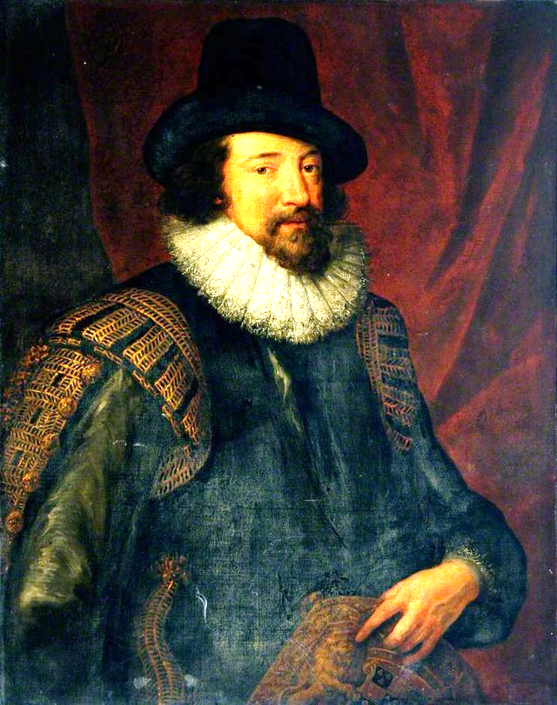
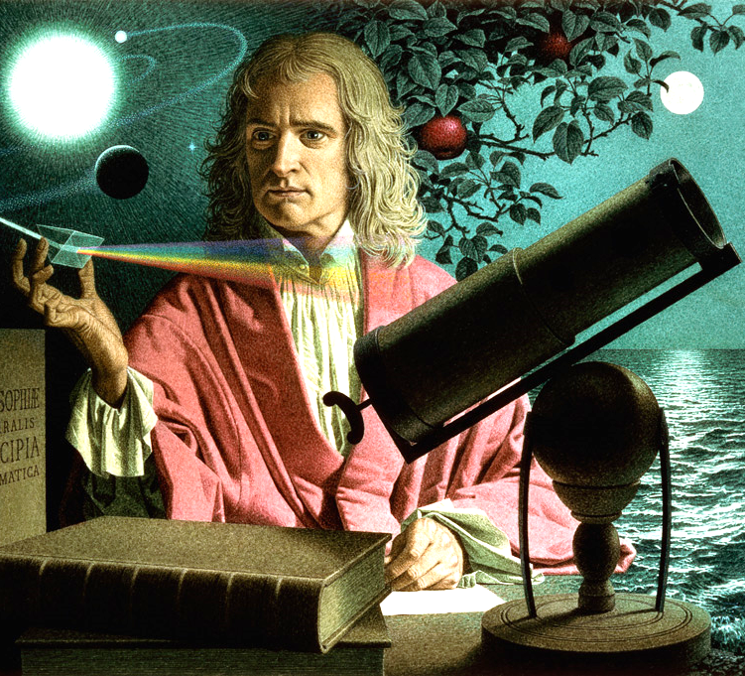
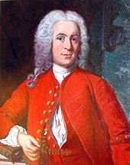
The Greatest Scientists of the Scientific Revolution Were All Believers, Searching for the Natural Laws Established by God
Eleven Creation Scientists of the Scientific Revolution
Gerardus Mercator (1512-1594), cartography
Francis Bacon (1561-1626), the classical scientific method
Galileo Galilei (1564-1642), astronomy, physics
Johannes Kepler (1571-1630), astronomy
Blaise Pascal (1623-1662), the barometer, probability, hydrostatics, geometry
Robert Boyle (1627-1691), gas dynamics, chemistry
Sir Isaac Newton (1642-1727), law of gravity, law of cooling, spectrum of light, co-inventor of calculus, dynamics, the reflecting telescope*
Gottfried Wilhelm Leibnitz (1646-1716), co-inventor of calculus, mathematics
Carolus Linnaeus (1707-1778), biological taxonomy*
John Dalton (1766-1844) gas law, atomic theory
Nicolas Steno (1638-1686) geology, paleontology, stratigraphy
Francis Bacon
Isaac Newton
Carolus Linnaeus

Slide 84
V. Universally-Accepted Scientific Theories Are Overturned All the Time

Slide 85
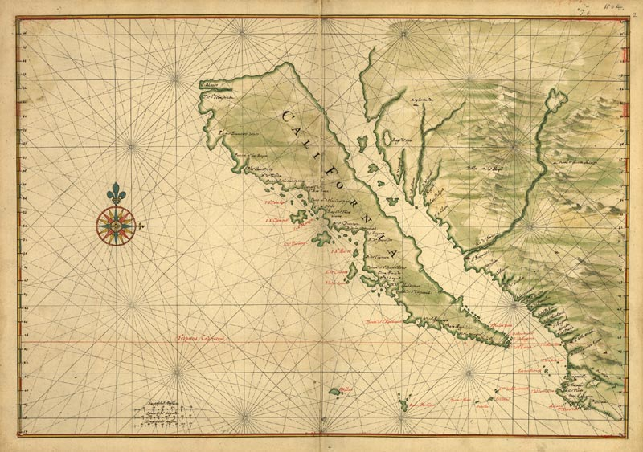
V. Universally-Accepted Scientific Theories Are Overturned All the Time
16th-18th Century “California Island” Theory

Slide 86
V. Universally-Accepted Scientific Theories Are Overturned All the Time
1600 - Science said the sun revolved around the earth
1750 - Science said that fire comes from the release of phlogiston
1800 - Science treated illnesses by bleeding people
1872 - Charles Darwin said that inheritance was transmitted through “gemmules” by “pangenesis”
1877 - Light waves transmitted through a substance called “ether”
1860 - Charles Darwin said women and African races were evolutionarily and intellectually inferior to white men
Notes:
86

Slide 87
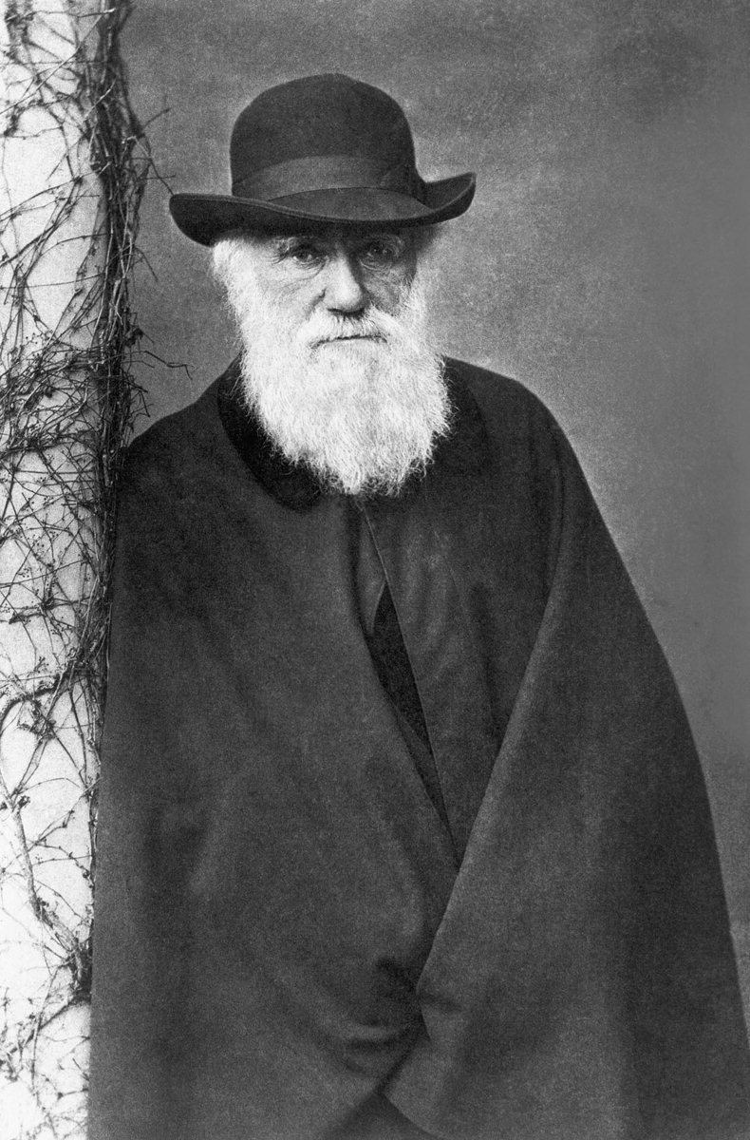
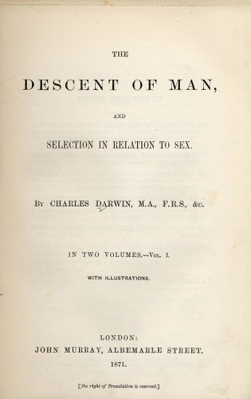

Slide 88
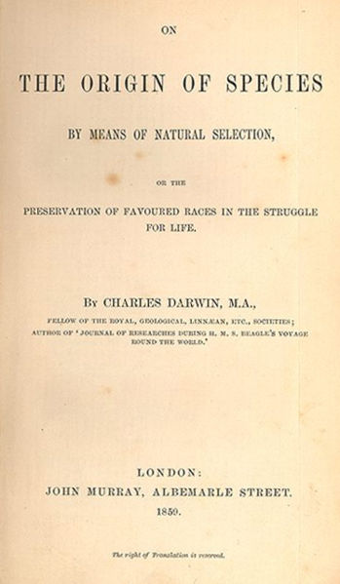
“At some future period, not very distant as measured by centuries, the civilized races of man will almost certainly exterminate and replace the savage races throughout the world. At the same time the anthropomorphous apes … will no doubt be exterminated."
- Charles Darwin, The Descent of Man, 2nd ed. (New York: A. L. Burt Co., 1874), p 178

Slide 89

"Looking to the world at no very distant date, what an endless number of the lower races will have been eliminated by the higher civilized races throughout the world.”
- Charles Darwin, Life and Letters, I, Letter to W. Graham, July 3, 1881, p. 316, cited in Darwin and the Darwinian Revolution, by Gertrude Himmelfarb (London: Chatto & Windus, 1959), p. 343.

Slide 90



Darwinian evolution taught that the Africans descended from the strong but unintelligent gorillas, the Orientals from the orangutans, and the Caucasians from the most intelligent chimpanzees
T.G. Crookshank. 1924. The Mongol in Our Midst. New York: E.R. Dutton.
Terminalalberita.com
Xmwallpapers.com
Adamthinks.com
Notes:
90

Slide 91

Ernst Henrich Haeckel
“I consider the Negro to be a lower species of man and cannot make up my mind to look upon him as ‘a man and a brother,’ for the gorilla would then also have to be admitted into the family.”
- Quoted in: Enrst Haeckel, the History of Creation: Vol. II, translated by E. Ray Lancaster. London: Henry S. King and Co., 1876, pp. 365-366.
91
Notes:
91

Slide 92

"Biological arguments for racism may have been common before 1859, but they increased by orders of magnitude following the acceptance of evolutionary theory.”
- Stephen J. Gould, Ontogeny and Phylogeny (Cambridge, MA: Belknap Press of Harvard University Press, 1977).

Slide 93

In Darwinian Evolution What’s Wrong with Murder?
“The price of perfect design is messy relentless slaughter.”
- Stephen Jay Gould, "Darwin and Paley Meet the Invisible Hand," Natural History (November 1990):8.
93
Notes:
93

Slide 94


As a result of Darwin’s teaching, Australian Aboriginal “specimens” were in high demand to demonstrate they were the missing link. Published documents prove that >10,000 Aboriginal remains were shipped to British museums
The Smithsonian institute housed the remains of thousands of Aborigines
Museum in Spain
- Ken Ham & A. Charles Ware. 2007. Darwin’s Plantation: Evolution’s Racist Roots. Green Forest, AR: Master Books, p. 24
94
Notes:
94

Slide 95


Slide 96

When there were only 4 remaining Aborigenes on the Island of Tasmania, Darwin requested their skulls, provided that the request did not “upset” their feelings*
Many museums wanted the skins of Aborigines or freshly killed “specimens” so they could be stuffed‡
Shhhhhh. Our little secret.
*Ken Ham & A. Charles Ware. 2007. Darwin’s Plantation: Evolution’s Racist Roots. Green Forest, AR: Master Books, p. 24.
‡David Monoghan. 1991. “The Body-Snatchers,” The Bulletin, November 12.
Notes:
96

Slide 97



Dr. Edward Ramsay, curator of the Australian Museum in Sydney, published a booklet on how to plug bullet holes in freshly killed “specimens”
Ramsay also requested skulls of the “Bungee Blacks.” Four weeks later a scientist sent him two corpses, proudly proclaiming, “The last of their tribe, had just been shot”
David Monoghan. 1991. “The Body-Snatchers,” The Bulletin, November 12, p. 33.
97
Religiopoliticaltalk.com
Notes:
97

Slide 98
V. Universally-Accepted Scientific Theories Are Overturned All the Time
1600- Science said the sun revolved around the earth
1750- Science said that fire is caused by the release of a substance called phlogiston
1800- science treated the ill by bleeding
1859- Lamarckian science said that inheritance transmitted by gemules (viz., Charles Darwin)
1860- Science said women and African races were evolutionarily and intellectually inferior to white men (viz., Charles Darwin)
1912 Fossils of “Piltdown man” trumpted for 40 years as ½ million year old predecessor to man until discovered to be an Orangutan jawbone in 1953
1940 - Lobotomies to treat the mentally ill
1960’s - Steady state theory of the universe replaced by the Big Bang theory- Wikipedia devotes 1,500 words to problems with the big bang
20th century eugenics to eradicate genetically "inferior" people
21st century eugenics in America to eradicate genetically "inferior" people
98
Notes:
98

Slide 99
What About the Scientific Truth That the Following Drugs are Safe?
1976-1997: Fen-Phen . . . Heart valve destruction
1962-2008: Fluoroquinolones. . . Ruptured tendons
1999-2004: Vioxx. . . 90,000-144,000 cases of heart disease
1955-2010: Darvocet. . . . Heart arrhythmias (commonly prescribed euthanasia drug)
2000-2010: Avandia. . . Up to 83,000 heart attacks in 8 years
Feb. 19, 2024: Niacin reported to induce heart disease via 4PY metabolite

Slide 100
Again, THE POINT. . .
Operational science (following the scientific method) is an accurate tool from God. Macroevolution does not follow the scientific method and is philosophy

Slide 101
VI. Why Has Darwinism Been Accepted?

Slide 102

VI. Why Has Darwinism Been Accepted?
1. Because we have been told we should believe
in evolution (the parroting effect)

Slide 103



VI. Why Has Darwinism Been Accepted?
1. Because we have been told we should believe
in evolution (the parroting effect)
2. For the sake of conformity (Majority Opinion = Fear)
DARWIN

Slide 104

VI. Why Has Darwinism Been Accepted?
1. Because we have been told we should believe
in evolution (the parroting effect)
2. For the sake of conformity (Majority Opinion = Fear)
Mt. 15:14

Slide 105

VI. Why Has Darwinism Been Accepted?
1. Because we have been told we should believe
in evolution (the parroting effect)
2. For the sake of conformity (Majority Opinion = Fear)

Slide 106


Slide 107
VI. Why Has Darwinism Been Accepted?
1. Because we have been told we should believe
in evolution (the parroting effect)
2. For the sake of conformity (majority opinion)
3. Because of a bias against Divine creation

Slide 108

VI. Why Has Darwinism Been Accepted?
1. Because we have been told we should believe
in evolution (the parroting effect).
2. For the sake of conformity (majority opinion)
3. Because of a bias against Divine creation
“Moreover, that materialism is absolute, we cannot allow a divine foot in the door”
- Richard Lewontin, Billions and billions of demons (review of The Demon-Haunted World: Science as a Candle in the Dark by Carl Sagan, 1997), The New York Review, p. 31, 9 January 1997.

Slide 109

VII. Intellectuals and Scholars from the Highest Tiers of Science and Medicine Reject Neo-Darwinian Evolution

Slide 110


Slide 111

Scientists and a Physician from Expelled
(Ben Stein movie)
- Dr. Richard Sternberg (two Ph.D.s in Molecular
Evolution and Systems Science)

Slide 112

Scientists and a Physician from Expelled
(Ben Stein movie)
- Dr. Caroline Crocker, Ph.D.
(Immunopharmacologist)

Slide 113

Scientists and a Physician from Expelled
(Ben Stein movie)
- Dr. Michael Egnor, M.D. (Neurosurgeon)

Slide 114

Scientists and a Physician from Expelled
(Ben Stein movie)
- Dr. Robert J. Marks II, Ph.D.
(Electrical and Computer Engineer)

Slide 115

Scientists and a Physician from Expelled
(Ben Stein movie)
- Dr. Guillermo Gonzalez, Ph.D. (Astrophysicist)

Slide 116
Claim:
“Belief in Macroevolution is Required to Understand Biology and Medicine”

Slide 117

Question:
“Is Belief in Macroevolution Required to Understand Biology and Medicine?”
- Dr. Mark Kirschner, Founding Chair of the Dept. of Systems Biology, Harvard Medical School, As quoted in the Boston Globe, 23 October, 2005

Slide 118
Question:
“Is Belief in Macroevolution Required to Understand Biology and Medicine?”
“In fact, over the last 100 years, almost all of biology has proceeded independent of evolution except evolutionary biology itself. Molecular biology, biochemistry, physiology, have not taken evolution into account at all.”
- Dr. Mark Kirschner, Founding Chair of the Dept. of Systems Biology, Harvard Medical School, As quoted in the Boston Globe, 23 October, 2005

Slide 119



14 Impactful Scientists Who Rejected Neo-Darwinian Evolution
Joseph Henry (Discovered Self Inductance; First Secretary of the Smithsonian Institute) b. 1797
Louis Pasteur (Father of Microbiology & Pasteurization; Disproved Spontaneous Generation) b. 1822

Slide 120


14 Impactful Scientists Who Rejected Neo-Darwinian Evolution
James Joule (Father of Thermodynamics) b. 1818
Joseph Lister (Father of Antiseptic Surgery) b. 1827

Slide 121

14 Impactful Scientists Who Rejected Neo-Darwinian Evolution
Gregor Mendel (Father of Genetics, 1822-1878)

Slide 122


14 Impactful Scientists Who Rejected Neo-Darwinian Evolution
James Irwin (Astronaut, Lunar Module Pilot, Apollo 15)

Slide 123


14 Impactful Scientists Who Rejected Neo-Darwinian Evolution
George Washington Carver (Father of African American Scientists) b. 1864
Werhner Von Braun (Preeminent 20th Century Rocket Scientist) b. 1912

Slide 124


14 Impactful Scientists Who Rejected Neo-Darwinian Evolution
Dr. Raymond V. Damadian (Discovered MRI Technology)

Slide 125



"`The truth is: One has to be brutally honest about science and in my opinion it's incompatible to be a scientist and an evolutionist. . . I've been looking at the data for years and objectively evaluating it and I think evolutionists are just spinning their wheels. . .The argument that evolution occurred by chance has no foundation in reality.” – Dr. Raymond V. Damadian (Discovered MRI Technology, 60 million/yr) http://www.summit.org/media/journal/1997-06-Summit-Journal.pdf
https://www.youtube.com/watch?v=cuutXnjFjLY
National Medal of Technology, 1988

Slide 126


Slide 127

“If anyone should be able to understand evolution, it is me. Because, I make molecules for a living. . . I don’t understand evolution and I will confess that to you. . . Let me tell you what goes on in the back rooms of science. With national academy members; with Nobel Prize Winners. . . When you get them alone, and not in public. . .I say, ‘do you understand where all of this came from and how this happens?’ Every time I have sat with people who are synthetic chemists, who understand this they go ‘nope, these people are just so far off on how they believe this stuff came together.’”
Dr. James Tour,
Organic Synthetic Chemist, Rice University
Among the Top 10 Most Cited Chemists in the World
https://www.youtube.com/watch?v=_TAUw4pvbug

Slide 128

“The influence of the evolutionary theory on fields far removed from biology is one of the most spectacular examples in history of how a highly speculative idea for which there is no really hard scientific evidence can come to fashion the thinking of a whole society and dominate the outlook of an age.’”
Dr. Michael Denton
Agnostic M.D., Ph.D. Biochemist
 | - Michael Denton, M.D. & Ph.D., Molecular Biology. Evolution: A Theory in CrisisAdler and Adler, 1985, p. 358

Slide 129



"From Mivart to Margulis, there have always been well-informed, respected scientists who have found Darwinism to be inadequate.”
- Dr. Michael Behe, Darwin’s Black Box, 1996, Professor of Biochemistry, Lehigh University, Bethlehem, PA
14 Impactful Scientists Who Rejected Neo-Darwinian Evolution

Slide 130


George Jackson Mivart - M.D., and Ph.D. Biologist
One of Darwin’s earliest critics who showed the inability of Darwinism to account for the evolution of the eye or to account for the parallel evolution of identical anatomical structures.
“The wings of pterosaurs (1), bats (2) and birds (3) are analogous as wings, but homologous as forearms.”
- Wikepedia
14 Impactful Scientists Who Rejected Neo-Darwinian Evolution

Slide 131


“[Neo-Darwinism will one day be viewed as] “a minor twentieth-century religious sect within the sprawling religious persuasion of Anglo-Saxon Biology”. . . [Neo-Darwinists] "wallow in their zoological, capitalistic, competitive, cost-benefit interpretation of Darwin . . .
14 Impactful Scientists Who Rejected Neo-Darwinian Evolution
Neo-Darwinism, which insists on the slow accrual of mutations by gene-level natural selection, is a complete funk."
- C.. Mann, (1991) "Lynn Margulis: Science's Unruly Earth Mother," Science, pp. 252:378-381 (American biologist and University Professor in the Department of Geosciences at the University of Massachusetts Amherst; 2008 Darwin-Wallace Medalist) - Symbiogenic Reorganization

Slide 132

www.dissentfromdarwin.org
- Began in 2001
- Ph.D. in relevant field or a physician and an academic appointment
1,004 More!

Slide 133
Signers include academics from National Academies of Science, all 8 Ivy League schools, as well as from Stanford, Duke, Rice, Emory, Carnegie Mellon, Cal. Tech., Johns Hopkins, Vanderbilt, U.C. Berkley, Univ. Chicago, Rutgers, MIT, UCLA, Tulane, McGill, Oxford, Cambridge, Manchester, Bristol, University of Nottingham, Imperial of London, Heidelberg University, Moscow State University, Seoul National University, Chitose of Japan, Ben-Gurion of Israel and the University of Tokyo.

Slide 134

- Began in 2004
- Boasts some of the top international physicians and surgeons in cardiology, neurology, orthopediology, plastic surgery, etc.
868 More

Slide 135

- Earl D. Hanson, “Evolution/Creation Debate,” Letter-to-the-Editor, Bioscience, 30:4-5, (January 1980) [Author of the book, “Understanding Evolution,” 1981]

Slide 136
“Why do creationists seem to be the consistent winners in public debates with evolutionists?. . . We biologists are our own worst enemies in the creationist-evolutionist controversies. We must no longer duck this and other issues related to biology and human affairs.”
- Earl D. Hanson, “Evolution/Creation Debate,” Letter-to-the-Editor, Bioscience, 30:4-5, (January 1980) [Author of the book, “Understanding Evolution, 1981]

Slide 137


- Eugenie C. Scott, “Monkey Business,” The Sciences (January/February 1996), pp. 20-25. Scott is Executive Director of the National Center for Science Education, Berkeley, California, and received her Ph.D. in Anthropology, Missouri University, 1974. Past previous position, Assistant Professor, University of Colorado at Boulder, 1984-86.

Slide 138
“Avoid Debates. If your local campus Christian fellowship asks you to ‘defend evolution,’ please decline. Public debates rarely change many minds . . .Have you ever watched the Harlem Globetrotters play the Washington Federals? The Federals get off some good shots, but who remembers them? The purpose of the game is to see the Globetrotters beat the other team. . .And you probably will get beaten.”
- Eugenie C. Scott, “Monkey Business,” The Sciences (January/February 1996), pp. 20-25. Scott is Executive Director of the National Center for Science Education, Berkeley, California, and received her Ph.D. in Anthropology, Missouri University, 1974. Past previous position, Assistant Professor, University of Colorado at Boulder, 1984-86.

Slide 139
Neo-Darwinian Evolution is Unscientific

Slide 140

“Indeed, let God be true but every man a liar” (Rom. 3:4). “When you received the word of God which you heard from us, you welcomed it not as the word of men, but as it is in truth, the word of God” (I Thess. 2:13). “Every word of God is pure. . . Do not add to His words, lest He rebuke you, and you be found a liar” (Prov. 30:5,6).

