Slide 1
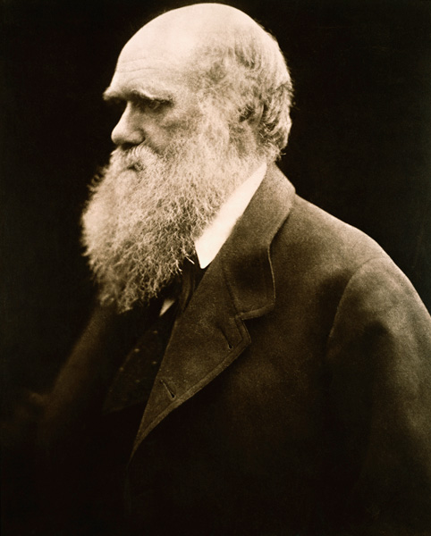


Neo-Darwinian Evolution Versus Biblical Faith
(Intelligent Design and Noah’s Worldwide Flood)

Slide 2

“Every house is built by someone, but He who builds all things is God.” - Heb. 3:4
2
Notes:
2

Slide 3
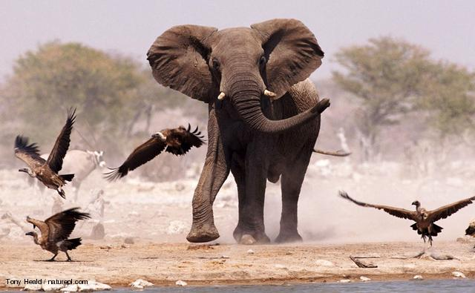
“In the beginning was the Word [Jesus], and the Word [Jesus] was with God, and the Word [Jesus] was God. He [Jesus] was in the beginning with God. All things came into being through Him [Jesus], and apart from Him [Jesus], nothing came into being that has come into being.” - Jn. 1:1-3
3
Notes:
3

Slide 4


Slide 5
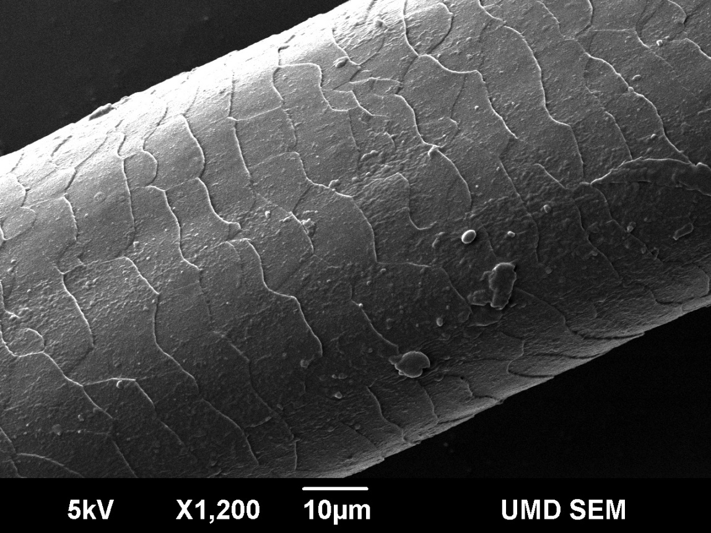

Slide 6


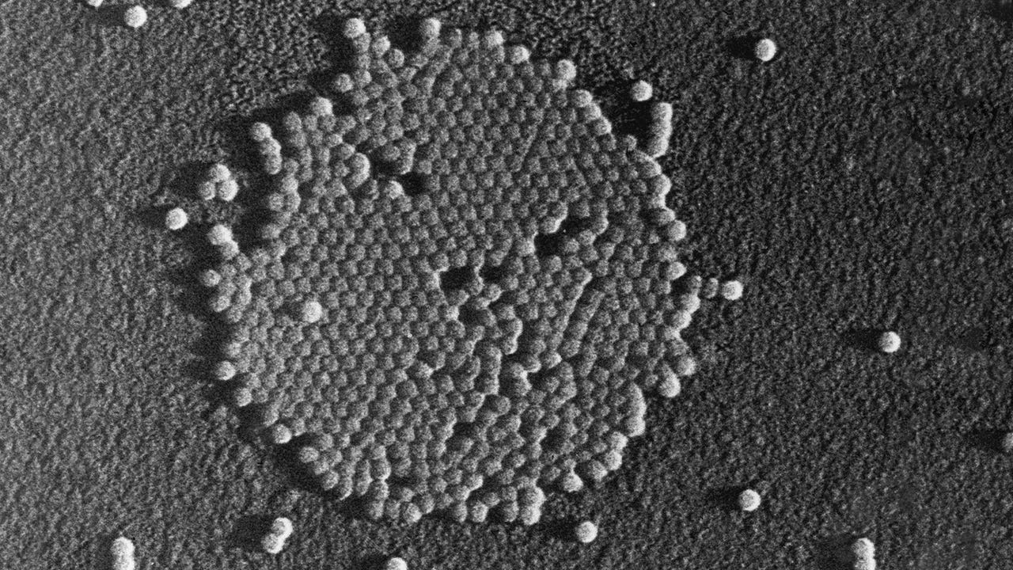

Slide 8
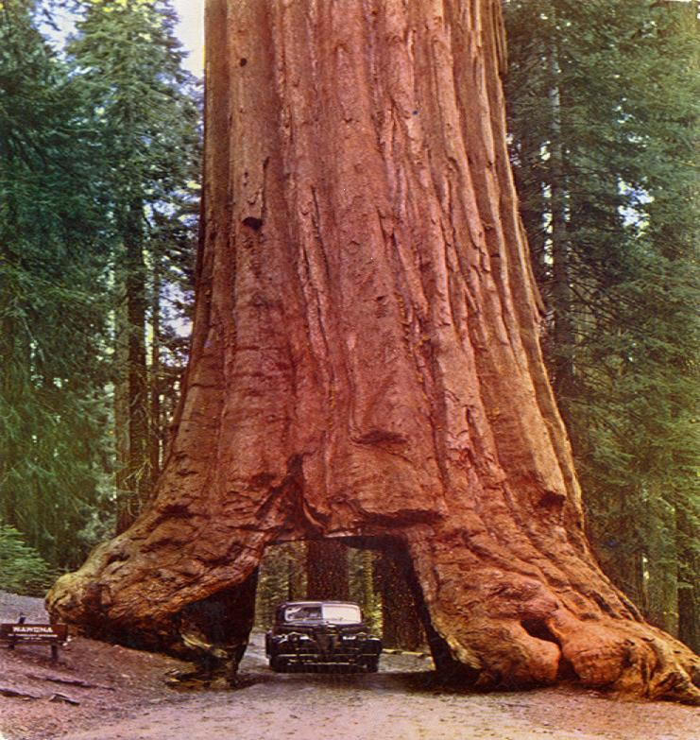
California Redwoods: Up to 379 feet high
Giant Redwood

Slide 9
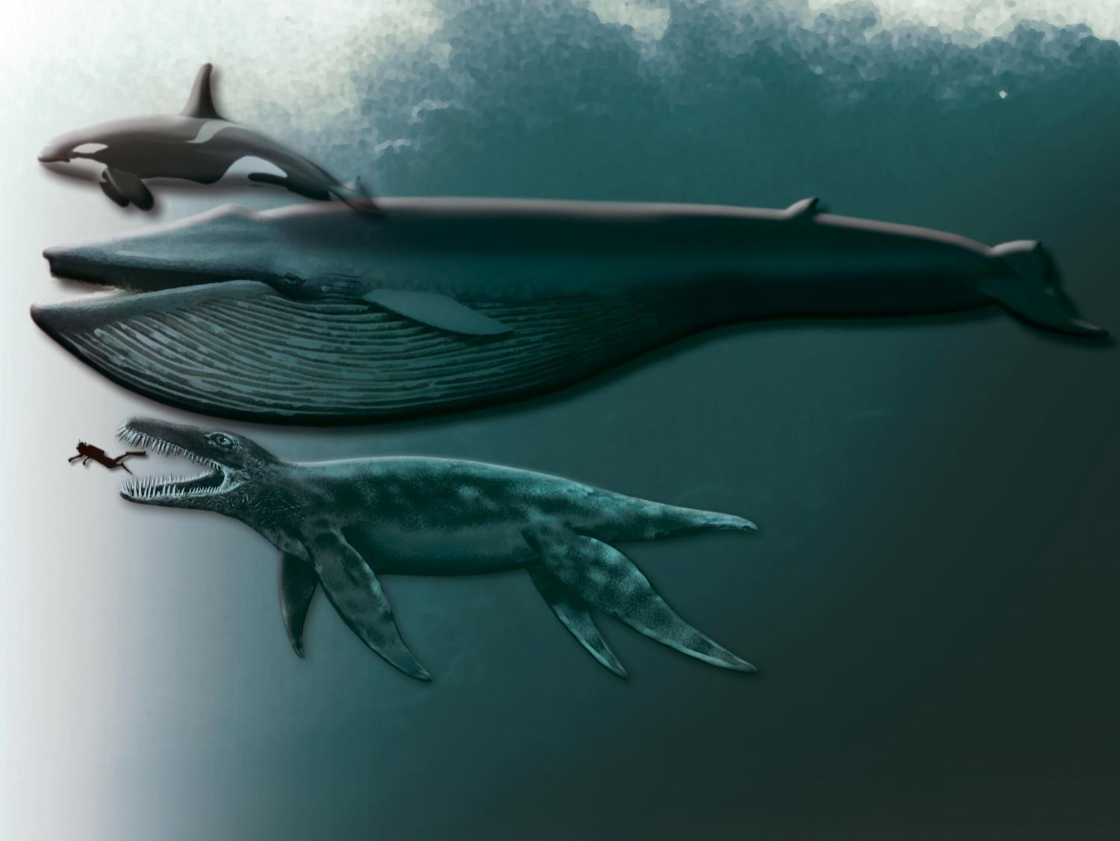

Slide 10
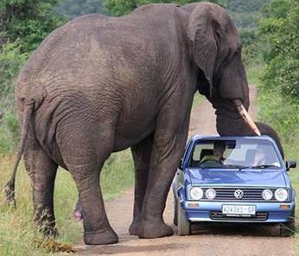

Slide 11
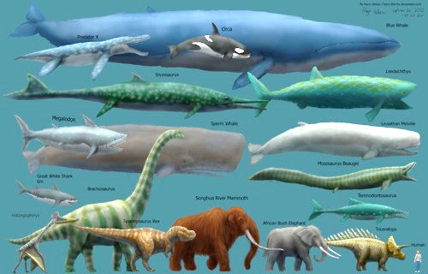

Slide 13
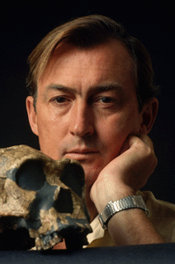
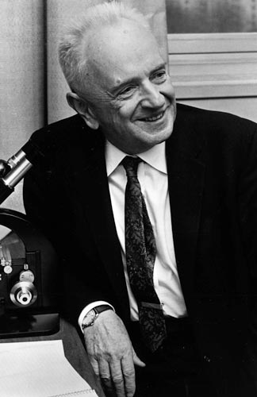
The Supposed Evolution of Man was 100% Accidental
“In many ways we are a biological accident, the product of countless propitious circumstances.” - Dr. Richard Leakey Co-author with Roger Lewin. Origins: What New Discoveries Reveal about the Emergence of our Species and its Posszible Future (1977), p. 256.
“Man was not programmed in biological evolution, because evolution has no program. In one sense, man, Drosophila, and all other forms of life are evolutionary accidents.” - Dr. Theodosius Dobzhansky, (Evolutionary Geneticist) “Evolution at Work,” Science (May 9, 1958), p. 1091

Slide 14

Dr. Michael Denton (1985)
Agnostic M.D., Ph.D. Biochemist
 | - Michael Denton, M.D. & Ph.D., Molecular Biology. Evolution: A Theory in Crisis Adler and Adler, 1985, p. 358

Slide 15

Modern Intelligent Design
Movement
Initiated by Dr. Phillip Johnson of U.C. Berkley (1991)
Centered in the Discovery Institute, Seattle, WA

Slide 16

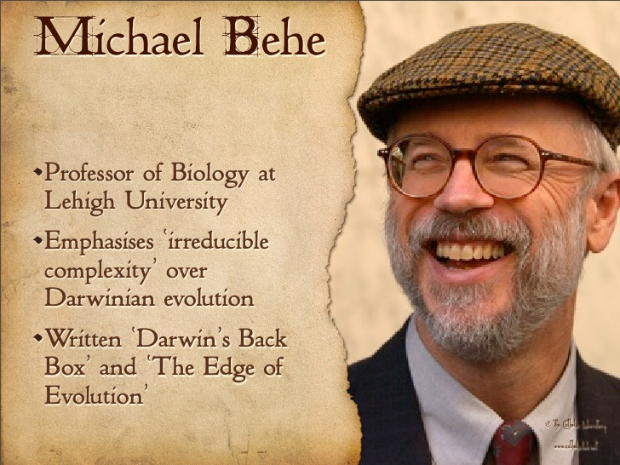
I. Irreducible Complexity

Slide 17
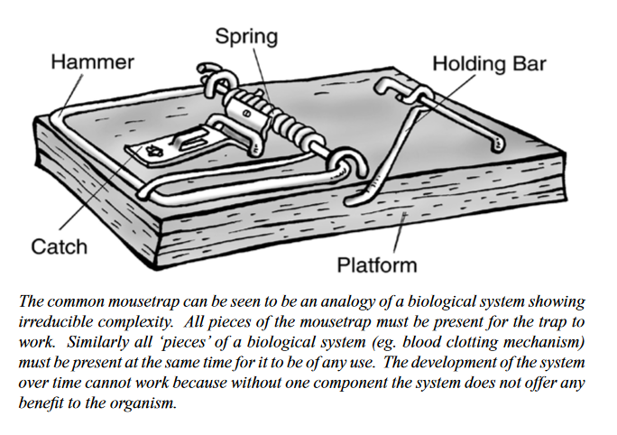
“Irreducibly Complex” Mousetrap
https://creation.com/images/pdfs/tj/j16_3/j16_3_32-39.pdf

Slide 18

“Irreducibly Complex” Blood Clotting Cascade
(13 Blood Clotting Factors)

Slide 19

Blood Clotting Required for Animal Life
But an Animal is Required for Blood Clotting to Occur
Irreducibly Complex. Both Must Have Been Created Simultaneously

Slide 20


Slide 21


Slide 22


Slide 23
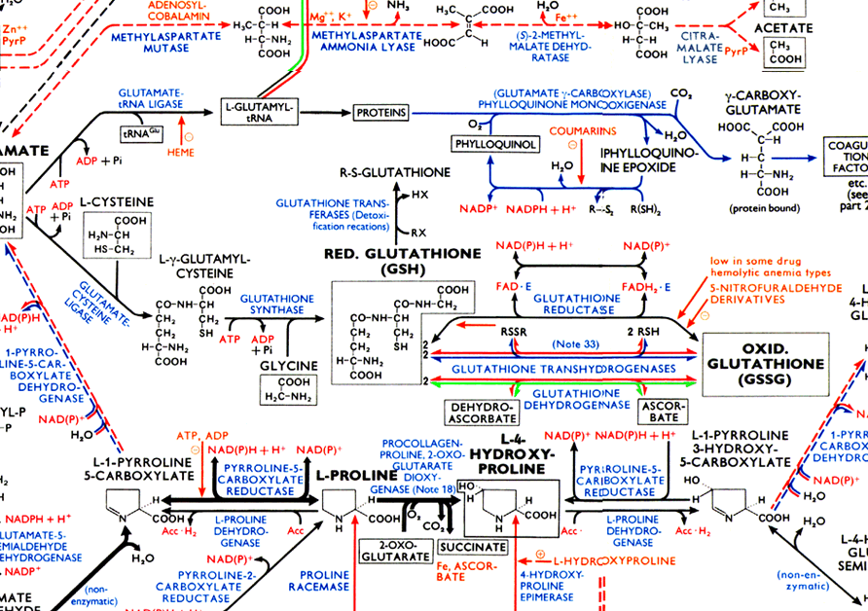

Slide 24
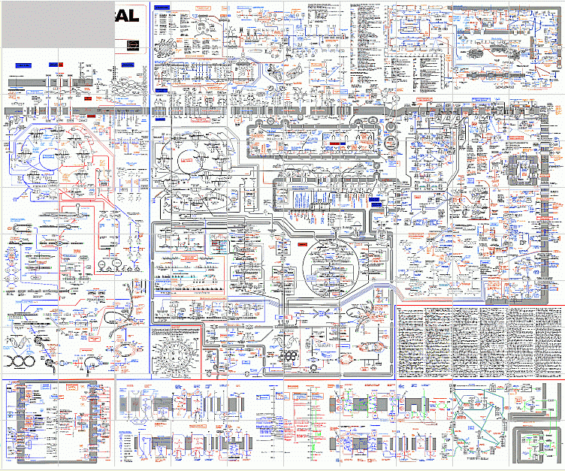

Slide 25
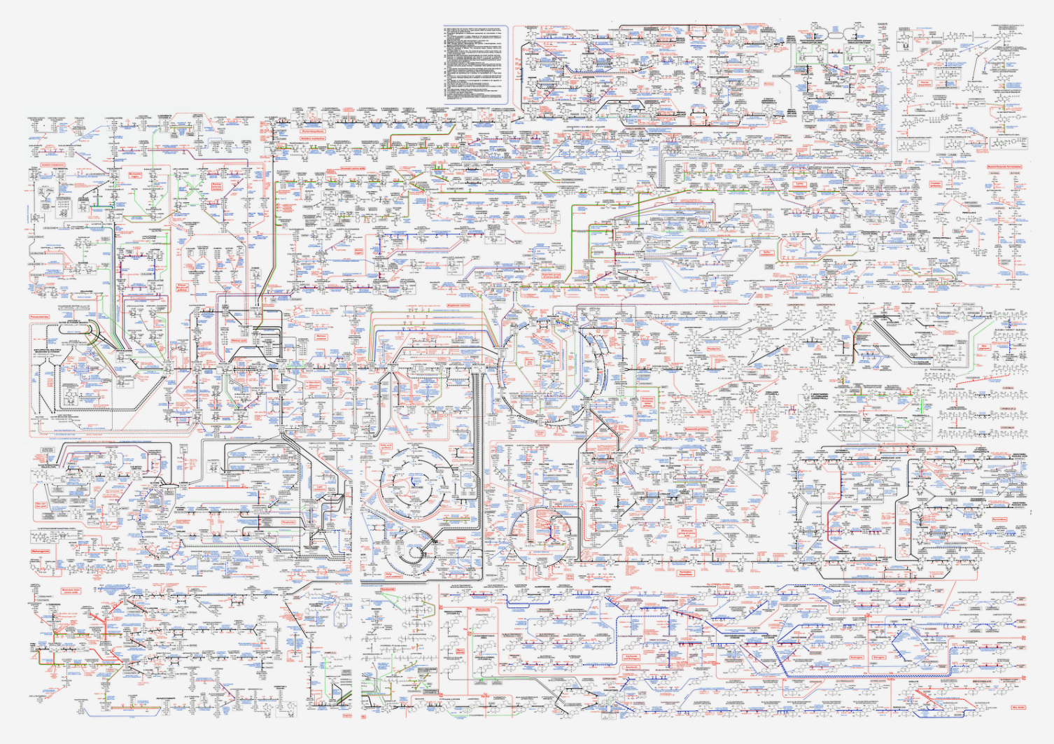
Biochemistry of a single cell in the human body.

Slide 26
The DNA in each cell incurs up to one million lesions of damage per cell per day, which is repaired by the cell.

Slide 27
The DNA in each cell incurs up to one million lesions of damage per cell per day, which is repaired by the cell.
32.7 trillion cells x 1 million lesions = 32.7 quintillion repairs per day
= 3.27 x 10¹⁹
= 32,700,000,000,000,000,000 DNA repairs in
the body per day.

Slide 28


Repair Mechanism Required for Functional DNA
BUT, Functional DNA Required to Code for Repair Mechanism
Irreducibly Complex. Both Must Have Been Created Simultaneously

Slide 29

“We should reject as a matter of principle the substitution of intelligent design for the dialogue of chance and necessity; but we must concede that there are presently no detailed Darwinian accounts of the evolution of any biochemical or cellular system, only a variety of wishful speculations.”
- Franklin M. Harold (Professor Emeritus Biochemistry, Colorado State University) The way of the cell: molecules, organisms and the order of life, Oxford University Press, New York, 2001, p. 205

Slide 30
Now, Who are the Ones Relying on Faith and Not Science?

Slide 31
Point I Summary
Intelligent Design is Required for Irreducibly Complex Systems

Slide 32


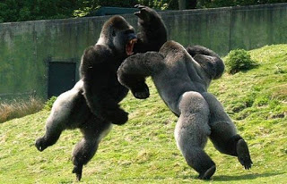
The philosophy that all life on earth gradually evolved from a single-celled organism by means of (1) random mutations (purely accidental) and (2) natural selection (i.e., survival of the fittest). AKA, “particles to people” or “molecules to man.”
What is Evolution?
(AKA, Macroevolution, Neo-Darwinism or The General Theory of Evolution)

Slide 33
The philosophy that all life on earth gradually evolved from a single-celled organism by means of (1) random mutations (purely accidental) and (2) natural selection (i.e., survival of the fittest). AKA, “particles to people” or “molecules to man.”
What is Evolution?
(AKA, Macroevolution, Naturalistic Evolution, Neo-Darwinism or The General Theory of Evolution)

Slide 34

II. The Cambrian Explosion
Principle: Every major animal phyla appears in the Cambrian layer
All major phyla supposedly evolved within the first 2% of the fossil record
Apologetics Press

Slide 35
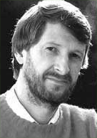
". . . the Cambrian explosion established virtually all the major animal body forms—Baupläne or phyla—that would exist thereafter."
- Roger Lewin, “A Lopsided Look at Evolution,” 1988, Science, 241:291-293.

Slide 36

". . . the problem of the Cambrian explosion has not receded, since our more extensive labor has still failed to identify any creature that might serve as a plausible immediate ancestor for the Cambrian faunas. . . Where, then, are all the Precambrian ancestors. . . ?"
-Stephen J. Gould, “A Short Way to Big Ends,” 1986, Natural History, 95:18-28.

Slide 37

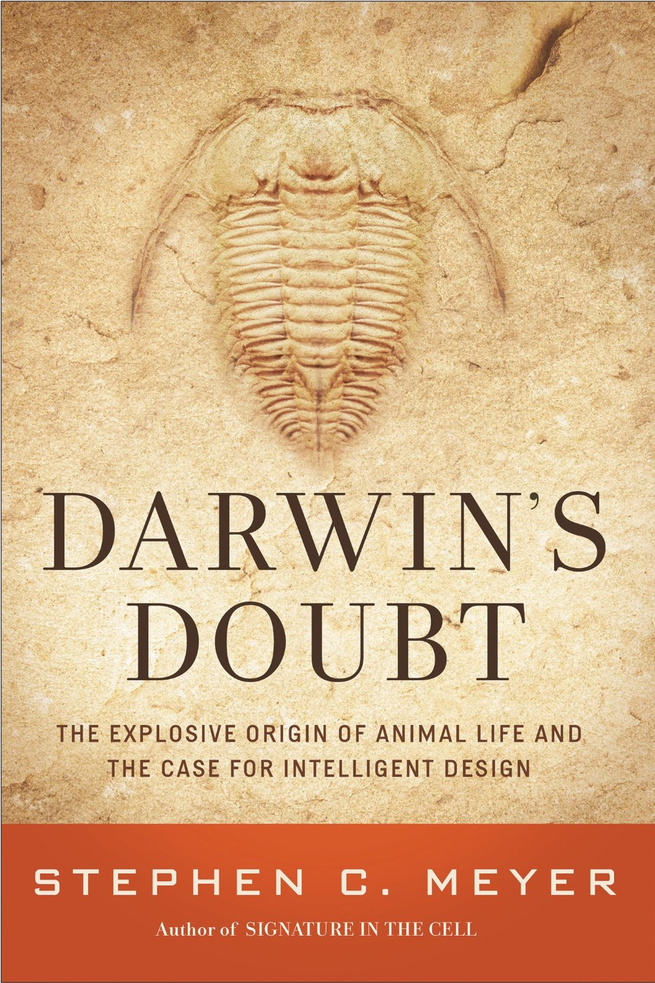

Slide 38
Point II Summary
The Cambrian Explosion Demonstrates Evidence for an Intelligent Designer

Slide 39

So, Why Is An Analysis of Neo-Darwinian Evolution Important?
39
Notes:
39

Slide 40
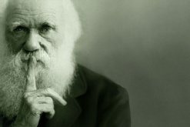
III. Macroevolution Can Undermine Christian Faith Because it Provides a Perceived Alternative to Creation

Slide 41

Can Darwinian Evolution Destroy Faith in God?
Notes:
41

Slide 42
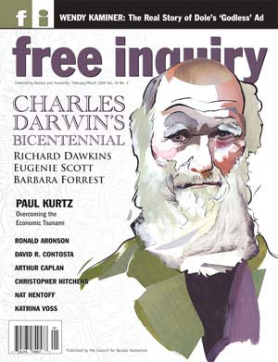

“Evolution thus becomes the most potent weapon for destroying the Christian faith.”
- A.J. Mattill Jr., “Three Cheers for the Creationists,” Free Inquiry, vol. 2 (Spring 1982)

Slide 43

Young Adults Who Lost Their Faith Because of Macroevolution
Notes:
43

Slide 44
Young Adults Who Lost Their Faith Because of Macroevolution
Young couple in South
(+ 2 more children: JW and W sons)
Christian Girl at Auburn University
Young preacher
Christian, college student in Oregon
Notes:
44

Slide 45

Examples of Famous Believers Who Became Atheists Because of Evolution
Notes:
45

Slide 46
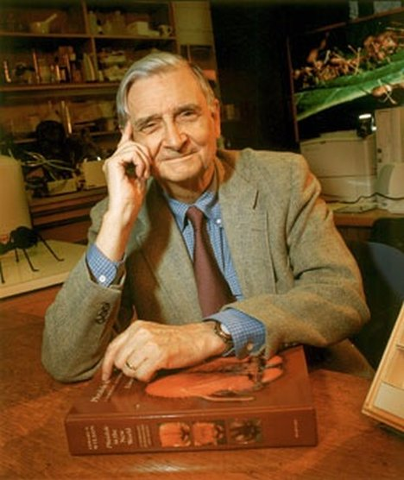

Atheist #1
E.O. Wilson, Harvard University
46
Notes:
46

Slide 47
“As were many persons from Alabama, I was a born-again Christian. When I was fifteen, I entered the Southern Baptist Church with great fervor and interest in the fundamentalist religion; I left at seventeen when I got to the University of Alabama and heard about evolutionary theory”
- E.O. Wilson, The Humanist, Vol 42, Sept/Oct, 1982, p. 40.
Atheist #1

Slide 48
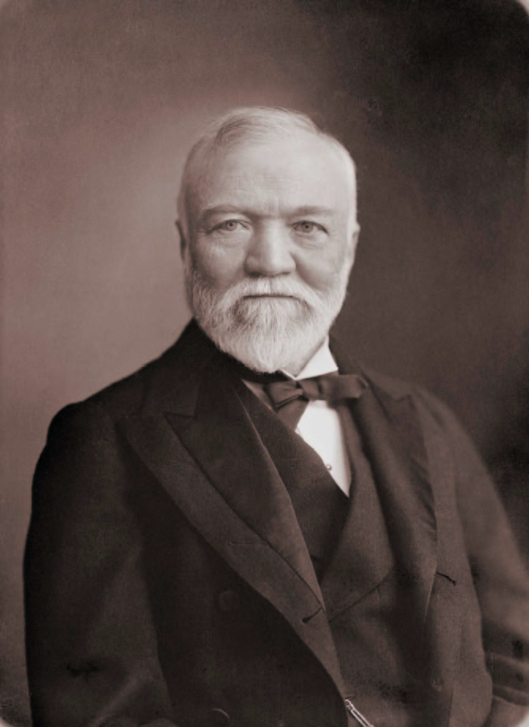
“I remember that light came in as a flood and all was clear. Not only had I got rid of theology and the supernatural but I found the truth of evolution.”
- Andrew Carnegie, Autobiography (Boston: 1920), cited in Social Darwinism in American Thought, by Richard Hofstadter (Boston: Beacon Press, 1955)
Agnostic #2
48
See Philosopedia.com for more information
Notes:
48

Slide 49

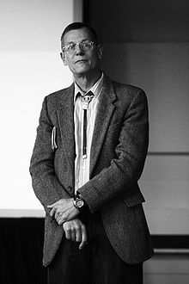


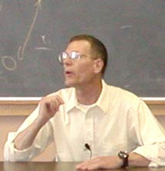
William B. Provine, Cornell University
Converted to Atheism via Darwinian Evolution
Atheist #3
49

Slide 50


Slide 51
William B. Provine, Cornell University
Converted to Atheism via Darwinian Evolution
Atheist #3
51

Slide 52
William B. Provine, Cornell University
Converted to Atheism via Darwinian Evolution
Atheist #3
1942 - 2015
52

Slide 53

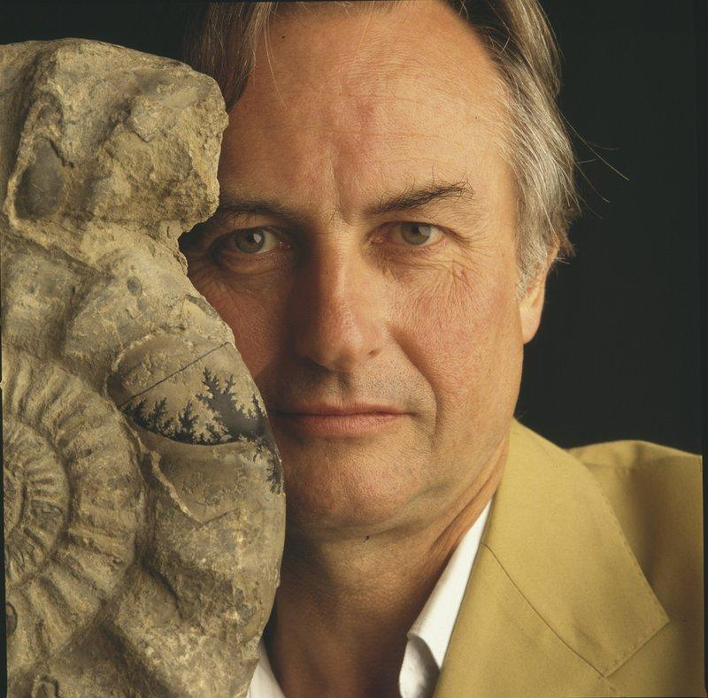

Richard Dawkins
Became and Atheist via Neo-Darwinian Evolution
Atheist #4
53

Slide 54
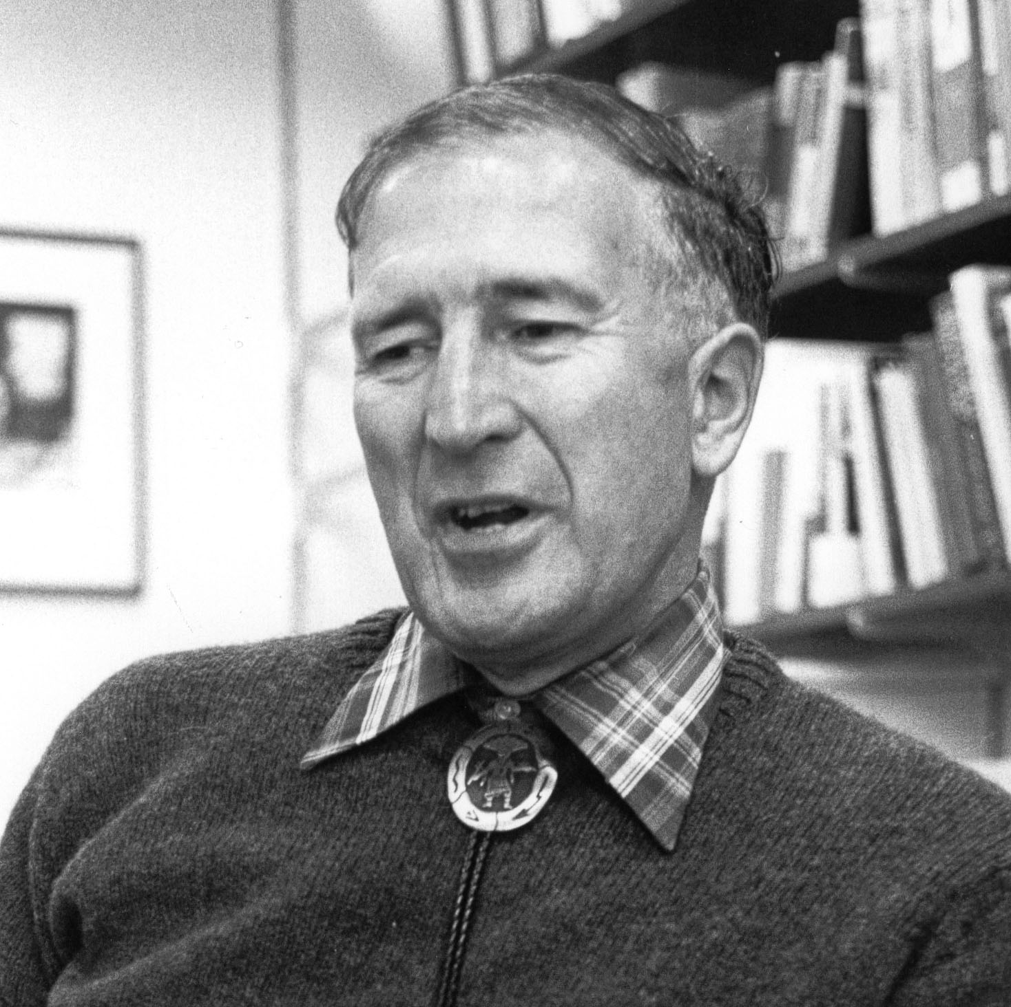

Slide 55

Thomas B. Warren; Professor @ Harding, Freed-Hardeman; Abilene Christian University; Tennessee Bible College; Forth Worth Christian College

Slide 56


Slide 57

IV. Belief in Macroevolution Can
Erode Morality
57
Notes:
57

Slide 58

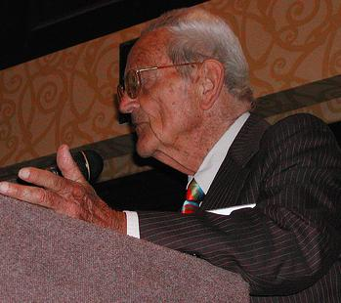
“Morality needs no supernatural sanctions or motivations. It is not heaven-sent; it is human-evolved. . . In the coming planetary civilization of a world-embracing humanism, those ‘religions’ that obstruct social advance must be sub-ordinated. In the world of scientific humanism, religion will be obsolete"
- Lloyd Morain, and Oliver Reiser, “Scientific Humanism: A Formulation,” The Humanist, vol. 48 (Sept./Oct. 1988)
*NOTE: Morrain helped found the Am. Human. Assoc., two-time president; Reiser is Prof. Organic chemistry, Univ. Regensburg, Germany

Slide 59

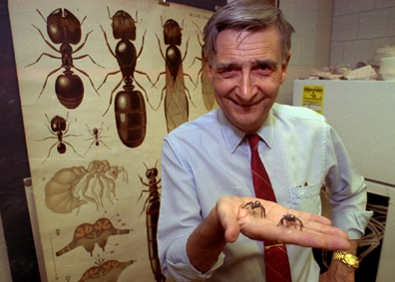
"The time has come to take seriously the fact that we humans are modified monkeys, not the favored Creation of a Benevolent God. . . We must think again especially about our so-called ‘ethical principles. . . As evolutionists we see that no (ethical) justification of the traditional kind is possible. . . In an important sense, ethics as we understand it is an illusion.”
- Michael Ruse and E.O. Wilson,
"The Evolution of Ethics", in
Religion and the Natural Sciences:
The Range of Engagement, comp.
James E. Huchingson, 1993.

Slide 60


Slide 61


Slide 62



Pekka-Eric Auvinen, Nov. 7, 2007, Killed 8 People and then himself at Jokela High School, Finland. Auvinen wrote: “I, as a natural selector, will eliminate all who I see unfit, disgraces of human race and failures of natural selection.”

Slide 63

Our Goal Isn’t Only to Disprove Evolution
But to Build Faith in the Lord Jesus
Notes:
63

Slide 64
What Have We Accomplished If We Convert the Whole World into Creationists Who Still Don’t Believe in Jesus?
ANSWER: Not Much
64
Notes:
64

Slide 65
What Have We Accomplished If We Convert the Whole World into Creationists Who Still Don’t Believe in Jesus?
ANSWER: Not Much
“. . . these times of ignorance God overlooked, but now commands all men everywhere to repent.” - Acts 17:30
“. . . the Lord Jesus is revealed from heaven with His mighty angels in flaming fire, taking vengeance on those who do not know God, and on those who obey not the gospel of our Lord Jesus Christ.” - II Thess. 1:7,8
“at the name of Jesus every knee should bow. . . and that every tongue should confess that Jesus Christ is Lord . . .” - Phil. 2:10,11
65
Notes:
65

Slide 66

“And there is salvation in no one else, for there is no other name under heaven given among men by which we must be saved.” - Acts 4:12
Spiral Galaxy NGC 1232
66
Notes:
66

Slide 67



You Must Decide: Is Your Faith Rooted in Fallible Anti-Biblical Science (Philosophy), or in the Infallible Word of God and Intelligent Design which Supports Valid Operational Science
OR
67
Notes:
67

Slide 68
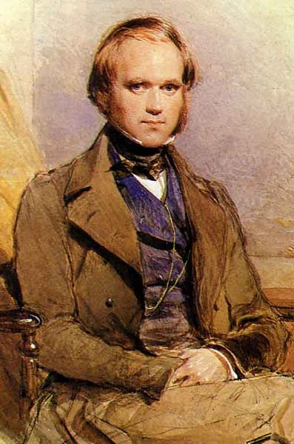
V. Charles Darwin Once Had Faith in the God of the Bible
How Did He Lose It?

Slide 69
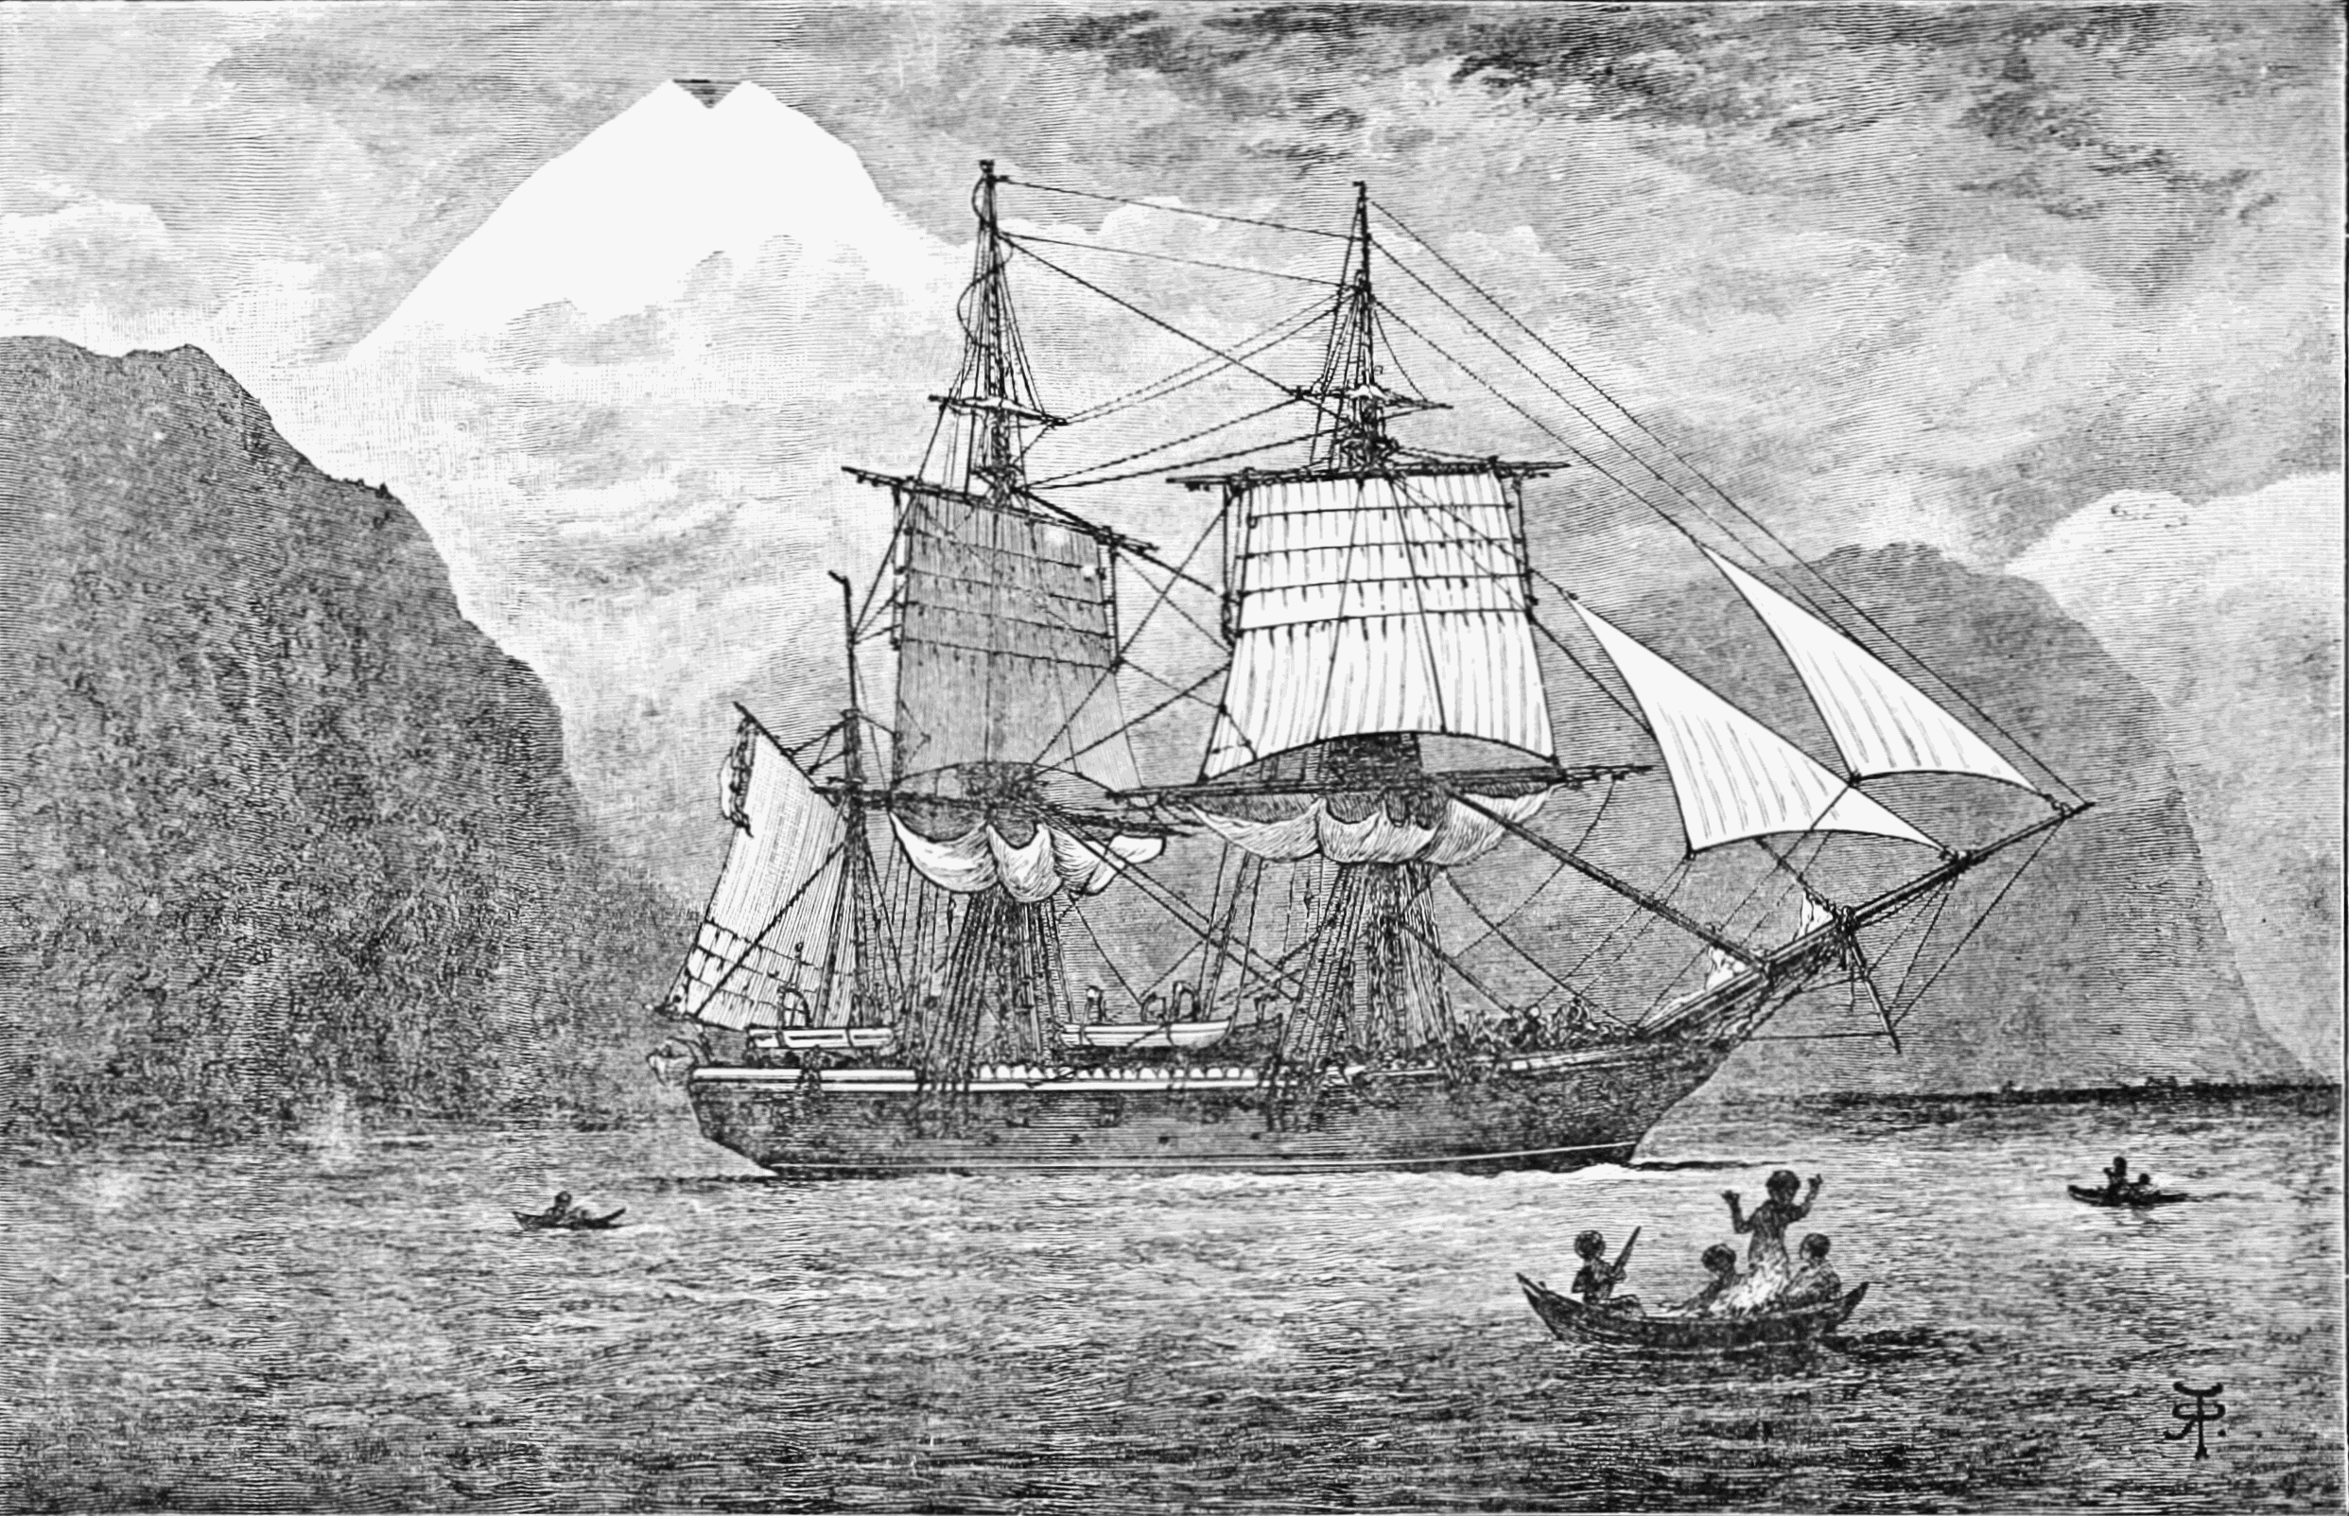
HMS Beagle - 1831

Slide 70
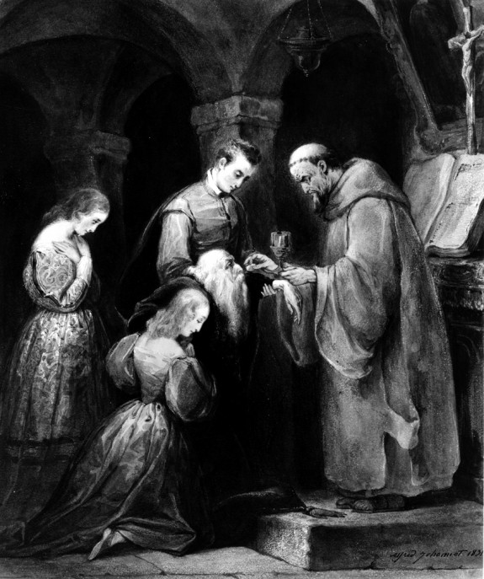

Slide 71

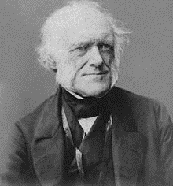
HMS Beagle - 1831
Lyell’s Principles of Geology
Charles Lyell

Slide 72
"During these two years I was led to think much about religion. Whilst on board the Beagle I was quite orthodox, & I remember being heartily laughed at by several of the officers (though themselves orthodox) for quoting the Bible as an unanswerable authority on some point of morality. I suppose it was the novelty of the argument that amused them. But I had gradually come, by this time, to see that the Old Testament from its manifestly false history of the world, with the Tower of Babel, rainbow as a sign, etc., etc., and from its attributing to God the feelings of a revengeful tyrant, was no more to be trusted than the sacred books of the Hindoos, or the beliefs of any barbarian.“
- Darwin, Charles (1958), Barlow, Nora, ed., The Autobiography of
Charles Darwin 1809–1882. p.85. With the original omissions restored.
Edited and with appendix and notes by his granddaughter Nora Barlow,
London: Collins
V. How Did Darwin Lose His Faith?

Slide 73
Answer:
By Shifting His Faith from the Word of God to Faith in Fallible Human Reasoning

Slide 74
VI. A History of Modernism vs. The Global Flood
Late-enlightenment, 18th century, western Europe shifted from orthodox Biblical (or Catholic/Protestant) based belief systems (aka, “Christendom”) to humanism, based on modernism, liberal Biblical criticism, and atheism, emanating out of German schools of thought

Slide 75
18th Century Modernist Agenda
Undermine authority of “the church”
Thus, undermine the authenticity (authority) of the Bible (viz., accuracy, authorship, transmission, preservation, etc.)
Thus, undermine the authority of God and morality
Thus, undermine the existence of God
Thus, undermine divine creation
What was the ultimate goal? To replace theism with humanism by shifting faith from scripture to pop science

Slide 76
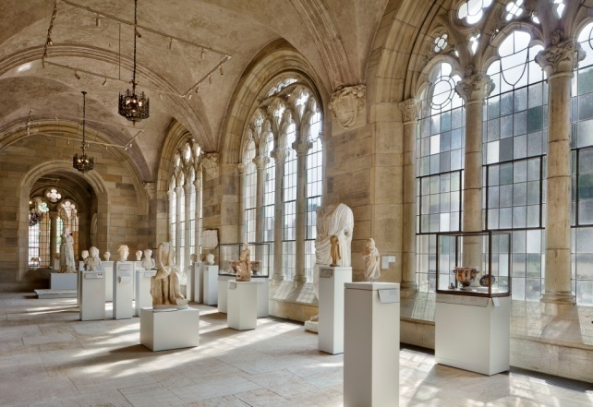
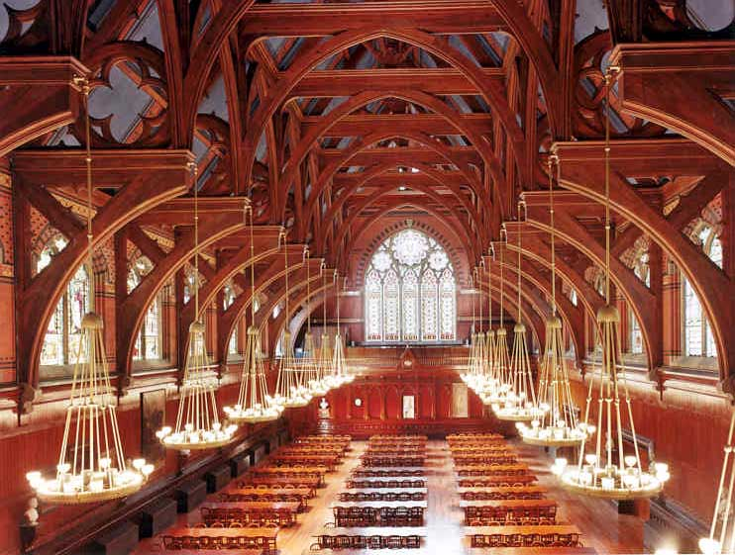
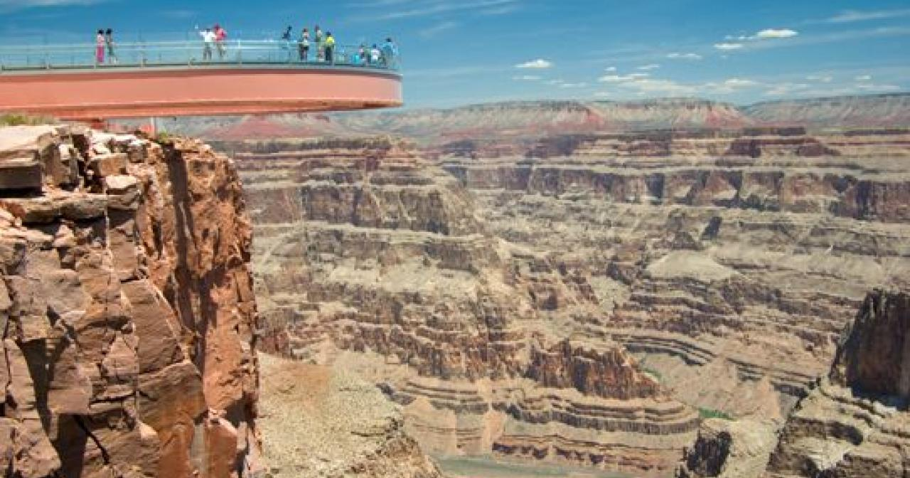
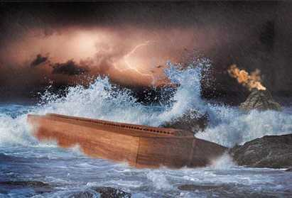


Until ca. 1800, all geological formations were interpreted as a result of the global flood and catastrophic activities in western universities such as Yale, Harvard, Oxford and Cambridge
76
Notes:
76

Slide 77
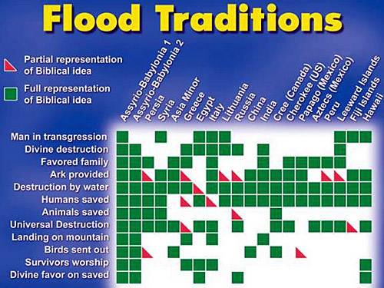

Slide 78


Slide 79
Athabascan Flood Legend
A very, very long time ago, giant animals lived in the world and there was no such thing as mankind. They were all big and could talk to each other and use magic. There were even some animals which no longer live on earth. One day Dotson' Sa, Great Raven, said to Raven, "Make a large raft."
So Raven made a large boat. It took a long time because it had to be very big. When Raven was finished, Dotson' Sa told him it wasn't big enough.
"You must build it bigger." he said.
When it was finished, it began to rain. At first it rained only a little and Dotson' Sa instructed Raven to gather all of the animals in pairs. Raven gathered the animals and food for them. It was very difficult but he did it anyhow.
Once all of the animals were on the raft, it started to rain very hard. The whole world was soon flooded and only those animals on the raft were left in the world.
When it stopped raining Raven asked some seagulls to fly in every direction in search of land. They flew away and returned saying how there was no land in sight. There was only water!
After a while the flood was almost gone. Raven told Muskrat to swim down to the ocean floor to make an island. The muskrat, who was really quite large, dived down and started piling up the mud from the bottom. He kept this up until land appeared.
Dotson' Sa used his magic and made berries, trees, and plants to cover the land. When he had done this, lakes and ponds were left where there had been low spots in the land. Next, Great Raven made rivers. He made them so that they flowed both ways! On one side the river ran down to the sea, and on the other it flowed up towards the mountains!
Later, though, he decided that it was too easy to travel and so he made it so that rivers only went down to the sea.
Now that the flood was gone and there was land, Dotson' Sa decided to make man. He created him from stone but because he was made of rock, man would never die and so Great Raven decided to make him from clay instead. - Dotson' Sa, Great Raven Makes The World
“And the Lord God formed man of the dust (APHAR) of the ground” - Gen. 2:7

Slide 80
Athabascan Flood Legend
A very, very long time ago, giant animals lived in the world and there was no such thing as mankind. They were all big and could talk to each other and use magic. There were even some animals which no longer live on earth. One day Dotson' Sa, Great Raven, said to Raven, "Make a large raft."
So Raven made a large boat. It took a long time because it had to be very big. When Raven was finished, Dotson' Sa told him it wasn't big enough.
"You must build it bigger." he said.
When it was finished, it began to rain. At first it rained only a little and Dotson' Sa instructed Raven to gather all of the animals in pairs. Raven gathered the animals and food for them. It was very difficult but he did it anyhow.
Once all of the animals were on the raft, it started to rain very hard. The whole world was soon flooded and only those animals on the raft were left in the world.
When it stopped raining Raven asked some seagulls to fly in every direction in search of land. They flew away and returned saying how there was no land in sight. There was only water!
After a while the flood was almost gone. Raven told Muskrat to swim down to the ocean floor to make an island. The muskrat, who was really quite large, dived down and started piling up the mud from the bottom. He kept this up until land appeared.
Dotson' Sa used his magic and made berries, trees, and plants to cover the land. When he had done this, lakes and ponds were left where there had been low spots in the land. Next, Great Raven made rivers. He made them so that they flowed both ways! On one side the river ran down to the sea, and on the other it flowed up towards the mountains!
Later, though, he decided that it was too easy to travel and so he made it so that rivers only went down to the sea.
Now that the flood was gone and there was land, Dotson' Sa decided to make man. He created him from stone but because he was made of rock, man would never die and so Great Raven decided to make him from clay instead. - Dotson' Sa, Great Raven Makes The World
“And the Lord God formed man of the dust (APHAR) of the ground” - Gen. 2:7
APHAR = “Clay, earth, mud” – Strong’s
5 Versions = Soil/Earth
- Catholic Public Domain Translation = Clay

Slide 81



Slide 82
How Was Destruction of Biblical Faith in the Global Flood Accomplished?
1. The doctrine of uniformitarianism (Slow and gradual, slow and gradual, slow and gradual)

Slide 83
What Is Uniformitarianism?
1. “The present is the key to understanding the past.”
2. “Natural events transpiring today occurred just like this in the past in the creation of the geological strata.”
3.“All geologic formations from the mountains, to the layers of rock layers, to coal and oil deposits evolved slowly over millions of years of gradual sedimentary deposition.”

Slide 84
"Know this first of all, that in the last days mockers will come with their mocking, following after their own lusts, 4and saying, “Where is the promise of His coming? For ever since the fathers fell asleep, all continues just as it was from the beginning of creation.” 5For when they maintain this, it escapes their notice that (#1) by the word of God the heavens existed long ago and the earth was formed out of water and by water, (#2) through which the world at that time was destroyed, being flooded with water. 7But by His word the present heavens and earth are being reserved for fire, kept for the day of judgment and destruction of ungodly men. 8But do not let this one fact escape your notice, beloved, that with the Lord one day is like a thousand years, and a thousand years like one.” - II Pet. 3:3-8
84
Notes:
84

Slide 85

500 feet x 12 inches /0.5 inches x 100 year = 1.2 MY Old

Slide 86
#1. Knife-Edged Boundaries

Slide 87
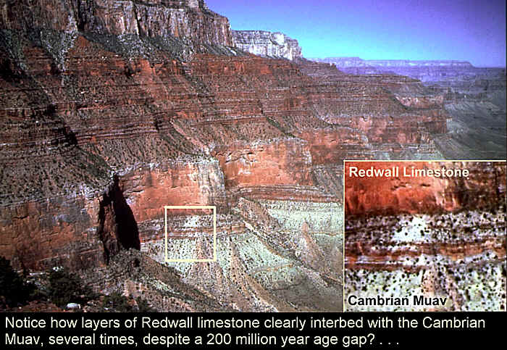
#2. Pseudoconformities
“Older” Layers on Top of “Younger”
Credit: Sean Pitman DetectingDesign.com
Redwall and Muav Limestone at least 165 million years older.

Slide 88
#2. Pseudoconformities
“Older” Layers on Top of “Younger”
Credit: Sean Pitman DetectingDesign.com
Redwall interbedded with Muav at least seven times, despite supposedly being at least 165 million years older.(?)

Slide 89
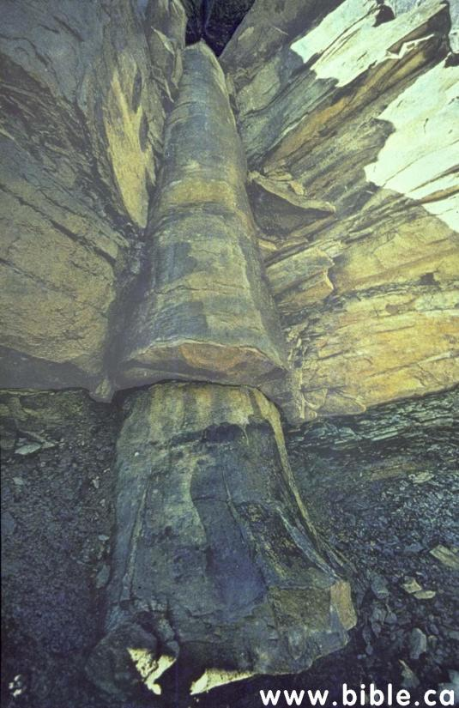
#3. Uniformitarianism also Disproven by Polystrate Fossils
Kettles coal mines near Cookville, TN
89
Notes:
89

Slide 90
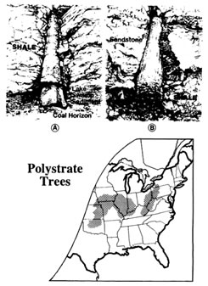
90
Gary Parker

Slide 91
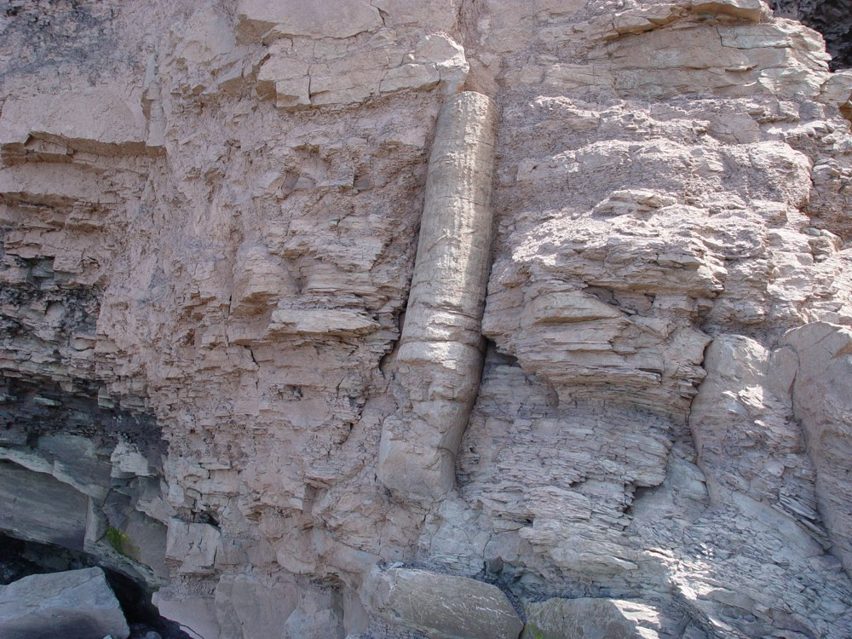
Slide Credit – Aaron Beard

Slide 92
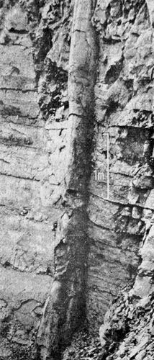
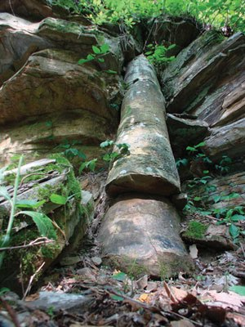
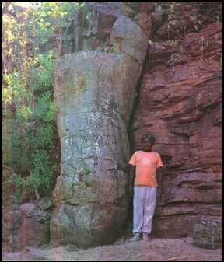
Slide Credit – Aaron Beard

Slide 93
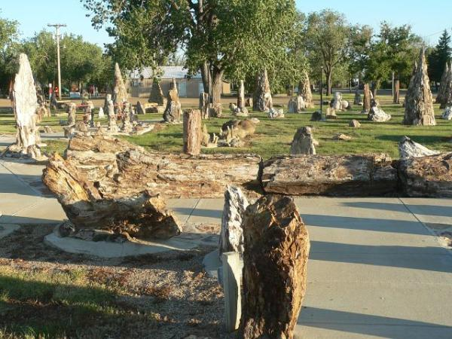
Yellowstone Petrified Forest
What Phenomenon Created Petrified Forests?
93

Slide 94
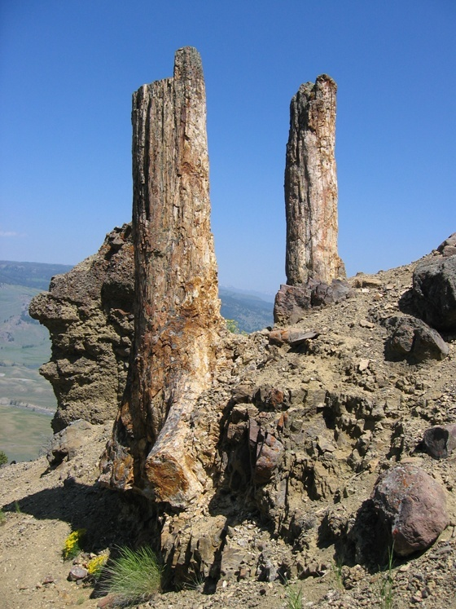
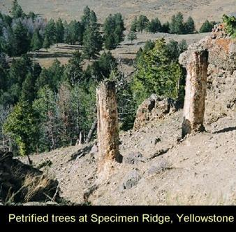
Yellowstone Petrified Forest
What Phenomenon Creates Petrified Forests?
http://petrifiedwoodmuseum.org/Images/SpecimenRidgeTour/SpecRidgeViney1.jpeg
94
Sean Pitman DetectingDesign.com

Slide 95

Mt. St. Helens – May 18, 1980 – 300 mph Gaseous Explosion
24 megatons of TNT = 1,000 Fat Man Bombs Dropped in Nagasaki

Slide 96


Slide 97
Mt. St. Helens – May 18, 1980 – 300 mph Gaseous Explosion
24 megatons of TNT = 1,000 Fat Man Bombs Dropped in Nagasaki

Slide 98
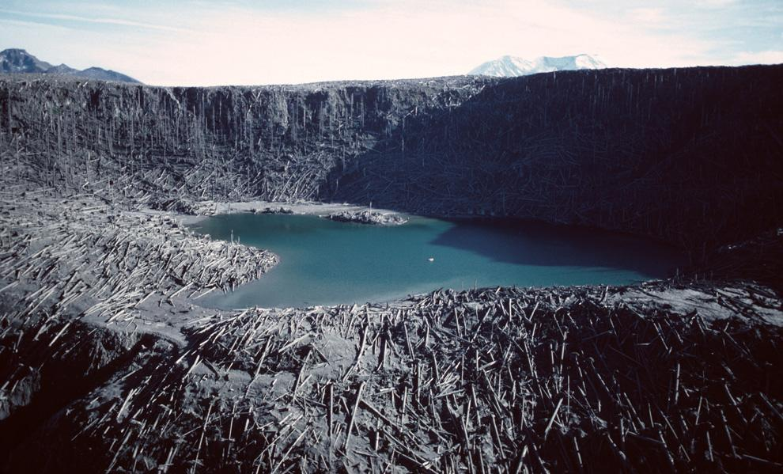
Millions of Trees Were Leveled in the Eruption
USGS
Notes:
98

Slide 99
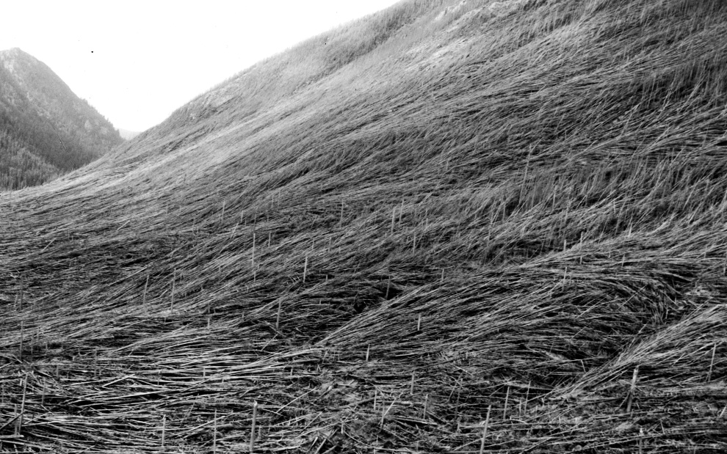
Millions of Trees Were Leveled in the Eruption
USGS
Notes:
99

Slide 100
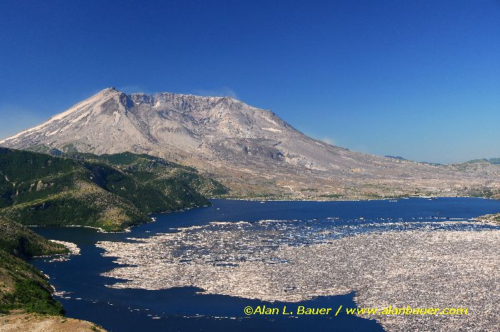
Floating Log Mat Would Move From One Side of Lake to the Other in 2 Hours Time
Notes:
100

Slide 101

Ca. 1 Million Logs Floating on Spirit Lake After the Eruption
101

Slide 102

Waterlogged Trees Sink at Different Times Over a Few Months/Years, Thus Affixed in Different Sedimentary Strata
Notes:
102

Slide 103


Trees Floating upright in Spirit Lake
Steve Austin Recorded 20,000 Logs That Sunk to the Bottom and Were Buried Upright by 1985
Steve Austin
Sean Pitman DetectingDesign.com
Notes:
103

Slide 104

Creationists Solved the Puzzle of the
Polystrate Fossil Trees
Answers In Genesis
Explains why Petrified Trees in one formation are (1) Buried at Different Layers, and (2) Always Appear to have their Roots Torn Away
Notes:
104

Slide 105
Yellowstone Petrified Forest
What Phenomenon Creates Petrified Forests?
http://petrifiedwoodmuseum.org/Images/SpecimenRidgeTour/SpecRidgeViney1.jpeg
105
Sean Pitman DetectingDesign.com

Slide 106


Slide 107


Slide 108


Slide 109


Slide 110


Slide 111


Slide 112


Slide 114



C¹⁴ in Coal Should have Disappeared 30-300 Million years ago
Notes:
114

Slide 116
"17Then the flood came upon the earth for forty days, and the water increased and lifted up the ark, so that it rose above the earth. . .19The water prevailed more and more upon the earth, so that all the high mountains everywhere under the heavens were covered. . . 21All flesh that moved on the earth perished, . . . and all mankind. . . 23Thus He blotted out every living thing that was upon the face of the land, from man to animals to creeping things and to birds of the sky, and they were blotted out from the earth; and only Noah was left, together with those that were with him in the ark. 24The water prevailed upon the earth one hundred and fifty days.” - Gen 7:17-24
116
Notes:
116

Slide 117

Update: Secular Geologists Have Changed Their
Minds Again
The Geologic Column Is Now Considered to be a Result of Catastrophism – “Neo-Catastrophism”
HOWEVER, No apologies will be made to the creationist geologists who have been ridiculed in the last 200 years
Notes:
117

Slide 118

“To me, the whole record is catastrophic, not in the old-fashioned apocalyptic sense . . . but in the sense that only the episodic events—the occasional ones—are preserved for us.”
- Derek V. Ager, “The Stratigraphic Code and What It Implies,” in Catastrophes and Earth History, p. 93, 1984.
NOTE: (1) The entire geologic column is admittedly the result of flood waters – from the bottom to the top it is composed of oceanic marine invertebrate fossils (e.g., clams, nautiloids, brachiopods, etc.). (2) 25’ of finely layered sediment deposited at Mt. St. Helens in 1 day = 1 mile in ca. 7 mos.
118
Notes:
118

Slide 119


#1. Shinarump Conglomerate
60-135’ Thick
Covering 100,000 square miles
From a watery slurry of sand, pebbles, rocks, logs
https://answersingenesis.org/geology/basic-geology-disproves-creationism/

Slide 120

#1. Shinarump Conglomerate
60-135’ Thick
Covering 100,000 square miles
From a watery slurry of sand, pebbles, rocks, logs

Slide 121

#1. Shinarump Conglomerate
60-135’ Thick
Covering 100,000 square miles
From a watery slurry of sand, pebbles, rocks, logs

Slide 122

#2. Tapeats Sandstone
Marine sedimentary deposits with large boulders, washed in place
235’ thick, composing most of North America
Equivalents found all around the world by different names

Slide 123
#2. Tapeats Sandstone
Marine sedimentary deposits with large boulders, washed in place
235’ thick, composing most of North America
Equivalents found all around the world by different names
V = ⁴⁄₃πr³.
V= 4/3 π 7.5³
V= 1,755³ ft
Sandstone = 175 lb/ft³
307,000 pounds = 154 Tons

Slide 124

#2. Tapeats Sandstone
Marine sedimentary deposits with large boulders, washed in place
235’ thick, composing most of North America
Equivalents found all around the world by different names

Slide 125

#2. Tapeats Sandstone
Marine sedimentary deposits with large boulders, washed in place
235’ thick, composing most of North America
Equivalents found all around the world by different names

Slide 126

Nubian Sandstone - Petra

Slide 127

#3. Nonmetamorphic Sedimentary Folding
No heating, melting, fracturing, breaking or crystallization
Bending Can Only Occur Before Layers Harden
Tapeats Sandstone, Carbon Canyon

Slide 128



No heating, Melting, Fracturing, Breaking or Crystallization
Bending Can Only Occur Before Layers Harden
ianjuby.org
90◦ Fold
Redwall and Muav Limestone
Tapeats Sandstone
(Carbon Canyon)
ianjuby.org

Slide 129
VII. Many 19th Century Churches Followed Charles Darwin into Unbelief
Notes:
129

Slide 130


By 1800, many mainstream protestant churches had already given up the “young earth” position by denouncing the 6 days of creation and Noah’s Flood, but they refused to accept evolution
The Slippery Slide From Evolution into Religious Unbelief

Slide 131
By 1800, many mainstream protestant churches had already given up the “young earth” position by denouncing the 6 days of creation and Noah’s Flood, but they refused to accept evolution
However, when Charles Darwin wrote his 1st book (1859), they accepted the evolution of animal life, but not of humans
The Slippery Slide From Evolution into Religious Unbelief

Slide 132
By 1800, many mainstream protestant churches had already given up the “young earth” position by denouncing the 6 days of creation and Noah’s Flood, but they refused to accept evolution
However, when Charles Darwin wrote his 1st book (1859), they accepted the evolution of animal life, but not of humans
But when Darwin wrote his 2nd book (1871), they accepted the evolution of man but didn’t reject the Bible
The Slippery Slide From Evolution into Religious Unbelief

Slide 133
By 1800, many mainstream protestant churches had already given up the “young earth” position by denouncing the 6 days of creation and Noah’s Flood, but they refused to accept evolution
However, when Charles Darwin wrote his 1st book (1859), they accepted the evolution of animal life, but not of humans
But when Darwin wrote his 2nd book (1871), they accepted the evolution of man but didn’t reject the Bible
Finally, they rejected the Bible as being wholly inspired by God
The Slippery Slide From Evolution into Religious Unbelief

Slide 134
Where Do We Stand Today?
The authority (or influence) of “the church” in the western world has been rejected
The authenticity (and authority) of the Bible (viz., accuracy, authorship, transmission, preservation, etc.) has been rejected in public schools and universities
Assaults against belief in creation are succeeding
Assaults against belief in the existence of God are succeeding
Assaults against morality are succeeding
What was the ultimate goal 200+ years ago? Replacing theism with humanism by shifting faith from God’s word to pop science

Slide 135
Where Do We Stand Today?
The authority (or influence) of “the church” in the western world has been rejected
The authenticity (and authority) of the Bible (viz., accuracy, authorship, transmission, preservation, etc.) has been rejected in public schools and universities
Assaults against belief in creation are succeeding
Assaults against belief in the existence of God are succeeding
Assaults against morality are succeeding
What was the ultimate goal 200+ years ago? Replacing theism with humanism by shifting faith from God’s word to pop science

Slide 136

“All flesh is as grass, and all the glory of man as the flower of the grass. The grass withers, and its flower falls away but the word of the Lord endures forever.”
- I Pet. 1:24-25
136
Notes:
136

Slide 137

Jesus Warns Us. . .
“And as it was in the days of Noah, so it will be also in the days of the Son of Man: They ate, they drank, they married wives, they were given in marriage, until the day that Noah entered the ark, and the flood came and destroyed them all.” - Mt. 24:37,38
137

Slide 138

Jesus Warns Us. . .
“And as it was in the days of Noah, so it will be also in the days of the Son of Man: They ate, they drank, they married wives, they were given in marriage, until the day that Noah entered the ark, and the flood came and destroyed them all.” - Mt. 24:37,38
138

Slide 139

"For in six days the LORD made the heavens and the earth, and on the seventh day He rested.”
- Exo. 31:17
139
Notes:
139

