Slide 1
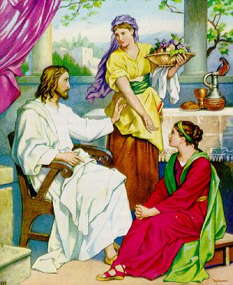
Good People Are Often
Troubled
Luke 10:38-42
“Martha, Martha, you are worried and troubled about many things” (v. 41)
Not a bad person
Not immoral
Not lacking in love for the Lord
Bothered (NASV) – many things
Distracted – thus struggled
We, like Martha, struggle with many things!

Slide 2

Struggle With Discouragement
It is not uncommon for Christians to be discouraged from time to time
  Some – occasionally / Others – Stay in it
  Some – “blahs” or “blues” / Some – Depression

Slide 3
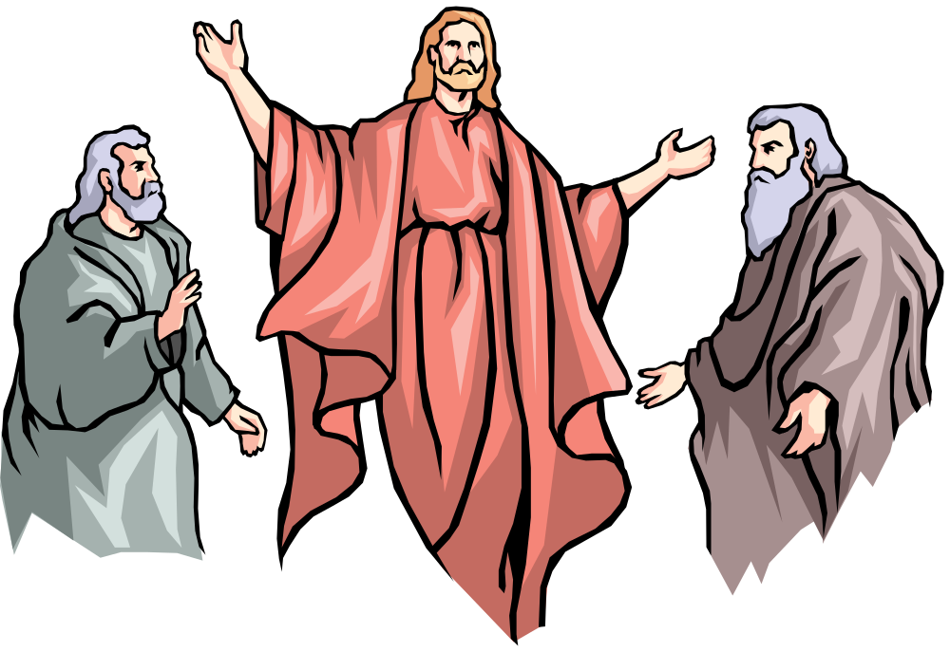
Elijah
Reached a Point Where He Was Pretty Low
Perhaps we think the great prophets are people of steel – unreal temperament
Jas. 5:17 – “nature like ours”
1 Kings 19:1-10 Reached a point:
  Thought no one cared
  Thought no one wanted to do right
  Lonely
  Just a soon die as live
Elijah Struggled – So Do We!

Slide 4
Struggle With Discouragement
I. What Is Discouragement?

Slide 5
Word “Discourage” in the NT Text
Col. 3:21 – (athymeō) – lose heart, disheartened, dispirited
Heb. 12:3, 5 – (eklyō)
  “become weary, give out” (BDAG)
  “become discouraged, to lose heart, to give up” (Louw Nida)
  Translated “faint” (Matt. 15:32; Mark 8:3)
  Translated “weary” (Matt. 9:36)
I. What Is Discouragement?
Lose heart, weary, grow faint, give out and give up

Slide 6
Word “Discourage” in the OT Text
Num. 21:4 – (qsr) - impatient
Num. 32:7, 9 – (nw) – to try to prevent something, frustrate, overrule, refuse
Deut. 1:21 – (htt) – low in spirits, be dismayed (translated “dismayed”)
Deut. 1:28 – (mss) – melt (2 Sam. 17:10)
Ezra 4:4 – (yad) – making the hand slack (NET fn)
Isa. 42:4 – (rss) – crush, break, (same word for bruised v. 3)
I. What Is Discouragement?
Impatient, being hindered, low, melting, bruised

Slide 7
Dictionary: “To deprive of courage, hope, confidence” (Webster)
Opposite of: Encouraged
Synonyms: disappointed, down, disheartened, troubled, blues, depression, gloomy, etc.
There is legitimate discouragement
  Possible to be discouraged (Heb. 12:3, 5)
  The need for encouragement (Rom. 1:12)
Broad term:
  Includes feelings hurt – heartache – clinical depression
  Some “Depression” is merely discouragement
I. What Is Discouragement?

Slide 8
Prov. 17:22
NKJV: A merry heart does good, like medicine, But a broken spirit dries the bones.
ESV: A joyful heart is good medicine, but a crushed spirit dries up the bones.
I. What Is Discouragement?
I. What Is Discouragement?
NCV: A happy heart is like good medicine, but a broken spirit drains your strength.
LEB: A cheerful heart is good medicine, but a downcast spirit will dry out bones.

Slide 9
Struggle With Discouragement
I. What Is Discouragement?
II. What Causes Discouragement?

Slide 10
Disappointment at Sin of Others
Physical Problems / Sickness
Material / Financial Difficulties
Own Sin
Death of a Stronghold
II. What Causes Discouragement?

Slide 11
Struggle With Discouragement
I. What Is Discouragement?
II. What Causes Discouragement?
III. How Does It Create A Struggle?

Slide 12
Feel Like You Are Alone (1 Kings 19:10)
Sees A Dark Future
Think Nothing Can Do
Exaggerate The Trouble
Forget The Good Of The Past
III. How Does It Create
A Struggle?

Slide 13
Struggle With Discouragement
I. What Is Discouragement?
II. What Causes Discouragement?
III. How Does It Create A Struggle?
IV. How Can One Deal With It?

Slide 14
Things That Don’t Help
  Running to escape (Psa. 55:6, 16-23)
  Self pity (1 Sam. 30:1-6)
  Alcohol (1 Pet. 4:3)
IV. How Can One Deal With It?

Slide 15
Things That Don’t Help
Elijah’s Case
  Prayed (1 Kings 19:4; 1 Pet. 5:7)
  Remember the power of God (1 Kings 19:11-14)
  Get busy doing Lord’s will (vv. 15-ff)
  Not as bad as you think (v. 18)
  Are others who will help (vv. 17-18)
IV. How Can One Deal With It?

Slide 16
Things That Don’t Help
Elijah’s Case
Hebrews’ Encouragement
  Know you are on right track (chapters 1-9)
  Consider danger if stay discouraged (6:4-8)
  You’ve done it in the past (6:9-12)
  Remember God’s promises (6:13-20)
  Consider how Jesus endured (12:3)
  Could be worse (12:4)
  Bad circumstances make us better (12:5-11)
  Take responsibility for self & be determined (12:12)
IV. How Can One Deal With It?

Slide 17
Things That Don’t Help
Elijah’s Case
Hebrews’ Encouragement
Instructions to Encourage the Fainthearted
IV. How Can One Deal With It?

Slide 18
1 Thess 5:14
Now we exhort you, brethren, warn those who are unruly, comfort the fainthearted, uphold the weak, be patient with all.
[ASV: “encourage”]
Remind them what the word says (4:18; 5:11; Acts 20:2; 1 Cor. 14:31)
Be positive – not negative (Num. 21:4; 32:7, 9)
Tell them to not give up (1 Thess. 3:2-3; Acts 11:23)
Let know care – are loved (Col. 2:2)
Remind them of cycles of life (Psa. 30:5)
Remind them of temporary – vs – spiritual (2 Cor. 4:16-18)

Slide 19
Things That Don’t Help
Elijah’s Case
Hebrews’ Encouragement
Instructions to Encourage the Fainthearted
Put trust in God
IV. How Can One Deal With It?
Psa. 11
Friends advise David to flee – for nothing can do (vv. 1-3)
David declares his confidence in the Lord (vv. 4-7)
  God in on his throne in control (v. 4)
  God will punish wicked (vv. 5-6)
  God will remember the righteous (v. 7)

Slide 20
Struggle With Discouragement
I. What Is Discouragement?
II. What Causes Discouragement?
III. How Does It Create A Struggle?
IV. How Can One Deal With It?

