Slide 1
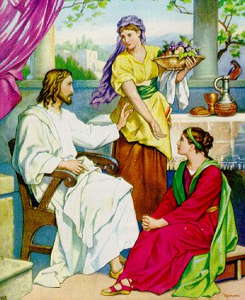
Good People Are Often
Troubled
Luke 10:38-42
“Martha, Martha, you are worried and troubled about many things” (v. 41)
Not a bad person
Not immoral
Not lacking in love for the Lord
Bothered (NASV) – many things
Distracted – thus struggled
We, like Martha, struggle with many things!

Slide 2
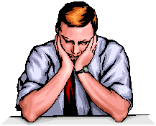
Struggle With Discouragement
It is not uncommon for Christians to be discouraged from time to time
  Some – occasionally / Others – Stay in it
  Some – “blahs” or “blues” / Some – Depression

Slide 3
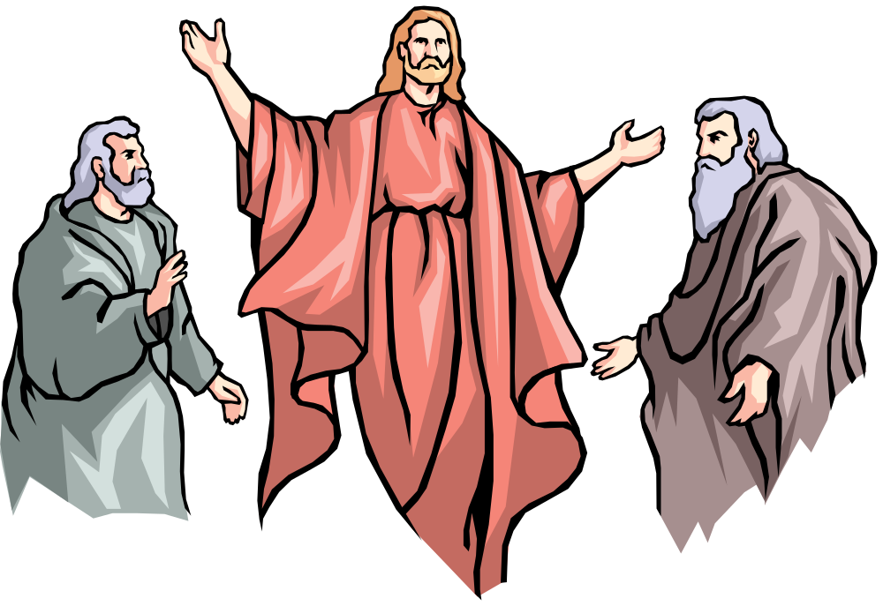
Elijah
Reached a Point Where He Was Pretty Low
Perhaps we think the great prophets are people of steel – unreal temperament
Jas. 5:17 – “nature like ours”
1 Kings 19:1-10 Reached a point:
  Thought no one cared
  Thought no one wanted to do right
  Lonely
  Just a soon die as live
Elijah Struggled – So Do We!

Slide 4
Struggle With Discouragement
I. What Is Discouragement?

Slide 5
Word “Discourage” in the NT Text
Col. 3:21 – (athymeō) – lose heart, disheartened, dispirited
Heb. 12:3, 5 – (eklyō)
  “become weary, give out” (BDAG)
  “become discouraged, to lose heart, to give up” (Louw Nida)
  Translated “faint” (Matt. 15:32; Mark 8:3)
  Translated “weary” (Matt. 9:36)
I. What Is Discouragement?
Lose heart, weary, grow faint, give out and give up

Slide 6
Word “Discourage” in the OT Text
Num. 21:4 – (qsr) - impatient
Num. 32:7, 9 – (nw) – to try to prevent something, frustrate, overrule, refuse
Deut. 1:21 – (htt) – low in spirits, be dismayed (translated “dismayed”)
Deut. 1:28 – (mss) – melt (2 Sam. 17:10)
Ezra 4:4 – (yad) – making the hand slack (NET fn)
Isa. 42:4 – (rss) – crush, break, (same word for bruised v. 3)
I. What Is Discouragement?
Impatient, being hindered, low, melting, bruised

Slide 7
Dictionary: “To deprive of courage, hope, confidence” (Webster)
Opposite of: Encouraged
Synonyms: disappointed, down, disheartened, troubled, blues, depression, gloomy, etc.
There is legitimate discouragement
  Possible to be discouraged (Heb. 12:3, 5)
  The need for encouragement (Rom. 1:12)
Broad term:
  Includes feelings hurt – heartache – clinical depression
  Some “Depression” is merely discouragement
I. What Is Discouragement?

Slide 8
Prov. 17:22
NKJV: A merry heart does good, like medicine, But a broken spirit dries the bones.
ESV: A joyful heart is good medicine, but a crushed spirit dries up the bones.
I. What Is Discouragement?
I. What Is Discouragement?
NCV: A happy heart is like good medicine, but a broken spirit drains your strength.
LEB: A cheerful heart is good medicine, but a downcast spirit will dry out bones.

Slide 9
Struggle With Discouragement
I. What Is Discouragement?
II. What Causes Discouragement?

Slide 10
Disappointment at Sin of Others
  1 Kings 19:10
  Brethren
    Psa. 119:136
    Sin / Error
    Church troubles
  Family
    Never obey gospel
    Turn astray – life of sin
    Believe or practice religious error
II. What Causes Discouragement?

Slide 11
Disappointment at Sin of Others
Physical Problems / Sickness
  Elijah was exhausted
    Ran from Ahab, Mt Carmel to Jezreel – 30 miles (18:46)
    Ran from Jezebel, to Beersheba – 60 miles (19:1-3)
    Ran another day’s journey (19:4)
    Then, felt despair (19:10)
  Prolonged sickness, stress on the body, extreme exhaustion – may discourage one
II. What Causes Discouragement?

Slide 12
Disappointment at Sin of Others
Physical Problems / Sickness
Material / Financial Difficulties
  Financial strain – causes stress
  Matt. 6:24-33 – worry, anxiety about material things
II. What Causes Discouragement?

Slide 13
Disappointment at Sin of Others
Physical Problems / Sickness
Material / Financial Difficulties
Own Sin
  Sometimes, “depression” is merely a problem of guilt (1 Jno. 3:20)
  Sometimes, “I’m discouraged” – used as an excuse!
    Not all that interested in spiritual matters
    Doing things questionable – maybe sinful
    Blame others – for being discouraged!
  Rom. 1:12 – Encouraged by mutual faith [Discouraged because not same faith]
II. What Causes Discouragement?

Slide 14
Disappointment at Sin of Others
Physical Problems / Sickness
Material / Financial Difficulties
Own Sin
Death of a Stronghold
  Moses’ death (Josh. 1:1, 7, 9)
  Jesus’ death (John 14:1)
  Parent, mentor, leader, etc.
  Wonder how can we do it without them
II. What Causes Discouragement?

Slide 15
Struggle With Discouragement
I. What Is Discouragement?
II. What Causes Discouragement?
III. How Does It Create A Struggle?

Slide 16
Feel Like You Are Alone (1 Kings 19:10)
  No one to help
  No one cares
  No one understands
III. How Does It Create
A Struggle?

Slide 17
Feel Like You Are Alone (1 Kings 19:10)
Sees A Dark Future
  1 Kings 19 - just as soon not live – no reason to keep going
  Heb. 12:12 – “hands which hang down”
  Can’t see past the dark cloud
  Tendency to want to just give out or give up
  Psa. 55:6-8 – wish I could fly away
III. How Does It Create
A Struggle?

Slide 18
Feel Like You Are Alone (1 Kings 19:10)
Sees A Dark Future
Think Nothing Can Do
  1 Kings 19 - Elijah wanted to die
  Col. 3:21 – feel can’t do anything right
  So, what’s the use?
III. How Does It Create
A Struggle?

Slide 19
Feel Like You Are Alone (1 Kings 19:10)
Sees A Dark Future
Think Nothing Can Do
Exaggerate The Trouble
  1 Kings 19 - “I alone am left” [Yet 7,000]
  Make the problem bigger – in our mind
  Reason: see the darker side
    Sick – think dying
    One thing wrong – does nothing right
    Difference – becomes a rift
    Financial reverse – ready for bankruptcy
    Feeling down – “I’m depressed”
    Problem – becomes hopeless
III. How Does It Create
A Struggle?

Slide 20
Feel Like You Are Alone (1 Kings 19:10)
Sees A Dark Future
Think Nothing Can Do
Exaggerate The Trouble
Forget The Good Of The Past
  Elijah seems to have forgotten:
    God’s answer to prayer (1 Kings 17:1-7)
    Widow’s flour & oil (1 Kings 17:8-16)
    Raising of widow’s son (1 Kings 17:17-24)
    Victory at Mt. Carmel (1 Kings 18:20-40)
III. How Does It Create
A Struggle?

Slide 21
Feel Like You Are Alone (1 Kings 19:10)
Sees A Dark Future
Think Nothing Can Do
Exaggerate The Trouble
Forget The Good Of The Past
  Elijah seems to have forgotten:
  We Forget:
    How been blessed – good of days gone by
    God answered prayers (over and over)
    Overcome in the past
III. How Does It Create
A Struggle?

Slide 22
Struggle With Discouragement
I. What Is Discouragement?
II. What Causes Discouragement?
III. How Does It Create A Struggle?
IV. How Can One Deal With It?

