Slide 1
Jesus Raised The Question of Who Men Say He Is
Matthew 16:13
“When Jesus came into the region of Caesarea Philippi, He asked His disciples, saying, ‘Who do men say that I, the Son of Man, am?’”
Matt 22:41-42
“While the Pharisees were gathered together, Jesus asked them, saying, ‘What do you think about the Christ? Whose Son is He?’ They said to Him, ‘The Son of David.’”

Slide 2
Knowing What Men Say Is Important
Jesus raised it in the mind of disciples (Matt. 16:13)
Helps us refute the error & teach the truth
Let’s us see how confused world is
Contrast helps us see truth with greater clarity

Slide 3
Who Men Say Jesus Is

Slide 4
Who Men Say Jesus Is
I. First Century Ideas

Slide 5
I. First Century Ideas
A. John the Baptist (Matt. 16:14)
B. Elijah (Matt. 16:14)
C. Jeremiah (Matt. 16:14)
D. One of the Great Prophets (Matt. 16:14)
E. Blasphemer (Matt. 9:1-8)
F. Winebibber & glutton (Matt. 11:19)
G. Sinner (John 9:24)
H. Lawbreaker (Matt. 12:1-8)

Slide 6
Who Men Say Jesus Is
I. First Century Ideas
II. Present Day Ideas

Slide 7
II. Present Day Ideas
A. World – Just a Man

Slide 8
“Today, one can find evidence virtually everywhere – on every continent, in both Protestant and Roman Catholic circles – that the theologically ‘in thing’ is to contend for a Jesus who was only a man by nature and for a Bible that is virtually silent regarding the classical incarnational Christology of a two-natured Christ – true God and true man in the one person of Jesus Christ. It is very much in vogue to believe that the better case can be made for understanding Jesus as only a man – a very unusual man, of course, with a special mission from God – to explain the biblical ascriptions of divine qualities to Him in the other than ontological terms.”
Robert L. Reymond, Jesus Divine Messiah, pp. 2-3

Slide 9
James D. G. Dunn:
“If we are to submit our speculations to the text and build our theology only with the bricks by careful exegesis we cannot say with any confidence that Jesus knew himself to be divine, the pre-existent Son of God.”
Christology in the Making: A New Testament Inquiry Into the Origins of the Doctrine of the Incarnation p. 32 as quoted by Reymon, ibid. p. 4

Slide 10
II. Present Day Ideas
A. World – Just a Man
B. Jews – Not the Messiah, Not Divine – Just a Man

Slide 11
Why Jews Don’t believe in Jesus
It’s a very popular question. Why don’t Jews believe Jesus was the Messiah? Aren’t the proofs convincing?
This is a sensitive issue, and it is hoped that no one will be offended by the candid answer provided here.
We do not believe that it is prophesied that the Messiah will be crucified. We do not believe that the Messiah will be the son of God. We do not believe that he will be raised from the dead any more than anyone else. We do not believe that he will appear twice, in what some Christians call a second coming. We do not believe that the Messiah will be our “savior” in the sense that he will redeem us from our sins.
These are all fascinating claims to make concerning anyone, but they are all irrelevant to the Messiah for whom the Jews have awaited these three thousand years. None of these things are prophesied in the Jewish Bible.
http://www.beingjewish.com/toshuv/whynotbrief.html

Slide 12
What then is this Messiah for whom we wait? The Messiah will be a mortal man, born of a normal man and woman. He will be a man very learned in all sections of the Torah, and he will be a very righteous man. He will be of the undisputed scion of David through his father. He will become uncontested ruler in the Land of Israel over all the People of Israel, that is, all Twelve Tribes of Israel. He will have at least one son, who will be king after the Messiah dies a normal death at an advanced age.
He will be as described by the Prophet Isaiah (Isaiah 11:2-4): “full of wisdom and understanding, counsel and might, knowledge and the fear of God . . . he will smite the tyrant with the rod of his mouth, and slay the wicked with the breath of his lips . . .” (Maimonides explains this last as merely a parable, and not to be taken literally.)
Still, the Messiah will primarily be a prince of peace. As it says (Isaiah 52:7) “How beautiful upon the mountains are the feet of the messenger who announces peace.”

Slide 13
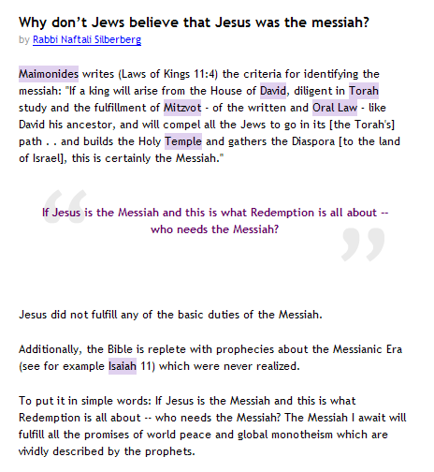
http://www.askmoses.com/article.html?h=120&o=350

Slide 14
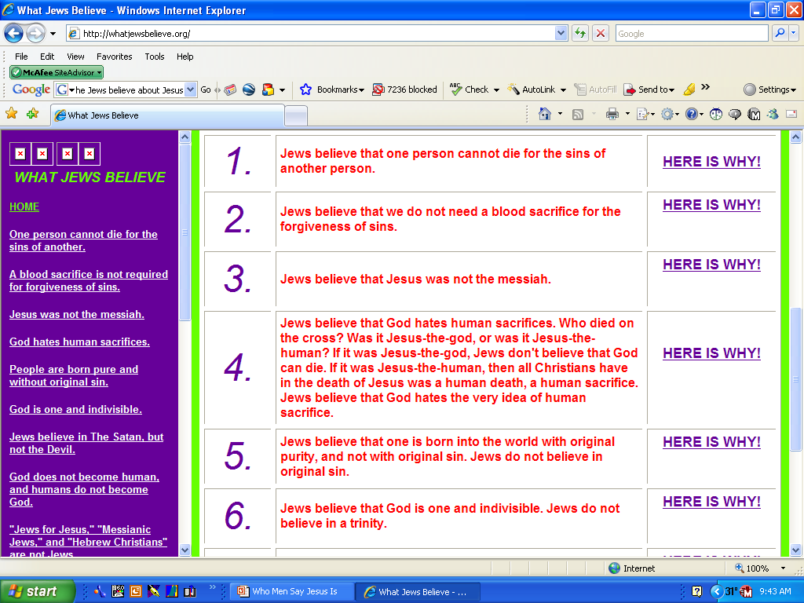
http://whatjewsbelieve.org/

Slide 15
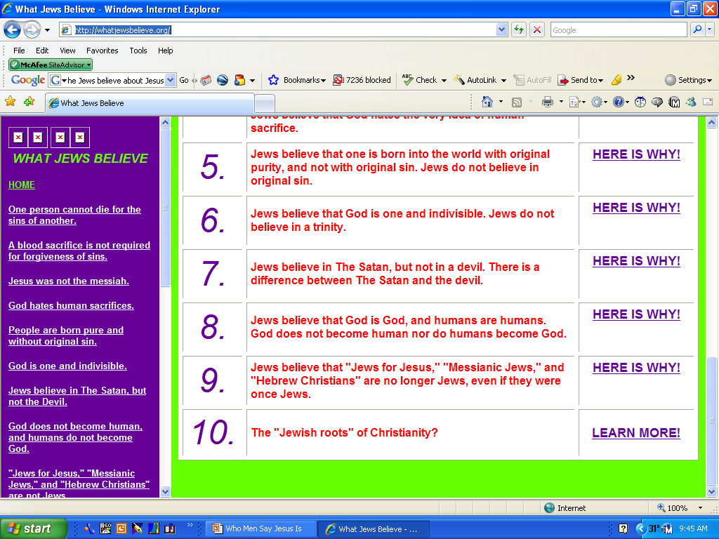
http://whatjewsbelieve.org/

Slide 16
II. Present Day Ideas
A. World – Just a Man
B. Jews – Not the Messiah, Not Divine – Just a Man
C. Muslims – Great Prophet, Not the Son of God

Slide 17

Dr. Salah El Dareer
President of the Islamic Center of Birmingham
Proposition: “Jesus the Messiah is the only begotten Son of God, was crucified for the sins of the world, and the New Testament is God’s final revelation” Affirm: Hiram O. Hutto
Deny: Dr. Salah El Dareer
“Jews and Muslims have held throughout history that Jesus could not have been the Son of God. But, whereas Judaism does not accept the mission of Jesus, Islam accords him the exalted position of prophet and messenger of God to his people – the Israelites” (p. 10)

Slide 18
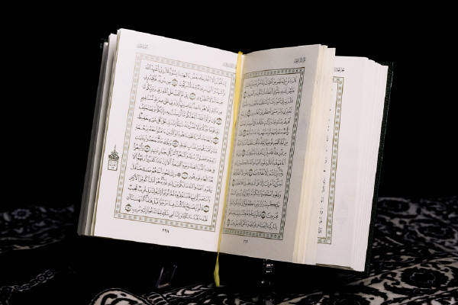
QUR’AN / KORAN
Jesus was not God’s Son (9:130; 19:135)
Not Crucified (4:157-159)
Not a Redeemer

Slide 19
II. Present Day Ideas
A. World – Just a Man
B. Jews – Not the Messiah, Not Divine – Just a Man
C. Muslims – Great Prophet, Not the Son of God
D. Jehovah’s Witnesses – a god- but not Divine

Slide 20
New World Translation:
(Jehovah’s Witnesses’ Own Translation)
John 1:1
“In [the] beginning the Word was, and the Word was with God, and the Word was a god.”
John 1:1
“In the beginning was the Word, and the Word was with God, and the Word was God.” (KJV)

Slide 21
Jehovah’s Witness Teaching
Jesus was not divine while on earth, but only human (Studies in the Scriptures, I, 179)
“In truth, when Jesus was on earth He was a perfect man, nothing more and nothing less.” (Reconciliation, p. 111)
Jesus’ body was not raised but preserved somewhere or dissolved into gases (Deliverance, p. 170; The Time is at Hand, p. 129)

Slide 22
II. Present Day Ideas
A. World – Just a Man
B. Jews – Not the Messiah, Not Divine – Just a Man
C. Muslims – Great Prophet, Not the Son of God
D. Jehovah’s Witnesses – a god- but not Divine
E. Mormons - Polygamist

Slide 23
Mormon Teaching
Church of Jesus Christ of Latter-Day Saints
Born of Adam
  “He was not begotten by the Holy Ghost. And who is His Father? He is the first of the human family (Adam)…” (Brigham Young, Journal of Discourses, Vol. I, p. 50).
Married to Mary & Martha
  (“…there were several holy women that greatly ‘loved Jesus, such as Mary and Martha her sister, and Mary Magdalene; and Jesus greatly loved them… if all the acts were written, we, no doubt should learn that these beloved women were His wives” (Orson Hyde, The Seer, pp. 158-159)

Slide 24
II. Present Day Ideas
A. World – Just a Man
B. Jews – Not the Messiah, Not Divine – Just a Man
C. Muslims – Great Prophet, Not the Son of God
D. Jehovah’s Witnesses – a god- but not Divine
E. Mormons – Polygamist
F. Christian Scientist – Great man – not Christ

Slide 25
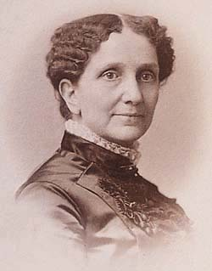
“…Jesus was the man that was a prophet and the best and greatest man that every has appeared on earth, but Jesus was not Christ, for Christ is the spiritual individual that the eye cannot see. Jesus was called Christ only in the sense that you say, a Godlike man…”
(Altman K. Swihart, Since Mrs. Eddy, p.53)
Mary Baker Eddy
Is not God (Science & Health, 36:12-18)
Was not incarnated in the flesh (ibid., 29:14-18)
Did not die (ibid., 46:2,3; 44:28-29; 45:11-12)
Was not raised from dead (ibid., 313:26-30)

Slide 26
II. Present Day Ideas
A. World – Just a Man
B. Jews – Not the Messiah, Not Divine – Just a Man
C. Muslims – Great Prophet, Not the Son of God
D. Jehovah’s Witnesses – a god- but not Divine
E. Mormons – Polygamist
F. Christian Scientist – Great man – not Christ
G. Dan Brown, Da Vinci Code - Just a man

Slide 27

Jesus was just a man
Married to Mary Magdalene
“At this gathering [Council of Niceau in 324 AD] many aspects of Christianity were debated and voted upon - the date of Easter, the role of the bishops, the administration of sacraments, and, of course, the divinity of Jesus . . . until that moment in history, Jesus was viewed by His followers as a mortal prophet . . . a great and powerful man, but a man nonetheless. A mortal.”
“The marriage of Jesus and Mary Magdalene is part of the historical record.”

Slide 28
Who Men Say Jesus Is
I. First Century Ideas
II. Present Day Ideas
III. God’s Idea

Slide 29
III. God’s Idea
A. Son of God (Matt. 3:16-17; 17:5; John 5; Rom. 1:4)
B. Christ (John 4; Acts 2:36)
C. God with us (Matt. 1:21-23)
D. Equal with God (Phil. 2:6-8)
E. Savior (Matt. 1:21)
F. Judge (John 5:22; Acts 17:30-31)
G. Lord (Acts 2:36)
H. High Priest (Heb. 4:14; 5:1-10)

Slide 30
Who Men Say Jesus Is
I. First Century Ideas
II. Present Day Ideas
III. God’s Idea
IV. Your Idea

Slide 31
IV. Your Idea
A. Is he your Lord (Luke 6:46)?
B. Is he your savior (Acts 10:43)?
C. In he your king (Matt. 6:33; Luke 17:21)?
D. Live like he is your judge (Acts 17:30-31)

Slide 32
Who Men Say Jesus Is
I. First Century Ideas
II. Present Day Ideas
III. God’s Idea
IV. Your Idea

