Slide 1
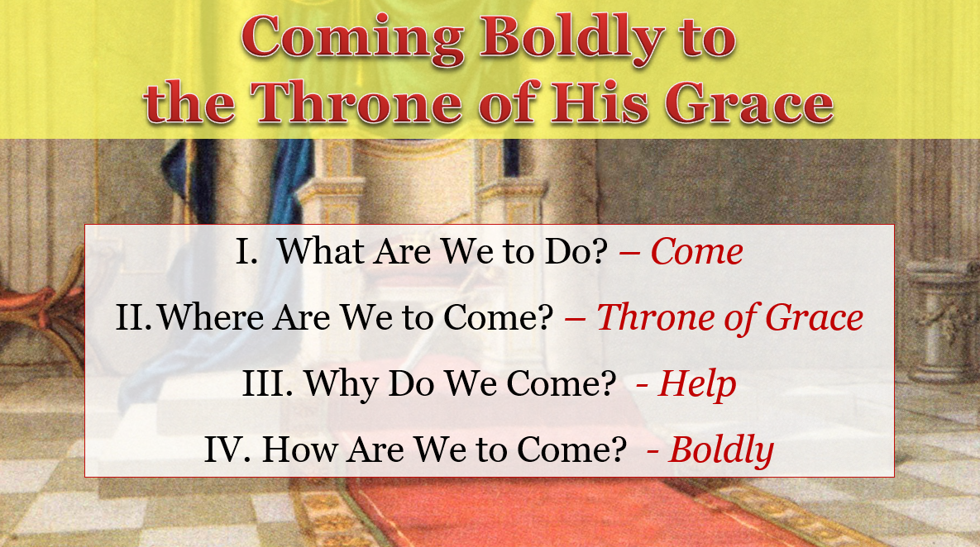
The Purpose of the Hebrew Letter:
To Encourage Christians to Remain Steadfast & Firm

Slide 2
The Purpose of the Hebrew Letter:
To Encourage Christians to Remain Steadfast & Firm
To Help
“Let Us” is used 13 times in the book of Hebrews
Used in the first person as an imperative: let us do something
Each of these involve what discouraged people are instructed to do to stand firm to the end.
These “let us” passages tell us how to press on in Christ!

Slide 3
“Let Us” Press on
in Christ
Encouragement from Hebrews

Slide 4
“Let Us” Press on in Christ
Go on to Perfection (6:1)

Slide 5
Go on to Perfection (6:1)
“Let Us” Press on in Christ
Context: lack of maturity (5:11-14)
  Became dull of hearting (v. 11)
  Not grown or matured (vv. 12-13)
  Maturity gained by use and exercise (v. 14)

Slide 6
Go on to Perfection (6:1)
“Let Us” Press on in Christ
Context: lack of maturity (5:11-14)
Time to leave the first principles (6:1)
  “Elementary principles” = first principles of the gospel (not Jewish /OT)
    Context dealing with those who have not grown and matured as they should (5:11-14)
    Written to Christians (not those in Judaism who need to leave that)
    Principles are “of Christ” (“first principles of Christ” – ASV) – Compare 5:12
  “Leave” –
    Not in the sense of abandoning
    Leave as a builder leaves the foundation to continue building
    Don’t keep laying the foundation – build on what you have!

Slide 7
Go on to Perfection (6:1)
“Let Us” Press on in Christ
Context: lack of maturity (5:11-14)
Time to leave the first principles (6:1)
Go on to perfection / maturity (6:1-3)
  “Perfection” = maturity (fn NKJV) / “completeness, maturity” (BDAG)
  The maturity that was lacking in 5:11-14
  Some never get beyond the basic elements – leaves them immature
  “We will do” (v. 3)
    With God’s help (Phil. 4:13)
    Points to the individual taking responsibility for self

Slide 8
Go on to Perfection (6:1)
“Let Us” Press on in Christ
Context: lack of maturity (5:11-14)
Time to leave the first principles (6:1)
Go on to perfection / maturity (6:1-3)
Point:
  Are you stuck on the foundation – house not being built?
  Have you forgotten some of those basics?
  Are you ready to grow into the “meat” of the word?
  Really trying to delve into a deeper / better knowledge and application of the word?

Slide 9
“Let Us” Press on in Christ
Go on to Perfection (6:1)
Consider One Another (10:24)

Slide 10
“Let Us” Press on in Christ
Consider One Another (10:24)
Context: exhortation to greater diligence (10:19-25)
  Based on the cleansing through Christ (vv. 19-22)
  What greater diligence involves (vv. 23-25)
    Holding fast to the “hope we profess” – NIV (v. 23)
    Consider one another to provoke to love and good works (v. 24)
    Not forsake assembling (v. 25a)
    Exhort one another (v. 25b)

Slide 11
“Let Us” Press on in Christ
Consider One Another (10:24)
Context: exhortation to greater diligence (10:19-25)
“Consider” (v. 24)
  “Think about each other” (NCV)
  “Be concerned about each other (Holman)
  “To think about carefully” (BDAG)
  Means to keep on considering – continually being attentive
  Who is the “one another” to be considered?
    Other Christians
    Consider their needs, condition, the circumstances of their weakness
    What needs to be said or done to encourage them?
    What can I do to help others do more?

Slide 12
“Let Us” Press on in Christ
Consider One Another (10:24)
Context: exhortation to greater diligence (10:19-25)
“Consider” (v. 24)
“Provoke” (v. 24)
  “Stimulate” (NASB)
  “Stir up” (ESV)
  Means to arouse to action
  Provoke to:
    Love – for God & his word that will drive their dedication / diligence
    Good works – what is involved in being diligent / greater service

Slide 13
“Let Us” Press on in Christ
Consider One Another (10:24)
Context: exhortation to greater diligence (10:19-25)
“Consider” (v. 24)
“Provoke” (v. 24)
Point:
  Easy to be self-absorbed and inactive
  “When some become weak in faith and cease to contribute to the well-being of the group, the entire group suffers” (McClister, 358).
  We should not be selfish – but think about the needs of others
  Result – others will encourage us as we need it

Slide 14
“Let Us” Press on in Christ
Go on to Perfection (6:1)
Consider One Another (10:24)
Lay Aside Every Weight and Sin (12:1)

Slide 15
Lay Aside Every Weight and Sin (12:1)
“Let Us” Press on in Christ
Context: life pictured as a race (12:1-3)
  We have a goal - the end we seek to obtain
  We must run in order to win
  The runner lays aside any weight or hindrance
  Focus is on the race – that’s all that matters

Slide 16
Lay Aside Every Weight and Sin (12:1)
“Let Us” Press on in Christ
Context: life pictured as a race (12:1-3)
Lay aside every sin
  Any and every sin separates from God (Jas. 1:15)
  Sin “easily ensnares” us
    Entangles our feet – so can’t run, in fact makes us fall
    “Clings so closely” (ESV)
    Means that we have to purposely put it away
    Reese: Anything that easily distracts the runner’s attention & focus

Slide 17
Lay Aside Every Weight and Sin (12:1)
“Let Us” Press on in Christ
Context: life pictured as a race (12:1-3)
Lay aside every sin
Lay aside every weight
  The Greek runner – removed ALL – ran without clothing
  “We should remove from our lives anything that would get in the way” (NCV)
  “Every encumbrance” (NASB)
  “Every impediment” (Williams)
  This involves things that may not be sinful (sin has already been mentioned)
    Diverts attention from the real focus
    May be our job, hobby, relationships, etc.

Slide 18
Lay Aside Every Weight and Sin (12:1)
“Let Us” Press on in Christ
Context: life pictured as a race (12:1-3)
Lay aside every sin
Lay aside every weight
Point:
  Are you dragging excess weight in your race?
  Is sin clinging closely to you as your trying to run?
  Is something (even something good) getting in your way?
  Is your attention being diverted?

Slide 19
“Let Us” Press on in Christ
Go on to Perfection (6:1)
Consider One Another (10:24)
Lay Aside Every Weight and Sin (12:1)
Run with Endurance (12:1)

Slide 20
Run with Endurance (12:1)
“Let Us” Press on in Christ
Context: picture of a race with the stands full of racers
  “Cloud of witness” = those who already run and won (chapter 11)

Slide 21
“Cloud of Witness”
“The metaphor refers to the great amphitheatre with the arena for the runners and the tiers upon tiers of seats rising up like a cloud. The μαρτυρες [martures] (word of witnesses, DVR) here are not mere spectators (θεαται [theatai]), but testifiers (witnesses) who testify from their own experience (11:2, 4, 5, 33, 39) to God’s fulfilling his promises as shown in chapter 11.”
A. T. Robertson, Word Pictures in the New Testament (Heb 12:1). Nashville, TN: Broadman Press.

Slide 22
Run with Endurance (12:1)
“Let Us” Press on in Christ
Context: picture of a race with the stands full of racers
  “Cloud of witness” = those who already run and won (chapter 11)
  Just a glance to the stands and seeing those who have won their race tells us we can win our race too!

Slide 23
Run with Endurance (12:1)
“Let Us” Press on in Christ
Context: picture of a race with the stands full of racers
Run
  Not just plan, talk about it or intend – but run!
  Must act, must go, must move!
  Not a “once and done” deal – but “let us keep on running” (Robertson)
  “Exert oneself to the limit of one’s powers in an attempt to go forward, strive to advance” (BDAG comments)

Slide 24
Run with Endurance (12:1)
“Let Us” Press on in Christ
Context: picture of a race with the stands full of racers
Run
With endurance
  There will be obstacles, problems and challenges
  Example: The Lord suffered (vv. 2-3)
  “Perseverance” (NIV)
  The Message (translation): “Strip down, start running and never quit”
  This is the endurance that was missing (cf. 10:36)

Slide 25
Run with Endurance (12:1)
“Let Us” Press on in Christ
Context: picture of a race with the stands full of racers
Run
With endurance
Point:
  Are you getting tired? Keep running!
  Are you beginning to hurt? Keep running!
  Is the run getting hard? Keep running!
  Wanting to quit? Keep running!
  Don’t quit till you reach the finish line!

Slide 26
“Let Us” Press on in Christ
Go on to Perfection (6:1)
Consider One Another (10:24)
Lay Aside Every Weight and Sin (12:1)
Run with Endurance (12:1)
Be Grateful & Reverently Worship (12:28; 13:15)

Slide 27
Be Grateful & Reverently Worship (12:28; 13:15)
“Let Us” Press on in Christ
Context: Exhortation based on the nature of the New Economy (12:18-29)
  Superior honors and blessings of the New covenant (vv. 18-24)
    The old (vv. 18-21)
    The new (vv. 22-24)
  The authoritative voice of God (vv. 25-26)
  A remaining and stable kingdom (vv. 27-29)
    Contrast between things that can be shaken (removed) and things that cannot be shaken (cannot be removed)
    Things shaken: Old Testament with its priesthood and sacrifices
    In contrast we have received a kingdom that cannot be shaken (Dan. 2:44)

Slide 28
Be Grateful & Reverently Worship (12:28; 13:15)
“Let Us” Press on in Christ
Context: Exhortation based on the nature of the New Economy (12:18-29)
Therefore, have grace (12:28)
  Be grateful (ESV)
  Show gratitude (NASB)

Slide 29
Be Grateful & Reverently Worship (12:28; 13:15)
“Let Us” Press on in Christ
Context: Exhortation based on the nature of the New Economy (12:18-29)
Therefore, have grace (12:28)
Gratefulness drives reaction:
  Reverence and honor (12:28)
  Continual sacrifice (13:15)
    Of praise (v. 15)
    Doing good (v. 16)
    Sharing (v. 16)

Slide 30
Be Grateful & Reverently Worship (12:28; 13:15)
“Let Us” Press on in Christ
Context: Exhortation based on the nature of the New Economy (12:18-29)
Therefore, have grace (12:28)
Gratefulness drives reaction:
Point:
  Are you grateful? Really appreciative?
  Understand what you have received?
  Are you driven to offer praise and worship?

Slide 31
“Let Us” Press on in Christ
Go on to Perfection (6:1)
Consider One Another (10:24)
Lay Aside Every Weight and Sin (12:1)
Run with Endurance (12:1)
Be Grateful & Reverently Worship (12:28; 13:15)

