Slide 1

Romans
A Series
A Textual Study
Romans
Paul, a bondservant of Jesus Christ, called to be an apostle, separated to the gospel of God ² which He promised before through His prophets in the Holy
Scriptures, ³ concerning His Son Jesus Christ our Lord, who was born of the seed of David according to the flesh, ⁴ and declared to be the Son of God with power according to the Spirit of
Romans
Paul, a bondservant of Jesus Christ, called to be an apostle, separated to the gospel of God ² which He promised before through His prophets in the Holy Scriptures, ³ concerning His Son Jesus Christ our Lord, who was born of the seed of David according to the flesh, ⁴ and declared to be the Son of God with power according to the Spirit of holiness, by the resurrection from the dead. ⁵ Through Him we have received grace and apostleship
Introduction &
Romans 1

Slide 2
In Romans We Will See:
  Creation (1:20)
  Old Testament prophecy (3:10-ff)
  Jesus is deity (1:4)
  Resurrection (1:4)
  Judgment to come (2)
  Work of Holy Spirit (8)
  Salvation from sin (3; 8)
  Baptism (6:3-4)
  Faith (4)
  Sin (3:23)
  Grace (5:20)
  Repentance (6)
  Free moral agency (6)
  Law of Moses (3)
  Heaven / Hope (8:24)
  Personal responsibility (10)
  Providence (11)
  Relationships (12)
  Enemies (12:17-21)
  Civil government (13)
  Personal conscience (14)
  Women serving (16)
  Local churches (16:16)
  Division (16:17-18)

Slide 3
Romans
(Introduction)
Author: Paul (1:1)
  Possibly takes place of a visit (1:13)
  Dictated to Tertius (16:22)

Slide 4
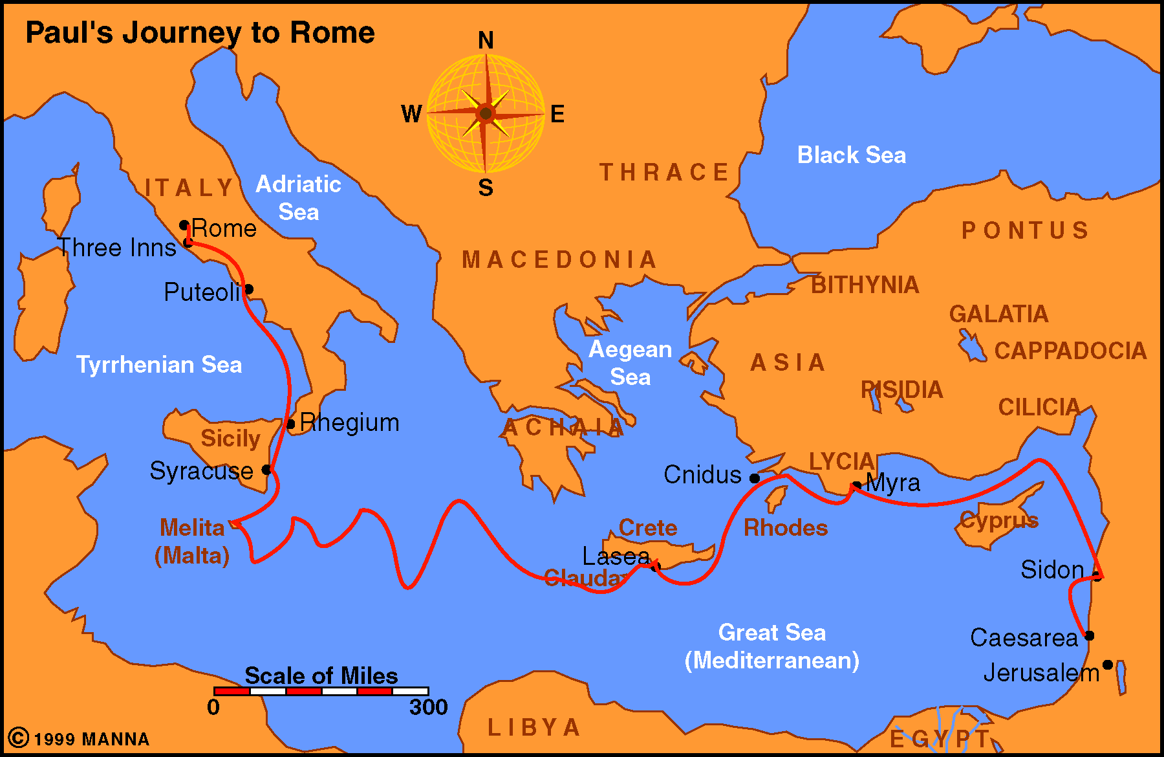
Romans
(Introduction)
Corinth
Author: Paul (1:1)
Date: Fall of 57 - Spring of 58 AD
Place: Corinth
  Time there - Acts 20:1-16 (3rd journey)
  Rom. 16:1 – Phebe
    From Cenchrea (7-8 miles away)
    Possibly was the messenger of this letter

Slide 5
Romans
(Introduction)
Author: Paul (1:1)
Date: Fall of 57 - Spring of 58 AD
Place: Corinth
  Time there - Acts 20:1-16
  Rom. 16:1 – Phebe
  Rom. 16:23 –
    Gaius was at Corinth (1 Cor. 1:14)
    “The city” - likely Corinth
    Erastus (2 Tim. 4:20)

Slide 6
Romans
(Introduction)
Author: Paul (1:1)
Date: Fall of 57 - Spring of 58 AD
Place: Corinth
Theme: “The just shall live by faith” (1:17)

Slide 7
“The Just Shall Live By Faith”
Hab. 2:4
Rom. 1:17
Gal. 3:11
Heb. 10:38
“He who through faith is righteous shall live.”
(Rom. 1:17, RSV)

Slide 8
“The Just Shall Live By Faith”
  “But it is different with regard to the righteous: by, from, or due to his faith he shall, indeed live.”
  R.C.H. Lenski
Point: The one who is JUST (due to his faith), he shall live (be saved)

Slide 9
“The Just Shall Live By Faith”
Hab. 2:4
Heb. 10:38
  “It is very true that the just lives by his belief; and it is equally true that he becomes just by it.”
  Moses E. Lard
Rom. 1:17
Gal. 3:11

Slide 10
Obedience of Faith
Rom 1:5
Through Him we have received grace and apostleship for obedience to the faith among all nations for His name,
Rom 16:26
but now has been made manifest, and by the prophetic Scriptures has been made known to all nations, according to the commandment of the everlasting God, for obedience to the faith--

Slide 11
Romans
(Introduction)
Author: Paul (1:1)
Date: Fall of 57 - Spring of 58 AD
Place: Corinth
Theme: “The just shall live by faith” (1:17)
Recipients: The church at Rome
Outline:

Slide 12
Romans
(Outline)
Justification by Faith Apart From the Law (1-8)
Rejection of the Jews & Accepting Gentiles (9-11)
The Christian’s Relationships (12-16)

Slide 13
Romans 1
The Gentiles are in Sin
“For the wrath of God is revealed from heaven against all ungodliness and unrighteousness of men, who suppress the truth in unrighteousness” (v. 18)

Slide 14
Romans 1
The Gentiles are in Sin
I. The Message: Gospel of God (vv. 1-6)
II. The Recipients: Church at Rome (vv. 7-15)
III. The Messenger: Ready to Preach (vv. 1, 15-17)
IV. The Problem: Sin Among Gentiles (vv. 18-32)

Slide 15
Romans 1
The Gentiles are in Sin
I. The Message: Gospel of God (vv. 1-6)
II. The Recipients: Church at Rome (vv. 7-15)
III. The Messenger: Ready to Preach (vv. 1, 15-17)
IV. The Problem: Sin Among Gentiles (vv. 18-32)

Slide 16
I. The Message: Gospel of God (vv. 1-6)
Foretold in the prophets (v. 2)
Concerns Jesus Christ (vv. 3-5)
  Humanity: of the seed of David (v. 3)
  Deity: Son of God (v. 4)
  By whom receive grace (v. 5)
Must be obeyed (v. 5)
For all nations (v. 5)
In response
to the
Jewish
teachers

Slide 17
Romans 1
The Gentiles are in Sin
I. The Message: Gospel of God (vv. 1-6)
II. The Recipients: Church at Rome (vv. 7-15)
III. The Messenger: Ready to Preach (vv. 1, 15-17)
IV. The Problem: Sin Among Gentiles (vv. 18-32)

Slide 18
II. The Recipients: Church at Rome (vv. 7-15)
Greeting to the saints at Rome (v.7)
Thanks for the saints at Rome (vv. 8-9)
Plans to visit the saints at Rome (v. 10-15)

Slide 19
Romans 1
The Gentiles are in Sin
I. The Message: Gospel of God (vv. 1-6)
II. The Recipients: Church at Rome (vv. 7-15)
III. The Messenger: Ready to Preach (vv. 1, 15-17)
IV. The Problem: Sin Among Gentiles (vv. 18-32)

Slide 20
III. The Messenger: Ready to Preach (vv. 1, 15-17)
Separated unto the gospel (v. 1)
Not ashamed of the gospel (v. 16)
Power of God unto salvation (vv. 16-17)
  To all who believe (v. 16)
  Reveals God’s plan (v. 17)

Slide 21
“The Righteousness of God”
(God’s Plan For Making Men Righteous)
1:17 - Reveal in the gospel
3:20-21 - Apart from law
10:3 - Must submit to it

Slide 22
“Faith to Faith”
17 For in it the righteousness of God is revealed from faith to faith; as it is written, "The just shall live by faith."
The story of salvation by faith
was revealed
in order to produce faith

Slide 23
Romans 1
The Gentiles are in Sin
I. The Message: Gospel of God (vv. 1-6)
II. The Recipients: Church at Rome (vv. 7-15)
III. The Messenger: Ready to Preach (vv. 1, 15-17)
IV. The Problem: Sin Among Gentiles (vv. 18-32)

Slide 24
IV. The Problem: Sin Among Gentiles (vv. 18-32)
The Results (vv. 18-20, 24, 28, 32)
  Stirred wrath of God (vv. 18-20, 32)
    Know better (vv. 18-20)
    Know wrath of God (v. 32)
  God gave them up (vv. 24, 28)

Slide 25
IV. The Problem: Sin Among Gentiles (vv. 18-32)
The Results (vv. 18-20, 24, 28, 32)
The Sins (vv. 21-32)
  Did not glorify God (vv. 21-25)
    Changed the glory of God to be like man (vv. 21-23)
    Served their own lust (vv. 24-25)

Slide 26
IV. The Problem: Sin Among Gentiles (vv. 18-32)
The Results (vv. 18-20, 24, 28, 32)
The Sins (vv. 21-32)
  Did not glorify God (vv. 21-25)
  Homosexuality (vv. 26-27)

Slide 27
Homosexuality
(vv. 26-27)
26 For this reason God gave them up to vile passions. For even their women exchanged the natural use for what is against nature.
27 Likewise also the men, leaving the natural use of the woman, burned in their lust for one another, men with men committing what is shameful, and receiving in themselves the penalty of their error which was due.
Vile passions
Against nature
Shameful
Error
Receiving penalty

Slide 28
IV. The Problem: Sin Among Gentiles (vv. 18-32)
The Results (vv. 18-20, 24, 28, 32)
The Sins (vv. 21-32)
  Did not glorify God (vv. 21-25)
  Homosexuality (vv. 26-27)
  All unrighteousness (vv. 29-32)

Slide 29
All Unrighteousness
(vv. 29-32)
Sexual immorality (v. 29)
Wickedness (v. 29)
Covetousness (v. 29)
Maliciousness (v. 29)
Full of envy (v. 29)
Murder (v. 29)
Strife (v. 29)
Deceit (v. 29)
Evil mindedness (v. 29)
Whisperers (v. 30)
Backbiters (v. 30)
Haters of God (v. 30)
Violent (v. 30)
Proud (v. 30)
Inventors of evil (v. 30)
Disobedient to parents (v. 30)
Undiscerning (v. 31)
Untrustworthy (v. 31)
Unloving (v. 31)
Unforgiving (v. 31)
Unmerciful (v. 31)
Approve of other’s sin (v. 32)

Slide 30
IV. The Problem: Sin Among Gentiles (vv. 18-32)
The Results (vv. 18-20, 24, 28, 32)
The Sins (vv. 21-32)
The Reasons (v. 28)
  Did not retain God in their knowledge
  Debased mind

Slide 31
Romans 1
The Gentiles are in Sin
I. The Message: Gospel of God (vv. 1-6)
II. The Recipients: Church at Rome (vv. 7-15)
III. The Messenger: Ready to Preach (vv. 1, 15-17)
IV. The Problem: Sin Among Gentiles (vv. 18-32)

Slide 32
Lessons to Learn
Humanity & Deity of Christ (vv. 3-4)
Proof of Deity - Resurrection (v. 4)
Being specific in prayer (v. 9)
Encouraged by mutual faith (v. 12)
Preach to saints (vv. 7, 15)
Gospel is still powerful (vv. 16-17)
Why we need to preach (vv. 15-17)
Possible to suppress the truth in unrighteousness (v. 18)
No excuse for sin (v. 20)
What is condemned: (“small” matters & lacking)

