Slide 1

The Purpose of the Hebrew Letter:
To Encourage Christians to Remain Steadfast & Firm
2:1-3 – Give heed lest drift or neglect
3:6 – Son’s house – If hold fast … firm to the end
3:14 – Hold confidence steadfast till the end
4:11 – Diligent to enter rest
4:14 – Let us hold fast our confession
Hold Fast
Be Firm
Steadfast
Be Diligent
Our Goal:

Slide 2
The Purpose of the Hebrew Letter:
To Encourage Christians to Remain Steadfast & Firm
Warning:
Israel’s Failure Could Happen to Them
Fell in the Wilderness (3:7-19)
  Problem:
    Hardened heart (v. 8, 15)
    Rebelled (vv. 8, 15, 16)
    Went astray (v. 10)
  Result: Didn’t make it to promise land (vv. 11, 18, 19)
Same Could Happen to Us (3:12; 4:11)

Slide 3

Many Fell
Before They
Made It…..
Bondage
of
Egypt
Israel
Wilderness
Wandering
Promise
Land
Water
We Too Could
Fall Before…
Bondage
of
Sin
Heaven
Our
Promise
Land
Now
Water
Today

Slide 4
The Purpose of the Hebrew Letter:
To Encourage Christians to Remain Steadfast & Firm
Warning:
Israel’s Failure Could Happen to Them
To Help With the Struggle:
Can Come Boldly to the Throne of Grace
(Heb. 4:14-16)

Slide 5
Hebrews 4:14-16
14 Seeing then that we have a great High Priest who has passed through the heavens, Jesus the Son of God, let us hold fast our confession.
15 For we do not have a High Priest who cannot sympathize with our weaknesses, but was in all points tempted as we are, yet without sin.
16 Let us therefore come boldly to the throne of grace, that we may obtain mercy and find grace to help in time of need.

Slide 6
Coming Boldly to
the Throne of His Grace

Slide 7
Coming Boldly to
the Throne of His Grace
What Are We to Do? – Come

Slide 8
What Are We to Do?
– Come
Draw Near (ASV / ESV) to God
  “Approach” (NIV)
  Coming directly to God’s throne

Slide 9
What Are We to Do?
– Come
Draw Near (ASV / ESV) to God
Refers to Priestly Service
  OT – Priest (only Priest) approached God (Lev. 21:17-21)
  Approached God for worship, prayer & sacrifice
  Now all are priest & can approach God
    Are a royal priesthood (1 Pet. 2:5, 9)
    We all have access to God (Eph. 2:18; 3:12)
  All Christians have freedom of access to the very throne of deity (Eph. 2:13)

Slide 10
What Are We to Do?
– Come
Draw Near (ASV / ESV) to God
Refers to Priestly Service
God Wants Us to Come to Him in Prayer
  1 Pet. 5:7 – Cast all your cares….
  1 Pet. 3:12 – Ears are open to our prayers
  Luke 18:1 – Men ought always to pray
  1 John 5:14 – Confidence that he hears us
  Phil. 4:6 – Let request be made know to God

Slide 11
Coming Boldly to
the Throne of His Grace
What Are We to Do? – Come
Where Are We to Come? – Throne of Grace

Slide 12
Where Are We to Come?
– Throne of Grace
Not All Thrones are Thrones of Grace
  Merciless
  Hateful
  Wrath
  Approach (if at all) with fear and trembling

Slide 13
Where Are We to Come?
– Throne of Grace
Not All Thrones are Thrones of Grace
Throne of God (a Gracious God)
  Alludes to mercy seat – thus to entire ark of Covenant
    Word (for “mercy seat” literally means “lid”
    Mercy seat was symbol of God’s throne (Jer. 3:16-17)
  Refers to throne of God – where grace, love, mercy, and peace are dispensed

Slide 14
Where Are We to Come?
– Throne of Grace
Not All Thrones are Thrones of Grace
Throne of God (a Gracious God)
When we Approach the Throne of God – See:
  He cares for us (1 Pet. 5:7)
  He loves us (John 3:16)
  Wants us to be saved (1 Tim. 2:4)
  Our coming is not a nuisance – but welcomed!

Slide 15
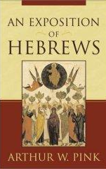
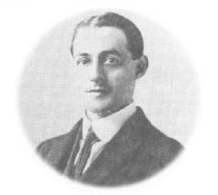
“There is not merely grace on the throne, but the throne is altogether the throne of grace. It is grace which disciplines us by the sharp and piercing Word, it is grace that looks on us when we have denied Him, and makes us weep bitterly. Jesus always intercedes: the throne is always a throne of grace. The lamb is in the midst of the throne. Hence we come boldly.”
- Arthur Pink, Exposition of Hebrews , 220

Slide 16
Coming Boldly to
the Throne of His Grace
What Are We to Do? – Come
Where Are We to Come? – Throne of Grace
Why Do We Come? - Help

Slide 17
Why Do We Come?
- Help
Rest Awaits Us (4:9, 11)
Jesus (our High Priest) is in Heaven (4:14)
We Have a High Priest Who Cares & Understands (4:15, “therefore”)
  Knows what its like to be tempted
  Knows the struggles of life
  He sympathizes
    Same word translated “compassion” (Heb. 10:34)
    Louw-Nida: “…to understand completely how one feels”

Slide 18
Why Do We Come?
- Help
Rest Awaits Us (4:9, 11)
Jesus (our High Priest) is in Heaven (4:14)
We Have a High Priest Who Cares & Understands (4:15, “therefore”)
Help in Time of Need (4:16)
  Time of need
    Weakness (v. 15)
    Temptation to sin (v. 15)
    Bodily affliction – sickness or disease
    Bereavement of friendships and loved ones
    Near our final hour
    “Before sinking through their own infirmity” (Delitzsch)

Slide 19
Why Do We Come?
- Help
Rest Awaits Us (4:9, 11)
Jesus (our High Priest) is in Heaven (4:14)
We Have a High Priest Who Cares & Understands (4:15, “therefore”)
Help in Time of Need (4:16)
  Time of need
  Mercy – Love that helps the wretched & discouraged
  Grace – Love that pardons the guilty & care that guides them

Slide 20
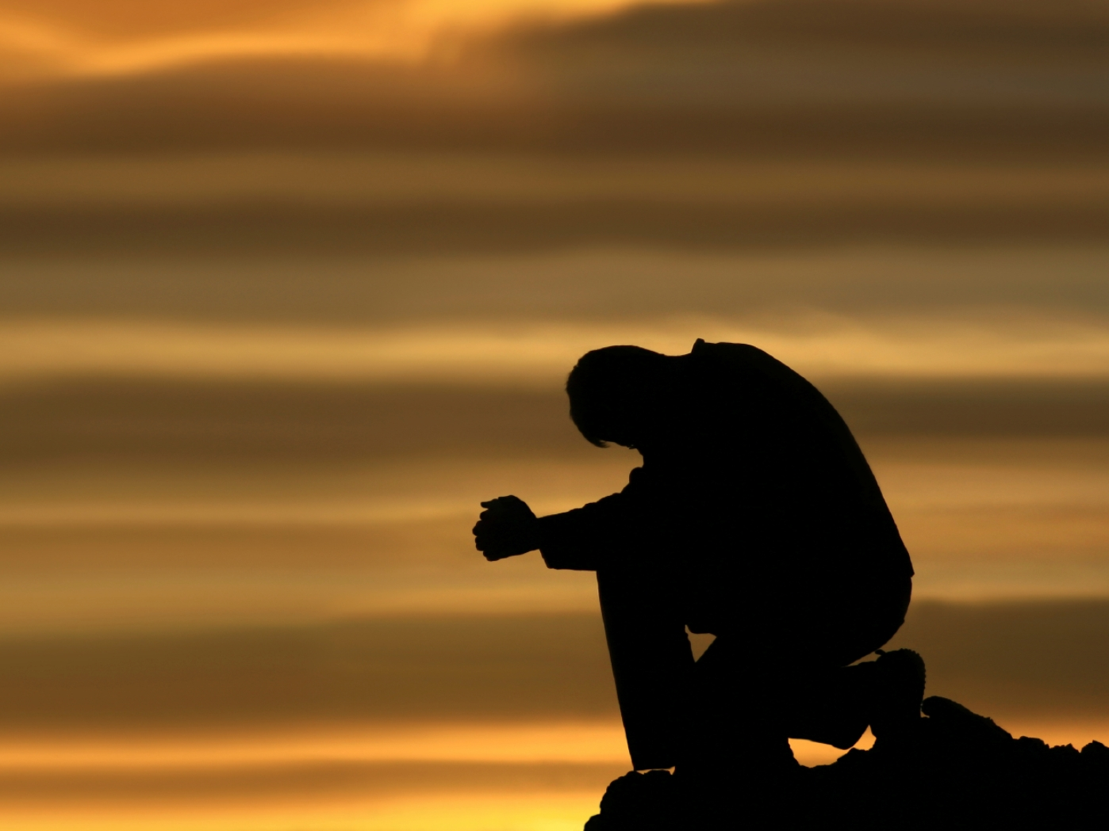
“…prayerlessness is the root of all sin. When we do not give time each day to earnest and believing prayer, we are saying that we can cope with life without divine aid. It is human arrogance at its worst….to be prayerless is to be guilty of the worst form of practical atheism.”
- Raymond Brown, Quoted by Dan King, The Book of Hebrews, 146-147

Slide 21
Coming Boldly to
the Throne of His Grace
What Are We to Do? – Come
Where Are We to Come? – Throne of Grace
Why Do We Come? - Help
How Are We to Come? - Boldly

Slide 22
How Are We to Come?
- Boldly
Approach with Confidence
  Joyful confidence
  “With confidence” (ESV;NASV; NIV)
  Assured of approaching an understanding, loving and forgiving God.

Slide 23
How Are We to Come?
- Boldly
Approach with Confidence
Not to be Confused with Arrogance / Self-Righteous
  Not trust in self (2 Cor. 1:9)
  Be humble (Rom. 12:1-3)

Slide 24
How Are We to Come?
- Boldly
Approach with Confidence
Not to be Confused with Arrogance / Self-Righteous
Not Contrasted to Reverent and Trembling
  Must fear God (Psa. 34)
  Must tremble (Isa. 66:2; Ps. 119:120)

Slide 25
How Are We to Come?
- Boldly
Approach with Confidence
Not to be Confused with Arrogance / Self-Righteous
Not Contrasted to Reverent and Trembling
Word literally means “saying all” (Pink)
  “All our spokenness, i.e. frankness , bluntness” (Strongs)
  Honest & frank (BDAG: “Outspokenness…frankness”)
  Pour out to Him our secret concerns (1 Pet. 5:7)
  Full and open discussion – hold back nothing
  Word translated:
    “Openly” (Jno. 11:54; 18:20)
    “Plainly” (Jno. 10:24;2 Cor. 3:12)

Slide 26
What a Contrast!
Thrones of Men
Not interested
Don’t want to hear all
Don’t want begging
Throne of God
Is interested
Wants to hear all
Wants your begging

Slide 27
Coming Boldly to
the Throne of His Grace
What Are We to Do? – Come
Where Are We to Come? – Throne of Grace
Why Do We Come? - Help
How Are We to Come? - Boldly

