Slide 1

Romans
A Series
A Textual Study
Romans
Paul, a bondservant of Jesus Christ, called to be an apostle, separated to the gospel of God ² which He promised before through His prophets in the Holy
Scriptures, ³ concerning His Son Jesus Christ our Lord, who was born of the seed of David according to the flesh, ⁴ and declared to be the Son of God with power according to the Spirit of
Romans
Paul, a bondservant of Jesus Christ, called to be an apostle, separated to the gospel of God ² which He promised before through His prophets in the Holy Scriptures, ³ concerning His Son Jesus Christ our Lord, who was born of the seed of David according to the flesh, ⁴ and declared to be the Son of God with power according to the Spirit of holiness, by the resurrection from the dead. ⁵ Through Him we have received grace and apostleship
Romans 4

Slide 2
Romans
(Outline)
“The Just Shall Live By Faith”
Justification by Faith Apart From the Law (1-8)
Rejection of the Jews & Accepting Gentiles (9-11)
The Christian’s Relationships (12-16)

Slide 3
Justification by Faith Apart From the Law (1-8)
Man’s need for justification (1-3)
  The Gentiles are in sin (1)
  The Jews are in sin (2)
  All are in sin (3:1-20)
Man is justified by faith (3:21-4:25)
  Justified by faith apart from the law (3:21-31)
  Abraham is an example to us of one justified by faith apart from the law (4)
What justification means to us (5-8)
  Blessings of salvation by faith (5)
  Doesn’t mean that we can continue in sin (6)
  Deliverance from the bondage of sin (7-8)

Slide 4
Abraham – Powerful Point to The Jews
Matt 3:9
“and do not think to say to yourselves, 'We have Abraham as our father.' For I say to you that God is able to raise up children to Abraham from these stones.”
John 8:33
“They answered Him, "We are Abraham's descendants, and have never been in bondage to anyone. How can you say, ‘You will be made free’?"

Slide 5
Justification by Faith
Exemplified in Abraham
Romans 4
3 For what does the Scripture say? "Abraham believed God, and it was accounted to him for righteousness."

Slide 6
Justification by Faith
Exemplified in Abraham
Romans 4
Abraham Justified by Faith Apart From Works (vv. 1-8)
Abraham Justified by Faith Apart From Circumcision (vv. 9-12)
The Promise to Abraham Was Not Through the Law (vv. 13-25)

Slide 7
Justification by Faith
Exemplified in Abraham
Romans 4
Abraham Justified by Faith Apart From Works (vv. 1-8)
Abraham Justified by Faith Apart From Circumcision (vv. 9-12)
The Promise to Abraham Was Not Through the Law (vv. 13-25)

Slide 8
Abraham Justified by Faith Apart From Works (vv. 1-8)
Abraham was counted righteous by his faith and not his works (vv. 1-3)
Works are reward by debt and not grace (vv. 4-5)
David said one could be justified without works (vv. 6-8)

Slide 9
Justified by the Law of Moses
Only Way To Be
Justified By The
Law
Perfect Obed.
(Lev. 18:5)
David Said
One Could
Be Saved –
Forgiven
(Psa. 32)
Therefore – David
Is Saying
Can be Saved
Apart From The Law
No One
Could Do
That

Slide 10
Before
Abraham
Believe
Counted
Righteous
Gen. 15
Law
Given
At
To
Moses
Exo. 20

Slide 11
Imputed
Impute / imputed
(NKJV)
  Rom. 4:6
  Rom. 4:8
  Rom. 4:11
  Rom. 4:23
  Rom. 4:24
Accounted
(NKJV)
  Rom. 4:3
  Rom. 4:4
  Rom. 4:5
  Rom. 4: 9
  Rom. 4:11
  Rom. 4:22

Slide 12
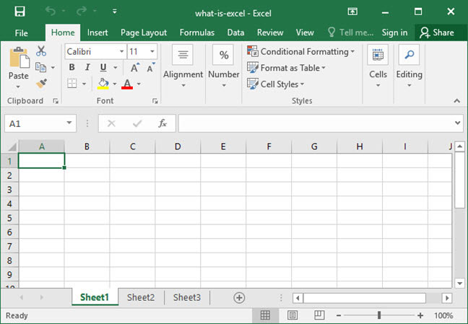

Imputed
Accounting term
Louw-Nida: “to keep records of commercial accounts, involving both debits and credits—‘to put into one’s account, to charge one’s account, to regard as an account.’”
Impute righteousness = mark down “righteous” on your account

Slide 13
Imputed Righteousness
Calvinism:
Christ
Righteousness
of Christ
transferred
Us

Slide 14


God Sees
Perfect
Righteousness of Christ
Sin
Sin
Sin
Sin
Error
Error
Sin

Slide 15
Imputed Righteousness
Calvinism:
Bible:
Christ
Nothing in Rom. 4 about the righteousness of Christ
Righteousness imputed = own
Sin imputed = own
If Righteousness = R. of Christ then sin = sin of Christ
Righteousness
of Christ
transferred
Us

Slide 16
Abraham Justified by Faith Apart From Works (vv. 1-8)
Abraham was counted righteous by his faith and not his works (vv. 1-3)
Works are reward by debt and not grace (vv. 4-5)
David said one could be justified without works (vv. 6-8)

Slide 17
Justification by Faith
Exemplified in Abraham
Romans 4
Abraham Justified by Faith Apart From Works (vv. 1-8)
Abraham Justified by Faith Apart From Circumcision (vv. 9-12)
The Promise to Abraham Was Not Through the Law (vv. 13-25)

Slide 18
Abraham Justified by Faith Apart From Circumcision (vv. 9-12)
Abraham was justified by faith while uncircumcised (vv. 9-10)

Slide 19
Before
Abraham
Believe
Counted
Righteous
Gen. 15
Abraham
Circum.
Gen. 17
Law
Given
At
To
Moses
Exo. 20
Before

Slide 20
Abraham Justified by Faith Apart From Circumcision (vv. 9-12)
Abraham was justified by faith while uncircumcised (vv. 9-10)
Abraham’s circum. was a seal of his righteousness (vv. 11-12)
  That he might be the father of all - including the uncircumcision (v. 11)
  That he might be the father of all - the circumcision who follow his faith (v. 12)

Slide 21
Justification by Faith
Exemplified in Abraham
Romans 4
Abraham Justified by Faith Apart From Works (vv. 1-8)
Abraham Justified by Faith Apart From Circumcision (vv. 9-12)
The Promise to Abraham Was Not Through the Law (vv. 13-25)

Slide 22
The Promise to Abraham Was Not Through the Law (vv. 13-25)
The promise was through the righteousness of faith (vv. 13, 16)
If it was through the law - faith is void and the promise is useless (vv. 14-15)
Abraham is the father of all (vv. 16-25)
Not just to those under the law – but to those of faith (16-17a)
Abraham believed God (against hope) and was counted righteous (vv. 17b-22)
Our faith is counted for righteousness if we believe (vv. 23-25)

Slide 23
Justification by Faith
Exemplified in Abraham
Romans 4
Abraham Justified by Faith Apart From Works (vv. 1-8)
Abraham Justified by Faith Apart From Circumcision (vv. 9-12)
The Promise to Abraham Was Not Through the Law (vv. 13-25)

Slide 24
Lessons to Learn
Teaching by example (Abraham) & inference (David)
Abraham is the father of Gentiles also
Circumcision = a sign; not a condition of salvation
Faith & Grace are not contradictory (v. 16)
If no law – no transgression
Imputed righteousness (Calvinism) is not taught in Rom. 4
Prophetic perfect (v. 17)
True faith believes against all odds (vv. 17-22)
Resurrection of Christ – necessary to offer blood (v. 25)

