Slide 2



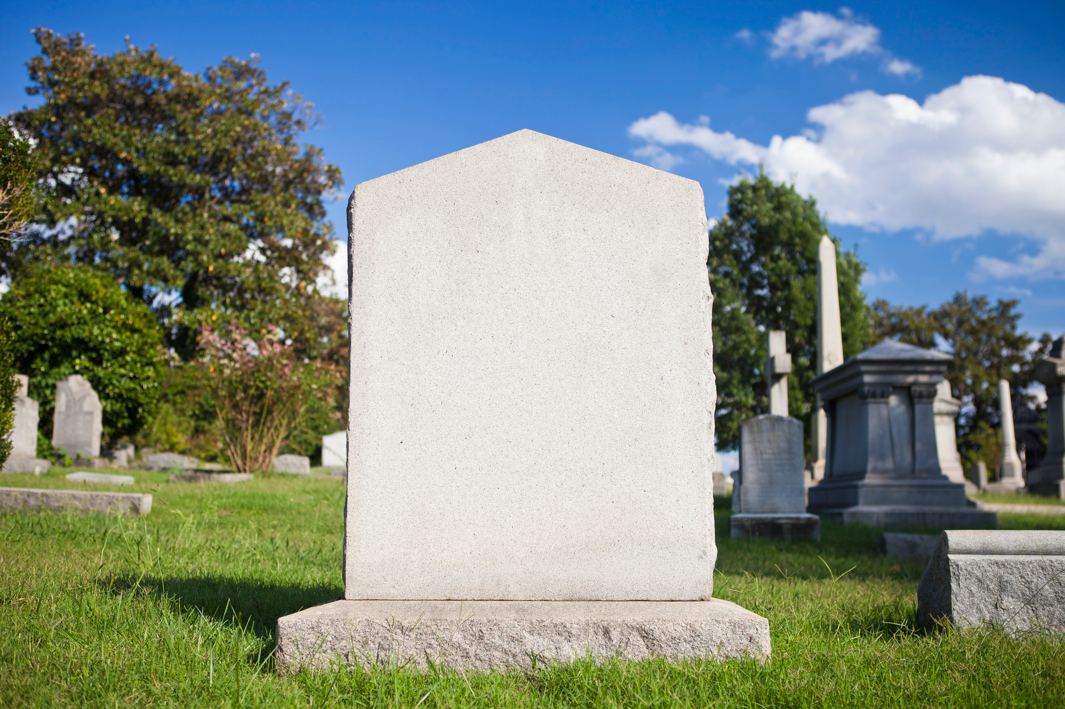
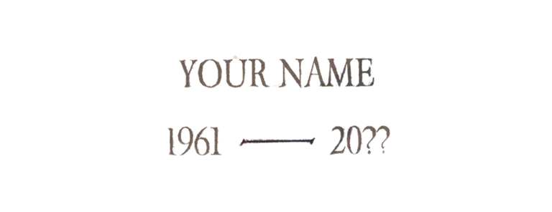
The
Dash
By Linda Ellis

Slide 3




The Dash
  It’s Brief & Uncertain

Slide 4
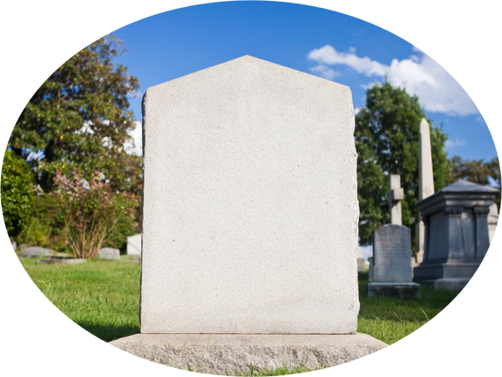
The Dash - It’s Brief & Uncertain
  Life Is Uncertain in Its Length
    There is uncertainty of life - Proverbs 27:1
    Some pass away at a young age
    Some pass away at an old age
    Life is brief in comparison to eternity

Slide 5
The Dash - It’s Brief & Uncertain
  Life Is Uncertain in Its Length
  The Brevity of Life
    Life is a vapor (James 4:14)
    Our days are as "hand-breaths" and a "shadow" (Ps 39:5-6)
    Man is like a breath and a passing shadow (Ps 144:4)
    Our days are like grass and the flower of the field (Psa 103:15-16)

Slide 6
The Dash - It’s Brief & Uncertain
  Life Is Uncertain in Its Length
  The Brevity of Life
  Since My Dash is Brief:
    Ask God to help me realize the "measure of my days" (Ps 39:4)
      Ignoring my brevity doesn't change it
      "Numbering my days" motivates me to be wise (Ps 90:12)
    Redeem the time (Eph 5:16)
    Rejoice in everyday that I have been given by God (Ps 118:24)
    Recognize the uncertainty of life (Prov 27:1; James 4:14)

Slide 7
The Dash
  It’s Brief & Uncertain
  It’s Not About What I Own

Slide 8
The Dash - It’s Not About What I Own
  Our life doesn’t consist about our possessions
    Luke 12:15
    Matthew 6:19-21

Slide 9
The Dash - It’s Not About What I Own
  Our life doesn’t consist about our possessions
  These Possessions are temporary
    1 Timothy 6:7
    Prov. 23:5

Slide 10
The Dash - It’s Not About What I Own
  Our life doesn’t consist about our possessions
  These Possessions are temporary
  Our possessions will not save us - Luke 16:19-31

Slide 11
The Dash
  It’s Brief & Uncertain
  It’s Not About What I Own
  It Will Be Judged

Slide 12
The Dash - It Will Be Judged
  Every Person Will Give Account
    Romans 14:12
    2 Corinthians 5:10
    None of us will be exempt from judgment - Rom. 2:3

Slide 13
The Dash - It Will Be Judged
  Every Person Will Give Account
  You Will Be Judged For Your Dash
    Rom. 2:6
    Rom. 14:12
    1 Pet. 1:17

Slide 14
The Dash - It Will Be Judged
  Every Person Will Give Account
  You Will Be Judged For Your Dash
  Our Dash Will Be judged by The Word of God
    John 12:48
    Rom. 2:16

Slide 15
The Dash - It Will Be Judged
  Every Person Will Give Account
  You Will Be Judged For Your Dash
  Our Dash Will Be judged by The Word of God
  Our Dash Will Be Judged by…
    Our words
    Our thoughts
    Our secrets
    Our Intents
    Everything

Slide 16
The Dash
  It’s Brief & Uncertain
  It’s Not About What I Own
  It Will Be Judged
  It Must Be Guided By The Word of God

Slide 17
The Dash - It Must Be Guided By The Word of God
  God’s word should be our Guide
    Psalm 119:105
    2 Timothy 3:16-17

Slide 18
The Dash - It Must Be Guided By The Word of God
  God’s word should be our Guide
  Man’s Way Leads to Death
    Jeremiah 10:23
    Proverbs 14:12

Slide 19
The Dash - It Must Be Guided By The Word of God
  God’s word should be our Guide
  Man’s Way Leads to Death
  Faith Comes by Hearing the Word
    Romans 10:17
    James 1:22

Slide 20
The Dash - It Must Be Guided By The Word of God
  God’s word should be our Guide
  Man’s Way Leads to Death
  Faith Comes by Hearing the Word
  Obedience to the Word Is Required
    John 14:15
    1 John 2:3-5

Slide 21
The Dash
  It’s Brief & Uncertain
  It’s Not About What I Own
  It Will Be Judged
  It Must Be Guided By The Word of God
  It Cannot Be Rewritten (You Only Get One)

Slide 22
The Dash - It Cannot Be Rewritten
(You Only Get One)
  Death Is Final - Hebrews 9:27
  You Can’t Come Back to Fix It
    Luke 16:24-26
    Matthew 25:10-13

Slide 23
The Dash - It Cannot Be Rewritten
(You Only Get One)
  Death Is Final - Hebrews 9:27
  You Can’t Come Back to Fix It
  Today Is the Day to Change
    2 Corinthians 6:2
    Acts 17:30-31

Slide 24
The Dash
  It’s Brief & Uncertain
  It’s Not About What I Own
  It Will Be Judged
  It Must Be Guided By The Word of God
  It Cannot Be Rewritten (You Only Get One)

Slide 25
The
Dash
How Are You Spending Your Dash?
By Linda Ellis

