Slide 2
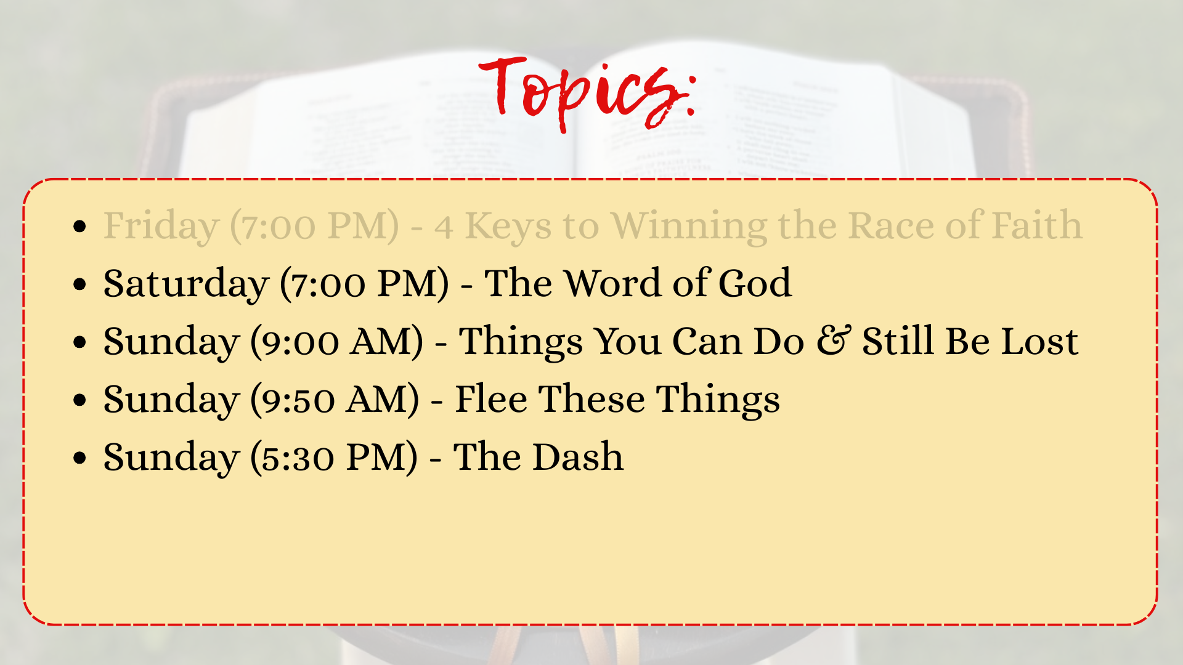

Slide 3
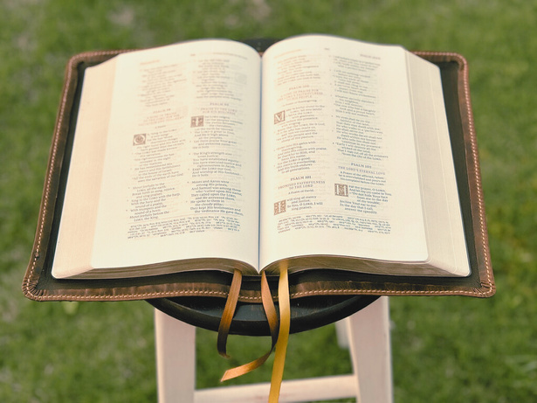
EL BETHEL CHURCH OF CHRIST 2025
TODAY’S VERSE
4
OCTOBER
Hebrews 4:11-13
11 Let us therefore be diligent to enter that rest, lest anyone fall according to the same example of disobedience.
12 For the word of God is living and powerful, and sharper than any two-edged sword, piercing even to the division of soul and spirit, and of joints and marrow, and is a discerner of the thoughts and intents of the heart.
13 And there is no creature hidden from His sight, but all things are naked and open to the eyes of Him to whom we must give account.

Slide 4
EL BETHEL CHURCH OF CHRIST 2025
TODAY’S VERSE
4
OCTOBER
Hebrews 4:11-13
11 Let us therefore be diligent to enter that rest, lest anyone fall according to the same example of disobedience.
12 For the word of God is living and powerful, and sharper than any two-edged sword, piercing even to the division of soul and spirit, and of joints and marrow, and is a discerner of the thoughts and intents of the heart.
13 And there is no creature hidden from His sight, but all things are naked and open to the eyes of Him to whom we must give account.

Slide 5
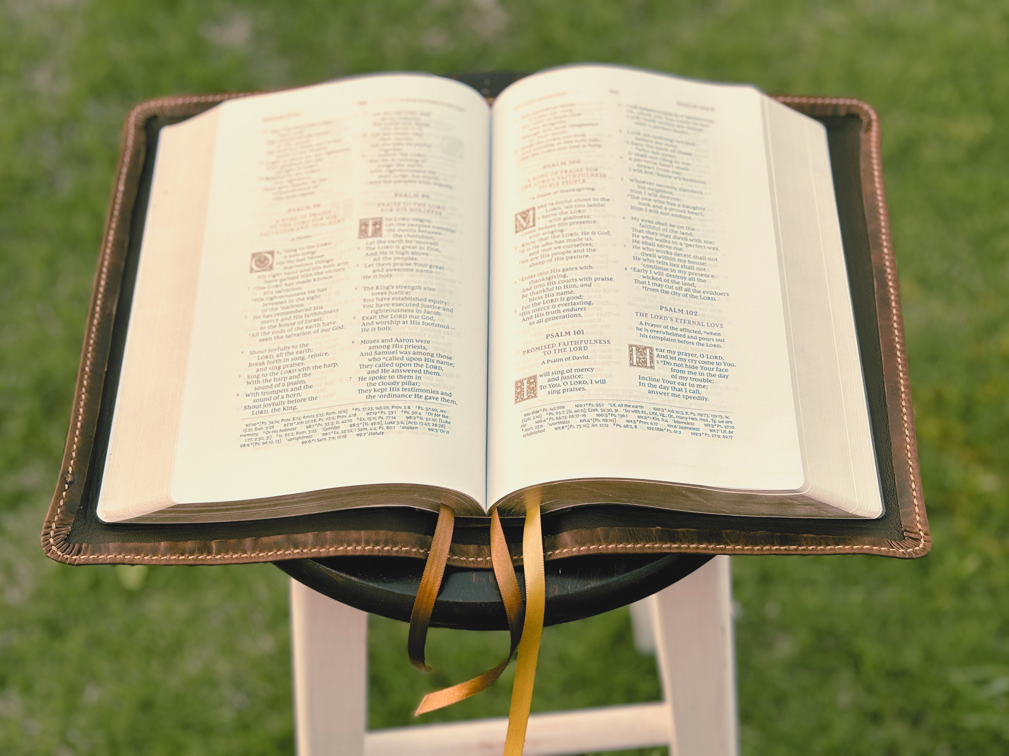

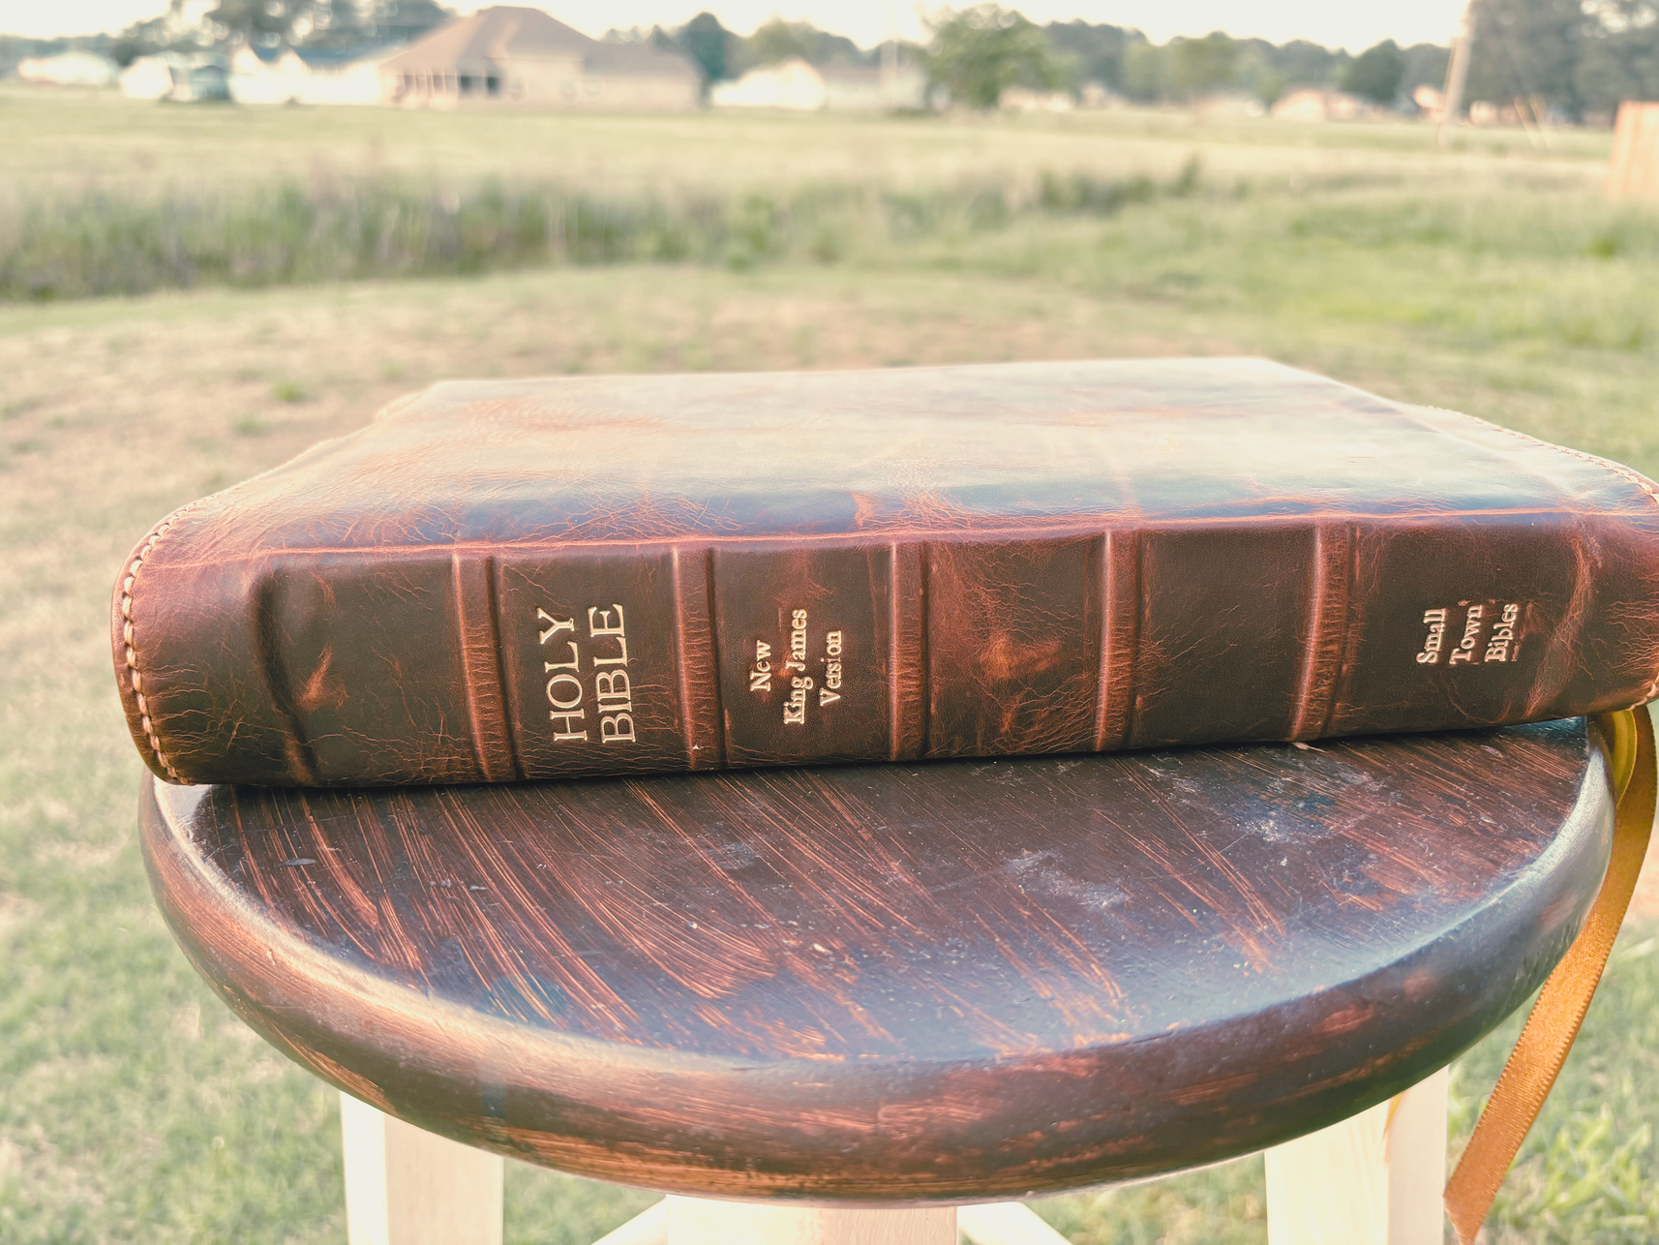
EL BETHEL CHURCH OF CHRIST 2025
THE
WORD OF GOD
Hebrews 4:12-13

Slide 6
THE
WORD OF GOD
  The Context

Slide 7
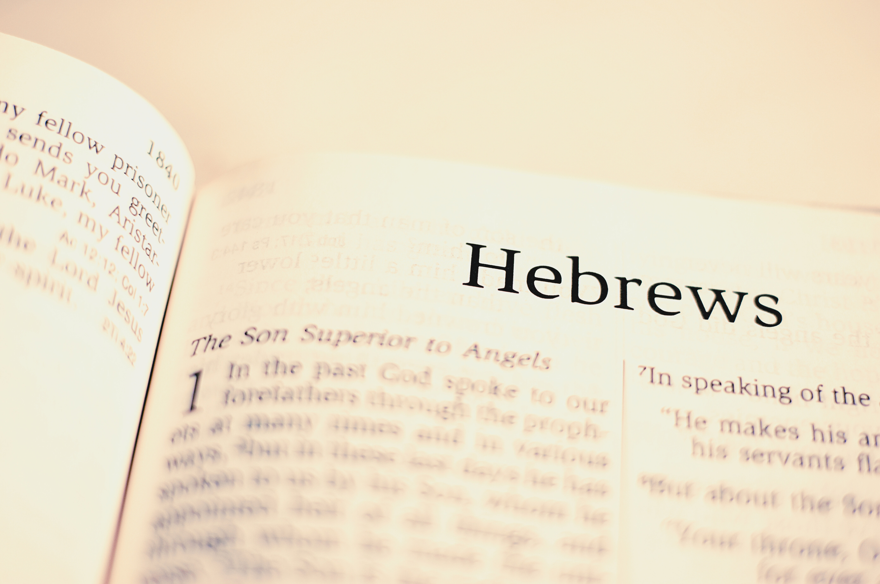
The Context
  The Hebrew Writer Had Discussed the Example of Disobedient Israel in Heb 3:7-19

Slide 8
Hebrews 4 - Strive to Enter That Rest
  Rest remains for the people of God (vv.1-10)
  Reasons to Continue (vv.11-13)
  Persevere Because of Christ (vv.14-16)

Slide 9
The Context
  The Hebrew Writer Had Discussed the Example of Disobedient Israel in Heb 3:7-19
  We Should Fear Lest We Miss Out on Our Promised Land Just Like They Did. (Heb 4:1-2)

Slide 10
THE
WORD OF GOD
  The Context
  The Power of the Word

Slide 11
The Power of the Word
  The Word of God is Not Dead, Powerless, or Ineffective
  The Word is Living, Abiding, and Effective
    1 Peter 1:23 - “living and abiding word”
    Isa 40:8 - “the word of God stands forever”
    Louw-Nida - “able to make things happen”

Slide 12
The Word is Powerful To:
  Save man from his sins (Romans 1:16; 2 Timothy 3:15)
  Build us up and give us an inheritance (Acts 20:32)
  Cut or prick man’s heart (Acts 2:37–38)
  Keep us from sinning (1 John 3:9; Luke 8:11; Psalm 119:9–11)
  Make us complete and equip us (2 Timothy 3:16–17)
  Sanctify us (John 17:17)
  Guide our path (Psalm 119:105)
  Cause us to grow to salvation (1 Peter 2:2)
  Defeat the fiery darts of the devil (Ephesians 6:13–15)
  Give us hope and encouragement (Romans 15:4)

Slide 13
THE
WORD OF GOD
  The Context
  The Power of the Word
  The Penetration of the Word

Slide 14
The Word is Sharper Than a Two-Edged Sword
  Ehud’s double-edged sword (Judges 3:16)
  The forbidden woman is sharper than “a two-edged sword” (Proverbs 5:4)
  Christ has a sharp two-edged sword (Revelation 1:16; Revelation 2:12)

Slide 15
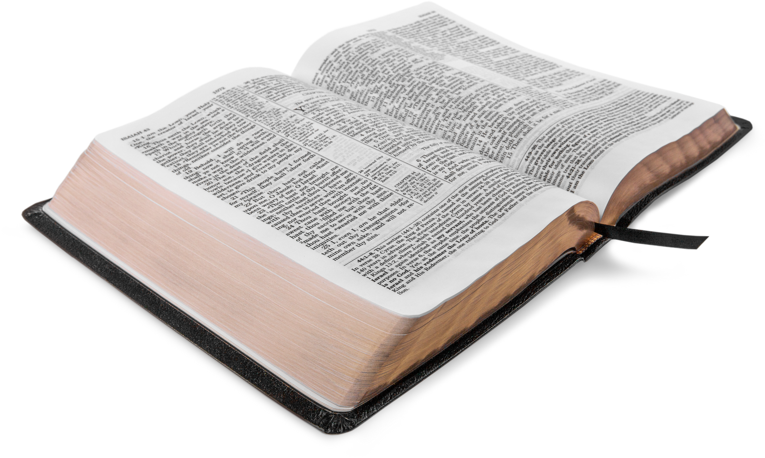
The Word Will Judge Us In the Last Day
  John 12:48
  Revelation 20:11–13
  Romans 2:16

Slide 16
In the Judgment Day God’s Word Will Lay Everything Open Before God - Everything Will Be Exposed
We will be judged by our deeds (2 Cor 5:10)
We will be judged by our secrets (Rom 2:16; Ecc 12:14)
01.
02.
We will be judged by our thoughts.
03.

Slide 17
We Will Be Judged By Our Thoughts
  God knows what is in man (Mark 2:8; John 2:25)
  He knows our thoughts afar off (Psalm 139:2)
  Psalm 94:11

Slide 18
In the Judgment Day God’s Word Will Lay Everything Open Before God - Everything Will Be Exposed
We will be judged by our deeds (2 Cor 5:10)
We will be judged by our secrets (Rom 2:16; Ecc 12:14)
01.
02.
We will be judged by our thoughts.
03.
04.
He knows our “intents”.

Slide 19
He Knows Our “Intents”
  You can do the right thing for the wrong reason. When we do God knows.
  Phil 1:15-18
  God looks deeper than man. He knows the heart (1 Sam 16:7)

Slide 20
You Won’t Be Able to Fool God Because His Word Will Expose Everything
  Gal 6:7
  Example of Jeroboam and his wife (1 Kings 14:1-18)

Slide 21
THE
WORD OF GOD
  The Context
  The Power of the Word
  The Penetration of the Word
  The Call of the Word

Slide 22
The Call of the Word
  Strive to Enter That Rest
    “make every effort” (CSB)
    “be diligent” (NKJV)

Slide 23
The Call of the Word
  Strive to Enter That Rest
  We Should Strive or Be Diligent
    To correctly divide the word of God (2 Tim 2:15)
    To make or call an election sure (2 Pet 1:10)
    To be found without spot or blemish (2 Pet 3:14)
    To recall the word of God (2 Peter 1:15)

Slide 24
The Call of the Word
  Strive to Enter That Rest
  We Should Strive or Be Diligent
  We Strive So We Don’t Fall The Same Way the Israelites Did
    What happened to them serves as a warning to us (1 Cor 10:11-12)
    They heard the word but didn’t believe it and were lost (Heb 4:1-2, NKJV).

Slide 25
THE
WORD OF GOD
  The Context
  The Power of the Word
  The Penetration of the Word
  The Call of the Word

Slide 26
EL BETHEL CHURCH OF CHRIST 2025
THE
WORD OF GOD
Hebrews 4:12-13

