Slide 2
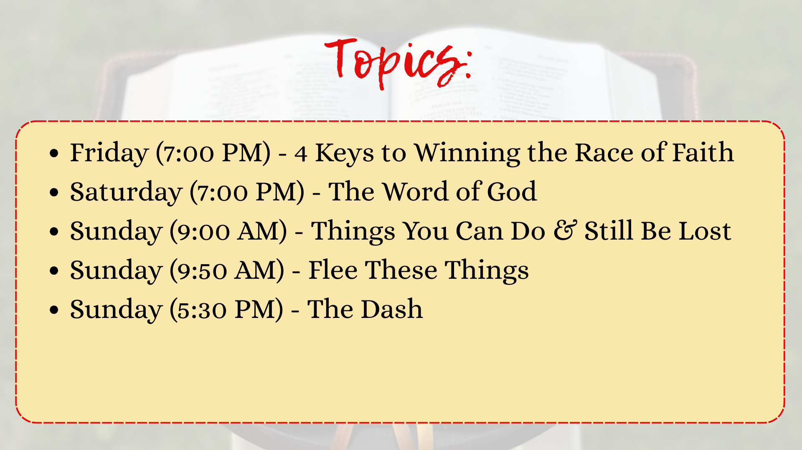

Slide 3
Familiar Examples Used To Illustrate How Christians Should Live
Farming
Luke 9:62
Building
Matthew 7:24-27
Soldiers
Eph. 6:10-20
Each of These Simple, Familiar Pictures Illustrates Important Lessons About Living As A Christian

Slide 4


THE CHRISTIAN LIFE IS ALSO ILLUSTRATED AS A RACE
1 Corinthians 9:24–27 (NKJV)
²⁴ Do you not know that those who run in a race all run, but one receives the prize? Run in such a way that you may obtain it.
²⁵ And everyone who competes for the prize is temperate in all things. Now they do it to obtain a perishable crown, but we for an imperishable crown.
²⁶ Therefore I run thus: not with uncertainty. Thus I fight: not as one who beats the air.
²⁷ But I discipline my body and bring it into subjection, lest, when I have preached to others, I myself should become disqualified.

Slide 5
THE CHRISTIAN LIFE IS ALSO ILLUSTRATED AS A RACE
Acts 20:24 (NKJV)
²⁴ But none of these things move me; nor do I count my life dear to myself, so that I may finish my race with joy, and the ministry which I received from the Lord Jesus, to testify to the gospel of the grace of God.

Slide 6
THE CHRISTIAN LIFE IS ALSO ILLUSTRATED AS A RACE
2 Timothy 2:5 (NKJV)
⁵ And also if anyone competes in athletics, he is not crowned unless he competes according to the rules.

Slide 7
THE CHRISTIAN LIFE IS ALSO ILLUSTRATED AS A RACE
2 Timothy 4:7 (NKJV)
⁷ I have fought the good fight, I have finished the race, I have kept the faith.

Slide 8
THE CHRISTIAN LIFE IS ALSO ILLUSTRATED AS A RACE
Hebrews 12:1–2 (NKJV)
¹ Therefore we also, since we are surrounded by so great a cloud of witnesses, let us lay aside every weight, and the sin which so easily ensnares us, and let us run with endurance the race that is set before us,
² looking unto Jesus, the author and finisher of our faith, who for the joy that was set before Him endured the cross, despising the shame, and has sat down at the right hand of the throne of God.

Slide 9



HEB. 12:1-2
4 KEYS TO WINNING THE RACE OF FAITH
THE RACE THAT IS SET BEFORE US
El Bethel Church of Christ 2025

Slide 10


4 KEYS TO WINNING THE RACE OF FAITH
  Recognize You Can Win (Heb. 12:1)
El Bethel Church of Christ 2025

Slide 11


WE CAN WIN THE RACE OF FAITH (HEB. 12:1)
  We Know We Can Win Because of “The Great Cloud of Witnesses”
    These men and women “obtained a good testimony through faith”. (NKJV) - Heb. 11:39-40
    These men and women faced challenges, difficulties and obstacles and still ran with endurance

Slide 12
WE CAN WIN THE RACE OF FAITH (HEB. 12:1)
  We Know We Can Win Because of “The Great Cloud of Witnesses”
  What Do We Learn from This Cloud of Witnesses?
    We learn that we can win the race if we are all alone. We learn this from Noah (Heb 11:7)
    We learn that we can win the race even when there is uncertainty about what is ahead. We learn from Abraham (Heb 11:8-12)
    We learn we can win the race even if it requires great sacrifice on our part. We learn this from Moses (Heb 11:23-27)
    We learn we can win the race even if we are mistreated and persecuted. We learn this from (Heb 11:32-38)

Slide 13
WE CAN WIN THE RACE OF FAITH (HEB. 12:1)
  We Know We Can Win Because of “The Great Cloud of Witnesses”
  What Do We Learn from This Cloud of Witnesses?
  We Have Something Better Than They Had, So We Should Be Able to Win the Race
    Heb 11:39-40
    These men and women never saw the complete fulfillment of God’s promise. They only saw it afar off (Heb 11:13)
    If they won the race and we have an advantage over them, then we should be able to win the race as well

Slide 14
4 KEYS TO WINNING THE RACE OF FAITH
  Recognize You Can Win (Heb. 12:1)
  Throw Off Every Hindrance (Heb. 12:1)
El Bethel Church of Christ 2025

Slide 15
THROW OFF EVERY HINDRANCE (HEB. 12:1)
  What does it mean to lay aside?
    NIV - “throw off everything...”
    NET - “must get rid of every weight...
    Translated as “put off” in Eph 4:22 and Col 3:8
    Translated as “cast off” in Rom. 13:12

Slide 16
THROW OFF EVERY HINDRANCE (HEB. 12:1)
  What Does It Mean To Lay Aside?
  What Should We Lay Aside?
    We must lay aside every weight
      NIV and CSB translate weight as “hinders” or “hindrance”

Slide 17
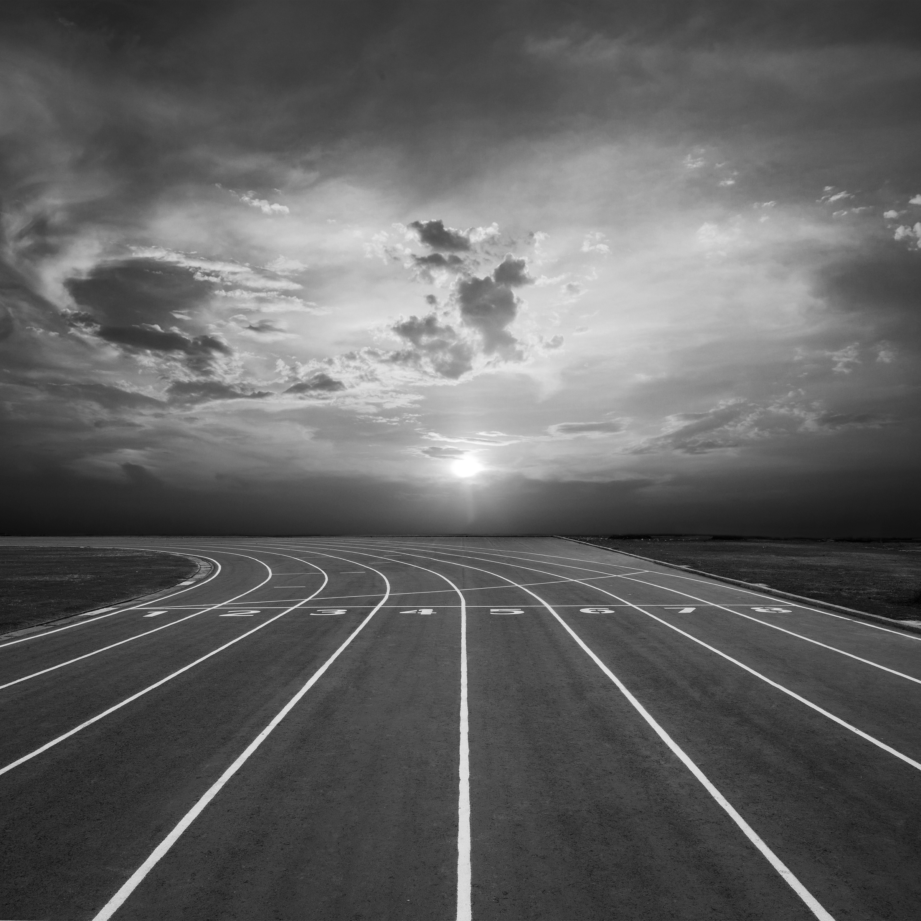
HEB. 12:1 - NIV
1Therefore, since we are surrounded by such a great cloud of witnesses, let us throw off everything that hinders and the sin that so easily entangles. And let us run with perseverance the race marked out for us,

Slide 18
HEB. 12:1 - CSB
1Therefore, since we also have such a large cloud of witnesses surrounding us, let us lay aside every hindrance and the sin that so easily ensnares us. Let us run with endurance the race that lies before us,

Slide 19
THROW OFF EVERY HINDRANCE (HEB. 12:1)
  What Does It Mean To Lay Aside?
  What Should We Lay Aside?
    We must lay aside every weight
      NIV and CSB translate weight as “hinders” or “hindrance”
      The Hebrew writer is not talking about sin because that is mentioned next. Rather, he is talking about things that might distract and keep us from running with endurance.

Slide 20
COFFMAN
“There are two classes of impediments to be avoided by the successful contender in the race of life, the first of these being ‘weights,’ as mentioned here. This class of hindrance includes just about everything that can get in the way, or impede the Christian contender's progress. Things not bad at all in themselves, but which, in the last analysis, hinder the work of the child of God must all be cast aside.”

Slide 21
THROW OFF EVERY HINDRANCE (HEB. 12:1)
  What Does It Mean To Lay Aside?
  What Should We Lay Aside?
    We must lay aside every weight
      NIV and CSB translate weight as “hinders” or “hindrance”
      The Hebrew writer is not talking about sin because that is mentioned next. Rather, he is talking about things that might distract and keep us from running with endurance.
      Jesus warned about things that could choke out the word in the parable of the Sower (Luke 8:14).
      Luke 10:38-41
      Anything that keeps us from running to win must be gotten rid of. Nothing is worth being lost over (Mark 9:42-48).

Slide 22
THROW OFF EVERY HINDRANCE (HEB. 12:1)
  What Does It Mean To Lay Aside?
  What Should We Lay Aside?
    We must lay aside every weight
    We must lay aside sin
      We must put off the old man of sin (Eph 4:20-24; Col 3:5,8)
      We must cast off the works of darkness (Romans 13:12-14)
      Why would you want to keep sin considering what it does?
        Romans 6:21-23
        Isa 59:1-2

Slide 23
4 KEYS TO WINNING THE RACE OF FAITH
  Recognize You Can Win (Heb. 12:1)
  Throw Off Every Hindrance (Heb. 12:1)
  Run with Endurance (Heb. 12:1)
El Bethel Church of Christ 2025

Slide 24
RUN WITH ENDURANCE (HEB. 12:1)
  To Run with Endurance Means Keep Running and Don’t Give Up
    We have need of endurance so we don’t give up (Heb 10:35-39)
    To run with endurance requires focus and discipline (1 Cor 9:24-27)
    We Must Be Patient in Doing Good (Rom. 2:7)
    Good Soil or Hearts Bear Fruit with Patience (Luke 8:14)

Slide 25
RUN WITH ENDURANCE (HEB. 12:1)
  To Run with Endurance Means Keep Running and Don’t Give Up
  How Do We Develop Endurance or Patience?
    We develop patience through the scriptures (Romans 15:4)
    We develop patience as we undergo trials (James 1:2-3)
    We develop patience by focusing on our hope (Romans 8:24-25; James 5:7-11)

Slide 26
4 KEYS TO WINNING THE RACE OF FAITH
  Recognize You Can Win (Heb. 12:1)
  Throw Off Every Hindrance (Heb. 12:1)
  Run with Endurance (Heb. 12:1)
  Keep Your Eyes on Jesus (Heb. 12:2)
El Bethel Church of Christ 2025

Slide 27
KEEP YOUR EYES ON JESUS (HEB. 12:2)
  We Might Glance At Others (the cloud of witnesses), but our focus must be on Jesus (Col 3:1-2)
  When We Look to Jesus, We See the Author and Finisher of Our Faith
    He is the author, which means that he is the “cause of our salvation”
      Acts 4:12
      He caused our salvation by suffering and becoming like us in all things (Heb 2:9-11)
    He is the finisher or perfecter. He brought it to completion

Slide 28
KEEP YOUR EYES ON JESUS (HEB. 12:2)
  We Might Glance At Others (the cloud of witnesses), but our focus must be on Jesus (Col 3:1-2)
  When We Look to Jesus, We See the Author and Finisher of Our Faith
  When We Look to Jesus, We See How He Endured
    He looked to the joy set before him, and this caused him to endure the cross and despise the shame
    We must focus on the joy before us if we are to endure
      2 Cor 4:16-18
      Heb 11:13-16

Slide 29
KEEP YOUR EYES ON JESUS (HEB. 12:2)
  We Might Glance At Others (the cloud of witnesses), but our focus must be on Jesus (Col 3:1-2)
  When We Look to Jesus, We See the Author and Finisher of Our Faith
  When We Look to Jesus, We See How He Endured
  When We Look to Jesus, We See What We Have to Endure Is Not That Bad
    Jesus faced great hostility from sinners (Luke 4:28-29; Luke 16:14)
    Ultimately, Jesus gave his life for us (Phil 2:8)
    We have not suffered to that extent. If he suffered for us then we can live for him (2 Cor 5:14-15)

Slide 30
4 KEYS TO WINNING THE RACE OF FAITH
  Recognize You Can Win (Heb. 12:1)
  Throw Off Every Hindrance (Heb. 12:1)
  Run with Endurance (Heb. 12:1)
  Keep Your Eyes on Jesus (Heb. 12:2)
El Bethel Church of Christ 2025

Slide 31
HEB. 12:1-2
4 KEYS TO WINNING THE RACE OF FAITH
THE RACE THAT IS SET BEFORE US
El Bethel Church of Christ 2025

