Slide 1
Short Version of O.T. History
Israel- North (722)
>
Captivity
Judah - South (606)
When Judah fell - Temple destroyed - City Burned
Jerusalem left in ruins

Slide 2
Short Version of O.T. History
Israel- North (722)
>
Post Exile
Restoration
Captivity
Nehemiah
Judah - South (606)
Nehemiah opens with remnant in sea of ruins
Much to be done!
Focus: Rebuilding the wall

Slide 3
Taking
A
Look
At
The
Situation
City & walls in ruins (1:3-ff)
So much to do - Looks hopeless
Overwhelming to look at whole
Cause for weeping (1:4)
No comfort - know brought on self
Story of the book:
Rebuilding the wall
Overcoming the obstacles

Slide 4

Your Wall May Need To Be Rebuilt
Wall of knowledge
Wall of spirituality
Wall of faith
Wall of hope
Wall of service
Wall of self control
We All Have Walls To Build

Slide 5
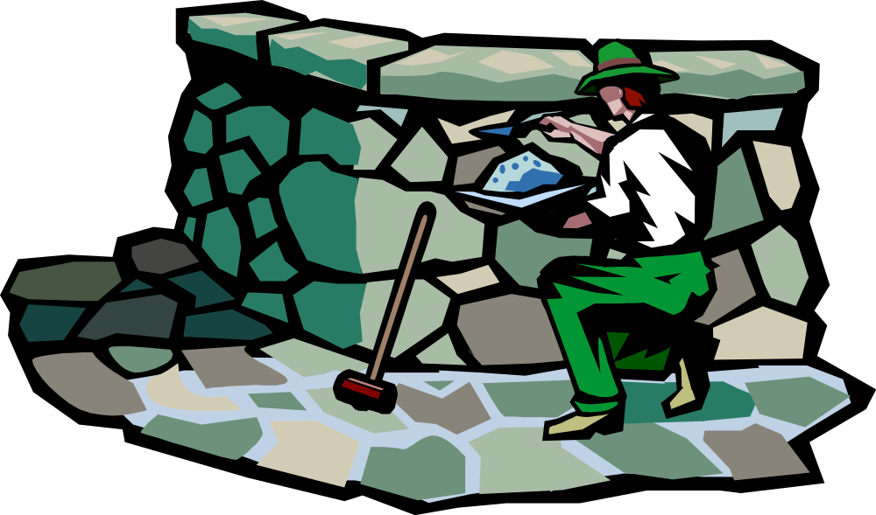
Fundamental
Principles:
Walls Are Built
One Stone At A Time
Walls Are Built
Staying With The Task

Slide 6
Hand Me Another Stone
I’m Building A Wall
Question:
How?

Slide 7
Hand Me Another Stone
I’m Building A Wall
Fear God

Slide 8

Fear God
Nehemiah & Israel Feared God
  Desire to fear (1:11)
  Stood in awe of God (1:5)
  Basis for how treat others (5:9)
We Must Fear God Almighty
  Stand in awe of God (Luke 7:16)
  Afraid of his wrath (Heb. 12:29)

Slide 9
Fear God

Slide 10
Hand Me Another Stone
I’m Building A Wall
Fear God
Pray

Slide 11
Pray
Nehemiah & Israel Prayed
  Praise, confession & plea for mercy (1:5-11)
  Asked for strength (6:9)
  Remember me (13:14, 22, 29, 31)
We Must Fervently Pray
  To overcome temptation (Matt. 6:9-13)
  Grace to help (Heb. 4:16)
  Strength (Col. 1:11)

Slide 12
Fear God
Pray

Slide 13
Hand Me Another Stone
I’m Building A Wall
Fear God
Pray
Led by God

Slide 14
Led by God
Nehemiah & Israel - Led by God
  Did what God told him (2:12)
  Behavior different - fear (5:15)
We Must Let God Lead Our Way
  Christ rule in our life (Matt. 6:33: Luke 6:46)
  Follow the rule of Gospel (Phil. 1:27)
  His way best (Isa. 55:6-7; Deut. 6:24)
  They are in this mess because didn’t follow

Slide 15
Fear God
Pray
Led by God

Slide 16
Hand Me Another Stone
I’m Building A Wall
Fear God
Pray
Led by God
Have A Plan / Goal

Slide 17
Have Plan/Goal
Nehemiah & Israel Had Plans / Goals
  Definite plan - how fix wall (2:17; 3)
  Certain goals - correct problem (5:11)
We Must Have Goals / Plans
  Be like Christ (1 Cor. 11:1; 1 Pet. 2:21)
  Like those who are faithful (Phil. 3:17)
  Ideal Christian (2 Pet. 1:5-10)
  Too often we have desire – no plan

Slide 18
Have Goals
Fear God
Pray
Led by God

Slide 19
Hand Me Another Stone
I’m Building A Wall
Fear God
Pray
Led by God
Have A Plan / Goal
Positive / Confident

Slide 20
Positive /
Confident
Nehemiah & Israel Positive / Confident
  Thought we can do it (2:18-20)
  Mind to work (4:6)
We Must Be Positive / Confident
  Can do what God expects (Phil. 4:13)
  God’s way works (Luke 7:35)
  Will do what should (Heb. 6:3)

Slide 21
Have Goals
Positive/
Confident
Fear God
Pray
Led by God

Slide 22
Hand Me Another Stone
I’m Building A Wall
Fear God
Pray
Led by God
Have A Plan / Goal
Positive / Confident
With the Help of Others

Slide 23
With Help of
Others
No One Built Wall By Himself
  Each family & each member (3)
  Some who refused (3:5)
We Need Help & Support of Others
  Need other’s prayer (Luke 22:31-32)
  Need other’s encouragement (Heb. 10:24)
  Bear one another’s burden (Gal. 6:2)

Slide 24
Help from
Others
Have Goals
Positive/
Confident
Fear God
Pray
Led by God

Slide 25
Hand Me Another Stone
I’m Building A Wall
Fear God
Pray
Led by God
Have A Plan / Goal
Positive / Confident
With the Help of Others
See the Dangers

Slide 26
See Dangers
Nehemiah Saw the Dangers
  Opposition from outside (4)
  Problem from inside (5)
  Set a watch - keep an eye (4:9)
We Must Ever Be Watchful
  Know the wiles devil (2 Cor. 2:11)
  Watch (Acts 20:31; 1 Cor. 16:13)
  Beware that can fall (Heb. 3:12)

Slide 27
Help from
Others
See the
Dangers
Have Goals
Positive/
Confident
Fear God
Pray
Led by God

Slide 28
Hand Me Another Stone
I’m Building A Wall
Fear God
Pray
Led by God
Have A Plan / Goal
Positive / Confident
With the Help of Others
See the Dangers
Develop Hatred for Sin

Slide 29
Develop Hatred
For Sin
Nehemiah Was Outraged by Sin
  Angry at mistreatment offered (5:6)
  Grieved bitterly (13:8)
  Strong rebuke for sin (13:25)
We Should Be Disturbed by Sin
  Hate it (Prov. 8:13)
  Sick of it (2 Pet. 2:7-8)
  Through with it (1 Pet. 4:1-3)

Slide 30
Help from
Others
See the
Dangers
Hatred for
Sin
Have Goals
Positive/
Confident
Fear God
Pray
Led by God

Slide 31
Hand Me Another Stone
I’m Building A Wall
Fear God
Pray
Led by God
Have A Plan / Goal
Positive / Confident
With the Help of Others
See the Dangers
Develop Hatred for Sin
Do What You Know

Slide 32
Do What
You Know
Nehemiah Did What He Knew He Ought
  Built the wall (4:6)
  Finished in 52 days (6:15)
Our Problem Is Not Knowing, but Doing
  Doers of word (Jas. 1:22)
  Don’t - it is sin (Jas. 4:17)

Slide 33
Do what
Know
Help from
Others
See the
Dangers
Hatred for
Sin
Have Goals
Positive/
Confident
Fear God
Pray
Led by God

Slide 34
Hand Me Another Stone
I’m Building A Wall
Fear God
Pray
Led by God
Have A Plan / Goal
Positive / Confident
With the Help of Others
See the Dangers
Develop Hatred for Sin
Do What You Know

