Slide 1
What About
Dinosaurs & Man?

Slide 2
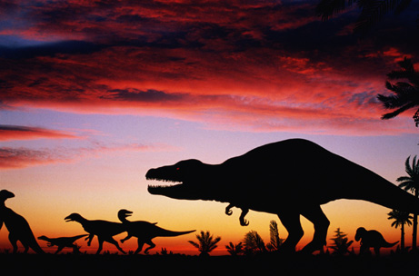
The Dinosaur
Is the “Poster Child” of Evolution
We have been inundated with information:
TV, books, classroom, museums, movies, & magazines
Says dinosaurs lived millions and millions of years ago
Dinosaurs and man separated by 60+ million years

Slide 3
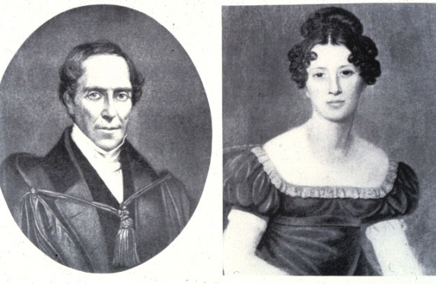
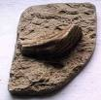
“Dinosaur”
Not An Ancient Term
1822 Dr. Gideon Mantell, an English doctor, lived near Oxford, England.
Wife, Mary, who collected fossils, tagged along on a visit one day.
On a walk, she found huge fossilized tooth. (Had to be cut out of rock)
Husband looked and found more teeth and bones as well.
Dr. Mantell sent them to Baron Georges Cuvier (French fossil expert) who mistakenly identified them from ancient rhinoceros or hippopotamus.
Dr. Mantell showed the tooth to one familiar with the iguana (though this tooth was much larger) – realized found a “new” kind of animal.
Gave it the name: “Iguanodon” (iguana tooth)
About same time fossil bones found – given name Megalosaurus (“giant lizard”)

Slide 4
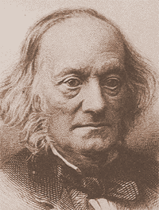
“Dinosaur”
Not An Ancient Term
1840 – Sir Richard Owen (one of England’s greatest anatomical researchers) studied the bones of Megalosaurus and iguanodon
Concluded these are not the bones of any animal living then
Gave the “new order” of animal the name “Dinosaur” (terrible lizard)
From Greek words: Deino = Terrible / Sauros = Lizard
Translated by Owen “Fearfully Great Lizards”

Slide 5
Questions About Dinosaurs
Were they real? Did they exist?
When did they exist?
Did man and dinosaurs live at the same time?
What happened to them?

Slide 6
What About
Dinosaurs & Man?
What is at Issue?

Slide 7
What is at Issue?
Average Child’s View – Dinosaurs lived millions of years ago
“Some time ago at a camp for Christian young people, a short, three-question quiz was given to the teenagers in attendance—most of whom were from homes with Christian parents (and many of whom already had made the decision to become a Christian themselves). The first question asked simply, ‘How long ago did the dinosaurs live?,’ and provided four possible answers. Over 70% of those present answered that dinosaurs had walked this Earth millions of years ago.”
Brad Harrub, Ph. D & Bert Thompson, Ph.d, Walking Amidst the Dinosaurs, Reason and Revelation

Slide 8
What is at Issue?
Average Child’s View – Dinosaurs lived millions of years ago
Dinosaur is a “Tool” for Teaching Evolution
  Kindergarten through Graduate School – used to indoctrinate students that evolution is a “fact”
  Discussed in the context of evolution (origin, development and extinction)
  “Given” (assumed) that they existed millions of years ago
  Told from an ancient reptile – evolved into dinosaurs – then evolved into birds
  Starts with fascination with dinosaurs – then march off to school where learn evolution

Slide 9
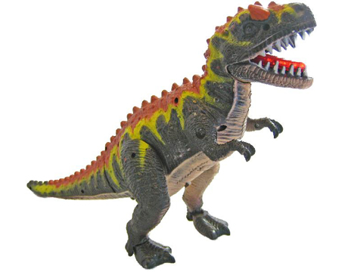
Toy
A Teaching
“Tool”
Because dinosaurs are fascinating to children
Because they are such an effective teaching aid
Because they generally are used to teach evolution
Therefore:
Becomes formidable tool to be used in robbing students of all ages of their faith in God and His Word
This makes the controversy over dinosaurs most important

Slide 10
Effective “Tool”
Evolutionists like the late paleontologist Stephen Jay Gould of Harvard, the famed dinosaur hunter, Robert Bakker, and others are on record as stating that it was the study of dinosaurs, at a very young age, which set them on their lifelong path as evolutionists.
Edward O. Wilson, the father of the discipline known as sociobiology, once commented that when he was fifteen years old, he had “great fervor and interest in the fundamentalist religion; I left at seventeen when I got to the University of Alabama and heard about evolutionary theory” (1982, p. 40).
Henry M. Morris, former professor and department head at Virginia Polytechnic Institute, observed that he “spent over twenty-eight years teaching in secular universities and saw this sad tale repeated in many lives” (1984, p. 113).

Slide 11
What is at Issue?
Average Child’s View – Dinosaurs lived millions of years ago
Dinosaur is a “Tool” for Teaching Evolution
Question of when they existed

Slide 12
Evolutionist:
Evolved 200 million years ago
Extinct 65-70 million years ago
Man evolved 2-3 million years ago

Slide 13
Dinosaurs: 65 – 70 Million Years Ago
In The Scientific American Book of Dinosaurs, Walter Alvarez and Frank Asaro wrote: “About 65 million years ago, something killed half of all the life on the Earth. This sensational crime wiped out the dinosaurs” (2000, p. 346)
Dewey McLean suggested: “Sixty-five million years ago, some phenomenon triggered mass extinctions on the lands and in the oceans so profound that they define the geological boundary between the older Mesozoic Era, often called the ‘Age of Reptiles,’ and the modern Cenozoic Era, the ‘Age of Mammals’.... This mass extinction is usually referred to as the K-T extinctions” (1995, emp. added).

Slide 14
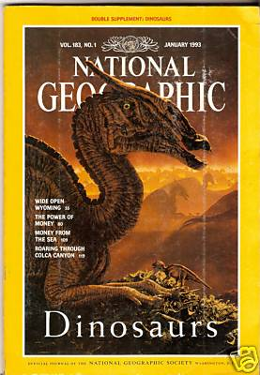
“No human being has ever seen a live dinosaur”
(“Age of the Dinosaurs,” 1993, 183[1]:142)

Slide 15
Evolutionist:
Evolved 200 million years ago
Extinct 65-70 million years ago
Man evolved 2-3 million years ago
Creationist:
Genesis account is literal
Dinosaurs were created within the six literal days
Man was created on 6th day
Man and dinosaurs lived together

Slide 16
What is at Issue?
Average Child’s View – Dinosaurs lived millions of years ago
Dinosaur is a “Tool” for Teaching Evolution
Question of when they existed
How Do Dinosaurs “Prove” Evolution?
  Common thought: Dinosaurs were enormous killing machines
  Man and dinosaurs could not have lived together
  Thus: they were separated by millions of years

Slide 17
What About
Dinosaurs & Man?
What is at Issue?
Where They Real – Did They Exist?

Slide 18
Where They Real – Did They Exist?
Mistake!
Tell child – dinosaurs were not real – didn’t exist

Slide 19
Where They Real – Did They Exist?
Physical Evidence
  What has been discovered & where

Slide 20
Walking Amidst the Dinosaurs
Brad Harrub, Ph.D. and Bert Thompson, Ph.D.
Apologetics Press, Reason and Revelation
“We have discovered their fossilized remains on all seven continents—from North America to the Antarctic. As a matter of fact, great dinosaur graveyards have been discovered in places like Tanzania, Africa, and at the Dinosaur National Monument on the Colorado/Utah border in the United States. Literally tons of fossilized dinosaur bones have been recovered from all over the globe. In 1993, Mike Hammer even unearthed a fossilized dinosaur (from the Hell Creek formation in northwestern South Dakota) that was said to still possess the ancient creature’s heart. Plus, of course, paleontologists have unearthed numerous caches of fossilized dinosaur eggs.”

Slide 21
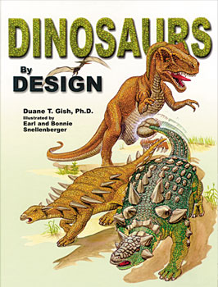
Duane T. Gish, Ph.D
“Fossils of dinosaurs have been discovered in just about every place in the world, from Alaska and Siberia to Antarctica. Many have been found in Canada, the U.S. (especially in some of the western states such as Colorado, Utah, Montana, and Wyoming), China, Mongolia, Europe, Africa, Mexico, South America, and Australia.”
p. 9

Slide 22
Where They Real – Did They Exist?
Physical Evidence
  What has been discovered & where
  Samples of the findings

Slide 23
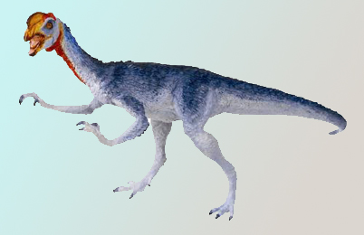
Oviraptor
(OHV-ih-RAP-tor)
Name means “egg thief”
First found in Gobi Desert of Mongolia (1922)
Bones were found in a nest of large eggs
Crushed skull may suggest a mother caught him stealing eggs
Gish, 27

Slide 24
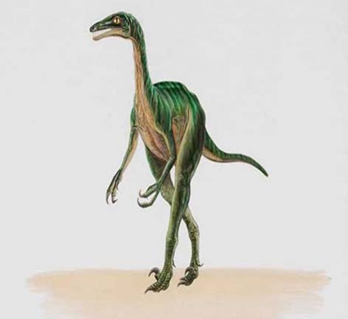
Troodon
(TROH-oh-don)
Name means “wounding tooth”
In 1980 teeth, nest, eggs, young and full size skeltons (Montana)
Gish, 27

Slide 25
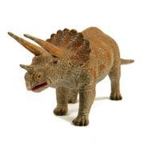
Triceratops
(tri-SAIR-ah-tops)
Three horned face
Full complete skull found in 1888 in Wyoming
Skull was 7’ long
Gish, 28

Slide 26
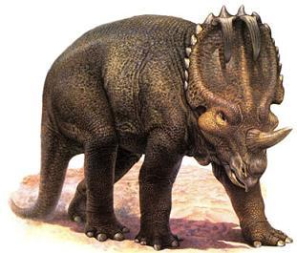
Eucentrosaurus
(yew-SEN-tro-SORE-us)
Name means “well horned lizard”
Was called Centrosaurus until 1989
Large herd found buried in Canada
Gish, 29

Slide 27
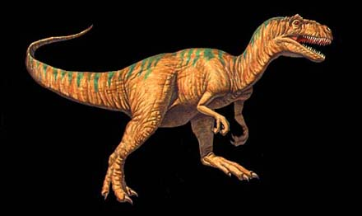
Allosaurus
(AL-oh-SORE-us)
1940 excavations in Utah found bones of 40-60 allosaurs buried together
Gish, 48

Slide 28
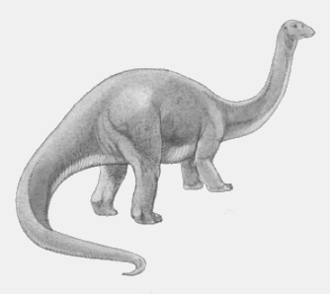
Apatosaurus
(uh-PAT-oh-SORE-us)
1877 Othniel Marsh found hip and back fossils near Morrison Colorado (Gave it the name “Apatosaurus”)
1879 March found almost complete skelton at Como Bluff, Wyoming (Gave name Brontosaurus)
1975 Dr. Jack McIntosh and Dr. David Berman convinced science community same animal
Texas: 23 sets of footprints – believe to be from Apatosaurus (each one 39 inches long)
Gish, 54

Slide 29
Where They Real – Did They Exist?
Physical Evidence
Biblical Evidence
  God created all animals
    Gen. 1:21 – God created every living thing
    Gen. 1:31 – God saw everything was good (complete)
    Gen. 2:1 – Heaven, earth and all host of them finished
    Exo. 20:11 – In 6 days created all in heavens, earth & sea
    John 1:3 – All things were made through him

Slide 30
Where They Real – Did They Exist?
Physical Evidence
Biblical Evidence
  God created all animals
  “Dinosaurs” not mentioned in Bible (assume didn’t exist)
    Word not used until 1840
    Bible does not mention: cats, kangaroos, penguins, elephants, or bacteria

Slide 31
Where They Real – Did They Exist?
Physical Evidence
Biblical Evidence
  God created all animals
  “Dinosaurs” not mentioned in Bible (assume didn’t exist)
  Large “dinosaur like” creatures are mentioned

Slide 32
Job 40:15-24
15 "Look now at the behemoth, which I made along with you; He eats grass like an ox.
16 See now, his strength is in his hips, And his power is in his stomach muscles.
17 He moves his tail like a cedar; The sinews of his thighs are tightly knit.
18 His bones are like beams of bronze, His ribs like bars of iron.
19 He is the first of the ways of God; Only He who made him can bring near His sword.
20 Surely the mountains yield food for him, And all the beasts of the field play there.
21 He lies under the lotus trees, In a covert of reeds and marsh.
22 The lotus trees cover him with their shade; The willows by the brook surround him.
23 Indeed the river may rage, Yet he is not disturbed; He is confident, though the Jordan gushes into his mouth,
24 Though he takes it in his eyes, Or one pierces his nose with a snare.

Slide 33
Job 41
1 "Can you draw out Leviathan with a hook, Or snare his tongue with a line which you lower?
2 Can you put a reed through his nose, Or pierce his jaw with a hook?
3 Will he make many supplications to you? Will he speak softly to you?
4 Will he make a covenant with you? Will you take him as a servant forever?
5 Will you play with him as with a bird, Or will you leash him for your maidens?
6 Will your companions make a banquet of him? Will they apportion him among the merchants?
7 Can you fill his skin with harpoons, Or his head with fishing spears?
8 Lay your hand on him; Remember the battle-- Never do it again!
9 Indeed, any hope of overcoming him is false; Shall one not be overwhelmed at the sight of him?
10 No one is so fierce that he would dare stir him up. Who then is able to stand against Me?
11 Who has preceded Me, that I should pay him? Everything under heaven is Mine.

Slide 34
12 "I will not conceal his limbs, His mighty power, or his graceful proportions.
13 Who can remove his outer coat? Who can approach him with a double bridle?
14 Who can open the doors of his face, With his terrible teeth all around?
15 His rows of scales are his pride, Shut up tightly as with a seal;
16 One is so near another That no air can come between them;
17 They are joined one to another, They stick together and cannot be parted.
18 His sneezings flash forth light, And his eyes are like the eyelids of the morning.
19 Out of his mouth go burning lights; Sparks of fire shoot out.
20 Smoke goes out of his nostrils, As from a boiling pot and burning rushes.
21 His breath kindles coals, And a flame goes out of his mouth.
22 Strength dwells in his neck, And sorrow dances before him.
23 The folds of his flesh are joined together; They are firm on him and cannot be moved.
24 His heart is as hard as stone, Even as hard as the lower millstone.."

Slide 35
25 When he raises himself up, the mighty are afraid; Because of his crashings they are beside themselves.
26 Though the sword reaches him, it cannot avail; Nor does spear, dart, or javelin.
27 He regards iron as straw, And bronze as rotten wood.
28 The arrow cannot make him flee; Slingstones become like stubble to him.
29 Darts are regarded as straw; He laughs at the threat of javelins.
30 His undersides are like sharp potsherds; He spreads pointed marks in the mire.
31 He makes the deep boil like a pot; He makes the sea like a pot of ointment.
32 He leaves a shining wake behind him; One would think the deep had white hair.
33 On earth there is nothing like him, Which is made without fear.
34 He beholds every high thing; He is king over all the children of pride."

Slide 36
Job 7:12
12 Am I a sea, or a sea serpent, That You set a guard over me?
tanniyn or tanniym (Ezek 29:3)
a dragon, a serpent, a sea monster
a) a dragon or a dinosaur
b) a sea or a river monster
c) a serpent, a venomous snake
(Brown Driver & Briggs Hebrew Lexicon, Copyright (c)1993)
Translated:
“Whales” (Gen. 1:21)
“Dragons” (Isa. 27:1, et.al)
“Sea monster” (Lam. 4:3)
“Serpent” (Exo. 7:10, 12)

Slide 37
Where They Real – Did They Exist?
Physical Evidence
Biblical Evidence
Dragons
  Bible mentions “Dragons” (KJV)
    Deut 32:33
    Psa. 91:13
    Psa. 148:7
    Isa. 27:1
    Isa. 51:9
    Jer. 9:11
    Jer. 14:6
    Micah 1:8
    Mal. 1:3

Slide 38
Where They Real – Did They Exist?
Physical Evidence
Biblical Evidence
Dragons
  Bible mentions “Dragons” (KJV)
  Dragon legends / traditions around the world

Slide 39


Dragons
“The frequent reference to dragons in the Bible, as well as in the early records and traditions of most of the nations of antiquity, certainly cannot be shrugged off as merely fairy tales. Most probably they represent memories of dinosaurs handed down by tribal ancestors who encountered them before they became extinct.”
Henry Morris, The Genesis Flood

Slide 40
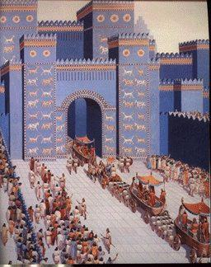
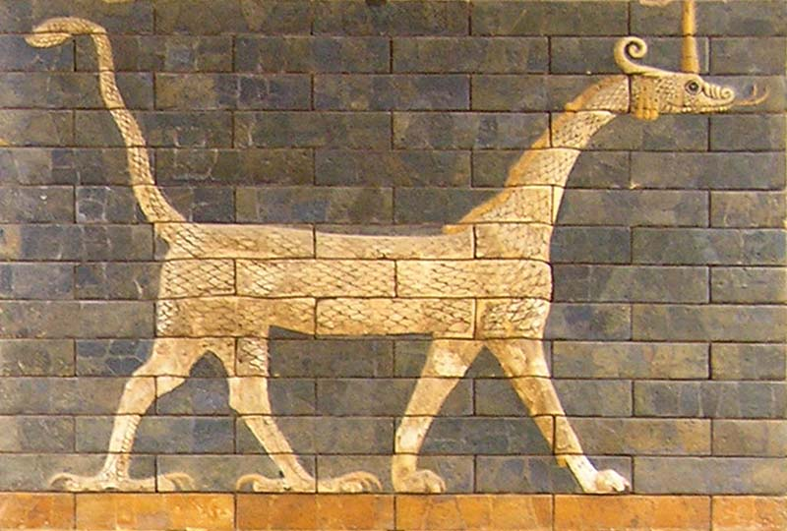
Nebuchadnezzer’s Ishtar Gate in Babylon
Had a dragon carved into it
Dragon called Sirrush

Slide 41
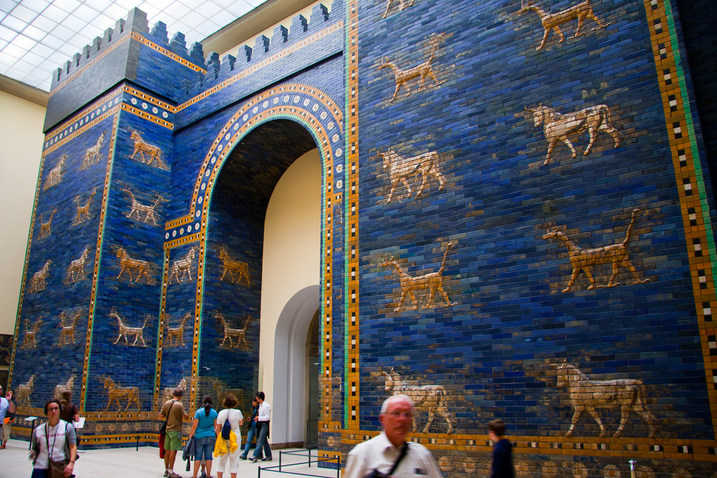
Berlin

Slide 42
What About
Dinosaurs & Man?
What is at Issue?
Where They Real – Did They Exist?
Did Dinosaurs & Man Co-Exist?

Slide 43
Did Dinosaurs & Man Co-Exist?
Man & Enormously Large Creatures Co-Exist
  Komodo Dragon (Largest lizard, 10’ long, 275 lbs, 15mph)
  Elephant (11 tons, yet controlled by man, i.e. circus)
  Whales (Blue Whale)
    Some as large as 200 tons (400,000 lbs)
    Heart size of a Volkswagon Beetle
    Tongue large enough to hold 50 people

Slide 44
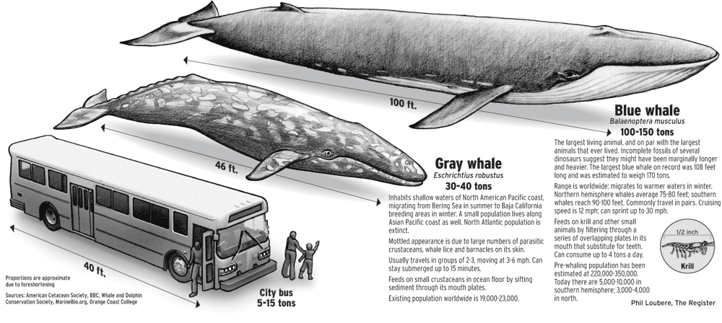
Notes:
http://www.ocregister.com/newsimages/news/2007/06/04bluewhale_gp.gif

Slide 45
Did Dinosaurs & Man Co-Exist?
Man & Enormously Large Creatures Co-Exist
Evidence of Co-Existence

Slide 46
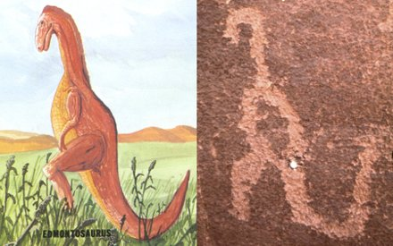
In the late 1800s, Samuel Hubbard, honorary curator of archaeology at the Oakland, California, Museum of Natural History, was excavating ancient Indian dwellings in the Havasupai Canyon in Arizona.
On the walls of the canyon where the Indians’ ancestors once lived, Dr. Hubbard found elegant drawings of an elephant, an ibex, a dinosaur, and other animals.
Left: Edmontosaurus (courtesy of Paul S. Taylor, Eden Communications).
Right: Petroglyph discovered by Dr. Samuel Hubbard in Havasupai Canyon (courtesy of www.bible.ca)
“The fact that some prehistoric man made a pictograph of a dinosaur on the walls of this canyon upsets completely all of our theories regarding the antiquity of man.... The fact that the animal is upright and balanced on its tail would seem to indicate that the prehistoric artist must have seen it alive “(1925, pp. 5,7, emp. in orig.).

Slide 47
Did Dinosaurs & Man Co-Exist?
Man & Enormously Large Creatures Co-Exist
Evidence of Co-Existence
Man Been Around Since Beginning
  Matt. 19:4
  Mark 10:6
  Rom. 1:20
  Created on 6th day (Gen. 1:24-31)

Slide 48
Did Dinosaurs & Man Co-Exist?
Man & Enormously Large Creatures Co-Exist
Evidence of Co-Existence
Man Been Around Since Beginning
How?
  God made man in his own image – basis for man having authority over the earth (Gen. 1:16-28)
  Man has dominion over creation:
    Gen. 1:26-28
    Psa. 8:4-9
    Jas. 3:7

Slide 49
Did Dinosaurs & Man Co-Exist?
Man & Enormously Large Creatures Co-Exist
Evidence of Co-Existence
Man Been Around Since Beginning
How?
Ancient Dragon Stories

Slide 50
Dinosaurs and Humans—Together?
Apologetics Press: Reason & Revelation
Eric Lyons, M.Min. and Bert Thompson, Ph.D.
“In far-eastern countries such as China, dragons often are described in ancient writings. Some of them are said to have been domesticated, and even were used to pull the chariots of Chinese rulers. Also, many of the ancient Chinese people are said to have used “dragon bones” for special medicines and potions. While visiting the continent of Asia in the 1200s, Italian explorer Marco Polo said that he saw long reptiles called Lindworms that easily ran as fast as a horse! In the British Isles, hundreds of dragon stories have come down to the present day. One account told of an animal with a crested head, teeth like a saw, and a long tail. Also, in 1449 in England, it was reported that two huge reptiles were seen fighting on the banks of the river Stour.”

Slide 51
What About
Dinosaurs & Man?
What is at Issue?
Where They Real – Did They Exist?
Did Dinosaurs & Man Co-Exist?
What Happened To Them?

Slide 52
What Happened To Them?
Evolutionist Explanations
  Sudden climate change – couldn’t survive
  Asteroid (6 mi wide) impacted the earth (caused dust & soot to block sun rays causing plants to die (in turn the herbivores and then the carnivores) (Thompson, Dinosaur Controversy)
  Massive disease
  Volcanic Greenhouse

Slide 53
Response:
Why did the asteroid kill every dinosaur but left many other forms of life unharmed?
Why did the asteroid not kill other reptiles such as turtles and alligators?
Nothing in the fossil record supports the idea that all the dinosaurs died at once.

Slide 54
All Agree
Something Catastrophic
Sudden
(Account for fossil record)

Slide 55

What Happened To Them?
Evolutionist Explanations
Creationist Explanation
  Flood (Gen. 6-8)
    Global (7:19)
    Explains the sudden death, massive fossil graveyard
    Evolutionist explain it as seasonal or flash flooding
    Historical evidence: Over 200 flood legends

Slide 56
Flood Legends
Legends have been reported from nations such as China, Babylon, Mexico, Egypt, Sudan, Syria, Persia, India, Norway, Wales, Ireland, Indonesia, Romania, etc
“In 95 percent of the more than two hundred flood legends, the flood was worldwide; in 88 percent, a certain family was favored; in 70 percent, survival was by means of a boat; in 67 percent, animals were also saved; in 66 percent, the flood was due to the wickedness of man; in 66 percent, the survivors had been forewarned; in 57 percent, they ended up on a mountain; in 35 percent, birds were sent out from the boat; and in 9 percent, exactly eight people were spared.” (James Perioff, Tornado in a Junkyard: The Relentless Myth of Darwinism, 168)

Slide 57
What Happened To Them?
Evolutionist Explanation
Creationist Explanation
  Flood (Gen. 6-8)
  In the Ark
    Some must have survived in the ark
    He took two of every kind, not species (Gen. 6:19-20)
    How in the ark?

Slide 58
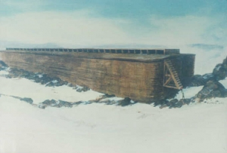

How Was It
Possible In The Ark?
Ark was huge:
  450 ft long, 75 ft wide, 45 ft high
  100,000 sq. ft
  Hold 520 modern railroad boxcars!

Slide 59
How Was It
Possible In The Ark?
Ark was huge:
Not all dinosaurs were massive

Slide 60
“To some, the idea of dinosaurs on the ark seems absurd. However, it is not so hard to accept the idea of dinosaurs on the ark after considering the subject carefully. First, remember that God was the Creator of all animals, and He knew exactly how big the ark needed to be in order to house all different kinds of land-living animals. Second, contrary to popular belief, not all dinosaurs were massive. According to the famous evolutionary dinosaur fossil-hunter John Horner, the average dinosaur was only about the size of a large cow (see Horner and Lessem, 1993, p. 124). Many dinosaurs were only a few feet tall—even as full-grown adults. Some were as small as chickens. Third, God may have allowed Noah to take baby dinosaurs into the ark, instead of those that were full grown. That allowance certainly would have saved space and reduced the amount of necessary food. The largest fossil dinosaur eggs indicate that a 40-foot-long dinosaur laid eggs that were less than a foot in diameter (see “Dinosaur Reproduction,” 2007). As hatchlings, even the largest dinosaurs were no bigger than an average house pet. Young dinosaurs on the ark would have needed no more space than the average dog.”
- Kyle Butts and Eric Lyons, What Happened to Dinosaurs?

Slide 61

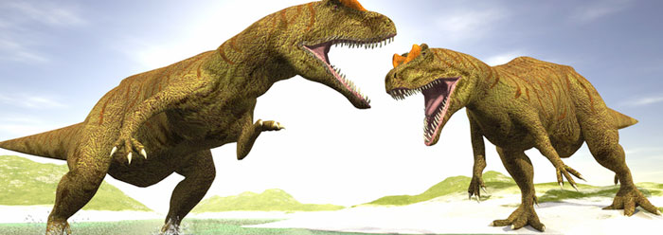
New Study Finds Dinosaur Models Are Too Thick
by Brian Thomas, M.S.
Dinosaur reconstructions in museums worldwide may all be too large, according to new research published in the Journal of Zoology. Researchers revisited the 25-year-old statistical formula used to estimate dinosaur mass, based on fossilized skeletal information. The old formula is “seriously flawed,” according to study author Gary Packard.¹
If the new formula holds up, it strengthens the feasibility of the Noah’s Ark account in Genesis, which has already been thoroughly established.² Not only would Noah have taken on two skinnier-than-previously-thought juvenile representatives of each of the larger dinosaur kinds, but his family would have been less burdened with feeding requirements during the year-long event
Notes:
http://www.icr.org/article/new-study-finds-dinosaur-models-are

Slide 62
New Study Finds Dinosaur Models Are Too Thick
by Brian Thomas, M.S.
The new predictions of dinosaur size may also alleviate a longstanding conundrum over herbivorous dinosaurs. How could the large dinosaurs, such as Stegosaurus and Apatosaurus, have eaten enough food to support their massive bodies when they had such small mouths on their tiny (by comparison) heads? Perhaps they didn’t have to eat quite so much after all, if their bodies were actually substantially less bulky.
How off was the old mass-estimation equation? According to this research, today’s dinosaur models depict dinosaurs being twice as massive as the new estimates say they should be. The fact that such a remarkable difference in mass estimation has gone unchallenged for so long illustrates how tenuous paleontological reconstructions tend to be.
Notes:
http://www.icr.org/article/new-study-finds-dinosaur-models-are

Slide 63
New Study Finds Dinosaur Models Are Too Thick
by Brian Thomas, M.S.
The old formula has had a widespread impact, having dictated perception of dinosaur sizes for the entire Western culture. If something so basic can so easily be misconstrued from the physical evidence, what other misinformation is being spread? Without being able to base depictions of early earth history on the trustworthy information from the biblical record, reconstructions of dinosaurs’ lives and times will forever inhabit a near-fictional realm.
Notes:
http://www.icr.org/article/new-study-finds-dinosaur-models-are

Slide 64
What Happened To Them?
Evolutionist Explanation
Creationist Explanation
  Flood (Gen. 6-8)
  In the Ark
  Driven to extinction
    Climate change after the flood (even people died at younger ages after the flood)
    Earth filled with humans (perhaps hunted & killed as happens with other animals)
    Eaten by mammals

Slide 65
Dinosaur Found Inside Mammal
“Villagers digging in China’s rich fossil beds have uncovered the preserved remains of a tiny dinosaur in the belly of a mammal, a startling discovery for scientists who have long believed early mammals couldn’t possibly attack and eat a dinosaur” (Verrengia, 2005).
(AP Report, Nature, Jan. 13, 2005)

Slide 66
What About
Dinosaurs & Man?
What is at Issue?
Where They Real – Did They Exist?
Did Dinosaurs & Man Co-Exist?
What Happened To Them?

