Slide 1
Records of the Great Commission
Matt. 28:19-20
Mark 16:15-20
Luke 24:47-48
John 20:21-23

Slide 2
Records of the Great Commission
Matthew | Teach |  |  | Baptized | Into Name
Mark | Preach | Believe |  | Baptized | Saved
Luke | Preached |  | Repentance |  | Remission of Sins
Summary | Teach | Believe | Repent | Baptized | Saved

Slide 3
The Book of Acts is
a Book of Conversions
An inspired commentary on the commission
Fulfillment of prophecy (i.e. Isaiah 2)
More teaching on conversion in this book that any other book
It tells us:
  Actual cases
  Type of people (common, high rank)
  Numbers (single conversion or thousands)
  What they were taught & what they did

Slide 4
Conversion of 3,000
Acts 2
Up till now – preached only in promise – now it is fact!
Called “The beginning” (Acts 11:15)
Called the “hub of the Bible”

Slide 5
Pentecost
One of three annual Jewish festivals
Observed on the 50th day (7 weeks) from Paschal Feast [7 Sabbaths + 1 day = 1st day]
Called “Feast of Harvest” (Exo. 23:16), “Feast of Weeks” (Num. 28:16; Lev. 23:17)
Fell in 3rd month (Sivan) = our late May

Slide 6
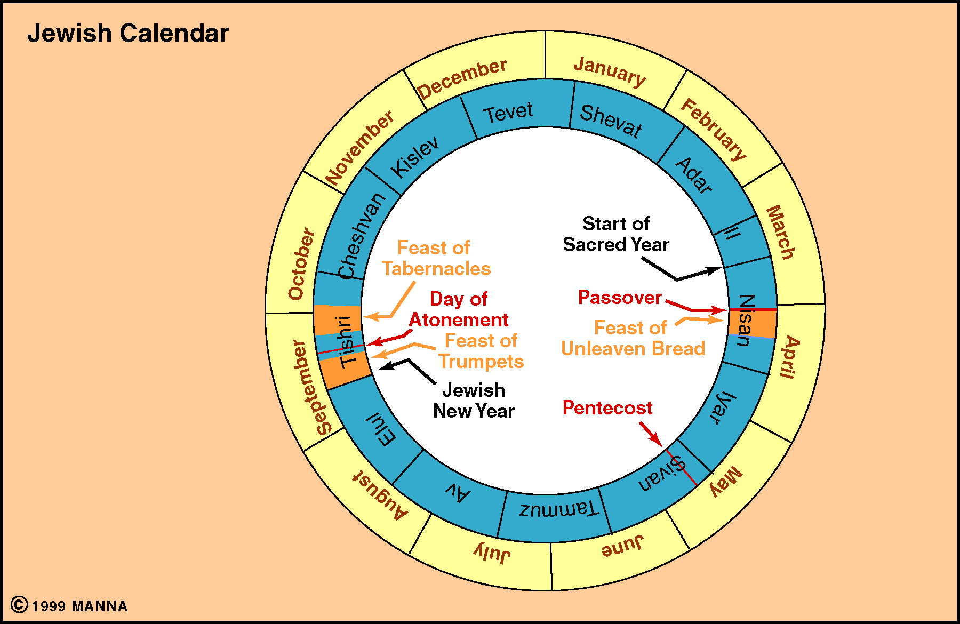

Slide 7
Conversion of 3,000
Acts 2
The Account
The Account

Slide 8
Acts 2: “The Beginning”
The Reception of the Holy Spirit (vv. 1-13)
Peter’s Sermon (vv. 14-36)
Response of the Multitude (vv. 37-41)
The Disciples Continued in the Apostles’ Doctrine (vv. 42-47)

Slide 9
Acts 2: “The Beginning”
The Reception of the Holy Spirit (vv. 1-13)
Peter’s Sermon (vv. 14-36)
Response of the Multitude (vv. 37-41)
The Disciples Continued in the Apostles’ Doctrine (vv. 42-47)

Slide 10
The Reception of the Holy Spirit (vv. 1-13)
The Audience:
In Sin
Think they are OK
Have some knowledge
  The apostles receive the Spirit and speak in tongues (vv. 1-4)
  The multitude is amazed (vv. 5-13)

Slide 11
Acts 2: “The Beginning”
The Reception of the Holy Spirit (vv. 1-13)
Peter’s Sermon (vv. 14-36)
Response of the Multitude (vv. 37-41)
The Disciples Continued in the Apostles’ Doctrine (vv. 42-47)

Slide 12
Peter’s Sermon (vv. 14-36)
A. Explanation of the events (vv. 14-21)

Slide 13
17'And it shall come to pass in the last days, says God,
That I will pour out of My Spirit on all flesh;
Your sons and your daughters shall prophesy,
Your young men shall see visions,
Your old men shall dream dreams.
18 And on My menservants and on My maidservants
I will pour out My Spirit in those days;
And they shall prophesy.
19 I will show wonders in heaven above
And signs in the earth beneath:
Blood and fire and vapor of smoke.
20 The sun shall be turned into darkness,
And the moon into blood,
Before the coming of the great and awesome day of the LORD.
21 And it shall come to pass
That whoever calls on the name of the LORD
Shall be saved.'
Revelation
Confirmation
Salvation

Slide 14
Peter’s Sermon (vv. 14-36)
What They
Heard:
Conviction of sin
Evidence of
Resurrection
of Christ
Explanation of the events (vv. 14-21)
Jesus is raised from the dead (vv. 22-36)
  The one you crucified is raised (vv. 22-24)
  David prophesied of this (vv. 25-31)
  He is now exalted as both Lord & Christ (vv. 32-36)

Slide 15
Three Evidences of
Resurrection of Christ
Prophecy (vv. 25-29; Psa. 16)
Empty tomb (v. 29)
Witnesses (v. 32)

Slide 16
Acts 2: “The Beginning”
The Reception of the Holy Spirit (vv. 1-13)
Peter’s Sermon (vv. 14-36)
Response of the Multitude (vv. 37-41)
The Disciples Continued in the Apostles’ Doctrine (vv. 42-47)

Slide 17
Response of the Multitude (vv. 37-41)
What They
Were Told:
Repent
Be Baptized
They asked what to do (vv. 37-40)
  The question (v. 37)
  The answer (vv. 38-40)
    Repent & be baptized for remission of sins (vv. 38-39)
    Save yourself (v. 40)
They gladly received word & obeyed (v. 41)

Slide 18
Records of the Great Commission
Matthew | Teach |  |  | Baptized | Into Name
Mark | Preach | Believe |  | Baptized | Saved
Luke | Preached |  | Repentance |  | Remission of Sins
Acts 2 | Hear (v. 22) | Know (v. 36) | Repent (v. 38) | Baptized (v. 38) | Remission of Sins (v. 38)

Slide 19
Acts 2: “The Beginning”
The Reception of the Holy Spirit (vv. 1-13)
Peter’s Sermon (vv. 14-36)
Response of the Multitude (vv. 37-41)
The Disciples Continued in the Apostles’ Doctrine (vv. 42-47)

Slide 20
The Disciples Continued in the Apostles’ Doctrine (vv. 42-47)
What Did They Become?
Active Christians
Worshiped
Dedicated
Active
Followed apostles’ authority (v. 42)
Were steadfast (v. 42)
Worshiped (v. 42)
Feared (v. 43)
Took care of needy (vv. 44-45)
Served daily (v. 46)
Grew (v. 47)

Slide 21
Conversion of 3,000
Acts 2
The Account
The Summary

Slide 22
What Were
They Told?
They were in sin
Jesus was raised from dead
Must repent & be baptized
What Did They
Understand?
That they needed to be saved
That Jesus is the Son of God
Must repent & be baptized
How Did They
Respond?
Glady & willingly obeyed
Summary of their Conversion

Slide 23
Records of the Great Commission
Matthew | Teach |  |  | Baptized | Into Name
Mark | Preach | Believe |  | Baptized | Saved
Luke | Preached |  | Repentance |  | Remission of Sins
Acts 2 | Hear (v. 22) | Know (v. 36) | Repent (v. 38) | Baptized (v. 38) | Remission of Sins (v. 38)
This is “Calling on the name of the Lord” (vv. 21, 47)

Slide 24
Conversion of 3,000
Acts 2
The Account
The Summary

