Slide 1
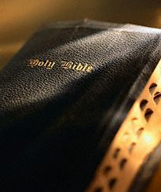
Believing
That The Bible Is
The Infallible Word of God
Fundamental to all Bible Study
Foundation of all Bible Preaching

Slide 2
First Question To Ask
?
What does the Bible claim for itself?
  Does it claim to be from God?
  Does it claim that all of it is inspired?
  Does it claim to be complete?
  Does it claim to be infallible?
  Does it claim that every word is divine?
Then we ask what evidence would sustain such a claim?
?
?

Slide 3
Inspiration
of the
Bible

Slide 4
Inspiration of the Bible
The Claim

Slide 5
“Thus Saith the Lord”
This expression
or its equivalent
is found
2000 times (plus)
“God said”
46
“Lord said”
221
“Thus saith the Lord”
414

Slide 6

The Claim
The Old Testament Claim
  Men of God claimed to speak as God directed them

Slide 7
David
2 Sam 23:1-2
Now these are the last words of David.Thus says David the son of Jesse; Thus says the man raised up on high,The anointed of the God of Jacob, And the sweet psalmist of Israel: The Spirit of the LORD spoke by me, And His word was on my tongue.
Matt 22:43-44
He said to them, "How then does David in the Spirit call Him 'Lord,' saying: The LORD said to my Lord, "Sit at My right hand, Till I make Your enemies Your footstool" '?

Slide 8
Isaiah
Isa. 1:1-2
The vision of Isaiah the son of Amoz, which he saw concerning Judah and Jerusalem in the days of Uzziah, Jotham, Ahaz, and Hezekiah, kings of Judah. Hear, O heavens, and give ear, O earth! For the LORD has spoken: "I have nourished and brought up children, And they have rebelled against Me;

Slide 9
Jeremiah
Jer. 1:4-9
4 Then the word of the LORD came to me, saying:
5 "Before I formed you in the womb I knew you; Before you were born I sanctified you; I ordained you a prophet to the nations."
6 Then said I: "Ah, Lord GOD! Behold, I cannot speak, for I am a youth."
7 But the LORD said to me: "Do not say, 'I am a youth,' For you shall go to all to whom I send you, And whatever I command you, you shall speak.
8 Do not be afraid of their faces, For I am with you to deliver you," says the LORD.
9 Then the LORD put forth His hand and touched my mouth, and the LORD said to me: "Behold, I have put My words in your mouth.

Slide 10
Ezekiel
Ezek 1:2-3
On the fifth day of the month, which was in the fifth year of King Jehoiachin's captivity, the word of the LORD came expressly to Ezekiel the priest, the son of Buzi, in the land of the Chaldeans by the River Chebar; and the hand of the LORD was upon him there.

Slide 11
Zechariah
Zech 7:12
Yes, they made their hearts like flint, refusing to hear the law and the words which the LORD of hosts had sent by His Spirit through the former prophets. Thus great wrath came from the LORD of hosts.

Slide 12
The Claim
The Old Testament Claim
  Men of God claimed to speak as God directed them
  The NT says the OT was inspired

Slide 13
Old
Testament
New
Testament
Inspired of God
2 Peter 1:20-21
20 knowing this first, that no prophecy of Scripture is of any private interpretation,
21 for prophecy never came by the will of man, but holy men of God spoke as they were moved by the Holy Spirit.

Slide 14
Scripture = Word of God
Scripture Said | God Said
Gen. 2:24 | Matt. 19:4-5
Psa. 2:1 | Acts 4:24-25
Isa. 55:3 | Acts 13:34
Psa. 16:10 | Acts 13:35
Deut 32:43 (LXX) | Heb. 1:5-6
Psa. 104:4 | Heb. 1:7
Psa. 95:7 | Heb. 3:7
Psa. 102:25-27 | Heb. 1:10

Slide 15
The Claim
The Old Testament Claim
The New Testament Claim
  Jesus spoke of the authority of the Scriptures

Slide 16
John 10:35
“If He called them gods, to whom the word of God came (and the Scripture cannot be broken).”
Jesus quotes from Psa. 82:6
Called it “law” (v. 34) and “Scripture” (v. 35)
“Cannot be broken” = cannot be loosed, undone
Affirmation of the authority of Scripture
If this most “casual” statement in the OT is authoritative, so is all the rest! (Warfield)

Slide 17
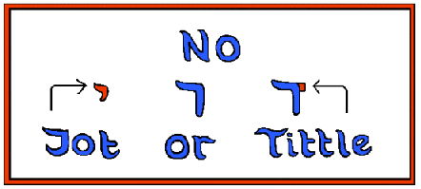
Matt. 5:18
For assuredly, I say to you, till heaven and earth pass away, one jot or one tittle will by no means pass from the law till all is fulfilled.
“Jot” – smallest letter of Hebrew alphabet
“Tittle” – a projection from a letter to distinguish it
Like our dot of the “i” and cross of a “t”
Point: Scriptures are true / reliable down to the smallest detail!

Slide 18
Endorsed
OT Stories
Jesus believed what was recorded in the OT to be FACT and not FICTION
Creation (Matt. 19:4)
Noah & Flood (Matt. 24:37-38)
Sodom’s Judgment (Matt. 11:24)
Lot’s Wife (Luke 17:32)
Jonah & the Whale (Matt. 12:40)

Slide 19
The Claim
The Old Testament Claim
The New Testament Claim
  Jesus spoke of the authority of the Scriptures
  Apostles and NT writers claimed to speak from God

Slide 20
Apostles & NT Writers Claimed To Speak
By the Inspiration of God
1 Tim. 4:1 – “Now the Spirit expressly says…”
2 Pet. 3:15-16 - Paul’s writings called “Scripture”
Eph. 3:3-5 – Apostles & prophets guided by Spirit
1 Thess. 2:13 – not word of men, but God
John 16:13 – Spirit would guide apostles into all truth
Gal. 1:11-12 – Not receive gospel from man, but God
1 Cor. 14:37 – I write the commandments of Lord

Slide 21
The Claim
The Old Testament Claim
The New Testament Claim
  Jesus spoke of the authority of the Scriptures
  Apostles and NT writers claimed to speak from God
  Some main passages

Slide 22
2 Tim. 3:16-17
16 All Scripture is given by inspiration of God, and is profitable for doctrine, for reproof, for correction, for instruction in righteousness,
17 that the man of God may be complete, thoroughly equipped for every good work.

Slide 23
2 Tim. 3:16-17
Scripture:
  From graphe – writings or oracles
  Includes OT & NT (1 Tim. 5:18)

Slide 24
1 Timothy 5:18
For the Scripture says, "You shall not muzzle an ox while it treads out the grain," and, "The laborer is worthy of his wages."
Luke 10:7
Deut. 25:4

Slide 25
2 Tim. 3:16-17
Scripture:
  From graphe – writings or oracles
  Includes OT & NT (1 Tim. 5:18).
All:
  Includes all – leaves none out
  Both OT & NT
Inspired of God:
  “God breathed” (A.T. Robertson)
  Not “breathed into” – taking man’s words and breathing into
  But “breathed out” – Words came from God’s breath
  Not the effect it has on one who reads it.

Slide 26
1 Cor. 2:9-14
v. 9 – Man did not know the mind of God until it was revealed
v. 10 – God has revealed them by the Spirit
v. 11 – Illustration: no one knows your mind unless you reveal it
vv. 12-13 – Speak words, not of man’s wisdom, but what the Holy Spirit teaches
13 These things we also speak, not in words which man's wisdom teaches but which the Holy Spirit teaches, comparing spiritual things with spiritual.

Slide 27
2 Pet. 1:20-21
20 knowing this first, that no prophecy of Scripture is of any private interpretation,
21 for prophecy never came by the will of man, but holy men of God spoke as they were moved by the Holy Spirit.
Prophecy did not owe its origin to man
Prophecy had its origin from God
Use the instrumentality of human authors
“Moved” = borne along as a ship moved by the wind.
Moved by the power of the Holy Spirit

Slide 28
Inspiration of the Bible
The Claim
The Nature

Slide 29
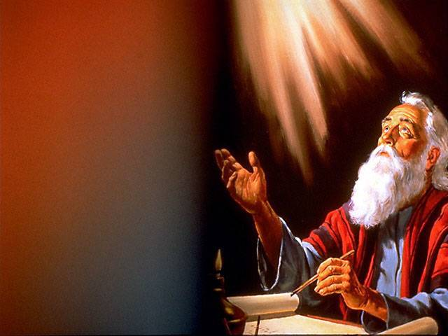
The Nature
Defined
“The supernatural influence exerted on the sacred writers by the Spirit of God, by virtue of which their writings are given Divine trustworthiness”
- Benjamin Warfield (ISBE, III:1473)
2 Sam 23:1-2
Now these are the last words of David.Thus says David the son of Jesse; Thus says the man raised up on high,The anointed of the God of Jacob, And the sweet psalmist of Israel: The Spirit of the LORD spoke by me, And His word was on my tongue.

Slide 30
The Nature
Defined
Plenary Inspiration

Slide 31
Plenary Inspiration
Plenary:
“Complete in
all aspects or
essentials; full.”
(AHD)
All of The
Bible
2 Tim. 3:16-17 – all Scripture
Psa. 119:128 – all precepts are right
2 Pet. 1:20-21 – What was true of one prophet was true of all
Both OT & NT
One writer is just as inspired as another

Slide 32
The Nature
Defined
Plenary Inspiration
Verbal Inspiration

Slide 33
Verbal Inspiration
Verbal:
“Of, pertaining
to words….”
(AHD)
Every word
of The Bible
1 Cor. 2:13 – Words chosen by the Holy Spirit

Slide 34
1 Cor. 2:13
These things we also speak, not in words which man's wisdom teaches but which the Holy Spirit teaches, comparing spiritual things with spiritual.

Slide 35
The Nature
Defined
Plenary Inspiration
Verbal Inspiration
Misconceptions

Slide 36
Thought Inspiration –
  God gave the idea or thought – but left the writer to choose his words
  Means the writings are subject to error
Misconceptions about Inspiration

Slide 37
Thought Inspiration –
Dictation –
  God dictated to each writer.
  Writers were mere stenographers
  Their writings are void of personal background and vocabulary
Inspiration is Lost in Translation –
  The Septuagint (LXX) was a translation of the OT (Hebrew) into Greek (about 285 BC)
  Jesus used & quoted from the LXX
  Yet attributed the quotes to writers & God
Misconceptions about Inspiration

Slide 38
The Nature
Defined
Plenary Inspiration
Verbal Inspiration
Misconceptions
Use of Writer’s Background & Vocabulary

Slide 39
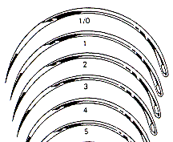

Use of Writer’s Background & Vocabulary
Matt 19:24
And again I say to you, it is easier for a camel to go through the eye of a needle than for a rich man to enter the kingdom of God."
Luke 18:25
For it is easier for a camel to go through the eye of a needle than for a rich man to enter the kingdom of God."
rhaphis NT:4476
belone NT:956

Slide 40
Use of Writer’s Background & Vocabulary
Matthew & Luke use different terms for “needle”
Luke’s medical terms (480)
  Luke 4:38 – Peter’s mother-in-law had high fever (Matthew & Mark – “fever”)
  Luke 5:12 – full of leprosy (Matthew & Mark – “leper”)
Use of personal experiences:
  1 Cor. 15:32
  Phil. 1:12-14

Slide 41
Inspiration of the Bible
The Claim
The Nature
The Evidence

Slide 42
The Evidence
Unity of the Bible

Slide 43
Unity of the Bible
Written over 1500 years
40 different writers – different parts of world
Three languages: (Hebrew, Aramaic, Greek)
Discussed 100’s (if not thousands) of controversial subjects
Not One Single Contradiction!
Unity in Doctrine / Purpose: Redemption through Christ
Organic Unity: All parts are necessary to completeness / Books complement each others (Gospels / Isaiah & Gospels / Leviticus & Hebrews)
Unity of Style: (Condensed / restraint / simplicity)

Slide 44
The Evidence
Unity of the Bible
Prophecy & Fulfillment

Slide 45
Prophecy & Fulfillment
Man cannot foreknow the future – Only God can
If men foretold the future – had to be by God!
Destruction of Babylon (Isa. 13:17, 19-22; Jer. 50)
Destruction of Tyre (Ezek. 26:7-11; 27)
  By Chaldeans (Ezek. 26:7-11)
  Ruins will provide a place to spread nets (Ezek. 26:5)
  Ruins of city dumped in water (Ezek. 26:12)
  Finally, be no more (Ezek. 26:5, 14)

Slide 46
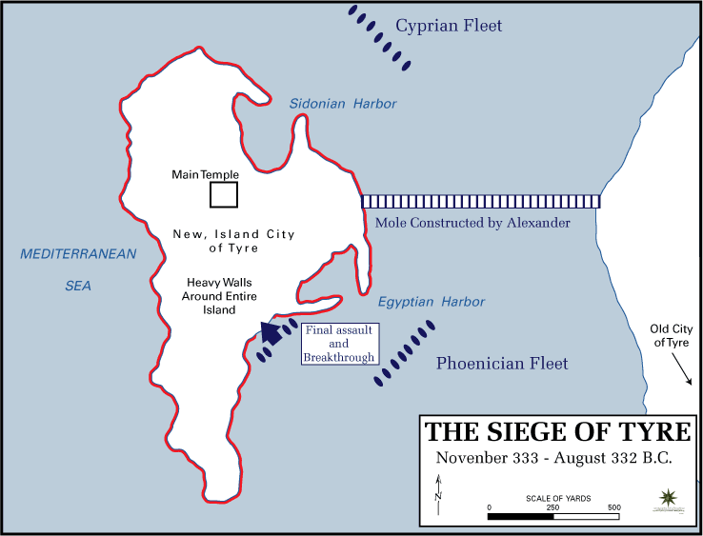
Notes:
tyresiege_unitedstatesmilitaryacademy.gif (738×563)

Slide 47
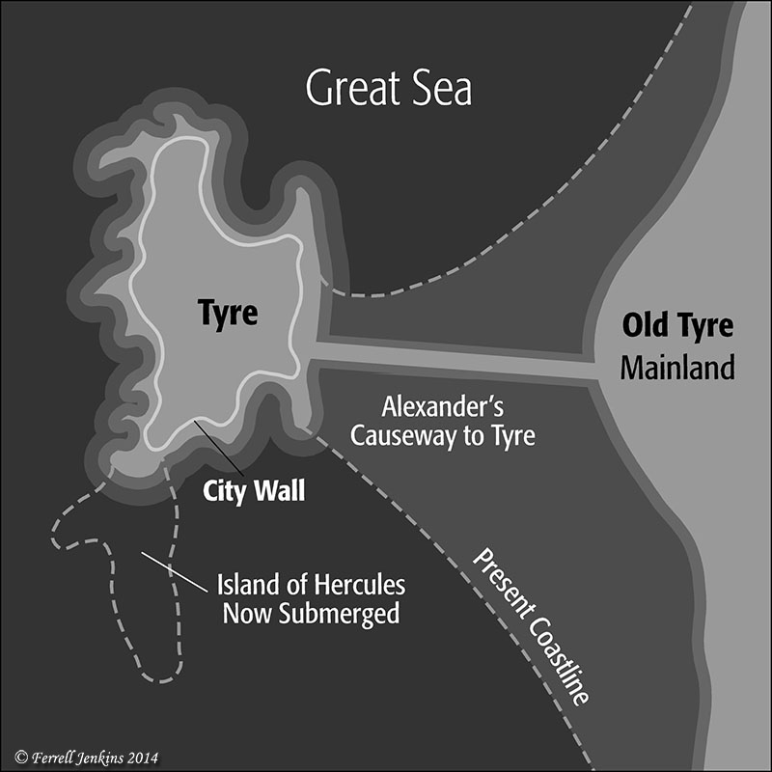

Slide 48
Prophecy & Fulfillment
Man cannot foreknow the future – Only God can
If men foretold the future – had to be by God!
Destruction of Babylon (Isa. 13:19-22; Jer. 50)
Destruction of Tyre (Ezek. 26:7-11; 27)
  By Chaldeans (Ezek. 26:7-11)
  Ruins will provide a place to spread nets (Ezek. 26:5)
  Ruins of city dumped in water (Ezek. 26:12)
  Finally, be no more (Ezek. 26:5, 14)
Return of a Remnant allowed by Cyrus – 200 yrs (Isa. 44:28; 45:1; Ezra 1:1ff)
Prophecy of the Messiah (300+)

Slide 49
Born of a virgin: Isaiah 7:14
A descendant of Abraham: Genesis 12:1-3; 22:18
Of the tribe of Judah: Genesis 49:10
Of the house of David: 2 Samuel 7:12-16
Born in Bethlehem: Micah 5:2
Taken to Egypt: Hosea 11:1
Forerunner (John the Baptist): Isaiah 40:3-5
Would perform miracles: Isaiah 35:5-6
Would preach good news: Isaiah 61:1
Would minister in Galilee: Isaiah 9:1
Would cleanse the Temple: Malachi 3:1
Would enter Jerusalem as a king on a donkey: Zechariah 9:9
Would be rejected by Jews: Psalm 118:22
Sold for 30 pieces of silver: Zechariah 11:12
300+

Slide 50
The Evidence
Unity of the Bible
Prophecy & Fulfillment
Historical Accuracy

Slide 51
Historical Accuracy
Bible is not written in “once upon a time… far away…”
Specific times and places – can be verified
Consider all the archaeological evidence
Belshazzar (Dan. 5) – was king of Babylon
41 kings mentioned from Abraham to End of OT
Cities mentioned in NT – agree with discoveries
Sir William Ramsey found no conflict in places, rulers or titles in Acts
Notes:
http://www.apologeticspress.org/apcontent.aspx?category=13&article=524
https://ferrelljenkins.wordpress.com/2012/02/24/the-big-three-nabonidus-belshazzar-and-daniel/

Slide 52
“The more I have studied the narrative of the Acts, and the more I have learned year after year about Graeco-Roman society and thoughts and fashions, and organization in those provinces, the more I admire and the better I understand. I set out to look for truth on the borderland where Greece and Asia meet, and found it here [in the Book of Acts—KB]. You may press the words of Luke in a degree beyond any other historian’s, and they stand the keenest scrutiny and the hardest treatment, provided always that the critic knows the subject and does not go beyond the limits of science and of justice.”
(Ramsay, William (1915), The Bearing of Recent Discovery on the Trustworthiness of the New Testament, 89).
Notes:
http://www.apologeticspress.org/apcontent.aspx?category=13&article=524

Slide 53
Inspiration of the Bible
The Claim
The Nature
The Evidence

