Slide 2
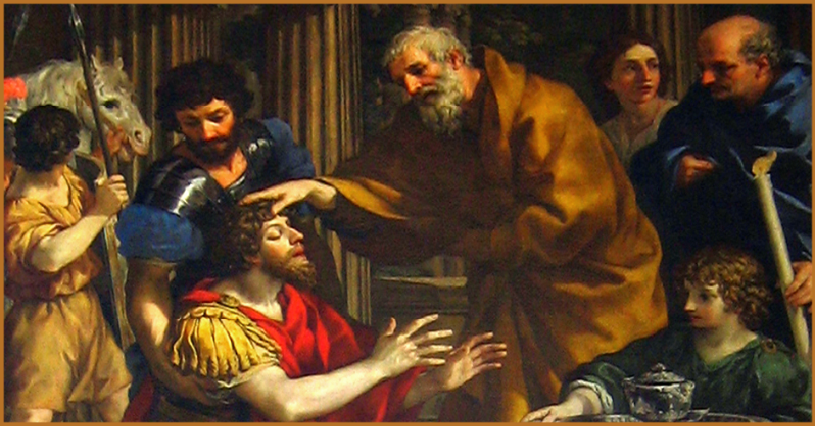
Acts 9:10-16
10 Now there was a disciple in Damascus named Ananias; and the Lord said to him in a vision, “Ananias.” And he said, “Here I am, Lord.” 11 And the Lord said to him, “Get up and go to the street called Straight, and inquire at the house of Judas for a man from Tarsus named Saul, for he is praying, 12 and he has seen [f]in a vision a man named Ananias come in and lay his hands on him, so that he might regain his sight.” 13 But Ananias answered, “Lord, I have heard from many people about this man, how much harm he did to Your [g]saints in Jerusalem; 14 and here he has authority from the chief priests to [h]arrest all who call on Your name.” 15 But the Lord said to him, “Go, for he is a chosen [i]instrument of Mine, to bear My name before the Gentiles and kings and the sons of Israel; 16 for I will show him how much he must suffer in behalf of My name.”

Slide 3
The lord said “GO…”

Slide 4
The lord said “GO…”
I. Love One Another

Slide 5
The lord said “GO…Love one another”
The command (I John 4:7)
  On the surface → simple, easy to carry out
  More difficult than we often consider!
The reason given (I John 4:7-11)
  Love itself comes from God (v7)
  Know love = know God (v8)
  God’s love was manifested through His son (v9-11)
The Lord said “Go!”
  We must love even those who we have little in common with
  We must love even if it is not reciprocated
  We must love even if there has been conflict
  We must love even if we feel the other party doesn’t “deserve” it

Slide 6
The lord said “GO…”
I. Love One Another
II. Assemble Together

Slide 7
The lord said “GO…Assemble Together”
The command
  Not expressly stated, however many examples exist (Acts 2, 14, 15, 20, etc.)
  Failing to assemble is condemned (Hebrews 10:22-27)
  Often, we convince ourselves that assembling is not always necessary
  Often, we convince ourselves that assembling is too difficult
The reason given
  The assembly is where we encourage each other! (Hebrews 10:24-25)
  The assembly is where we worship together! (Acts 2:42, 20:7)
The Lord said “Go!”
  Even when its inconvenient
  Even when I don’t feel like it
  Even when it is costly
  Even when it is deadly

Slide 8
The lord said “GO…”
I. Love One Another
II. Assemble Together
III. Withdraw From The Disorderly

Slide 9
The lord said “GO…Withdraw from the disorderly”
The command (I Cor. 5:9-13; II Thess. 3:6)
  Notice that no exceptions are given
  Many are perplexed by this command
  Amongst the most difficult given to Christians!
The reasons given
  It is how the church maintains its purity! (I Cor. 5:6-8)
  To save the erring (I Cor. 5:5; II Thess. 3:14)
The Lord said “Go!”
  Even when it is someone you are close to
  Even if others fail to do so
  Even if it appears that it may cause more harm than good
  Even if you can see no way that it may restore the erring

Slide 10
The lord said “GO…”
I. Love One Another
II. Assemble Together
III. Withdraw From The Disorderly
IV. Forsake All For Christ

Slide 11
The lord said “GO…forsake all for Christ”
The command (Matt 10:34-38, Luke 18:27-30)
  Focus on family (Matthew 10)
  Focus on possessions and family (Luke 18)
  Incredibly difficult!
The reasons given
  Service to Christ will bring controversy (Matt. 10:35-36)
  Service to Christ requires sacrifice (Matt. 10:38)
The Lord said “Go!”
  Even if you lose friends
  Even if you lose your job
  Even if it tears your family apart
  Even if it requires your very life!

Slide 12
The lord said “GO…”
I. Love One Another
II. Assemble Together
III. Withdraw From The Disorderly
IV. Forsake All For Christ
V. Be At Peace With All Men

Slide 13
The lord said “GO…Be at peace with all men”
The command (Romans 12:16-21)
  It seems that some seek to find the exception (v18)
  Others overlook this command for the sake of politics, sports, etc.
  Not difficult to understand → often willfully neglected
The reasons given
  God is the vindicator! (v19)
  Doing good produces good (v20-21)
The Lord said “Go!”
  Even if there are political differences (even the extremes!)
  Even if I am treated poorly
  Even if I have “tried”, try some more!

Slide 14
The lord said “GO…”
I. Love One Another
II. Assemble Together
III. Withdraw From The Disorderly
IV. Forsake All For Christ
V. Be At Peace With All Men
VI. Be Ready To Defend Your Hope

Slide 15
The lord said “GO…Be ready to defend your hope”
The command (I Pet. 3:15; II Tim. 2:24-25)
  Sometimes viewed as unrealistic
  Sometimes viewed as too difficult
The reasons given
  The word “defense” implies necessity! (I Pet. 3:15)
  So that those who revile us will be put to shame (I Pet. 3:16)
  To save the erring! (II Tim. 2:25)
The Lord said “Go!”
  Even when I don’t “know it all”
  Even if there are things I don’t fully understand yet
  Even if others could “do it better”

Slide 16
The lord said “GO…”
I. Love One Another
II. Assemble Together
III. Withdraw From The Disorderly
IV. Forsake All For Christ
V. Be At Peace With All Men
VI. Be Ready To Defend Your Hope
VII. Live Faithfully Until Death

Slide 17
The lord said “GO…Live Faithfully until death”
The command (Rev. 2:10; I John 2:1, 3:4-6)
  Much of religious world sees little need for faithful living
  Even some Christians fool themselves into continuing in sin (Rom. 6:1-2)
  God demands faithful living (John 8:21-24)
The reasons given
  Living in sin = spiritual death (James 1:13-15)
  Living faithfully = spiritual life (Rev. 2:10)
The Lord said “Go!”
  Even though it requires constant attention and effort
  Even when I have to admit I’ve done wrong
  Even when it may cost me in this life
  Even if it may cost me my life

Slide 18
Acts 9:10-17
10 Now there was a disciple in Damascus named Ananias; and the Lord said to him in a vision, “Ananias.” And he said, “Here I am, Lord.” 11 And the Lord said to him, “Get up and go to the street called Straight, and inquire at the house of Judas for a man from Tarsus named Saul, for he is praying, 12 and he has seen [f]in a vision a man named Ananias come in and lay his hands on him, so that he might regain his sight.” 13 But Ananias answered, “Lord, I have heard from many people about this man, how much harm he did to Your [g]saints in Jerusalem; 14 and here he has authority from the chief priests to [h]arrest all who call on Your name.” 15 But the Lord said to him, “Go, for he is a chosen [i]instrument of Mine, to bear My name before the Gentiles and kings and the sons of Israel; 16 for I will show him how much he must suffer in behalf of My name.” 17 So Ananias departed and entered the house, and after laying his hands on him said, “Brother Saul, the Lord Jesus, who appeared to you on the road by which you were coming, has sent me so that you may regain your sight and be filled with the Holy Spirit.”

