Slide 1
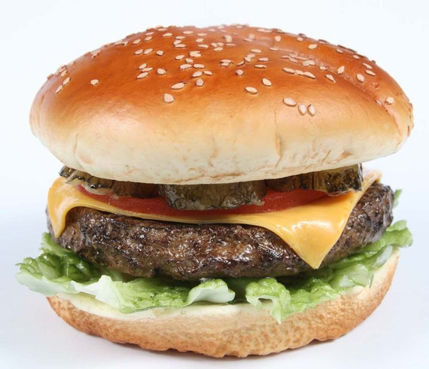
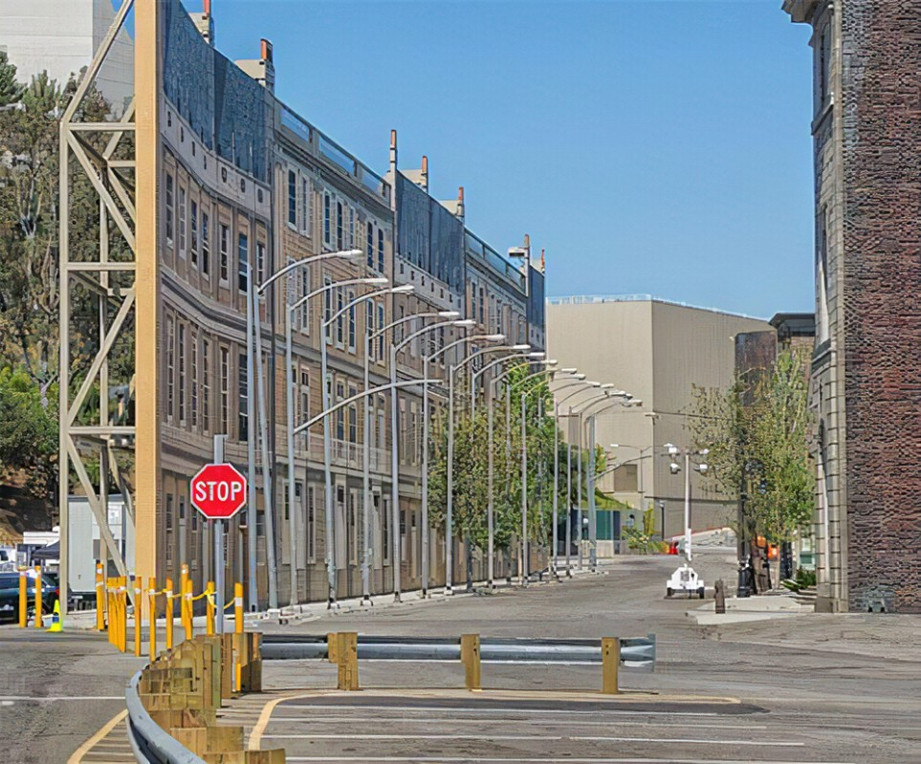
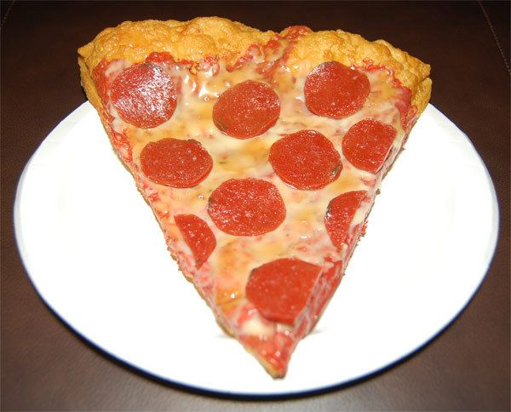
Some Things Look Real- But Are Not

Slide 2
Is your religion REAL?
Is your faith REAL?
Is your service REAL?

Slide 3
Is It Real?
Or is it merely convenient?
Or is it just talk?
Or is it for display only?

Slide 4
Define: Real
Acts 12:9
So he went out and followed him, and did not know that what was done by the angel was real, but thought he was seeing a vision.
BDAG: “real, genuine, not imaginary”
TLNT: “authentic”
Translated: “true” (Acts 12:9 ASV); “really happening” (Acts 12:9 NIV)
Most often translated “true” (i.e. Titus 1:13;1 Pet. 5:12)
Notes:
TLNT = Theological Lexicon of the New Testament

Slide 5
What Is Real?
Is It Real?

Slide 6
What Is Real?
Faith
  Based upon real evidence (Rom. 10:17; Acts 2:21-36)
  Faith is: (Heb. 11:1)
    “Substance of things hoped for”
      “Faith is being sure of things we hope for” (NCV)
      Real faith is being “absolutely certain that what it believes is true” (Barclay, 144)
    “Evidence of things not seen”
      “know that something is real even if we do not see it” (NCV)
      “Faith is that which enables us to treat as real the things that are unseen” (EGNT IV, 352)

Slide 7
What Is Real?
Faith
  Based upon real evidence (Rom. 10:17; Acts 2:21-36)
  Faith is: (Heb. 11:1)
  Genuine faith (1 Pet. 1:7)
    Genuineness – same word for “testing” (Jas. 1:3)
    Means – has passed the test

Slide 8
What Is Real?
Faith
  Based upon real evidence (Rom. 10:17; Acts 2:21-36)
  Faith is: (Heb. 11:1)
  Genuine faith (1 Pet. 1:7)
  Real faith is active
    Jas. 1:22 – doers of the word – not hearers only
    Jas. 2:14-26

Slide 9
What Is Real?
Faith
Priorities
  God over family (Matt. 10:37)
  Forsake all to be a disciple (Matt. 4:22; Luke 5:11)
  Don’t wait till bury father (Matt. 8:22)
  Not forsake assembling when persecuted (Heb. 10:25)

Slide 10
What Is Real?
Faith
Priorities
Practice
  Do what you say – practice what you preach
  Those who say and don’t do are hypocrites (Matt. 23:3)
  Practice should match what we advocate (1 Tim. 4:16)

Slide 11
What Is Real?
When It Is Real
Is It Real?

Slide 12
When It Is Real
Actually & completely believe what God says (Rom. 4:16-21)
Do what is required – even when it is hard (Gen. 12:1, 5; Heb. 11:8)
Will go to any length – do what it takes (Heb. 11:17; Gen. 22:2, 10)
Actions match what say you believe (Jer. 32:6-9; Ezra 8:22)
See daily situations where you make it real (Deut. 6:7)
Stand your ground and not give in (Dan. 1:8; 3:17-18)
Trust God in the storms (Acts 27:25)

Slide 13
What Is Real?
When It Is Real
When It Is Not Real
Is It Real?

Slide 14
When It Is Not Real
Do only what is convenient (Matt. 19:16-22)
Creates an impression that you are more than are (Acts 5:1ff)
Talk doesn’t match performance (Matt. 15:8)
Turn back on the Lord for things that are worthless (Matt. 26:14ff)
Serve self under the banner of caring for others (John 12:4-6)
Indifferent – apathetic (Rev. 3:14-ff)
Hypocrites (play actors – not real)

Slide 15
Hypocrites (play actors – not real)
  More concerned how look to others (Matt. 23:28)
  Does what he knows to be wrong (Gal. 2:11-13)
  God is not impressed (Hosea 6:6)

Slide 16
What Is Real?
When It Is Real
When It Is Not Real
It Will Be Tested
Is It Real?

Slide 17
It Will Be Tested
Our Faith Will be Tested
  1 Pet. 1:6-7
  Quite often there is a conflict between what I want and what I know is right (Matt. 26:41)

Slide 18
It Will Be Tested
Our Faith Will be Tested
Many Situations / Circumstances – Must Realize “This Is Real”
Ask: “What do we do now?”
Will our actions match our faith?
Will we do what we claim?
We will have hard choices to make
We will have hard decisions
This is not just theory or belief!

Slide 19
It Will Be Tested
Our Faith Will be Tested
Many Situations / Circumstances – Must Realize “This Is Real”
  Conflict between God & family
    God says stay (Matt. 19:3-6; 1 Pet. 3:7)
    God says leave (Ezra 10)
    God says submit (Eph 5:22)
    Given a choice: family relationship or God (cf. 1 Cor. 7:15)

Slide 20
It Will Be Tested
Our Faith Will be Tested
Many Situations / Circumstances – Must Realize “This Is Real”
  Conflict between God & family
  Been wronged & offender asks for forgiveness
    God says forgive (Matt. 18:35)
    God says forgive multiple times (Luke 17:1-4)

Slide 21
It Will Be Tested
Our Faith Will be Tested
Many Situations / Circumstances – Must Realize “This Is Real”
  Conflict between God & family
  Been wronged & offender asks for forgiveness
  Do what promise
    God says do what you promise (Jas. 5:12)
    When you’ve given your word – but rather not do what promised…

Slide 22
It Will Be Tested
Our Faith Will be Tested
Many Situations / Circumstances – Must Realize “This Is Real”
  Conflict between God & family
  Been wronged & offender asks for forgiveness
  Do what promise
  Take an uncomfortable stand
    Hard for Peter and Barnabas (Gal. 2:11-13)
    May be a stand you know is right – but really don’t want the pressure

Slide 23
It Will Be Tested
Our Faith Will be Tested
Many Situations / Circumstances – Must Realize “This Is Real”
  Conflict between God & family
  Been wronged & offender asks for forgiveness
  Do what promise
  Take an uncomfortable stand
  Accept that someone you know & love will be lost
    Jesus brings division among men (Luke 12:51-53)
    Hard time admitting what know the Bible teaches?

Slide 24
It Will Be Tested
Our Faith Will be Tested
Many Situations / Circumstances – Must Realize “This Is Real”
  Conflict between God & family
  Been wronged & offender asks for forgiveness
  Do what promise
  Take an uncomfortable stand
  Accept that someone you know & love will be lost
  Crisis (persecution or pandemic)
    Cast the principles of authority out / at least ignore?
    Are there still divine instructions to follow?

Slide 25
It Will Be Tested
Our Faith Will be Tested
Many Situations / Circumstances – Must Realize “This Is Real”
  Conflict between God & family
  Been wronged & offender asks for forgiveness
  Do what promise
  Take an uncomfortable stand
  Accept that someone you know & love will be lost
  Crisis (persecution or pandemic)
  Really believe God is in control & rules in the kingdoms of men?

Slide 26
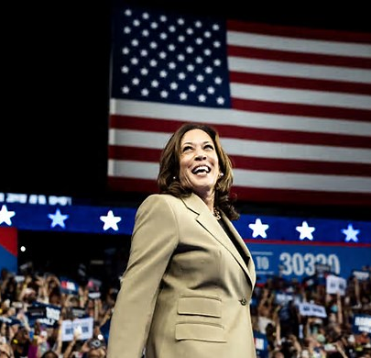

Has the Political Climate
Caused Us to Forget?
That God is still on his throne & in control (Rev. 4)?
That God rules in the kingdoms of men (Dan. 4:32)?

Slide 27
What Is Real?
When It Is Real
When It Is Not Real
It Will Be Tested
Is It Real?

