Slide 2
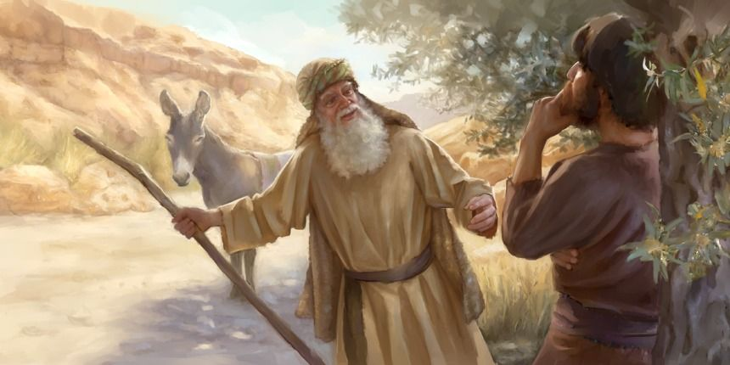
Lessons Learned Too Late
1 Kings 13

Slide 3
Lessons Learned Too Late
God Is Not An Author of Confusion
1 Kings 13

Slide 4
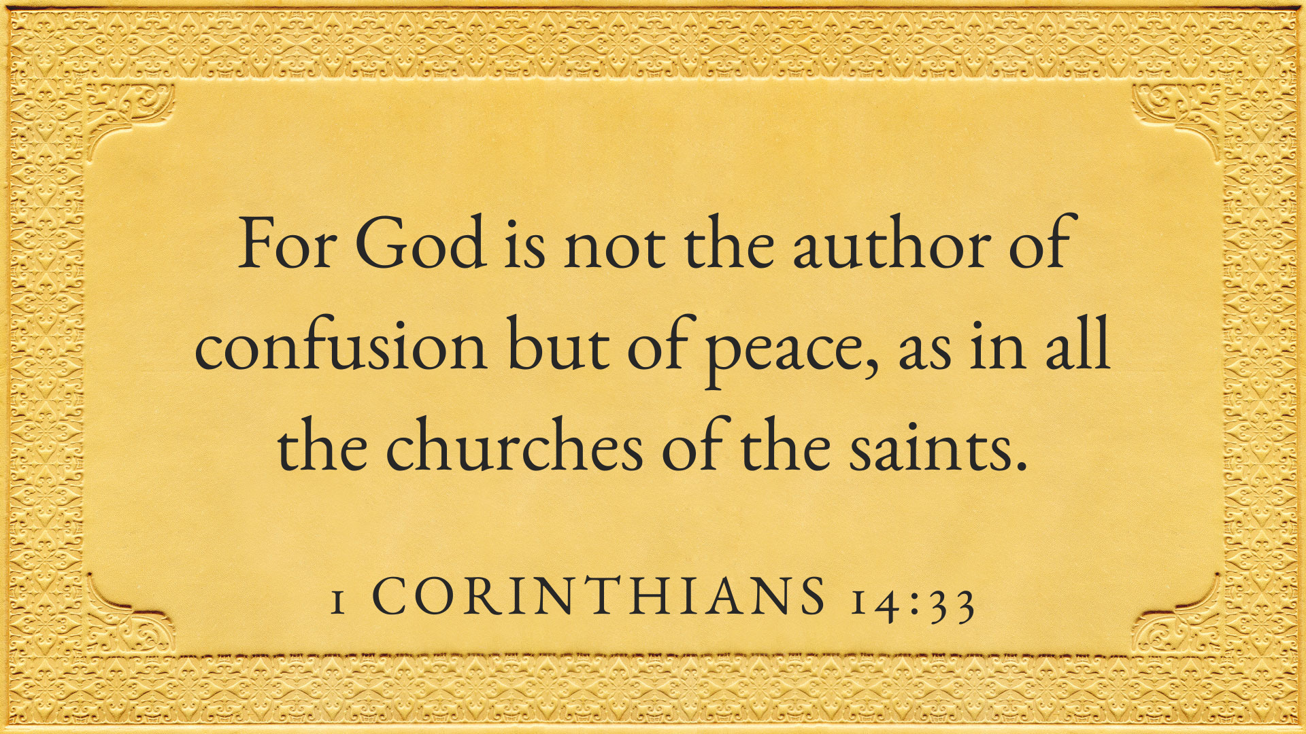

Slide 5
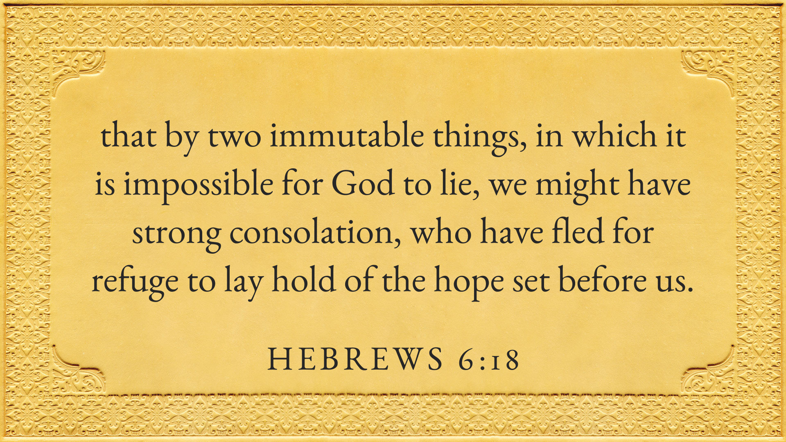

Slide 6
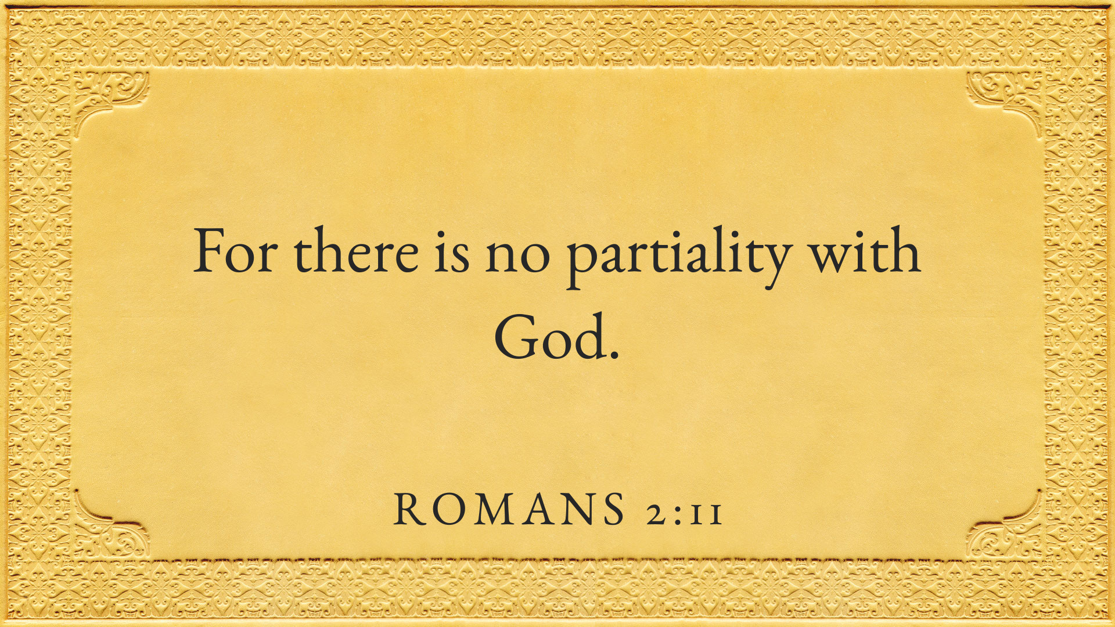

Slide 7
God Is Not An Author of Confusion
When you have people saying one thing and others saying another, you have confusion.
The Young Prophet Was Somehow Able To Convince Himself That God Would Contradict Himself
  He was told, “...‘You shall not eat bread, nor drink water, nor return by the same way you came.’ ” - 1 Kings 13:8-9
  He knew his message was God-given.
  There was a sign to confirm the message – 1 Kings 13:3,5
  The older prophet told him something different than the command of God – 1 Kings 13:15-19
  He was convinced that God would tell him something and the older prophet something else.

Slide 8
God Is Not An Author of Confusion
When you have people saying one thing and others saying another, you have confusion.
The Young Prophet Was Somehow Able To Convince Himself That God Would Contradict Himself.
The Devil Tries To Get Us When We Are Most Vulnerable.
  The young prophet must have been hungry.
  The devil tempted Jesus when he was hungry - Matt. 4:2-3

Slide 9
Lessons Learned Too Late
God Is Not An Author of Confusion
Religious Leaders Don’t Always Tell The Truth
1 Kings 13

Slide 10
Religious Leaders Don’t Always Tell The Truth
A Fellow Came Along and Said, “I too am a Prophet”
  He didn’t question whether he was telling the truth
  Some say, “I am a preacher...”
  Many people believe "he wouldn't lie" or "he surely knows what he's talking about.”

Slide 11
Religious Leaders Don’t Always Tell The Truth
A Fellow Came Along and Said, “I am a Prophet”
We Are Told To Investigate
  1 Thess. 5:21
  Acts 17:11
  Who Should We Investigate? (Everyone)

Slide 12
Religious Leaders Don’t Always Tell The Truth
A Fellow Came Along and Said, “I am a Prophet”
We Are Told To Investigate
He Claimed To Have A More Up To Date Revelation
  This claim is made repeatedly today (Jehovah's Witnesses, Mormons, Etc...)
  Gal. 1:6-8

Slide 13
Lessons Learned Too Late
God Is Not An Author of Confusion
Religious Leaders Don’t Always Tell The Truth
Sincerity Is No Excuse For Disobedience
1 Kings 13

Slide 14
Sincerity Is No Excuse For Disobedience
No One Can Doubt The Sincerity of The Young Prophet
  He faced danger and risked his life with the king’s wrath
  He turned down the offer of royalty – to be loyal to God

Slide 15
Sincerity Is No Excuse For Disobedience
No One Can Doubt The Sincerity of The Young Prophet
However, despite his sincerity – he died for his disobedience
  We all know when we violate natural laws – sincerity isn’t enough to protect us
  When will people learn that sincerity in religion (although important) is not enough alone
    Matt. 7:21-24
    Matt. 15:14

Slide 16
Lessons Learned Too Late
God Is Not An Author of Confusion
Religious Leaders Don’t Always Tell The Truth
Sincerity Is No Excuse For Disobedience
Yesterday's Obedience Doesn’t Atone For Today's Disobedience
1 Kings 13

Slide 17
Yesterday's Obedience Doesn’t Atone For Today's Disobedience
God Doesn’t Overlook Today’s Disobedience Because of Our Obedience In The Past
  It can be easy for us to dwell in our accomplishments of the past.
  But if I don't remain faithful to the Lord, yesterday's obedience doesn't help.

Slide 18
Yesterday's Obedience Doesn’t Atone For Today's Disobedience
God Doesn’t Overlook Today’s Disobedience Because of Our Obedience In The Past
God Requires Continual Obedience
  1 Cor. 15:58
  Rev. 2:10

Slide 19
Lessons Learned Too Late
God Is Not An Author of Confusion
Religious Leaders Don’t Always Tell The Truth
Sincerity Is No Excuse For Disobedience
Yesterday's Obedience Doesn’t Atone For Today's Disobedience
Partial Obedience Isn’t Obedience At All
1 Kings 13

Slide 20
Partial Obedience Isn’t Obedience At All
The Young Prophet Successfully Completed The First Part of His Mission
However, There Was A Second Part of His Mission – Just As Vital As His First.
  Both parts were God-given missions.
  He didn’t obey what the Lord said about his return trip.

Slide 21
Partial Obedience Isn’t Obedience At All
The Young Prophet Successfully Completed The First Part of His Mission
However, There Was A Second Part of His Mission – Just As Vital As His First.
Have You, As A Member of The Church, Contented Yourself With Partial Obedience?

Slide 22
Lessons Learned Too Late
God Is Not An Author of Confusion
Religious Leaders Don’t Always Tell The Truth
Sincerity Is No Excuse For Disobedience
Yesterday's Obedience Doesn’t Atone For Today's Disobedience
Partial Obedience Isn’t Obedience At All
1 Kings 13

