Slide 1
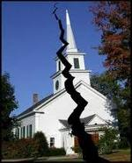
Divisions Within
The Church of Christ
Authority
  Missionary Society (1849)
  Instrumental Music (1859)
  Colleges in Church Budget (1938)
  Orphan Homes (1950’s)
  Sponsoring Church (1950’s)
  Social Gospel (1960’s)

Slide 2
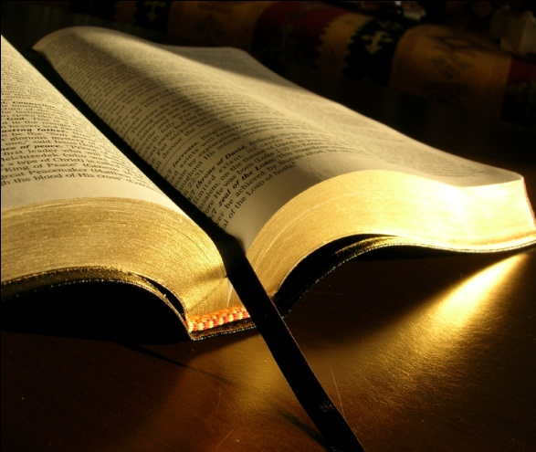
Authority
A Simple Study of How Authority Works In Religion

Slide 3
Authority
I. What Is Authority?
I. What Is Authority?
II. God Has Authority Over Man
II. God Has Authority Over Man
III. The Need For Authority
III. The Need For Authority
IV. Must Have Bible Authority
IV. Must Have Bible Authority

Slide 4
Authority
I. What Is Authority?
I. What Is Authority?
II. God Has Authority Over Man
II. God Has Authority Over Man
III. The Need For Authority
III. The Need For Authority
IV. Must Have Bible Authority
IV. Must Have Bible Authority
V. How Authority Is Established
V. How Authority Is Established

Slide 5
V. How Authority Is Established
John 13:34-35
34 A new commandment I give to you, that you love one another; as I have loved you, that you also love one another.
35 By this all will know that you are My disciples, if you have love for one another."
1. Command /
Direct Statement
Tell
2. Approved
Example
Show
Imply
3. Necessary
Inference

Slide 6
V. How Authority Is Established
Tell
This is How
You know
Anything You Know
Show
Imply

Slide 7
V. How Authority Is Established
Acts 15
VV. 13-21 – James appealed to direct statement from Amos 9
Command / Statement
Tell
V. 12 – Paul & Barnabas appealed to example of their work & miracles
Approved Example
Show
Necessary Inference
VV. 7-11 – Peter appealed to events at Cornelius’ house – infers…
Imply

Slide 8
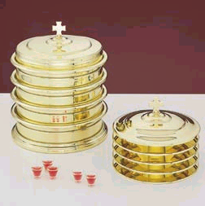
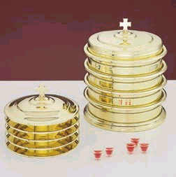
V. How Authority Is Established
Illustrated with Lord’s Supper
Command / Statement
Observance
(1 Cor. 11:23-24)
Tell
Approved Example
Time of Observance
(Acts 20:7)
Show
Necessary Inference
Frequency of Observance
(Acts 20:7)
Imply

Slide 9
Authority
I. What Is Authority?
I. What Is Authority?
II. God Has Authority Over Man
II. God Has Authority Over Man
III. The Need For Authority
III. The Need For Authority
IV. Must Have Bible Authority
IV. Must Have Bible Authority
V. How Authority Is Established
V. How Authority Is Established
VI. Applying Bible Authority
VI. Applying Bible Authority

Slide 10
A. Generic & Specific Authority
When A Command
Is Left In The
Generic
Can Choose Any
Specific
Within That Generic
When A Command
Is
Specific
Can Not Choose Any
Other Specific
Within That Generic
Generic: Wood
Specific:
Cedar, Oak, Walnut,
Pine, Gopher, Hickory
Specified: Gopher
Eliminates:
Cedar, Oak, Walnut,
Pine, Hickory, etc.

Slide 11
A. Generic & Specific Authority
Command | Generic | Specific
Buy me a canned drink | Cola | Pepsi

Slide 12
A. Generic & Specific Authority
Command | Generic | Specific
Buy me a canned drink | Cola | Pepsi
Build ark - Gen. 6:14 | Wood | Gopher

Slide 13
A. Generic & Specific Authority
Command | Generic | Specific
Buy me a canned drink | Cola | Pepsi
Build ark - Gen. 6:14 | Wood | Gopher
Wash 7 Times - 2 Kings 5 | River | Jordan

Slide 14
A. Generic & Specific Authority
Command | Generic | Specific
Buy me a canned drink | Cola | Pepsi
Build ark - Gen. 6:14 | Wood | Gopher
Wash 7 Times - 2 Kings 5 | River | Jordan
Offer – Lev. 14:12-13 | Animal | Lamb

Slide 15
A. Generic & Specific Authority
Command | Generic | Specific
Buy me a canned drink | Cola | Pepsi
Build ark - Gen. 6:14 | Wood | Gopher
Wash 7 Times - 2 Kings 5 | River | Jordan
Offer – Lev. 14:12-13 | Animal | Lamb
Praise – Eph. 5:19 | Music | Sing

Slide 16


Singing
If God had said: “Music”
X
X
X
Sing
Instrum.
Hum
Whistle
Sing

Slide 17
B. Aids & Additions
Aid
Expedites command
Doing nothing more
No addition
Addition
Another element
Doing more than
commanded

Slide 18
B. Aids & Additions
An Addition Involves Another Element Being Added!
Command | Aid | Addition
Buy Me A Pepsi | Car, sack, cooler | Sprite, RC, etc.

Slide 19
B. Aids & Additions
An Addition Involves Another Element Being Added!
Command | Aid | Addition
Buy Me A Pepsi | Car, sack, cooler | Sprite, RC, etc.
Eat Bread – 1 Cor. 11 | Table, plates … | Jam, beef, cola

Slide 20
B. Aids & Additions
An Addition Involves Another Element Being Added!
Command | Aid | Addition
Buy Me A Pepsi | Car, sack, cooler | Sprite, RC, etc.
Eat Bread – 1 Cor. 11 | Table, plates … | Jam, beef, cola
Baptize – Matt. 28:19 | Baptistry, heater | Sprinkling

Slide 21
B. Aids & Additions
An Addition Involves Another Element Being Added!
Command | Aid | Addition
Buy Me A Pepsi | Car, sack, cooler | Sprite, RC, etc.
Eat Bread – 1 Cor. 11 | Table, plates … | Jam, beef, cola
Baptize – Matt. 28:19 | Baptistry, heater | Sprinkling
Build an ark – Gen. 6:14 | Tool, Animal | Oak, Cedar

Slide 22
B. Aids & Additions
An Addition Involves Another Element Being Added!
Command | Aid | Addition
Buy Me A Pepsi | Car, sack, cooler | Sprite, RC, etc.
Eat Bread – 1 Cor. 11 | Table, plates … | Jam, beef, cola
Baptize – Matt. 28:19 | Baptistry, heater | Sprinkling
Build an ark – Gen. 6:14 | Tool, Animal | Oak, Cedar
Contribute – 1 Cor. 16 | Basket, Account | Mon. / Sat.

Slide 23
B. Aids & Additions
An Addition Involves Another Element Being Added!
Command | Aid | Addition
Sing – Eph. 5:19 | Books, Tuner | Instrumental Music

Slide 24
C. The Silence of God
“God did not say not to”
“There is no passage that says ‘Thou shalt not…”
“Where is the passages that says it is wrong to…?”
Common Thought:
Silence of God gives permission

Slide 25
C. The Silence of God
1 Cor. 4:6 – forbidden to go beyond things written
Col. 2:22-23 – will worship (kjv)
  Will worship = according to commandments of men
  “voluntarily adopted worship, whether unbidden or forbidden” (W. E. Vine)
Any Passage That Says We Must Have Authority – Says We Must Respect God’s Silence!

Slide 26
C. The Silence of God
X
Two Mindsets
Permissive
At liberty to do what
is not
condemned
Prohibitive
Forbidden to act
Without authority
Heb. 7:14
For it is evident that our Lord arose from Judah, of which tribe Moses spoke nothing concerning priesthood

Slide 27
God Did Not Say Not To:
Ice Cream with the Lord’s Supper
Handle snakes as an act of worship
Church sponsored sports
Offer a bull or lamb as sacrifice
Count beads as an act of worship
Mechanical Instrum. of music in worship
Church to be in secular business

Slide 28
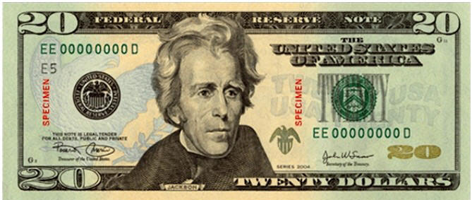
Suppose Someone Sends You To The Store
“Go buy me a gallon of milk & a box of cereal.”
Inherent Authority: One who owns the money
Delegated Authority: You have the authority to spend it
Only
Authorized To
Buy:
Milk & Cereal
“Did not say, ‘Don’t buy candy’”
“Did not say, ‘Don’t buy meat’”
“Did not say, ‘Don’t buy colas’”
“Did not say, ‘Don’t buy magazines’”

Slide 29
Bible
Authority
What we do in worship (sing or play)
What we do as a church (support organ.)
Who has a right to remarry (MDR controversy)
Role of elders & deacons (what they do)

Slide 30
Bible
Authority
Learned
Principle
Not Learned
Application
Learned
Application
Not Learned
Principle

Slide 31
Authority
I. What Is Authority?
I. What Is Authority?
II. God Has Authority Over Man
II. God Has Authority Over Man
III. The Need For Authority
III. The Need For Authority
IV. Must Have Bible Authority
IV. Must Have Bible Authority
V. How Authority Is Established
V. How Authority Is Established
VI. Applying Bible Authority
VI. Applying Bible Authority

