Slide 1
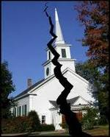
Divisions Within
The Church of Christ
Authority
  Missionary Society (1849)
  Instrumental Music (1859)
  Colleges in Church Budget (1938)
  Orphan Homes (1950’s)
  Sponsoring Church (1950’s)
  Social Gospel (1960’s)

Slide 2
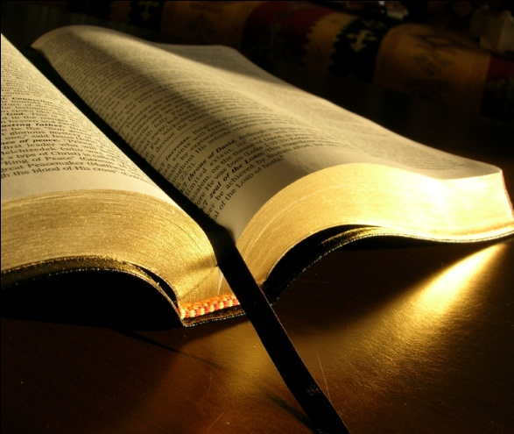
Authority
A Simple Study of How Authority Works In Religion

Slide 3
Authority
I. What Is Authority?
I. What Is Authority?

Slide 4
I. What Is Authority?
English: “The power to command, enforce laws, exact obedience, determine, or judge” (AHD, 142)
Greek (EXOUSIA): “Power of rule or government, the power of one whose will and commands must be obeyed by others e.g. Matt. 28:18…” (Vines I:89)
Inherent
Because of who one is
  God
  I have over my money
Delegated
Received from one in authority
  Given to man by God
  You spend my money

Slide 5
Authority
I. What Is Authority?
I. What Is Authority?
II. God Has Authority Over Man
II. God Has Authority Over Man

Slide 6
II. God Has Authority Over Man
Because He Is God
God (Exo. 3:14; Rev. 4:8)
Creator (Gen. 1:1; Heb. 3:4)
Infinite wisdom (Isa. 55:8-9)
Has all authority (Mt. 28:18)
Word Is Authoritative
Inspired (2 Tim. 3:16-17)
Violation = Sin (1 Jno. 3:4)
Taught w/ auth. (Tit. 2:15)
Can’t alter (Rev. 22:18-19)
Judged by it (Jno. 12:48)

Slide 7
Authority
I. What Is Authority?
I. What Is Authority?
II. God Has Authority Over Man
II. God Has Authority Over Man
III. The Need For Authority
III. The Need For Authority

Slide 8
III. The Need For Authority
A. The Order of Authority (1 Cor. 11:3)

Slide 9
1 Cor 11:3
“But I want you to know that the head of every man is Christ, the head of woman is man, and the head of Christ is God.”
God
(Father)
Christ
(son)
Man
Woman

Slide 10
III. The Need For Authority
A. The Order of Authority (1 Cor. 11:3)
B. Man Is Not His Own Authority
1. Jer. 10:23 – not to direct his own steps
2. Prov. 14:12 – way that seems right…

Slide 11
III. The Need For Authority
A. The Order of Authority (1 Cor. 11:3)
B. Man Is Not His Own Authority
C. Following Authority
1. Cain & Abel (Gen. 4)

Slide 12
Gen 4:3-5
3 And in the process of time it came to pass that Cain brought an offering of the fruit of the ground to the LORD.
4 Abel also brought of the firstborn of his flock and of their fat. And the LORD respected Abel and his offering,
5 but He did not respect Cain and his offering. And Cain was very angry, and his countenance fell.

Slide 13



Cain
Abel
Offering:
“Fruit of ground”
Offering:
“firstborn of his flock”
Lord
Did Not Respect
Lord
Respected
Not: “By Faith”
“By Faith”
(Heb. 11:4)
Word
Rom. 10:17

Slide 14
III. The Need For Authority
A. The Order of Authority (1 Cor. 11:3)
B. Man Is Not His Own Authority
C. Following Authority
1. Cain & Abel (Gen. 4)
2. Nadab & Abihu (Lev. 10:1-2)

Slide 15
Lev 10:1-2
1 Then Nadab and Abihu, the sons of Aaron, each took his censer and put fire in it, put incense on it, and offered profane fire before the LORD, which He had not commanded them.
2 So fire went out from the LORD and devoured them, and they died before the LORD.
“…offered unauthorized fire…” (NIV)

Slide 16
Authority
I. What Is Authority?
I. What Is Authority?
II. God Has Authority Over Man
II. God Has Authority Over Man
III. The Need For Authority
III. The Need For Authority
IV. Must Have Bible Authority
IV. Must Have Bible Authority

Slide 17



IV. We Must Have Bible Authority
God Has A Pattern
Hebrews 8:5
Then This
If This
Pattern
Model
Real

Slide 18
IV. We Must Have Bible Authority
Do all in name of Christ (Col. 3:17)

Slide 19

Col 3:17
17 And whatever you do in word or deed, do all in the name of the Lord Jesus, giving thanks to God the Father through Him.
“Open up in the name of the law!”
Acts 4:7
And when they had set them in the midst, they asked, "By what power or by what name have you done this?
Authority

Slide 20
IV. We Must Have Bible Authority
Do all in name of Christ (Col. 3:17)
Abide within the doctrine of Christ (2 John 9)

Slide 21
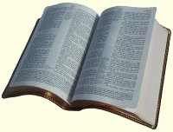
2 John 9
Whoever transgresses and does not abide in the doctrine of Christ does not have God. He who abides in the doctrine of Christ has both the Father and the Son.
Doctrine
of
Christ
Doctrine
Practice
ASV
Whosoever goeth onward and abideth not in the teaching of Christ…

Slide 22
IV. We Must Have Bible Authority
Do all in name of Christ (Col. 3:17)
Abide within the doctrine of Christ (2 John 9)
Christ is head of the church (Eph. 1:22-23; 5:23-24)
If not, can do anything!

Slide 23
Where We Apply Bible Authority
All that we teach (1 Pet. 4:11)
What we do in worship?
Who has a right to marry?
Who is to lead in the local church?
What is the church to be doing (work / role)?
What is the organization of the church?

Slide 24
Authority
I. What Is Authority?
I. What Is Authority?
II. God Has Authority Over Man
II. God Has Authority Over Man
III. The Need For Authority
III. The Need For Authority
IV. Must Have Bible Authority
IV. Must Have Bible Authority

