Slide 1
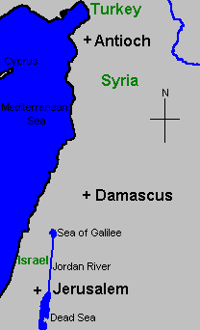
Acts 13-14
First Missionary Journey
Antioch is “home base” for Paul – from which he goes out to preach
The Church at Antioch – greatly involved in his work

Slide 2
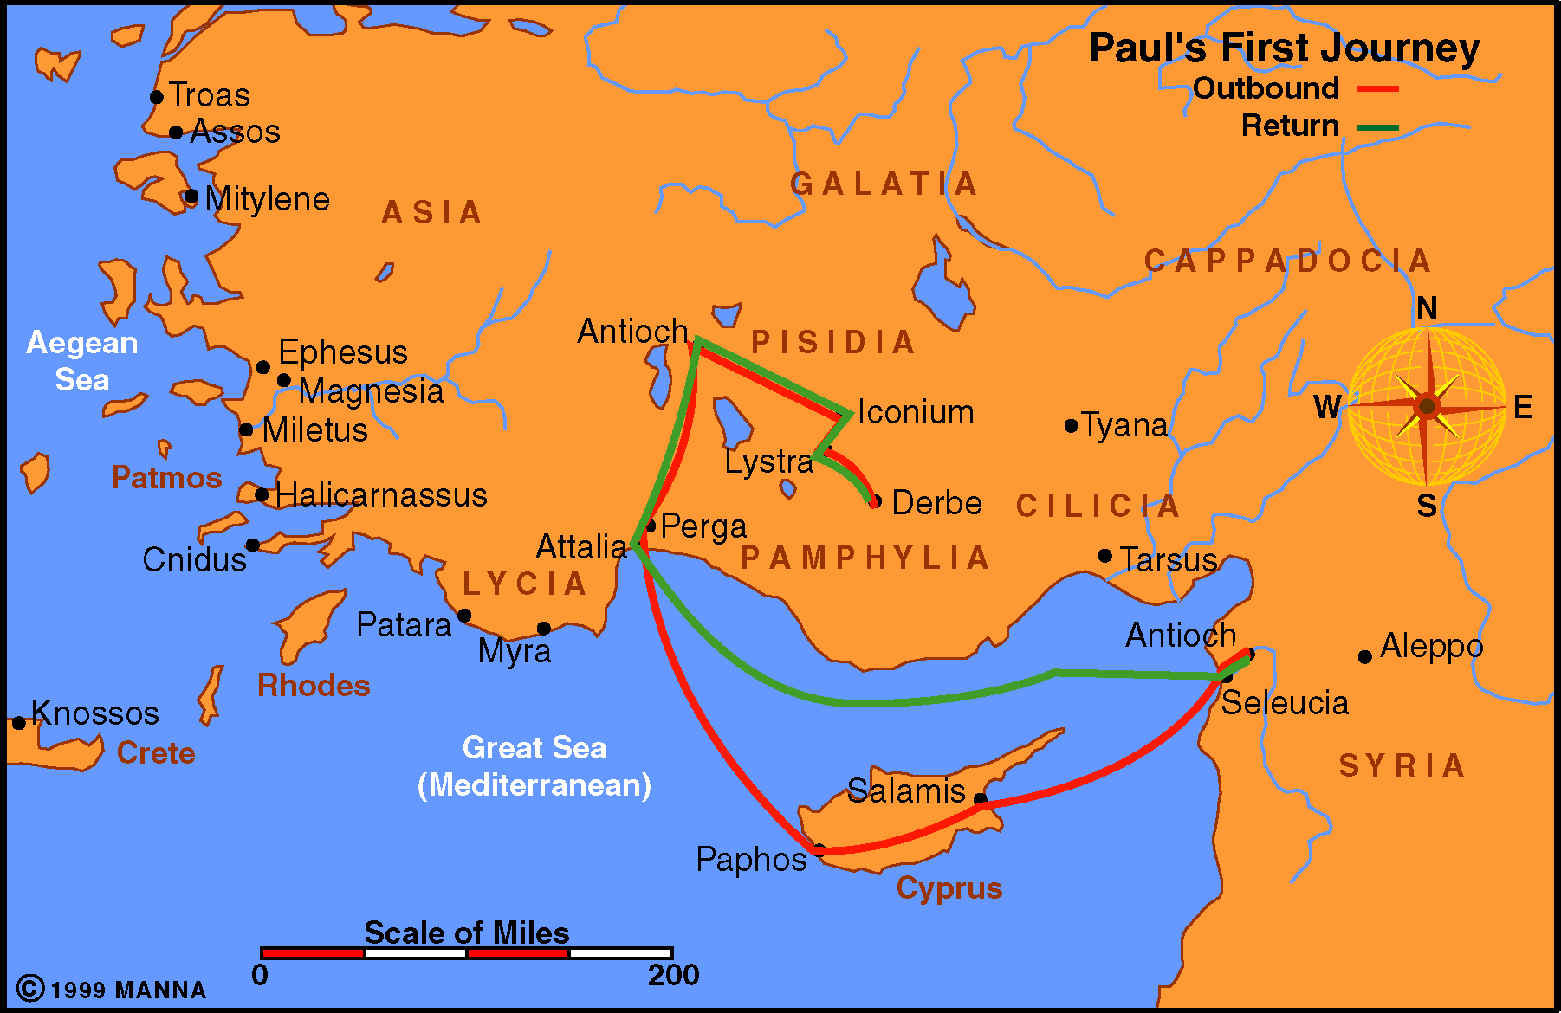

Slide 3
Acts 13
Beginning the First Missionary Journey
From Antioch to Cyprus (vv. 1-12)
  Paul and Barnabas sent forth (vv. 1-3)
  Preaching in Cyprus (vv. 4-12)
At Antioch in Pisidia (vv. 13-52)
  From Paphos to Antioch (vv. 13-15)
  Paul sermon in Antioch (vv. 16-41)
  Results of the sermon (vv. 42-52)

Slide 5
Acts 13
Beginning the First Missionary Journey
From Antioch to Cyprus (vv. 1-12)
  Paul and Barnabas sent forth (vv. 1-3)
  Preaching in Cyprus (vv. 4-12)
At Antioch in Pisidia (vv. 13-52)
  From Paphos to Antioch (vv. 13-15)
  Paul sermon in Antioch (vv. 16-41)
  Results of the sermon (vv. 42-52)

Slide 7
Acts 13
Beginning the First Missionary Journey
From Antioch to Cyprus (vv. 1-12)
  Paul and Barnabas sent forth (vv. 1-3)
  Preaching in Cyprus (vv. 4-12)
At Antioch in Pisidia (vv. 13-52)
  From Paphos to Antioch (vv. 13-15)
  Paul sermon in Antioch (vv. 16-41)
  Results of the sermon (vv. 42-52)

Slide 8
Acts 14
Opposition Faced & Completion of the First Journey
At Iconium (vv. 1-7)
  Great multitudes believed (v. 1)
  Some unbelieving Jews created a stir (vv. 2-7)
At Lystra (vv. 8-20a)
  Crippled man healed (vv. 8-10)
  People attempted to worship Paul and Barnabas (vv. 11-18)
  Jews (from Antioch) persecuted the disciples and stoned Paul (vv. 19-20a)
At Derbe and the Return Trip Home (vv. 20b-28)
  Many believed at Derbe (vv. 20b-21)
  Return home and revisiting churches (vv. 21-28)

Slide 10
Acts 14
Opposition Faced & Completion of the First Journey
At Iconium (vv. 1-7)
  Great multitudes believed (v. 1)
  Some unbelieving Jews created a stir (vv. 2-7)
At Lystra (vv. 8-20a)
  Crippled man healed (vv. 8-10)
  People attempted to worship Paul and Barnabas (vv. 11-18)
  Jews (from Antioch) persecuted the disciples and stoned Paul (vv. 19-20a)
At Derbe and the Return Trip Home (vv. 20b-28)
  Many believed at Derbe (vv. 20b-21)
  Return home and revisiting churches (vv. 21-28)

Slide 12
Acts 14
Opposition Faced & Completion of the First Journey
At Iconium (vv. 1-7)
  Great multitudes believed (v. 1)
  Some unbelieving Jews created a stir (vv. 2-7)
At Lystra (vv. 8-20a)
  Crippled man healed (vv. 8-10)
  People attempted to worship Paul and Barnabas (vv. 11-18)
  Jews (from Antioch) persecuted the disciples and stoned Paul (vv. 19-20a)
At Derbe and the Return Trip Home (vv. 20b-28)
  Many believed at Derbe (vv. 20b-21)
  Return home and revisiting churches (vv. 21-28)

Slide 14
Acts 14
Opposition Faced & Completion of the First Journey
At Iconium (vv. 1-7)
  Great multitudes believed (v. 1)
  Some unbelieving Jews created a stir (vv. 2-7)
At Lystra (vv. 8-20a)
  Crippled man healed (vv. 8-10)
  People attempted to worship Paul and Barnabas (vv. 11-18)
  Jews (from Antioch) persecuted the disciples and stoned Paul (vv. 19-20a)
At Derbe and the Return Trip Home (vv. 20b-28)
  Many believed at Derbe (vv. 20b-21)
  Return home and revisiting churches (vv. 21-28)

Slide 16
Acts 14
Opposition Faced & Completion of the First Journey
At Iconium (vv. 1-7)
  Great multitudes believed (v. 1)
  Some unbelieving Jews created a stir (vv. 2-7)
At Lystra (vv. 8-20a)
  Crippled man healed (vv. 8-10)
  People attempted to worship Paul and Barnabas (vv. 11-18)
  Jews (from Antioch) persecuted the disciples and stoned Paul (vv. 19-20a)
At Derbe and the Return Trip Home (vv. 20b-28)
  Many believed at Derbe (vv. 20b-21)
  Return home and revisiting churches (vv. 21-28)

Slide 17
The Church At Antioch
Was first church among Gentiles
Well taught by Saul & Barnabas
Strong church
Evangelistic church
Influential church
Illustrious church

Slide 18
An
Illustrious
Church
Acts 13-14

Slide 19
An Illustrious Church
Something it Has

Slide 20
Those who are involved in important work – though not in the forefront
Five prophets and teachers at Antioch (13:1)
  Barnabas (Acts 4:26; 9:27; 11:22-30; 12:24-25)
  Simeon – Niger
  Lucious of Cyrene (Rom. 16:21)
  Manaen - brought up with Herod
  Saul
Something it Has

Slide 21
Those who are involved in important work – though not in the forefront
Five prophets and teachers at Antioch (13:1)
John Mark (13:5)
  Nephew of Barnabas (Col. 4:10)
  Mother was devout (Acts 12:12)
  Brought to Antioch from Jerusalem (Acts 12:25)
  He assisted & helped in the work
Something it Has

Slide 22
Those who are involved in important work – though not in the forefront
Five prophets and teachers at Antioch (13:1)
John Mark (13:5)
Barnabas & Saul were in forefront – others were not
  Mark to a lesser degree
    Traveled with Saul & later Barnabas (15:39)
    Wrote the book of Mark
  Others: Simeon, Lucious, Manaen
Many who are not in forefront – yet vital
  Deacons
  Teachers
  Work privately – better than publicly
  Encourage / support / edify
Something it Has

Slide 23
An Illustrious Church
Something it Has
Something it Seeks

Slide 24
Those who want to hear the truth
Sergius Paulus (13:7-12)
  Asked to hear word of God (v. 7)
  Effort to turn him away (vv. 8-11)
  Believed what he heard (v. 12)
  Astonished at teaching (doctrine) of Lord (v. 12)
Something it Seeks

Slide 25
Those who want to hear the truth
Sergius Paulus (13:7-12)
Gentiles (at Antioch) Begged to hear again (13:42)
  Heard
  But they want more!
Something it Seeks

Slide 26
Those who want to hear the truth
Sergius Paulus (13:7-12)
Gentiles (at Antioch) Begged to hear again (13:42)
Every church seeks those who want to hear the truth
  In the world – those who want the truth of God
  In denominations who are starving for word
  Among brethren – those who heard little preaching who want to hear
  When one wants to hear:
    Ask (13:7)
    Beg for more (13:42)
    Impressed with the word (13:12)
    Do not shut ears
    Want what demands changes in them (13:12, 42)
Something it Seeks

Slide 27
An Illustrious Church
Something it Has
Something it Seeks
Something it Faces

Slide 28
Those who seek to turn others away
Barjesus – Elymas (13:6-11)
  Sorcerer (v. 6)
  False prophet (v. 6)
  Sought to turn Sergius Paulus away (v. 8)
  Full of deceit and fraud (v. 10)
  Son of devil (v. 10)
  Enemy of all righteousness (v. 10)
  Pervert the ways of the Lord (v. 10)
Something it Faces

Slide 29
Those who seek to turn others away
Barjesus – Elymas (13:6-11)
Jews at Antioch (13:45, 50)
Jews at Iconium (14:2) – Poisoned minds
People who will prejudice others against the truth
  Tell things that are not true
  Misrepresent what we believe
  Family – wants all to stay in family religion
  Teaching contrary words
  Distract or cause one to lose interest
Something it Faces

Slide 30
Those who seek to turn others away
Those who don’t get it
Prophets read every Sabbath (13:27)
  Repeatedly heard the reading of the prophets
  Every opportunity to learn – study - ask
Something it Faces

Slide 31
Those who seek to turn others away
Those who don’t get it
Prophets read every Sabbath (13:27)
Didn’t know: (13:27)
  Him – The Christ (foretold in the prophets)
  Voices of the prophets – Didn’t know the teaching
  Didn’t apply it
Something it Faces

Slide 32
Those who seek to turn others away
Those who don’t get it
Prophets read every Sabbath (13:27)
Didn’t know: (13:27)
Today we face those who don’t get it
  Not listening
  Ignore what they do hear
  Fail to make application / draw the conclusion
  Oblivious to how point fits their life
  Unaware that a text is contrary to own life
Something it Faces

Slide 33
Those who seek to turn others away
Those who don’t get it
Those tossed in any direction
Something it Faces
First were ready to worship Paul & Barnabas (14:12-18)
Before it was over – stoned Paul (14:19-20)
Today – some are tossed to and fro – unstable / fickle
  High –then low
  On fire – then fire is blown out
  Hot – then cold
  Excited – then they oppose it
  Best friend – then enemy

Slide 34
An Illustrious Church
Something it Has
Something it Seeks
Something it Faces
Something it Does

Slide 35
Spread the gospel beyond
Send Paul & Barnabas out to preach (13:1-3)
Work that was done on this journey – the church had a hand in it
Something it Does

Slide 36
Spread the gospel beyond
Preaching that fits the need
Redemption (13:23, 38-39)
Evidence (13:31-39)
  Witnesses (v. 31)
  OT Scripture (vv. 33-35)
  Empty tomb (v. 37)
Warning (13:40-41)
Something it Does

Slide 37
Spread the gospel beyond
Preaching that fits the need
Interested in the work in other places
Something it Does
Send Paul & Barnabas out to preach (13:1-3)
Wanted to hear about work on the journey (14:27)
“This church did not seem to believe the argument ‘there are heathen enough at home’ although a half million pagans were in Antioch.”
- J. W. McGarvey

Slide 38
An Illustrious Church
Something it Has
Something it Seeks
Something it Faces
Something it Does
Something it Needs

Slide 39
Encouragement
Churches established were encouraged (14:21-22)
  Exhorting them to continue in faith
    Can do it (Phil. 4:13; Heb. 6:3)
    Don’t get discouraged – or give up
  Warning that it will not be easy (v. 22)
Every church needs encouragement
Something it Needs

Slide 40
Encouragement
Elders
Elders are to lead (Acts 20:28)
Elder in every church (14:23)
Didn’t take decades to develop elders (14:23)
Something it Needs

Slide 41
An Illustrious Church
Something it Has
Something it Seeks
Something it Faces
Something it Does
Something it Needs

