Slide 1
Worship
Why are you here
Why are you worshiping
Why did you worship this morning
What does worship mean to you

Slide 2
Worship to God
What is Worship

Slide 3
A. Definition
1. Lexham- “To bow down”
2. Webster’s- To honor; Show reverence
3. “Fall down before”
What is Worship

Slide 4
A. Definition
B. Bible Context
1. Matt 20:20- “Bow down”
2. Matt 18:26- “Fell down”
What is Worship

Slide 5
A. Definition
B. Bible Context
C. Bible Examples
1. Abram. Gen 22:12-14
2. Moses. Exo 34:8
What is Worship

Slide 6
Worship to God
What is Worship
Who to Worship

Slide 7
A. GOD!
1. Rev 22:9
2. Rev 7:11
3. 1 Sam 15:31
4. John 4:21-24
ll. Who to Worship

Slide 8
A. GOD!
B. Who is God?
1. The Creator. (Gen. 1:1;Rev. 14:7)
2. The Great I Am. (John. 8:58)
3. Rules in the Kingdoms of men. (Dan. 4:32)
ll. Who to Worship

Slide 9
A. GOD!
B. Who is God?
C. NO ONE ELSE!
1. Matt. 4:10
ll. Who to Worship

Slide 10
Worship to God
What is Worship
Who to Worship
Why Should we Worship

Slide 11
A. Commanded to Worship.
1. Jesus. (Matt. 4:10)
2. God. (Exo. 20:5)
Why Should We Worship
ll. Who to Worship

Slide 12
A. Commanded to Worship.
B. I’m edified
1. 1 Cor 14:26
Why Should We Worship
ll. Who to Worship

Slide 13
A. Commanded to Worship.
B. I’m edified
C. We should want to
1. Ps. 122:1
Why Should We Worship
ll. Who to Worship

Slide 14
Worship to God
What is Worship
Who to Worship
Why Should we Worship
When to Worship

Slide 15
A. Any time.
1. Jesus. (Matt 26:36-46)
2. Paul & Silas. (Acts 16:25)
When to Worship

Slide 16
A. Any time
On first day of the week.
1. Acts.20:7
2. 1 Cor. 16:1-2
When to Worship

Slide 17

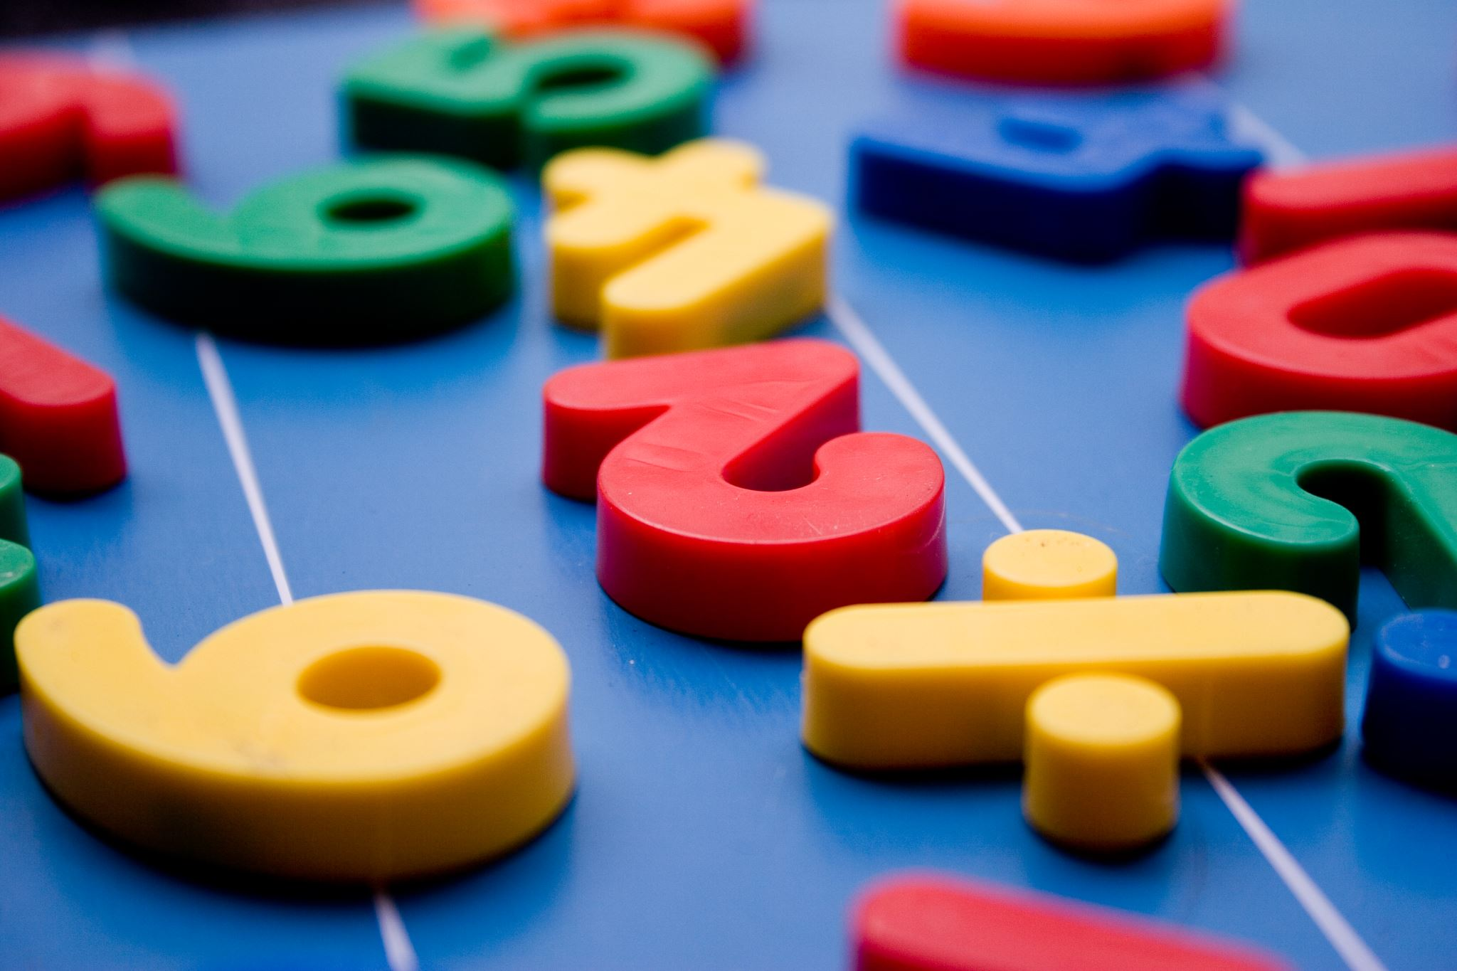


Movies
School
Work
Game
Shopping
just not going

Slide 18
Worship to God
What is Worship
Who to Worship
Why Should we Worship
When to Worship
How to Worship

Slide 19
Humility. (Acts 20:19) - Humble yourselves
Reverence. (Ps 5:7) - Honor; Deep respect
Joy. (Ps 95:1-2) – Happy
Thankfulness. (Ps 100:4) – Thankful to be at worship
Dignity. (1 Cor 14:40) – Properly; Seriousness
How to Worship

Slide 20
Worship to God
What is Worship
Who to Worship
Why Should we Worship
When to Worship
How to Worship
Who to Worship With

Slide 21
Some worship is not acceptable
1. Jews. (Matt 6:5)
2. Ethiopian Eunuch. (Acts 8:27)
Who to Worship With

Slide 22
Some worship is not acceptable
Only accepts worship of the obedient
1. Know that God does not hear sinners. (John 9:31)
Who to Worship With

Slide 23
Some worship is not acceptable
Only accepts worship of the obedient
Worship with right people
1. If the Lord is not in it, it will be rooted up. (Matt 15:13)
Who to Worship With

Slide 24
Worship to God
What is Worship
Who to Worship
Why Should we Worship
When to Worship
How to Worship
Who to Worship With
Mind for Worship

Slide 25
Lord’s supper
1. 1 Cor 11:26-28
Mind for Worship

Slide 26
Lord’s supper
Love the Lord
1. Deut. 6:5
Mind for Worship

Slide 27
Lord’s supper
Love the Lord
Same mind
1. Rom 12:16
Mind for Worship

Slide 28
Lord’s supper
Love the Lord
Same mind
Focus on God
1. Rom 8:7
Mind for Worship

Slide 29
Worship to God
What is Worship
Who to Worship
Why Should we Worship
When to Worship
How to Worship
Who to Worship With
Mind for Worship

