Slide 1




Please
Silence
Your
Phone

Slide 2

2023-2024 Dates
Nov. 3-5, 2023 ♦ Meeting (Micah Webb)
May 2024 ♦ Singing School (Tim Stevens)
Mark These On Your Calendar

Slide 3

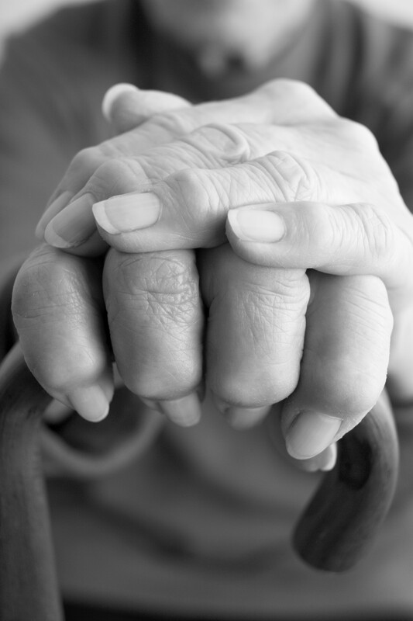
Remember those who are shut in
Betty Ann Wood
Wanda Kelly
Robert Bonds
Francis Bonds
Alice Harris
Betty Prater
Betty Reeves
Annette Sissom
Some of these are continually shut in, others are temporary

Slide 4

Quiet
Please
Let us all prepare to worship the Almighty God

Slide 6
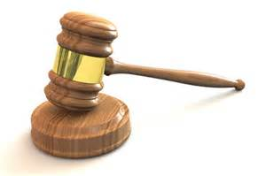
There is a
Judgment Day Coming
Heb 9:27
“And as it is appointed for men to die once, but after this the judgment.”
Acts 24:25
“Now as he reasoned about righteousness, self-control, and the judgment to come, Felix was afraid and answered, ‘Go away for now; when I have a convenient time I will call for you.’”

Slide 7
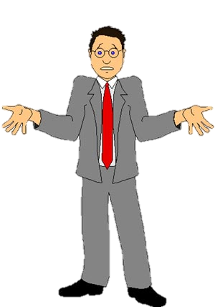
Not Uncommon for People to Think Little or Nothing About the Judgment Day
Romans 2
“Our situation is different” (v. 3)
Think “Goodness is approval” (v. 4)
Don’t fear (v. 5)
Our Attitude Affects How We Live!

Slide 8
The
Judgment Day

Slide 9
The Judgment Day
The Day

Slide 10
The Day
God has appointed a day for judgment (Acts 17:30-31)
Yet future
  Heb. 9:27 – after death
  John 12:48 – in last day (cf. 11:24; 6:40)

Slide 11
The Day
God has appointed a day for judgment (Acts 17:30-31)
Yet future
After second coming and resurrection
  Matt. 13:40
  Matt. 25:31-32
  2 Thess. 1:7-10
  2 Pet. 3:7,9-10

Slide 12
The Day
God has appointed a day for judgment (Acts 17:30-31)
Yet future
After second coming and resurrection
We don’t know when
  Matt. 24:36
  Thus, it behooves us to live like it is today!

Slide 13
The Judgment Day
The Day
The Judge

Slide 14
The Judge
All judgment is with God
  Heb. 11:6
  1 Pet. 1:17
  1 Pet. 2:23

Slide 15
The Judge
All judgment is with God
Committed all judgment to the Son (Jesus Christ)
  John 5:22, 27 – committed all judgment to Son
  Acts 17:30-31- judge world by one raised
  Matt. 25:31-32 – all nations gathered before him
  Acts 10:42 – God ordained him to be the judge
  2 Cor. 5:10 – judgment seat of Christ
  2 Tim. 4:1, 8 – Lord Jesus will judge living & dead

Slide 16
The Judge
All judgment is with God
Committed all judgment to the Son (Jesus Christ)
The perfect judge
  2 Tim. 4:8 – righteous judge
  Heb. 2:17-18 – lived as man –knows suffering and temptation
  Heb. 4:15 – tempted in all points like us

Slide 17
The Judgment Day
The Day
The Judge
The Judged

Slide 18
The Judged
All who ever lived
  John 5:27-29 – all in graves will come forth
  Acts 24:15 - resurrection of just and unjust
  Matt. 25:32 – all nations be gathered before him
  Rom. 2:5-6; 3:6 – each one; world
  Rev. 20:12-13 – all the dead

Slide 19
The Judged
All who ever lived
None are exempt / or will escape
  Rom. 2:3
  God is no respecter of persons (Rom. 2:11)

Slide 20
The Judged
All who ever lived
None are exempt / or will escape
Even angels are included
  2 Pet. 2:4
  Jude 6

Slide 21
The Judged
All who ever lived
None are exempt / or will escape
Even angels are included
Judged as individuals
  Rom. 2:6 – render to each one
  Rom. 14:12 – give an account of himself
  1 Pet. 1:17 – according to each one’s work
  Not as a church (just because in right church)
  Not as a family (just because family godly)

Slide 22
The Judgment Day
The Day
The Judge
The Judged
The Standard

Slide 23
The Standard
Not
  The world’s standard (what world thinks right)
  Own thinking or conscience (Jer. 10:23)
  What brethren think (1 Cor. 4:3-4)

Slide 24
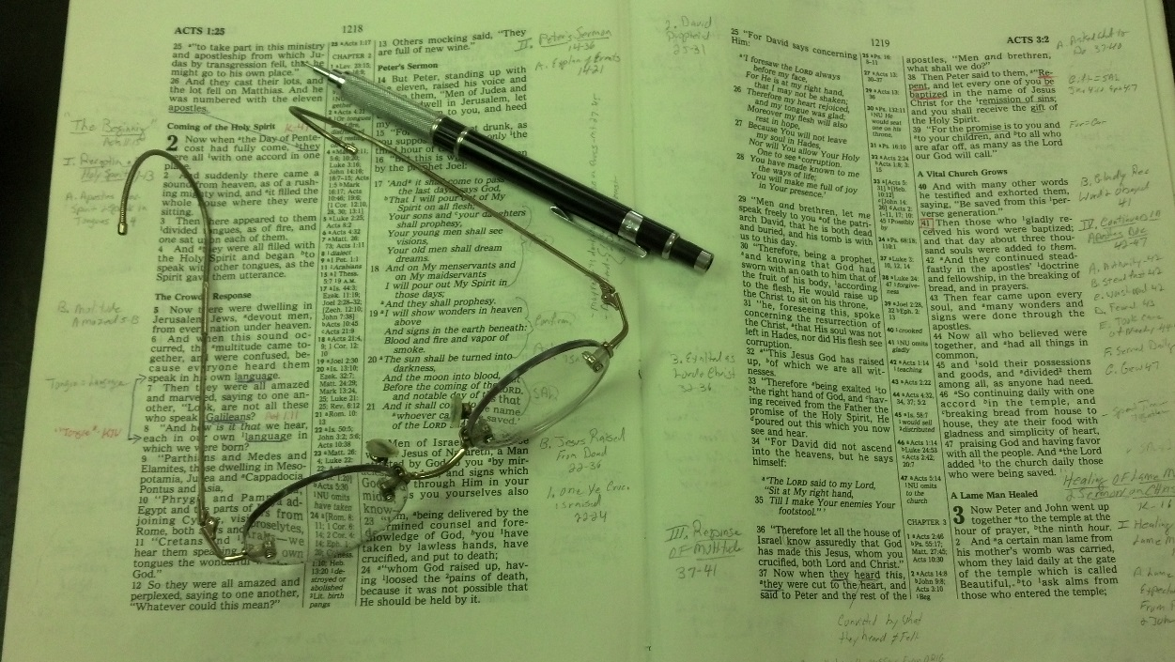
The Standard
Not
Word of God
  John 12:48
  Rom. 2:16
  Rev. 20:11-15
Does not change!

Slide 25
The Judgment Day
The Day
The Judge
The Judged
The Standard
The Deeds

Slide 26
The Deeds
All of our actions
  2 Cor. 5:10 – both good and evil
  Rev. 20:12 – according to their works
  Matt. 25:31-46 – deeds or lack of them
  Eph. 6:8 – what ever good – does – receive same
  Heb. 6:10 – God will not forget work and labor

Slide 27
The Deeds
All of our actions
Our words
  Matt. 12:36-37
  Careful what we say, what we tell
  Jas. 3:1 – careful in our teaching

Slide 28
The Deeds
All of our actions
Our words
Our thoughts
  1 Cor. 4:5 – God will reveal the hidden counsels of the heart
  Why it is important to control our thoughts (2 Cor. 10:5)

Slide 29
The Deeds
All of our actions
Our words
Our thoughts
Our secrets
  Rom. 2:16
  Things kept to self – no one knows

Slide 30
The Judgment Day
The Day
The Judge
The Judged
The Standard
The Deeds
The Purpose

Slide 31
The Purpose
Not at trial or investigation
  Not like a trial – evidence is presented & counter arguments, etc. to determine if one is guilty
  God is all knowing (Heb. 4:12) – thus he already knows who is guilty and who is not.
  Luke 16:19-ff demonstrates that God already knows the destiny of those who have died

Slide 32
The Purpose
Not at trial or investigation
To declare a sentence (Heaven of Hell)
  Matt 25:31-46 – separation
  Rom. 2:3, 5, 8-11 – render to each one - separated
  2 Thess. 1:7-9 – coming to take vengence
  Jude 6, 15 – to execute judgment

Slide 33
The Judgment Day
The Day
The Judge
The Judged
The Standard
The Deeds
The Purpose

