Slide 1
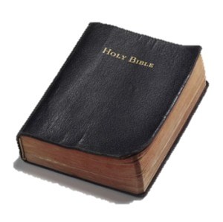
What is the Bible About?
How to treat others?
Love your neighbor?
Being a good person?
Better society?
Summarize in one sentence?
Summarize in three words?
What is the main thrust?

Slide 2

Redemption
in
Christ
Romans 3:24

Slide 3
“being justified freely by His grace through the redemption that is in Christ Jesus,”
Romans 3:24

Slide 4
Redemption in Christ
Can easily lose sight of the message of redemption
The social gospel shifts the message
If we think most of our teaching should focus on being a better person or coping with life – missed the message
Let’s See What The Message Is & Why It Is Needed

Slide 5
Redemption in Christ
The Need for Redemption

Slide 6
The Need for Redemption
The Fall of Man
Man’s Condition Before the Fall
  God created man – very good (Gen. 1:26-31)
  Innocent & pure – right with God (nothing to separate)
  Nothing to mar man’s perfect condition – no evil
  No toil – no weariness – no cares – no anxiety – no pain – no sickness – no sorrow – no death
  Capable of understanding – making own choices (Gen.2:16-17)

Slide 7
The Need for Redemption
The Fall of Man
Man’s Condition Before the Fall
Man’s Fall
  God warned – would die – if sinned (Gen. 2:16-17)
  Adam and Eve sinned (Gen. 3:1-6)

Slide 8
The Need for Redemption
The Fall of Man
Man’s Condition Before the Fall
Man’s Fall
Man’s Condition After the Fall
  Separated from God
    Driven from the garden (Gen. 3:23-24)
    Sin separates from God (Isa. 59:1-2; Jas. 1:15)
  Physical death (1 Cor. 15:22)
  Sickness, disease, pain, and suffering
  Woman: pain in childbirth (Gen. 3:16; 1 Tim. 2:15)
  Man: by sweat of face eat bread (Gen. 3:19)
Man is left in a wretched condition (Rom. 7:24-25)

Slide 9
The Need for Redemption
The Fall of Man
Man’s Condition Before the Fall
Man’s Fall
Man’s Condition After the Fall
All Men Sin
  All men become sinners & fall (Rom. 3:9, 23)
  Become sinners by own sin (Rom. 5:12; Ezek. 18:20)
  Become sinners when we become accountable (Rom. 7:9)

Slide 10
Rom 7:9
I was alive once without the law, but when the commandment came, sin revived and I died.
Before He Was Accountable
After He Was Accountable
Without Law
No Sin
Alive
Commandment Came
Sin Revived
Died
Point of Accountability

Slide 11
Evolution Model
Creation Model
Starts perfect
Evolves / improves
Fall / Declines
Different Starting Points
Starts low / imperfect

Slide 12
Redemption in Christ
The Need for Redemption
The Promise of Redemption

Slide 13
The Promise of Redemption
God said he would save
At the Time of the Fall (Gen. 3:15)

Slide 14
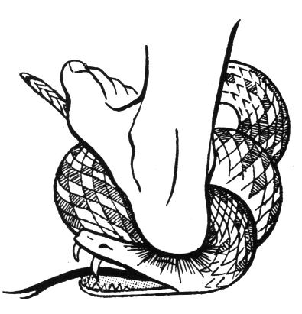
Genesis 3:15
“And I will put enmity Between you and the woman, And between your seed and her Seed; He shall bruise your head, And you shall bruise His heel.”
Christ
“bruise His heel”
(Death)
Satan
“bruise your head”
(Resurrection)

Slide 15
The Promise of Redemption
God said he would save
At the Time of the Fall (Gen. 3:15)
To Abraham (Gen.12:1-3)

Slide 16
Gen 12:1-3
1 Now the LORD had said to Abram: "Get out of your country, From your family And from your father's house, To a land that I will show you.
2 I will make you a great nation; I will bless you and make your name great; And you shall be a blessing.
3 I will bless those who bless you, And I will curse him who curses you; And in you all the families of the earth shall be blessed."
Land
Nation
Seed

Slide 17
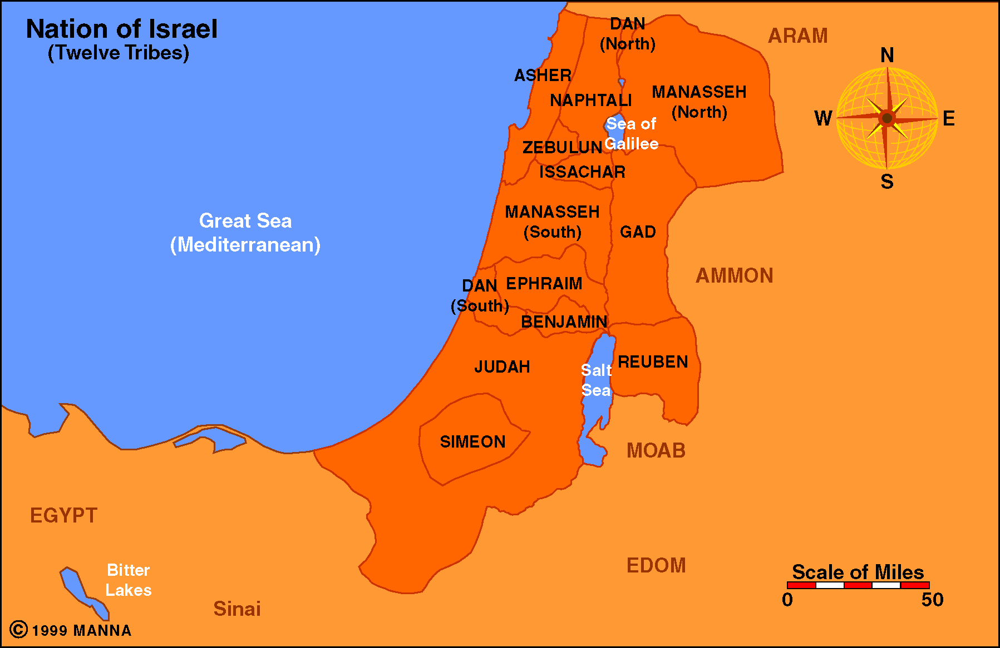
1
Land Promise

Slide 18
Joshua 21:43-45
43 So the LORD gave to Israel all the land of which He had sworn to give to their fathers, and they took possession of it and dwelt in it.
44 The LORD gave them rest all around, according to all that He had sworn to their fathers. And not a man of all their enemies stood against them; the LORD delivered all their enemies into their hand.
45 Not a word failed of any good thing which the LORD had spoken to the house of Israel. All came to pass.

Slide 19
2
Into Egypt - 70
Nation Promise
Gen. 46:27
Exo. 1:5

Slide 20
2
Into Egypt - 70
Nation Promise
Out of Egypt - 600,000 +
Exo. 12:37

Slide 21
2
Into Egypt - 70
Nation Promise
Out of Egypt - 600,000 +
At Sinai - Covenant
Exo. 19:4-6

Slide 22
3
Seed of woman
Christ = seed of woman
  Born of a woman (virgin) - Isa. 7:14
  Made of a woman (Gal. 4:4)
Seed Promise

Slide 23
3
Gal. 3:16
Now to Abraham and his Seed were the promises made. He does not say, "And to seeds," as of many, but as of one, "And to your Seed," who is Christ.
Seed of woman
Seed of Abraham
Seed Promise
Gen. 12:3; 22:18
Seed = Christ
  Gal. 3:16 - “seed who is Christ”

Slide 24
3
Seed of woman
Seed of Abraham
Seed Promise
How does the promise
relate to us?

Slide 25
Our Salvation is a Result
of the Seed Promise
Acts 3:25-26
25 You are sons of the prophets, and of the covenant which God made with our fathers, saying to Abraham, 'And in your seed all the families of the earth shall be blessed.'
26 To you first, God, having raised up His Servant Jesus, sent Him to bless you, in turning away every one of you from your iniquities."

Slide 26
Our Salvation is a Result
of the Seed Promise
Gen 12:3
“And in you
all the families
of the earth
shall be
blessed”
Acts 3:26
“turning away
every one
of you from
your iniquities”
IS

Slide 27
Our Salvation is a Result
of the Seed Promise
Gal 3:26-29
26 For you are all sons of God through faith in Christ Jesus.
27 For as many of you as were baptized into Christ have put on Christ.
28 There is neither Jew nor Greek, there is neither slave nor free, there is neither male nor female; for you are all one in Christ Jesus.
29 And if you are Christ's, then you are Abraham's seed, and heirs according to the promise.

Slide 28
Our Salvation is a Result
of the Seed Promise
Children
of God
(Baptized)
Gal. 3:26-27
Abraham’s
Seed
Heirs of
Promise
Gal. 3:29
ARE

Slide 29
The Promise of Redemption
God said he would save
At the Time of the Fall (Gen. 3:15)
To Abraham (Gen.12:1-3)
In the Prophets
  Isaiah 53 – The suffering servant died for our iniquity
  Jeremiah 31:31-34 – New covenant with complete forgiveness

Slide 30
Redemption in Christ
The Need for Redemption
The Promise of Redemption
The Agent of Redemption

Slide 31
The Agent of Redemption
Christ is the Redeemer
Jesus Christ is the One Foretold In O.T.
  John 4:25-26 – Claimed to be the Messiah
  Acts 2:22-36 – God made him Lord and Christ
  Acts 3:12-26 – Sermon about Jesus
    Suffering servant of prophecy (v. 18)
    Prophet of prophecy (vv. 22-24)
    Seed of Abraham (vv. 25-26)

Slide 32
The Agent of Redemption
Christ is the Redeemer
Jesus Christ is the One Foretold In O.T.
Mission to Save Man From Sin
  Not: make man religious, make man better, spare man from human suffering
  Matt. 1:21 – call him Jesus – for save from sins
  Luke 19:10 - came to seek and save lost
  1 Tim. 1:15 – came into world to save sinners
  What is lost in Adam is gained in Christ (1 Cor. 15:22)

Slide 33
The Agent of Redemption
Christ is the Redeemer
Jesus Christ is the One Foretold In O.T.
Mission to Save Man From Sin
Shed His Blood
  Redeemed by the blood (Eph. 1:7; Col. 1:14; 1 Pet. 1:18-19)
  Why did he have to shed his blood?
    Sin (violation of law) demands a penalty for sin
    Man cannot pay to redeem
    God has always demanded blood sacrifices
      Reason: Life is in the blood (Gen.9:4; Lev. 17:1-14; Deut. 12:28)
      Animal blood will not work (Heb. 10:4)
      Perfect sacrifice – blood of Christ (1 Pet. 1:19)

Slide 34
Redemption in Christ
The Need for Redemption
The Promise of Redemption
The Agent of Redemption
The Message of Redemption

Slide 35
The Message of Redemption
Gospel is Redemptive
About Christ
  Is deity (John 1:1; 8:24)
  Is the Messiah (John 1:41)
  Died for our sins (1 Cor. 15:1-4)

Slide 36
The Message of Redemption
Gospel is Redemptive
About Christ
Convicts Man of Sin
  Holy Spirits convicts of sin (John 16:8)
  First sermon included conviction of sin (Acts 2:23)
  Man must know in sin before knows he needs redemption (Rom. 1-3)

Slide 37
The Message of Redemption
Gospel is Redemptive
About Christ
Convicts Man of Sin
Tells Man What Must Do
  Hear (Acts 2:22)
  Believe (Acts 2:36)
  Repent (Acts 2:38)
  Be Baptized (Acts 2:38)

Slide 38
The Message of Redemption
Gospel is Redemptive
About Christ
Convicts Man of Sin
Tells Man What Must Do
Promises to be Received
  Remission of sins (Acts 2:38)
  Clear conscience (1 Pet. 3:21)
  Hope of heaven (Titus 1:2)

Slide 39
The Message of Redemption
Gospel is Redemptive
  Sermons Focused On Spiritual Need
  The Redemptive Message
    Acts 2:21, 37-40
    Acts 3:19-26
    Acts 10:43
    Acts 13:23, 39-41
    Acts 17:30-31

Slide 40
Redemption in Christ
The Need for Redemption
The Promise of Redemption
The Agent of Redemption
The Message of Redemption

