Slide 1
The book of Joshua - Is an Exciting Book
The Conquest
Joshua 1-5 Crossing the River
Joshua 6-ff The Conquest
  Victory at Jericho (Josh. 6)
  Defeat at Ai (Josh. 7)
  Victory at Ai (Josh 8)
Much to learn from Israel’s defeat & victory
that may help us avoid defeat & gain victory

Slide 2
Defeat on the Heels of Victory (Joshua 7)
Turning Defeat into Victory (Joshua 8)

Slide 3
Defeat on the Heels of Victory (Joshua 7)
Turning Defeat into Victory (Joshua 8)

Slide 4
Defeat on the Heels of Victory (Joshua 7)
The Disobedient Soldier (vv. 1, 20-21)
  The sinner:
    Achan (“trouble”) – known for having troubled Israel (v. 25)
    Because of his sin – Israel was defeated & 36 men lost lives (v. 5)
    God held Israel responsible because of sin in the camp (vv. 1, 11, 13)
    Learn – never underestimate the damage one person can do outside the will of God

Slide 5
Defeat on the Heels of Victory (Joshua 7)
The Disobedient Soldier (vv. 1, 20-21)
  The sinner:
  The sin:
    Achan heard the orders & knew (6:17-21, 24)
    His progression into sin (vv. 20-21)
      Looked at the treasures a second time
      Reclassified the treasures as “spoils”
        Calling evil – good (Isa. 5:20)
        “Rewriting God’s dictionary”
      Coveted
      Took them
      Thought he could get away with it

Slide 6
Defeat on the Heels of Victory (Joshua 7)
The Disobedient Soldier (vv. 1, 20-21)
The Defeated Army (vv. 2-5)

Slide 7
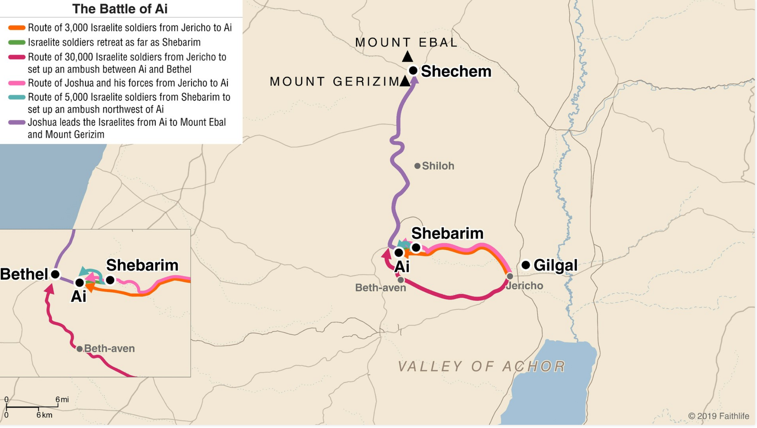

Slide 8
Defeat on the Heels of Victory (Joshua 7)
The Disobedient Soldier (vv. 1, 20-21)
The Defeated Army (vv. 2-5)
  Joshua prepares (vv. 2-3)
    He assumes the Lord is with them & is pleased
    Victory at Jericho had given them confidence – which may have caused some presumption
    Confidence is in the large army & Ai is small
  Defeated (vv. 4-5)
    3,000 men fled being chased by few
    36 men were killed
    Their hearts melted
Lesson: presuming confidence in own power & not depending on God

Slide 9
Defeat on the Heels of Victory (Joshua 7)
The Disobedient Soldier (vv. 1, 20-21)
The Defeated Army (vv. 2-5)
A Discouraged Leader (vv. 6-15)
  Remorse (v. 6) – his best plans are dashed to pieces
  Reproach (v. 7)
    At first, he seems to be reproaching God – blaming Him!
    Would have been content to stay on other side! (With less than God’s best!)

Slide 10
Defeat on the Heels of Victory (Joshua 7)
The Disobedient Soldier (vv. 1, 20-21)
The Defeated Army (vv. 2-5)
A Discouraged Leader (vv. 6-15)
  Remorse (v. 6) – his best plans are dashed to pieces
  Reproach (v. 7)
  Repentance (vv. 8-9)
    Israel’s sin had robbed God of his glory!
    His concern – not for his own reputation, but God’s!

Slide 11
Defeat on the Heels of Victory (Joshua 7)
The Disobedient Soldier (vv. 1, 20-21)
The Defeated Army (vv. 2-5)
A Discouraged Leader (vv. 6-15)
  Remorse (v. 6) – his best plans are dashed to pieces
  Reproach (v. 7)
  Repentance (vv. 8-9)
  Rebuke (vv. 10-15)
    “Get up” – now is time to act (vv. 10, 13)
    Problem is sin in camp (vv. 10-13)
      Everything up to this point is of no avail if they can’t go forward!
    Sinner must be identified in the morning (vv. 14-15)

Slide 12
Defeat on the Heels of Victory (Joshua 7)
The Disobedient Soldier (vv. 1, 20-21)
The Defeated Army (vv. 2-5)
A Discouraged Leader (vv. 6-15)
A Discovered Sinner (vv. 16-26)
  The investigation (vv. 16-18)
    Nobody hides from God (Jer. 23:24)
  The confession (vv. 19-23)
  The judgment (vv. 24-26)
    Achan’s family must have assisted or covered for him
    The value of the stolen goods – was not worth it!

Slide 13
Defeat on the Heels of Victory (Joshua 7)
The Disobedient Soldier (vv. 1, 20-21)
The Defeated Army (vv. 2-5)
A Discouraged Leader (vv. 6-15)
A Discovered Sinner (vv. 16-26)
Defeated
Because did not obey!
Because did not take the word of God seriously!
Can go down in defeat – even on the heels of victory!

Slide 14
Defeat on the Heels of Victory (Joshua 7)
Turning Defeat into Victory (Joshua 8)

Slide 15
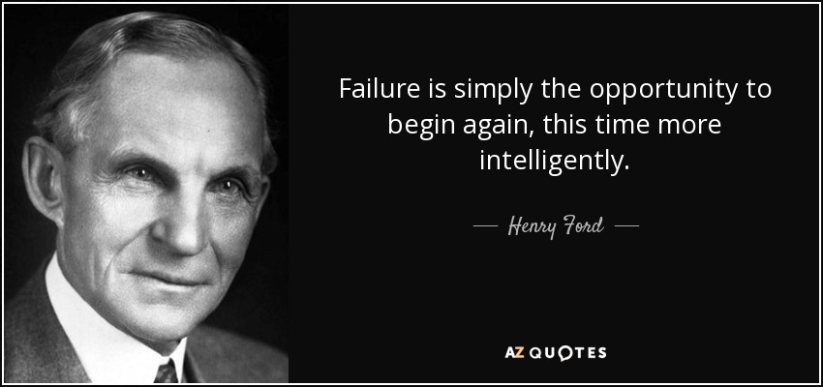

Slide 16
Turning Defeat into Victory (Joshua 8)
A New Beginning (vv. 1-2)
  A word of encouragement (v. 1a)
    Discouragement over the past & fear of future often come with failure
    Answer to discouragement is to listen to God!
    There is no reason to fear!

Slide 17
Turning Defeat into Victory (Joshua 8)
A New Beginning (vv. 1-2)
  A word of encouragement (v. 1a)
  A word of instruction (vv. 1b-2)
    This time the spoils are yours (v. 2a)
      Had Achan waited a few days – could have pick all the spoils he wanted (only God’s ways)
      “God always gives His best to those who leave the choice with Him.”
      Don’t run ahead of God!
    Lay an ambush (v. 2b)

Slide 18
Turning Defeat into Victory (Joshua 8)
A New Beginning (vv. 1-2)
  A word of encouragement (v. 1a)
  A word of instruction (vv. 1b-2)
  A word of promise (v. 1c-2a)
    I have given Ai to you (v. 1b)
    Same promise as given about Jericho (6:2)
    In both cases – promise of God was conditional
No matter how bad we fail
we can always get up and begin again.
God is a God of New Beginnings!

Slide 19
Turning Defeat into Victory (Joshua 8)
A New Beginning (vv. 1-2)
A New Strategy (vv. 3-13)
  A new beginning requires a new strategy – the old strategy led to defeat!
  Even different than at Jericho
  This strategy seems to be based on Israel’s defeat (using that to cause Ai to be overconfident…)
  Victory requires planning – that takes God’s instructions

Slide 20
Turning Defeat into Victory (Joshua 8)
A New Beginning (vv. 1-2)
A New Strategy (vv. 3-13)
A New Victory (vv. 14-29)
  Ai emptied (vv. 14-17)
    The men of Ai were confident of victory
    “They are most in danger who are least aware of it” (M. Henry)
  Ai captured (vv. 18-20)
  Ai’s army & people destroyed (vv.21-29)
  Ai’s king slain (vv. 23, 29)
  Ai’s spoils claimed (v. 27)
The Disgrace & Defeat
Now Seems to be Erased!

Slide 21
Turning Defeat into Victory (Joshua 8)
A New Beginning (vv. 1-2)
A New Strategy (vv. 3-13)
A New Victory (vv. 14-29)
A New Commitment (vv. 30-35)
  Commitment to honor and worship (vv. 30-31)
  Commitment to follow the word (vv. 32-35)
    Wrote the law on stones (vv. 32-33)
    Read from the law (vv. 34-35)

Slide 22
Turning Defeat into Victory (Joshua 8)
A New Beginning (vv. 1-2)
A New Strategy (vv. 3-13)
A New Victory (vv. 14-29)
A New Commitment (vv. 30-35)
Victorious
Because obeyed!
Because took word of God seriously!
Can turn defeat into victory!

Slide 23
Defeat on the Heels of Victory (Joshua 7)
Turning Defeat into Victory (Joshua 8)

