Slide 2
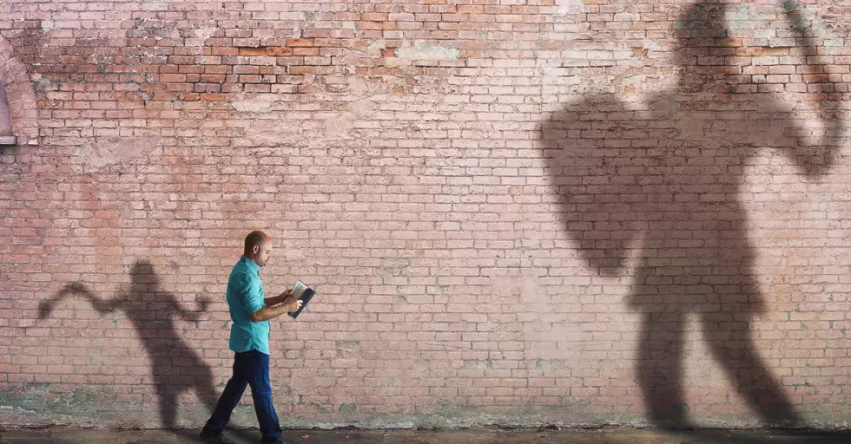
Facing
Goliath

Slide 3
Goliath
Seemingly Invincible Enemy
1 Samuel 17:4-7
4 And a champion went out from the camp of the Philistines, named Goliath, from Gath, whose height was six cubits and a span.
5 He had a bronze helmet on his head, and he was armed with a coat of mail, and the weight of the coat was five thousand shekels of bronze.
6 And he had bronze armor on his legs and a bronze javelin between his shoulders.
7 Now the staff of his spear was like a weaver's beam, and his iron spearhead weighed six hundred shekels; and a shield-bearer went before him.
@ 9 feet tall
@ 150 lbs.
@ 20 lbs.

Slide 4
Goliath
Seemingly Invincible Enemy
1 Samuel 17:8-11, 16
8 Then he stood and cried out to the armies of Israel, and said to them, "Why have you come out to line up for battle? Am I not a Philistine, and you the servants of Saul? Choose a man for yourselves, and let him come down to me.
9 "If he is able to fight with me and kill me, then we will be your servants. But if I prevail against him and kill him, then you shall be our servants and serve us."
10 And the Philistine said, "I defy the armies of Israel this day; give me a man, that we may fight together."
11 When Saul and all Israel heard these words of the Philistine, they were dismayed and greatly afraid.
16 And the Philistine drew near and presented himself forty days, morning and evening.
Notes:
To Goliath, they were the armies of Israel, but to David it was the armies of the Living God (v. 36) and the Lord of hosts was the God of the armies (v. 45)

Slide 5
Goliath
WAS NOT An Invincible Enemy – He Fell
Because he was arrogant.
  1 Samuel 17:10 And the Philistine said, "I defy the armies of Israel this day; give me a man, that we may fight together."
  Proverbs 16:18 Pride goes before destruction, And a haughty spirit before a fall.
  Jeremiah 9:23 Thus says the LORD: "Let not the wise man glory in his wisdom, Let not the mighty man glory in his might, Nor let the rich man glory in his riches”

Slide 6
Goliath
WAS NOT An Invincible Enemy – He Fell
Because he had contempt for God.
  1 Samuel 17:43 So the Philistine said to David, "Am I a dog, that you come to me with sticks?" And the Philistine cursed David by his gods.
  Psalms 2:2-4
  2 The kings of the earth set themselves, And the rulers take counsel together, Against the LORD and against His Anointed, saying,
  3 "Let us break Their bonds in pieces And cast away Their cords from us."
  4 He who sits in the heavens shall laugh; The Lord shall hold them in derision.

Slide 7
Goliath
WAS NOT An Invincible Enemy – He Fell
Because he trusted in himself.
  1 Samuel 17:45 Then David said to the Philistine, "You come to me with a sword, with a spear, and with a javelin. But I come to you in the name of the LORD of hosts, the God of the armies of Israel, whom you have defied.
  Jeremiah 10:23 O LORD, I know the way of man is not in himself; It is not in man who walks to direct his own steps.

Slide 8
Goliath
WAS NOT An Invincible Enemy – He Fell
Because he overlooked the simple things.
  1 Samuel 17:42-43
  42 And when the Philistine looked about and saw David, he disdained him; for he was only a youth, ruddy and good-looking.
  43 So the Philistine said to David, "Am I a dog, that you come to me with sticks?" And the Philistine cursed David by his gods.
  Psalms 8:1-2
  1 O LORD, our Lord, How excellent is Your name in all the earth, Who have set Your glory above the heavens!
  2 Out of the mouth of babes and nursing infants You have ordained strength, Because of Your enemies, That You may silence the enemy and the avenger.

Slide 9
How Will We Face “Goliath?”
NOT An Invincible Enemy – Will Fall
Like the soldiers in the armies of the living God of hosts?
  Fear
  1 Samuel 17:11 When Saul and all Israel heard these words of the Philistine, they were dismayed and greatly afraid.
  1 Samuel 17:24 And all the men of Israel, when they saw the man, fled from him and were dreadfully afraid.

Slide 10
How Will We Face “Goliath?”
NOT An Invincible Enemy – Will Fall
Like the soldiers in the armies of the living God of hosts?
  Accuse others of the wrong motives
  1 Samuel 17:28 Now Eliab his oldest brother heard when he spoke to the men; and Eliab's anger was aroused against David, and he said, "Why did you come down here? And with whom have you left those few sheep in the wilderness? I know your pride and the insolence of your heart, for you have come down to see the battle."

Slide 11
How Will We Face “Goliath?”
NOT An Invincible Enemy – Will Fall
Like king Saul?
  Discourage those who are willing
  1 Samuel 17:33 And Saul said to David, "You are not able to go against this Philistine to fight with him; for you are a youth, and he a man of war from his youth."
  Put your responsibilities on others
  1 Samuel 17:38-39
  38 So Saul clothed David with his armor, and he put a bronze helmet on his head; he also clothed him with a coat of mail.
  39 David fastened his sword to his armor and tried to walk, for he had not tested them. And David said to Saul, "I cannot walk with these, for I have not tested them." So David took them off.

Slide 12
How Will We Face “Goliath?”
NOT An Invincible Enemy – Will Fall
Like David?
  Recognized the challenge
  1 Samuel 17:23 Then as he talked with them, there was the champion, the Philistine of Gath, Goliath by name, coming up from the armies of the Philistines; and he spoke according to the same words. So David heard them.
  1 Samuel 17:26 Then David spoke to the men who stood by him, saying, "What shall be done for the man who kills this Philistine and takes away the reproach from Israel? For who is this uncircumcised Philistine, that he should defy the armies of the living God?"

Slide 13
How Will We Face “Goliath?”
NOT An Invincible Enemy – Will Fall
Like David?
  Ignored discouragement
  1 Samuel 17:29 And David said, "What have I done now? Is there not a cause?"

Slide 14
How Will We Face “Goliath?”
NOT An Invincible Enemy – Will Fall
Like David?
  Trusted God
  1 Samuel 17:32, 36-37
  32 Then David said to Saul, "Let no man's heart fail because of him; your servant will go and fight with this Philistine."
  36 "Your servant has killed both lion and bear; and this uncircumcised Philistine will be like one of them, seeing he has defied the armies of the living God."
  37 Moreover David said, "The LORD, who delivered me from the paw of the lion and from the paw of the bear, He will deliver me from the hand of this Philistine." And Saul said to David, "Go, and the LORD be with you!"

Slide 15
How Will We Face “Goliath?”
NOT An Invincible Enemy – Will Fall
Like David?
  Trusted God
  1 Samuel 17:45-47
  45 Then David said to the Philistine, "You come to me with a sword, with a spear, and with a javelin. But I come to you in the name of the LORD of hosts, the God of the armies of Israel, whom you have defied.
  46 "This day the LORD will deliver you into my hand, and I will strike you and take your head from you. And this day I will give the carcasses of the camp of the Philistines to the birds of the air and the wild beasts of the earth, that all the earth may know that there is a God in Israel.
  47 "Then all this assembly shall know that the LORD does not save with sword and spear; for the battle is the LORD'S, and He will give you into our hands."

Slide 16
How Will We Face “Goliath?”
NOT An Invincible Enemy – Will Fall
Like David?
  Trusted Abilities
  1 Samuel 17:39-40
  39 David fastened his sword to his armor and tried to walk, for he had not tested them. And David said to Saul, "I cannot walk with these, for I have not tested them." So David took them off.
  40 Then he took his staff in his hand; and he chose for himself five smooth stones from the brook, and put them in a shepherd's bag, in a pouch which he had, and his sling was in his hand. And he drew near to the Philistine.

Slide 17
How Will We Face “Goliath?”
NOT An Invincible Enemy – Will Fall
Like David?
  Trusted Abilities
  1 Samuel 17:49-51
  49 Then David put his hand in his bag and took out a stone; and he slung it and struck the Philistine in his forehead, so that the stone sank into his forehead, and he fell on his face to the earth.
  50 So David prevailed over the Philistine with a sling and a stone, and struck the Philistine and killed him. But there was no sword in the hand of David.
  51 Therefore David ran and stood over the Philistine, took his sword and drew it out of its sheath and killed him, and cut off his head with it. And when the Philistines saw that their champion was dead, they fled.

