Slide 1
Is it a Sin?
Drink?
Dance?
Gamble?
Pre-marital sex?
Homosexuality?
Wear short attire?

Slide 2
Is it a Sin?
To engage in
Pre-Marital Sex?

Slide 3

What Constitutes Sin?
Sin is a violation of God’s law
Sin is a violation of God’s law
1 John 3:4
Rom. 4:15
It does not have to be specifically stated

Slide 4
Is it a Sin to Engage
in Pre-marital Sex?
Dangers of Fornication
Is Nothing New
Gen. 34:1-7 – Shechem & Dinah
Gen. 38:12-18 – Judah & Tamar

Slide 5
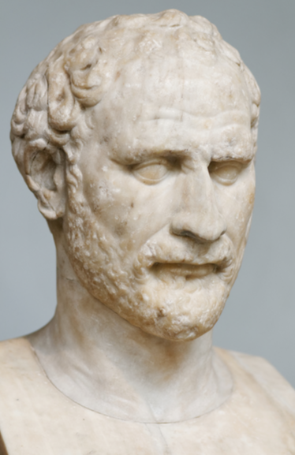
“We keep mistresses for our pleasure, concubines for our constant attendance and wives to bear us legitimate children and be our faithful housekeepers”
Domosthenes
382-322 BC

Slide 6
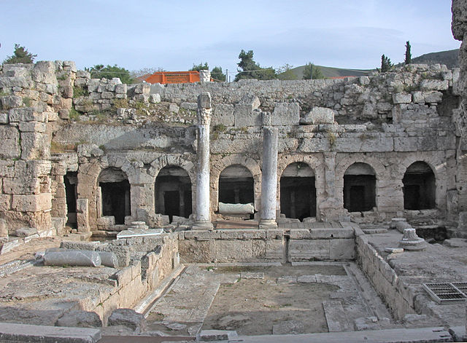
……….
……….
……….
……….
……….
……….
……….……….
……….
……….
1,000 Prostitutes found daily
at Temple of Aphrodite at Corinth
……….
……….
……….
……….
……….
……….
……….……….
……….
……….
……….
……….
……….
……….
……….
……….
……….……….
……….
……….
……….
……….
……….
……….
……….
……….
……….……….
……….
……….
……….
……….
……….
……….
……….
……….
……….……….
……….
……….
……….
……….
……….
……….
……….
……….
……….……….
……….
……….
……….
……….
……….
……….
……….
……….
……….……….
……….
……….
……….
……….
……….
……….
……….
……….
……….……….
……….
……….
……….
……….
……….
……….
……….
……….
……….……….
……….
……….
……….
……….
……….
……….
……….
……….
……….……….
……….
……….

Slide 7
25% of girls and 30% of boys have sex by age 15, 21% of 9th graders have slept with four or more partners, 50% of 17 year olds have had sex, 80% of teens have sex by age 19.
  Mama, don’t let your babies grow up to be sexually ignorant, Shannon Ethridge. Enrichment Journal. 2005
Almost half of high school students nationwide and about 62% of students in the twelfth-grade have had sexual intercourse.
  State of the Nation: Challenges Facing STD Prevention in Youth. American Social Health Association, 2005
Notes:
http://www.purehope.net/teens.asp

Slide 8
Fifty-two percent of American women have sex before turning 18, and 75% have sex before they get married.
  Sex in the Body of Christ, Lauren F. Winner. Christianity Today, May 2005.
Notes:
http://www.purehope.net/teens.asp

Slide 9
Extra-Marital Affairs
(Adultery)
Are Not Uncommon In Our Society
High estimate: 60% of men / 40% of women – have extra- marital affairs
More conservative: 24% of men and 14% of women have had sex outside their marriages
75% of men & women admit to having fantasies about a co- worker (Half carry them out)
60% begin in the workplace or on the internet
Notes:
http://www.dearpeggy.com/statistics.html
http://www.spousealert.homestead.com/spouse.html
http://www.reenasommerassociates.mb.ca/affairs.html

Slide 10
Is it a Sin to Engage
in Pre-marital Sex?
What is it?

Slide 11
What is it?
Fornication:
“Properly of illicit sexual
intercourse in general”
(Thayer)
Adultery:
“To have unlawful
intercourse with
another’s wife”
(Thayer)
Fornication
Adultery

Slide 12
Is it a Sin to Engage
in Pre-marital Sex?
What is it?
Why is it Wrong?

Slide 13

Why is it Wrong?
Old Testament
Forbidden (Exo. 20:14)
Punishable by death
(Lev. 20:10)
Heinous Crime
Wickedness
(Job. 31:11)
New Testament
Sin – Keep us out of
Heaven
1 Cor. 6:9-11
Gal. 5:19-21
1 Thess. 4:3
The Sin Is: Before or Outside of Marriage
Heb. 13:4

Slide 14

Why is it Wrong?
Marriage
Honorable
Undefiled
Heb. 13:4
Fornication
Before
marriage
God Will
Condemn
Adultery
Outside marriage
God Will
Condemn

Slide 15
Why is it Wrong?
Value of Reminders
that Fornication is a Sin
# 1
Answer
Among Students at
“Christian Colleges”
Pulpit Preaching &
Teaching
It may help someone avoid the sin
“…How then can I do this great wickedness, and sin against God?” (Gen. 39:9)

Slide 16
Is it a Sin to Engage
in Pre-marital Sex?
What is it?
Why is it Wrong?
Where it Leads?

Slide 17
Where it Leads?
Perverts the body - 1 Cor. 6:12-20
Destroys one’s reputation & respect for self – Job 31:12; Prov. 6:27, 33

Slide 18
“Having premarital sex was the most horrifying experience of my life. It wasn’t at all the emotionally satisfying experience the world deceived me into believing. I felt as if my insides were being exposed and my heart was left unattended. I know that God has forgiven me of this haunting sin, but I also know I can never have my virginity back. I dread the day that I have to tell the man I truly love and wish to marry that he is not the only one – though I wish he were. I have stained my life – a stain that will never come out.”
David:
“My sin is every before me”
(Psa. 51:3)
“If I could have read Josh McDowell’s article ‘Helping Teens Say No to Sex’ when I was a teenager, perhaps I would not have given in so many times back then. Even after I became a Christian and knew God forbade premarital sex, the old habit was hard to break. Now I am a wife and mother and am still haunted by my past. It hurts to realize that the most precious gift I could have given my husband on our wedding day – a pure wife – was not possible.”

Slide 19
Where it Leads?
Perverts the body - 1 Cor. 6:12-20
Destroys one’s reputation & respect for self – Job 31:12; Prov. 6:27, 33
Mistreats others - Prov. 5:9
Creates jealousy - Prov. 6:34-35
Destroys a marriage - Matt. 19:9
Hinders worship - 1 Pet. 3:7
Stirs the wrath of God - Col. 3:6
Brings disfellowship - 1 Cor. 5
Breeds other sins - 2 Sam. 11
Sends soul to hell - Rev. 21:8

Slide 20
Is it a Sin to Engage
in Pre-marital Sex?
What is it?
Why is it Wrong?
Where it Leads?
What Causes it?

Slide 21
What Causes it?
Forget Covenant with God & Mate

Slide 22
Forget The Covenant
Prov. 2:17
With God
Faith
Grows
Weaker
With
Companion
Marriage
Deteriorates

Slide 23
What Causes it?
Forget Covenant with God & Mate
Careless
  2 Sam. 11:1-5
  Prov. 5:8
  Prov. 7:6-23

Slide 24
What Causes it?
Forget Covenant with God & Mate
Careless
Heed the Look of the Eyes (Prov. 6:24-25)
Listen to the Flatter & Lies (Prov. 6:24-25; 7:15, 21)
Encouraged by Society (Movies, TV, Music, Books)

Slide 25

Analyses of broadcast media content indicate that, on average, teenaged viewers see 143 incidents of sexual behavior on network television at prime time each week,⁸with portrayals of three to four times as many sexual activities occurring between unmarried partners as between spouses.⁹ As much as 80% of all movies shown on network or cable television stations have sexual content.² An analysis of music videos indicates that 60% portray sexual feelings and impulses, and a substantial minority display provocative clothing and sexually suggestive body movements.¹⁰Analyses of media content also show that sexual messages on television are almost universally presented in a positive light, with little discussion of the potential risks of unprotected sexual intercourse and few portrayals of adverse consequences.^{11,12}
http://www.ncbi.nlm.nih.gov/pmc/articles/PMC1070813/

Slide 26
What Causes it?
Forget Covenant with God & Mate
Careless
Heed the Look of the Eyes (Prov. 6:24-25)
Listen to the Flatter & Lies (Prov. 6:24-25; 7:15, 21)
Encouraged by Society (Movies, TV, Music, Books)
Look for Opportunity (Prov. 7:19)

Slide 27
Is it a Sin to Engage
in Pre-marital Sex?
What is it?
Why is it Wrong?
Where it Leads?
What Causes it?
What Prevents it?

Slide 28

What Prevents it?
Flee
1 Cor. 6:18
Eph. 5:3
1 Thess. 4:3

Slide 29
What Prevents it?
Say “No” - Gen. 39:8, 10
Remember someone trust you - Gen. 39:8
Remember it is a sin - Gen. 39:9
Run - literally! - Gen. 39:12 (cf. Prov. 5:8)
Watch behavior around the opposite sex - Gen. 39:10-11
Get married - 1 Cor. 7:2
Keep thoughts pure - Prov. 6:25

Slide 30
Stop Fornication Before It Happens
1 Thess 4:3-7
3 For this is the will of God, your sanctification: that you should abstain from sexual immorality;
4 that each of you should know how to possess his own vessel in sanctification and honor,
5 not in passion of lust, like the Gentiles who do not know God;
Control
Your
Thoughts
Control
Your
Body
Fornication

Slide 31
What Prevents it?
Say “No” - Gen. 39:8, 10
Remember someone trust you - Gen. 39:8
Remember it is a sin - Gen. 39:9
Run - literally! - Gen. 39:12 (cf. Prov. 5:8)
Watch behavior around the opposite sex - Gen. 39:11
Get married - 1 Cor. 7:2
Keep thoughts pure - Prov. 6:25
Be what you ought to be in marriage – 1 Cor. 7:2-5

Slide 32
Is it a Sin to Engage
in Pre-marital Sex?
What is it?
Why is it Wrong?
Where it Leads?
What Causes it?
What Prevents it?

