Slide 1
Letters To Seven Church of Asia
(Rev. 2-3)
Some were good (Smyrna, Philadelphia)
Some were good / bad (Ephesus, Pergomas, Thyatira, Sardis)
One was bad (Laodicea)

Slide 2
Letters To Seven Church of Asia
(Rev. 2-3)
Good/
Bad
Good/
Bad
Good
Good
Good/
Bad
Good/
Bad
Bad
Most of us would like to be in GOOD church (no condemnation)
None of us would have anything to do with a BAD church (no commendation)
Reality: may be in a church that is GOOD / BAD (Some commendation & Some condemnation)

Slide 3
A Church Left Its First Love – Ephesus (Rev. 2:1-7)
A Church Under Pressure – Smyrna (Rev. 2:8-11)
A Church That Compromised – Pergamos (Rev. 2:12-17)

Slide 4

The Church At Thyatira (Rev. 2:18-29)
Get a letter – You have allowed the wicked to do their work!
A Church
That was Tolerant

Slide 5
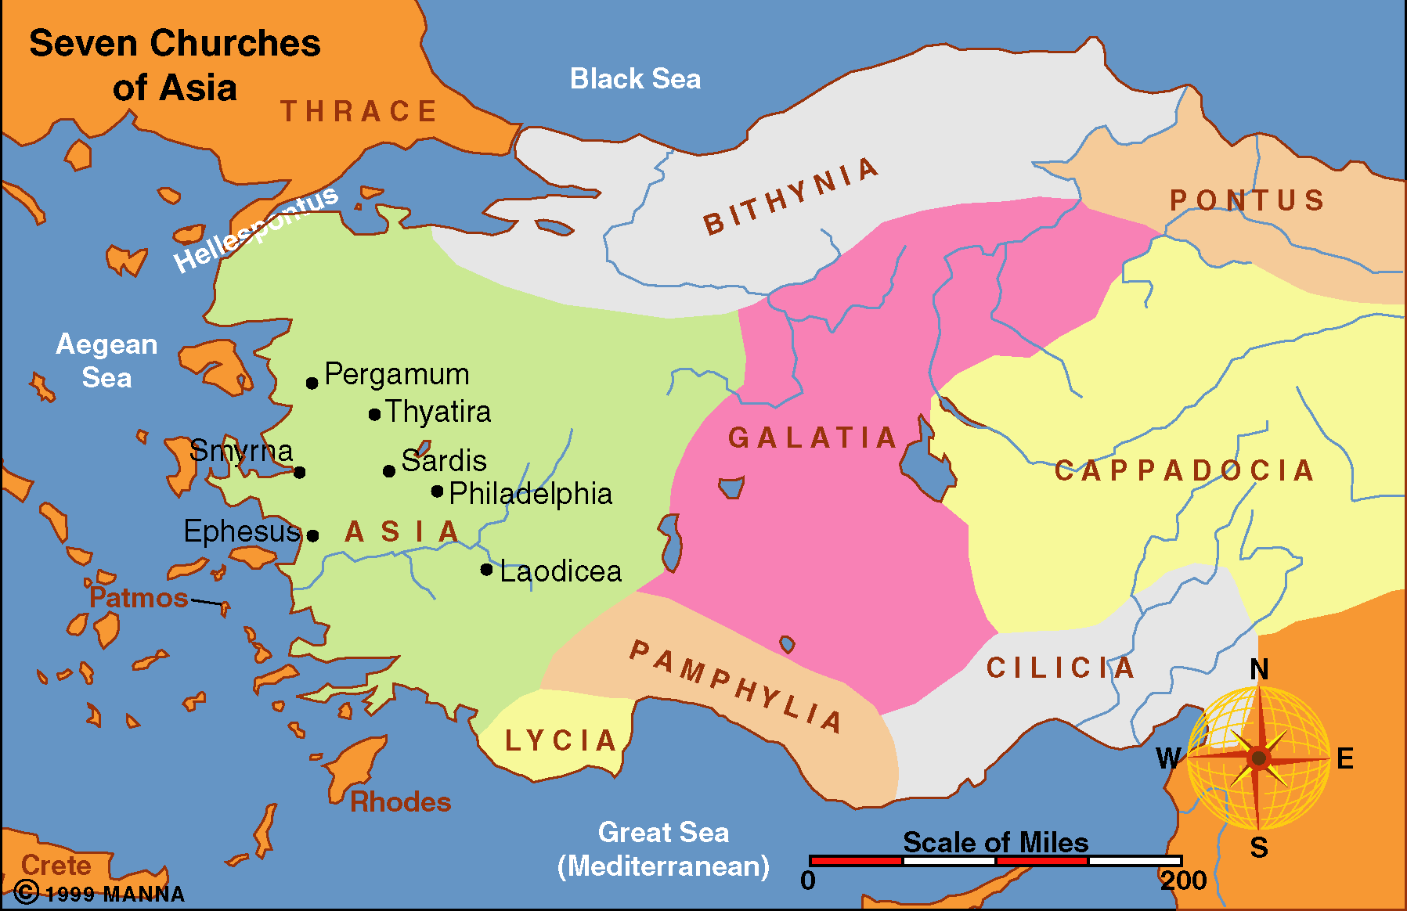
Little known about the city from the text
Lydia was from Thyatira (Acts 16:14)

Slide 6
Rev 2:18-29
18 "And to the angel of the church in Thyatira write, 'These things says the Son of God, who has eyes like a flame of fire, and His feet like fine brass:
19 "I know your works, love, service, faith, and your patience; and as for your works, the last are more than the first.
20 Nevertheless I have a few things against you, because you allow that woman Jezebel, who calls herself a prophetess, to teach and seduce My servants to commit sexual immorality and eat things sacrificed to idols.
21 And I gave her time to repent of her sexual immorality, and she did not repent.

Slide 7
22 Indeed I will cast her into a sickbed, and those who commit adultery with her into great tribulation, unless they repent of their deeds.
23 I will kill her children with death, and all the churches shall know that I am He who searches the minds and hearts. And I will give to each one of you according to your works.
24 Now to you I say, and to the rest in Thyatira, as many as do not have this doctrine, who have not known the depths of Satan, as they say, I will put on you no other burden.
25 But hold fast what you have till I come.
26 And he who overcomes, and keeps My works until the end, to him I will give power over the nations--

Slide 8
27'He shall rule them with a rod of iron; They shall be dashed to pieces like the potter's vessels'-- as I also have received from My Father;
28 and I will give him the morning star.
29 "He who has an ear, let him hear what the Spirit says to the churches." '

Slide 9
A Tolerant Church
Rev. 2:18-29
I. The Messenger (vv. 18, 23)
II. The Strength (vv. 18-19)
III. The Weakness (v. 20)
IV. The Warning (vv. 21-23)
V. The Assurance (vv. 24-29)

Slide 10
A Tolerant Church
Rev. 2:18-29
I. The Messenger (vv. 18, 23)

Slide 11
I. The Messenger (vv. 18, 23)
A. Son of God – deity, God, Judge (John 17:22)
B. Eyes like a flame of fire (cf. Rev. 1:1)
1. May refer to his anger when saw the problems
2. May refer to penetrating nature of his vision
C. Feet like fine brass (cf. Rev. 1:1)
1. Firmness of his stand against sin & error
2. The beauty of his stand
D. Searches the mind & heart
1. Knows all
2. Examines fully before judgment

Slide 12
A Tolerant Church
Rev. 2:18-29
I. The Messenger (vv. 18, 23)
II. The Strength (vv. 18-19)

Slide 13
II. The Strength (vv. 18-19)
A. Works – Active, busy, doing, etc.
B. Love – for God, truth, others.
C. Service – Serving God & others (from love)
D. Faith – belief, reaction to word, obedience
E. Patience – Perseverance, steadfast
G. Last greater than first –
1. Grown, progressed
2. Doing more now than had at first (often it is just the opposite)

Slide 14
A Tolerant Church
Rev. 2:18-29
I. The Messenger (vv. 18, 23)
II. The Strength (vv. 18-19)
III. The Weakness (v. 20)

Slide 15
III. The Weakness (v. 20)
Tolerant

Slide 16
Jezebel
Wicked wife of wicked king Ahab (1 Kings 21:25)
Here used symbolically like “Balaam” (2:14)
May refer to a faction within the church
May refer to a woman who had evil influence
Claims to be a prophetess – but was not

Slide 17
III. The Weakness (v. 20)
Tolerant
A. Allow
1. Not doing so themselves – but tolerate it!
2. Could have been stopped – but nothing was done!
3. Condemned for not taking action!

Slide 18
III. The Weakness (v. 20)
Tolerant
A. Allow
B. What allow
1. Teach Christians to commit adultery (spiritual)
2. Perhaps: by joining the trade guilds (with its sacrifices to idols & drunken revelry)
3. No evidence that “just quit”

Slide 19
“The woman (or faction) referred to as Jezebel had not quit the church at Thyatira, and was not encouraging others to quit the church…Many there are who would not think of quitting the church altogether, but who compromise with the devil on first one thing and then another.”
- Bobby Duncan, Spiritual Sword

Slide 20
III. The Weakness (v. 20)
Tolerant
A. Allow
B. What allow
1. Teach Christians to commit adultery (spiritual)
2. Perhaps: by joining the trade guilds (with its sacrifices to idols & drunken revelry)
3. No evidence that “just quit”
4. Allowed her to sin and lead others into sin!

Slide 21
III. The Weakness (v. 20)
Tolerant
A. Allow
B. What allow
C. The church bore some responsibility
1. God held the church respon. for its members
2. Blame is not just on Jezebel, but the church!

Slide 22
A Tolerant Church
Rev. 2:18-29
I. The Messenger (vv. 18, 23)
II. The Strength (vv. 18-19)
III. The Weakness (v. 20)
IV. The Warning (vv. 21-23)

Slide 23
IV. The Warning (vv. 21-23)
A. Rejected opportunities & Refused to Repent (v. 21)
B. Faces Judgment to come (v. 23)
C. Punishment
1. Sickbed (“bed of pleasure becomes bed of pain”)
2. Tribulation
3. Kill with death
D. Choice was theirs (v. 22)

Slide 24
A Tolerant Church
Rev. 2:18-29
I. The Messenger (vv. 18, 23)
II. The Strength (vv. 18-19)
III. The Weakness (v. 20)
IV. The Warning (vv. 21-23)
V. The Assurance (vv. 24-29)

Slide 25
V. The Assurance (vv. 24-29)
A. All do not compromise or sin (v. 24)
B. Lord knows and understands (v. 24)
C. Can endure & overcome (vv. 25-26a)
D. Rewarded (vv. 26b-29)

Slide 26
A Tolerant Church
Rev. 2:18-29
I. The Messenger (vv. 18, 23)
II. The Strength (vv. 18-19)
III. The Weakness (v. 20)
IV. The Warning (vv. 21-23)
V. The Assurance (vv. 24-29)

