Slide 1
Letters To Seven Church of Asia
(Rev. 2-3)
Some were good (Smyrna, Philadelphia)
Some were good / bad (Ephesus, Pergomas, Thyatira, Sardis)
One was bad (Laodicea)

Slide 2
Letters To Seven Church of Asia
(Rev. 2-3)
Good/
Bad
Good/
Bad
Good
Good
Good/
Bad
Good/
Bad
Bad
Most of us would like to be in GOOD church (no condemnation)
None of us would have anything to do with a BAD church (no commendation)
Reality: may be in a church that is GOOD / BAD (Some commendation & Some condemnation)

Slide 3
A Church Left Its First Love – Ephesus (Rev. 2:1-7)
A Church Under Pressure – Smyrna (Rev. 2:8-11)
A Church That Compromised – Pergamos (Rev. 2:12-17)
A Tolerant Church – Thyatira (Rev. 2:18-29)
A Dead Church – Sardis (Rev. 3:1-6)
A Faithful Church – Philadelphia (Rev. 3:7-13)

Slide 4

The Church At Laodicea (Rev. 3:14-22)
Get a letter – You are sickening!
You disgust me! You make me want to vomit!
A Church
That was Lukewarm

Slide 5
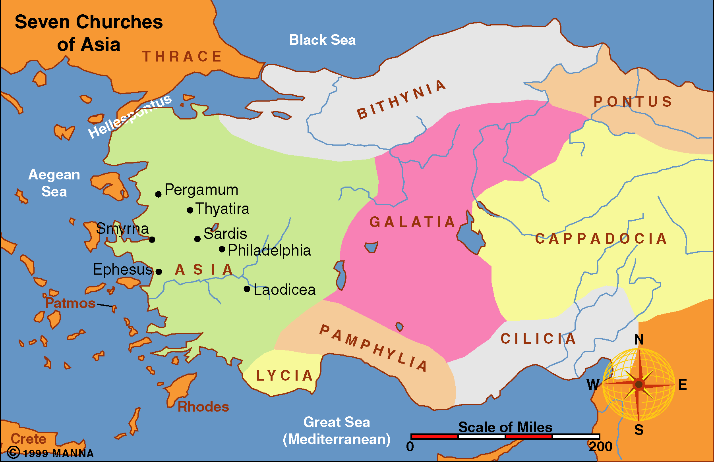
40 Miles SE from Philadelphia
City that was rich.
So rich needed no help to rebuild after mostly destroyed by earthquake in 60 AD

Slide 6
Tacitus, the Roman historian, inferred that it was unusual that any city would be rich enough to rebuild itself.
(The Annals of Tacitus, 14.27.1)

Slide 7
40 Miles SE from Philadelphia
City that was rich.
So rich needed no help to rebuild after mostly destroyed by earthquake in 60 AD
Main commercial city of the region
Easy target for lethargy & self-satisfied complacency

Slide 8
Commercial Background
Three Main Businesses
Banking center for the region (riches)
Black wool market (fine garments)
Ointment for eyes (good vision)
True Wealth
True Raiment
True Vision

Slide 9
Col 4:12-16
12 Epaphras, who is one of you, a bondservant of Christ, greets you, always laboring fervently for you in prayers, that you may stand perfect and complete in all the will of God.
13 For I bear him witness that he has a great zeal for you, and those who are in Laodicea, and those in Hierapolis.
14 Luke the beloved physician and Demas greet you.
15 Greet the brethren who are in Laodicea, and Nymphas and the church that is in his house.
16 Now when this epistle is read among you, see that it is read also in the church of the Laodiceans, and that you likewise read the epistle from Laodicea.

Slide 10
Letters To Seven Church of Asia
(Rev. 2-3)
Good/
Bad
Good/
Bad
Good
Good
Good/
Bad
Good/
Bad
Bad
The Only One of The Seven
That All Bad!
No Commendation
Bad

Slide 11
Rev 3:14-22
14 "And to the angel of the church of the Laodiceans write, 'These things says the Amen, the Faithful and True Witness, the Beginning of the creation of God:
15 "I know your works, that you are neither cold nor hot. I could wish you were cold or hot.
16 So then, because you are lukewarm, and neither cold nor hot, I will vomit you out of My mouth.
17 Because you say, 'I am rich, have become wealthy, and have need of nothing'--and do not know that you are wretched, miserable, poor, blind, and naked--

Slide 12
18 I counsel you to buy from Me gold refined in the fire, that you may be rich; and white garments, that you may be clothed, that the shame of your nakedness may not be revealed; and anoint your eyes with eye salve, that you may see.
19 As many as I love, I rebuke and chasten. Therefore be zealous and repent.
20 Behold, I stand at the door and knock. If anyone hears My voice and opens the door, I will come in to him and dine with him, and he with Me.
21 To him who overcomes I will grant to sit with Me on My throne, as I also overcame and sat down with My Father on His throne.

Slide 13
22 He who has an ear, let him hear what the Spirit says to the churches." ' "

Slide 14
A Lukewarm Church
Rev. 3:14-22
The Problem (vv. 15-16)

Slide 15
I. The Problem (vv. 15-16)
Lukewarm
Indifferent – Apathy, lacking in diligence
Like own water supply
  One of the weaknesses of the city – lacked adequate water supply.
  “Hemer writes that the mineral deposits in the remains of it’s aqueduct system lend evidence to the theory that its water came from the hot springs to the south. If this is so, the water would have been lukewarm, even after flowing several miles. In contrast, only a few miles away, Colossae had a good supply of refeshing cold water, and Hierapolis prized its hot spring water which helped administer healing to the ailing” (Harkrider)

Slide 16
I. The Problem (vv. 15-16)
Lukewarm
Indifferent – Apathy, lacking in diligence
Like own water supply
Knowledge without zeal
  Opposite of the Jews (Rom. 10:2)
  General conviction of the truth & of the importance of Christianity – but no zeal or enthusiasm
  Uncommitted & uninvolved.

Slide 17
I. The Problem (vv. 15-16)
Lukewarm
Indifferent – Apathy, lacking in diligence
Like own water supply
Knowledge without zeal
Neither cold nor hot
  Hot = diligent, zealous
  Cold = total against what is right
    Knows his abject poverty
    Honest – no disguise or pretense

Slide 18
I. The Problem (vv. 15-16)
Lukewarm
Indifferent – Apathy, lacking in diligence
Like own water supply
Knowledge without zeal
Neither cold nor hot
Hard to deal with
  One who is cold – is more apt to change
  Lukewarm does not see any need (v. 17)

Slide 19
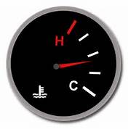
Picture of a Lukewarm Christian
Love God, but not first
Believe that religion is a good and important thing to have in life, but think it should not consume them
Love others in theory, but in practice do very little for strangers and outcast
Have good intentions to participate in good deeds someday, but don’t redeem their time and resources to take action.
Love hearing stories about those who live zealously for God, but the stories never inspire real change and greater zeal in own life
Are often silent about their faith
Settle into a one-sided religion (personal or doctrinal)
Lean on own strength, rather than full faith in God
Phillip Shumake, Lifelong Zeal, pp 21-22

Slide 20
Hard To See What We Are NOT DOING
Overt acts of sin are easily seen by self & others (lie, cheat, curse, drink, steal).
Even sins of attitude that involve DOING are easily seen (hate, lust, bitter, envy, jealousy, anger).
Harder to detect what I fail to do.
Even harder to see:
  That I don’t care as much as should
  That I’m not involved as I ought to be
  That I am not as dedicated as ought to be
  That I should have grown more by now
Especially true with one whose apathy has not caused them to quit altogether.

Slide 21
A Lukewarm Church
Rev. 3:14-22
The Problem (vv. 15-16)
The Reason (v. 17)

Slide 22
II. The Reason (v. 17)
Don’t See Self As They Are
False Sense of Security
  “Need of nothing” (v. 17)
  Reason that are self-sufficient since are rich
  Doing quite well – so not concerned about the spiritual

Slide 23
II. The Reason (v. 17)
Don’t See Self As They Are
False Sense of Security
“You say” (v. 17)
  In own eyes thought selves to be strong.
  “Like many modern Christians who do just enough to keep their names on a church roll, they would likely have been insulted had anyone else accused them of being lukewarm and unpleasing before the Lord.” (Harkrider)

Slide 24
II. The Reason (v. 17)
Don’t See Self As They Are
False Sense of Security
“You say” (v. 17)
Don’t See Their Real Condition
  Wretched – Deplorable
  Miserable – To be pitied
  Poor – Do have need
  Blind – Can’t see
  Naked – Lacking so much
Opposite of what they thought!

Slide 25
II. The Reason (v. 17)
Don’t See Self As They Are
False Sense of Security
“You say” (v. 17)
Don’t See Their Real Condition
Calloused
  Heb. 6:4-6
  Possible to allow the word to become meaningless – hear so much of it preached, taught, etc.

Slide 26
A Lukewarm Church
Rev. 3:14-22
The Problem (vv. 15-16)
The Reason (v. 17)
The Reaction (vv. 16, 19, 20)

Slide 27
III. The Reaction (vv. 16, 19, 20)
God is Greatly Displeased
Spew them out (v. 16)
  Footnote: “spit or vomit”
  Makes God sick!
  God is disgusted with indifference
  Utter rejection
Lord’s view of:
carelessness, indifference, slothfulness, etc.

Slide 28
III. The Reaction (vv. 16, 19, 20)
God is Greatly Displeased
Spew them out (v. 16)
Rebukes & Chastens (v. 19)
  Because of his Love (not inconsiderate)
  Disciplines as a Father would a child

Slide 29
III. The Reaction (vv. 16, 19, 20)
God is Greatly Displeased
Spew them out (v. 16)
Rebukes & Chastens (v. 19)
Knocks & Pleads (v. 20)
  Desires to come into your dwelling
  Not force himself – waiting for admission

Slide 30
A Lukewarm Church
Rev. 3:14-22
The Problem (vv. 15-16)
The Reason (v. 17)
The Reaction (vv. 16, 19, 20)
The Answer (vv. 18-19)

Slide 31
IV. The Answer (vv. 18-19)
Repent
Buy From Me (v. 18)
  Gold – so that will be rich
  White garment – so that be clothed
  Salve – so that might see
  Buy = do what have to do to attain…

Slide 32
IV. The Answer (vv. 18-19)
Repent
Buy From Me (v. 18)
Be Zealous (v. 19)
  Hot – not lukewarm
  Since it is a command – can just do it!
  Col. 3:23

Slide 33
IV. The Answer (vv. 18-19)
Repent
Buy From Me (v. 18)
Be Zealous (v. 19)
Repent (v. 19)
  Change your mind
  Then change your life

Slide 34
A Lukewarm Church
Rev. 3:14-22
The Problem (vv. 15-16)
The Reason (v. 17)
The Reaction (vv. 16, 19, 20)
The Answer (vv. 18-19)

