Slide 1
Is it a Sin?
Drink?
Dance?
Gamble?
Pre-marital sex?
Homosexuality?
Wear short attire?

Slide 2

Is it a Sin?
Homosexuality?

Slide 3

What Constitutes Sin?
Sin is a violation of God’s law
Sin is a violation of God’s law
1 John 3:4
Rom. 4:15
It does not have to be specifically stated

Slide 4
Is Homosexuality
a Sin?
Political Issue
  “Gay rights”
  “Hate crimes”
  “Same sex marriage”
  Part of a political party platform
Moral Issue
Biblical Issue

Slide 5
We Are
Told That
10%
Of
Population
Are
Homosexual
Based on 1948 Kinsey Research
Kinsey Research flawed
  Database included a high percentage of prison inmates and known sex offenders.
  Convicted criminals comprised a full 25% of Kinsey’s male sample, compared to less than 1% of the total U.S. population
  Newsweek, (2/93) “Ideology, not sound science, has perpetuated a 1-in-10 myth. In the nearly half century since Kinsey, no survey has come close to duplicating his findings.”

Slide 6
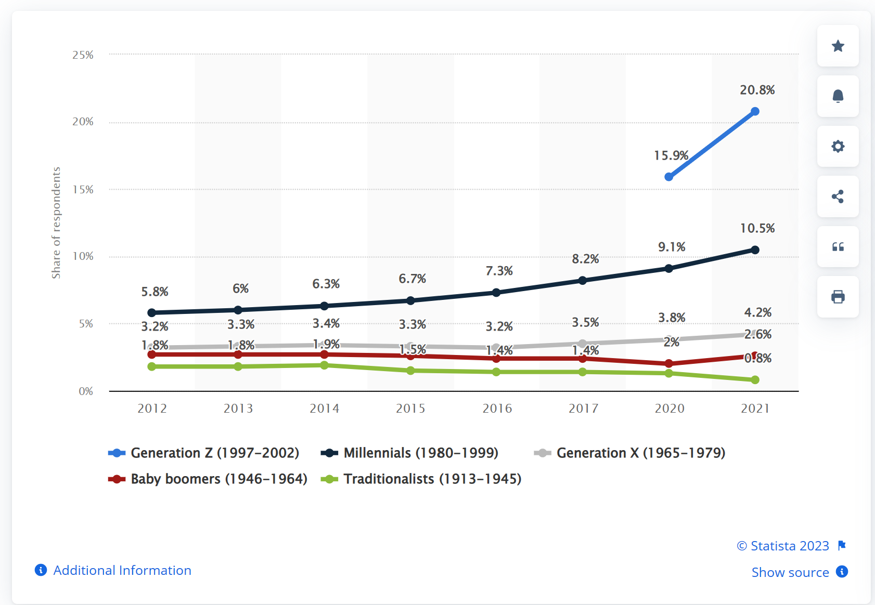
Share of Americans who identify as LGBT from 2012 to 2021, by generation
Statista.com

Slide 7
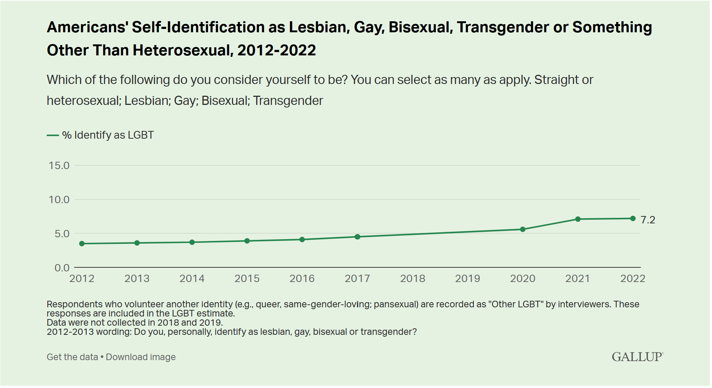
March 2022

Slide 8

What Does This Say?
Not as many as we are told
Yet, more and more think it is okay
Push to be more tolerant
Is a relation to acceptance & religious views

Slide 9

Is Homosexuality
a Sin?
Passages Addressing It

Slide 10
Passages Addressing It
Genesis 19

Slide 11
Gen. 19:1-28
4 Now before they lay down, the men of the city, the men of Sodom, both old and young, all the people from every quarter, surrounded the house.
5 And they called to Lot and said to him, "Where are the men who came to you tonight? Bring them out to us that we may know them carnally."
Bring them out to us so we can have sexual relations with them.” (NCV)

Slide 12
Gen. 19:1-28
24 Then the LORD rained brimstone and fire on Sodom and Gomorrah, from the LORD out of the heavens.
25 So He overthrew those cities, all the plain, all the inhabitants of the cities, and what grew on the ground.
26 But his wife looked back behind him, and she became a pillar of salt.
27 And Abraham went early in the morning to the place where he had stood before the LORD.
28 Then he looked toward Sodom and Gomorrah, and toward all the land of the plain; and he saw, and behold, the smoke of the land which went up like the smoke of a furnace.

Slide 13
Passages Addressing It
Genesis 19
Leviticus 18 & 20

Slide 14
Lev. 18:22
22 You shall not lie with a male as with a woman. It is an abomination.
“ ‘You must not have sexual relations with a man as you would a woman. That is a hateful sin’” (NCV).

Slide 15
Lev. 20:13
13 If a man lies with a male as he lies with a woman, both of them have committed an abomination. They shall surely be put to death. Their blood shall be upon them.
“ ‘If a man has sexual relations with a man as one does with a woman, both of them have done what is detestable. They are to be put to death; their blood will be on their own heads.” (NIV)

Slide 16
Passages Addressing It
Genesis 19
Leviticus 18 & 20
Deuteronomy 23

Slide 17
Deut. 23:17
17 "There shall be no ritual harlot of the daughters of Israel, or a perverted one of the sons of Israel.
“sodomite” (KJV)

Slide 18
Passages Addressing It
Genesis 19
Leviticus 18 & 20
Deuteronomy 23
1 Kings 14, 15 & 22

Slide 19
1 Kings 14:24
24 And there were also perverted persons in the land. They did according to all the abominations of the nations which the LORD had cast out before the children of Israel.
“Sodomites” (KJV, ASV)
“male cult prostitute” (ESV)
“(1) a sodomite” (Gensenius, 725)

Slide 20
1 Kings 15:12
12 And he banished the perverted persons from the land, and removed all the idols that his fathers had made.
Footnote NKJV: “Heb. qedeshim, those practicing sodomy and prostitution in religious rituals”
“Sodomites” (KJV, ASV)

Slide 21
1 Kings 22:46
46 And the rest of the perverted persons, who remained in the days of his father Asa, he banished from the land.
2 Kings 23:7
7 Then he tore down the ritual booths of the perverted persons that were in the house of the LORD, where the women wove hangings for the wooden image.

Slide 22
Passages Addressing It
Genesis 19
Leviticus 18 & 20
Deuteronomy 23
1 Kings 14, 15 & 22
Judges 19

Slide 23
Judges 19:22-25
22 As they were enjoying themselves, suddenly certain men of the city, perverted men, surrounded the house and beat on the door. They spoke to the master of the house, the old man, saying, "Bring out the man who came to your house, that we may know him carnally!"
23 But the man, the master of the house, went out to them and said to them, "No, my brethren! I beg you, do not act so wickedly! Seeing this man has come into my house, do not commit this outrage.
24 Look, here is my virgin daughter and the man's concubine; let me bring them out now. Humble them, and do with them as you please; but to this man do not do such a vile thing!"
25 But the men would not heed him. So the man took his concubine and brought her out to them. And they knew her and abused her all night until morning; and when the day began to break, they let her go.

Slide 24
Passages Addressing It
Genesis 19
Leviticus 18 & 20
Deuteronomy 23
1 Kings 14, 15 & 22
Judges 19
Romans 1

Slide 25
Romans 1:24-29
24 Therefore God also gave them up to uncleanness, in the lusts of their hearts, to dishonor their bodies among themselves,
25 who exchanged the truth of God for the lie, and worshiped and served the creature rather than the Creator, who is blessed forever. Amen.
26 For this reason God gave them up to vile passions. For even their women exchanged the natural use for what is against nature.

Slide 26
Romans 1:24-29
27 Likewise also the men, leaving the natural use of the woman, burned in their lust for one another, men with men committing what is shameful, and receiving in themselves the penalty of their error which was due.
28 And even as they did not like to retain God in their knowledge, God gave them over to a debased mind, to do those things which are not fitting;
29 being filled with all unrighteousness, sexual immorality, wickedness, covetousness, maliciousness; full of envy, murder, strife, deceit, evil-mindedness; they are whisperers,

Slide 27
Passages Addressing It
Genesis 19
Leviticus 18 & 20
Deuteronomy 23
1 Kings 14, 15 & 22
Judges 19
Romans 1
1 Corinthians 6

Slide 28
1 Cor. 6:9-10
9 Do you not know that the unrighteous will not inherit the kingdom of God? Do not be deceived. Neither fornicators, nor idolaters, nor adulterers, nor homosexuals, nor sodomites,
10 nor thieves, nor covetous, nor drunkards, nor revilers, nor extortioners will inherit the kingdom of God.

Slide 29
“Homosexual” (NKJV) | “Sodomites” (NKJV)
ESV fn: passive partner in homosexual acts | ESV fn: active partner in homosexual acts
“effeminate” (ASV) | “abusers of themselves with men” (ASV)
“men who have sex with men” (NIV) | “men who have sex with men (NIV)
“passive homosexual partners” (LEB) | “dominant homosexual partners” (LEB)
“soft…a man who submits himself to unnatural lewdness” (Thayer) | “one who lies with a male as with a female” (Thayer)
Notes:
LEB = Lexham English Bible

Slide 30
Passages Addressing It
Genesis 19
Leviticus 18 & 20
Deuteronomy 23
1 Kings 14, 15 & 22
Judges 19
Romans 1
1 Corinthians 6
1 Timothy 1

Slide 31
1 Tim. 1:9-10
9 knowing this: that the law is not made for a righteous person, but for the lawless and insubordinate, for the ungodly and for sinners, for the unholy and profane, for murderers of fathers and murderers of mothers, for manslayers,
10 for fornicators, for sodomites, for kidnappers, for liars, for perjurers, and if there is any other thing that is contrary to sound doctrine,
“who have sexual relations with people of the same sex” (NCV)

Slide 32
Passages Addressing It
Genesis 19
Leviticus 18 & 20
Deuteronomy 23
1 Kings 14, 15 & 22
Judges 19
Romans 1
1 Corinthians 6
1 Timothy 1
Jude 7

Slide 33
Jude 7
7 as Sodom and Gomorrah, and the cities around them in a similar manner to these, having given themselves over to sexual immorality and gone after strange flesh, are set forth as an example, suffering the vengeance of eternal fire.
“pursued unnatural desire” (ESV)
“desired sexual relations that God does not allow” (NCV)

Slide 34
Summary
Gen. 19:1-28 - God Destroyed Sodom
Lev. 18:22 – Abomination
Lev. 20:13 – Death
Deut 23:17 – Perverted
1 Kings 14:24 – Perverted
1 Kings 15:12 – Associated with idolatry
1 Kings 22:46 – Perverted Banished
2 Kings 23:7 – Perverted
Judges 19:22-30 – Wicked / Outrage / Vile
Rom. 1:24-29 – Against Nature
1 Cor. 6:9-10 – Can’t go to heaven
1 Tim. 1:9-10 – Law lies against (penalty)
Jude 7 – Suffer Vengeance

Slide 35

Bible Terms
Homosexuals (1 Cor. 6:9, NKJV)
Sodomites (1 Cor. 6:9, NKJV)
Abusers of themselves (1 Cor. 6:9 KJV)
Perverted (Deut. 23:17; 1 Tim. 1:10)
Dogs (Deut. 23:18; Rev. 22:15)

Slide 36
Is Homosexuality
a Sin?
Passages Addressing It
A Great Problem

Slide 37
A Great Problem
An old problem (Gen. 19)
A problem in society
  Advocacy groups
    Homophile Movement
    Gay Liberation Movement
    New Alliance for Gay Equality
  Accepted in some denominations

Slide 38
The “Gay” Agenda
Human Rights Campaign (HRC) – annual budget of 50 Million
Goal:
  Remove from society all traditional notions of sexual morality. When it comes to sex, there is no right or wrong.
  Redefine legitimate marriage and the nuclear family
  Not just tolerate, but celebrate (“celebrate diversity”)
Plan of Attack
  Create acceptance by presenting “gay” as normal
  Create laws that protect “gays” from condemnation
Notes:
http://www.cwfa.org/articles/14696/CFI/family/index.htm

Slide 39
The “Gay” Agenda
2005 Article – by Clinton Fein
On “hate crimes” laws: “Hate Crime laws are just the beginning. Once those are passed either federally or in all 50 states, begin campaign to eliminate homophobia entirely.”
On “hate thoughts” and “hate speech” laws: “Homophobic inclinations alone, even without any actions, should be criminal and punishable to the full extent of the law.”
On influencing public policy: “Make sure that gay representation permeates every level of governance.”
On “same-sex marriage”: “Demand the institution and then wreck it. James Dobson was right about our evil intentions. We just plan to be quicker than he thought.”
On “gays” in the Church: “Reclaim Jesus. He was a Jewish queer to begin with, and don’t let anyone forget it.”

Slide 40

The “Gay” Agenda
Desensitization
Jamming
Conversion
Continuous flood of “Gay” propaganda
Example: Ellen, Brokeback Mountain, Philadelphia, Will and Grace
Public smearing of traditionalist, Christians who oppose
“Homphobe”, “hatemonger”, “bigot”, “Nazi”
Marshall Kirk
Hunter Madsen
Convert American emotion, mind & will
“Gay civil right” –focus on “civil rights” rather than conduct

Slide 41
A Great Problem
An old problem (Gen. 19)
A problem in society
A problem in the church
  Same as any other sin – some are guilty
  Some would justify it

Slide 42
Is Homosexuality
a Sin?
Passages Addressing It
A Great Problem
A Learned Behavior

Slide 43
A Learned Behavior
Seen in that the Bible condemns it
Same with any sin (drinking, fornication)
Testimony of the Gay & Lesbian community:

Slide 44
Camille Paglia, - Lesbian Activist & Writer
“No one is born gay. The mere idea that that is possible is a flimsy fabrication of sloppy journalists and amoral queer activists. Any person, male or female, who cannot feel the sexual allure of the opposite sex has been traumatized by some early combination of social circumstances.”

Slide 45
Contributing Factors
Sexual Revolution (loosening standards)
Domineering Parents (Mother)
Feminist Movement

Slide 46
Is Homosexuality
a Sin?
Passages Addressing It
A Great Problem
A Learned Behavior
It is a Sin

Slide 47

It is a Sin
Fornication (1 Cor. 6:18)
Specifically forbidden (1 Cor. 6:9)
Against nature (Rom. 1:26-27)
Violates God’s plan for sexuality (Heb. 13:4; Matt. 19:4-6)

Slide 48
Is Homosexuality
a Sin?
Passages Addressing It
A Great Problem
A Learned Behavior
It is a Sin
Can Overcome

Slide 49
Can Overcome
If it is sinful – you can overcome (Phil. 4:13)
Requires repentance (Acts 17:30-31)
The Corinthians did (1 Cor. 6:9-11)

Slide 50
Is Homosexuality
a Sin?
Passages Addressing It
A Great Problem
A Learned Behavior
It is a Sin
Can Overcome

