Slide 1
Letters To Seven Church of Asia
(Rev. 2-3)
Some were good (Smyrna, Philadelphia)
Some were good / bad (Ephesus, Pergomas, Thyatira, Sardis)
One was bad (Laodicea)

Slide 2
Letters To Seven Church of Asia
(Rev. 2-3)
Good/
Bad
Good/
Bad
Good
Good
Good/
Bad
Good/
Bad
Bad
Most of us would like to be in GOOD church (no condemnation)
None of us would have anything to do with a BAD church (no commendation)
Reality: may be in a church that is GOOD / BAD (Some commendation & Some condemnation)

Slide 3
A Church Left Its First Love – Ephesus (Rev. 2:1-7)
A Church Under Pressure – Smyrna (Rev. 2:8-11)
A Church That Compromised – Pergamos (Rev. 2:12-17)
A Tolerant Church – Thyatira (Rev. 2:18-29)
A Dead Church – Sardis (Rev. 3:1-6)

Slide 4

The Church At Philadelphia (Rev. 3:7-13)
Get a letter – You’ve done great, so keep on!
You have promise & opportunity.
A Church
That was Faithful

Slide 5
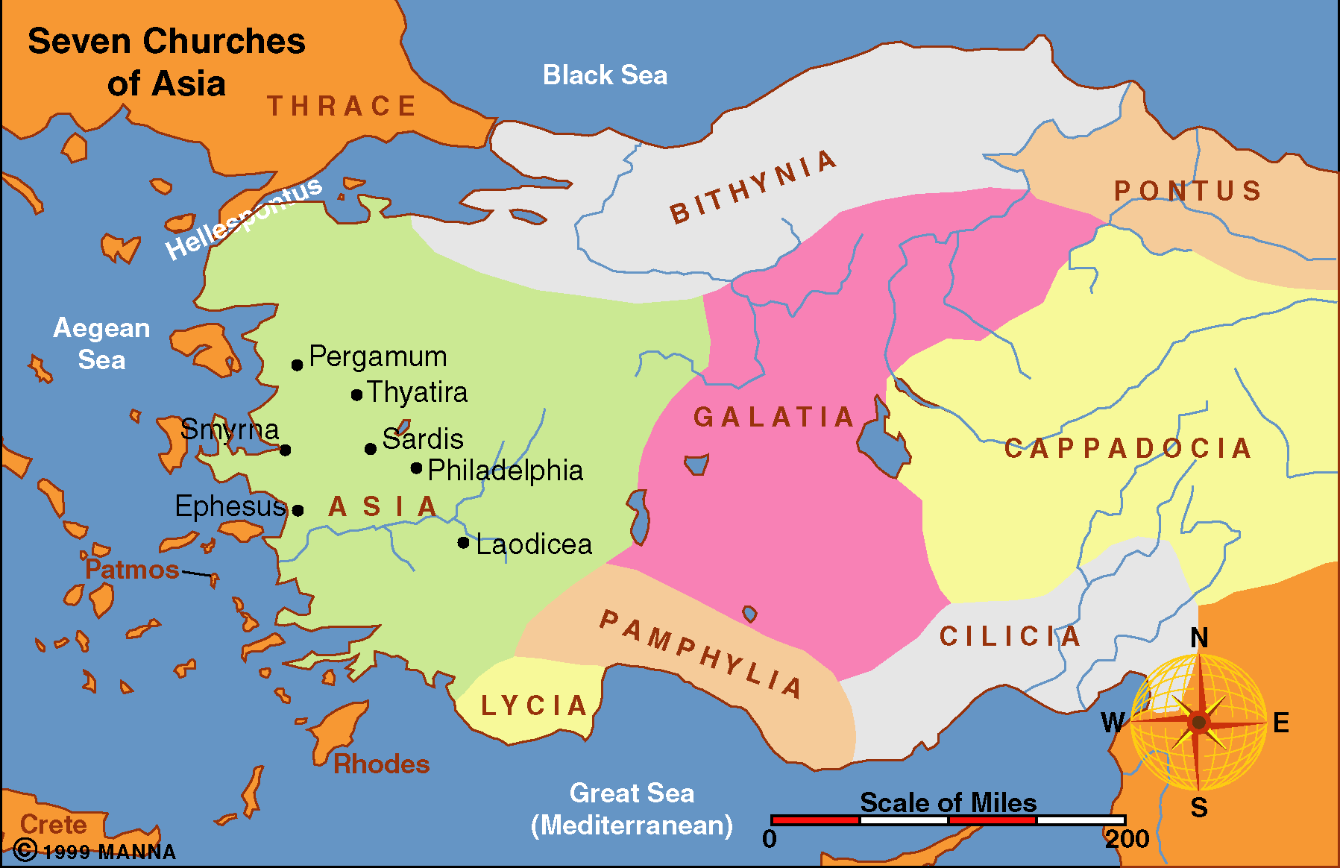
28 miles SE of Sardis
Dates back to 150 BC
Named after King Attalus II Philadephus, of Pergamum (159-138 BC). Named the city out of affection for his brother Ecumenus II
“Missionary” city – for the purpose of spreading Greek culture and language.
Youngest of the 7 cities

Slide 6
Background / Circumstance
We know nothing about the establishment or beginning of this church
Faced some opposition – from Jews

Slide 7
Rev 3:7-13
7 "And to the angel of the church in Philadelphia write, 'These things says He who is holy, He who is true, "He who has the key of David, He who opens and no one shuts, and shuts and no one opens":
8 "I know your works. See, I have set before you an open door, and no one can shut it; for you have a little strength, have kept My word, and have not denied My name.
9 Indeed I will make those of the synagogue of Satan, who say they are Jews and are not, but lie--indeed I will make them come and worship before your feet, and to know that I have loved you.

Slide 8
10 Because you have kept My command to persevere, I also will keep you from the hour of trial which shall come upon the whole world, to test those who dwell on the earth.
11 Behold, I am coming quickly! Hold fast what you have, that no one may take your crown.
12 He who overcomes, I will make him a pillar in the temple of My God, and he shall go out no more. And I will write on him the name of My God and the name of the city of My God, the New Jerusalem, which comes down out of heaven from My God. And I will write on him My new name.
13 He who has an ear, let him hear what the Spirit says to the churches." '

Slide 9
A Faithful Church
Rev. 3:7-13
The Salutation (v. 7)

Slide 10
The Salutation (v. 7)
Holy
  Identified with the holiness of the Father
  Purity – set apart
  Rev. 4:8 – “Holy, Holy, Holy”
  Psa. 111:9 – Holy & Reverend

Slide 11
The Salutation (v. 7)
Holy
True
  Dependable
  Genuine – real
  “True”
    bread (John 6:32)
    Light (John 1:9)
    Vine (John 15:1)
  In contrast to Jews who are “untrue”

Slide 12
The Salutation (v. 7)
Holy
True
Key of David
  One in whom promise to David’s seed is fulfilled (Isa. 9:6, 7; Luke 1:32-33)
  “Key” implies power to open & shut – suggests authority over his kingdom
“His character of holiness and truth
is his right to kingship.”
Ray Summers

Slide 13
A Faithful Church
Rev. 3:7-13
The Salutation (v. 7)
The Praise (vv. 8, 10)
Were Faithful!

Slide 14
The Praise (vv. 8, 10)
A Choice
  Not merely an ability that some have and some don’t
  A choice – a decision
  Required of all (2:10)
  Thus, anyone can make same choice!

Slide 15
The Praise (vv. 8, 10)
A Choice
Little Strength
  Likely means – not large in number
    A Church does not have to be large & growing to be faithful & effective
    Faithful in spite of little strength
    Size within self – does not tell us whether a church is strong, weak, true and untrue, etc.
  Could refer to little or no monetary resources
  Having just 1 talent does not justify not using it (Matt. 25:14-30)

Slide 16
Conversely, it is also an encouraging fact to realize that others may regard us as insignificant and unimportant, but the Lord knows even what the “poor widow” does (Mark 12:41-44; 2 Tim. 2:19). - Harkrider

Slide 17
The Praise (vv. 8, 10)
A Choice
Little Strength
Kept my name
  Faithful in the service that honors the name of God
  Faced some test – withstood & remained loyal
  Thus far, persevered (v. 10)
  None of the excuses: live in a wicked world – “gonna just do some things like…”

Slide 18
A Faithful Church
Rev. 3:7-13
The Salutation (v. 7)
The Praise (vv. 8, 10)
The Encouragement (vv. 8, 9, 11)

Slide 19
The Encouragement (vv. 8, 9, 11)
Open Door (v. 8)
  Means opportunity
    “door of faith” open to Gentiles (Acts 14:27)
    “great door” was open to Paul (1 Cor. 16:9)
    door open at Troas (2 Cor. 2:12)
    Prayer for an open door (Col. 4:3)
  Thus, an opening through which a goal can be achieved
  May refer to door of evangelism
    As this was a missionary city – spread of culture
    So would be missionary church – spread gospel

Slide 20
The Encouragement (vv. 8, 9, 11)
Open Door (v. 8)
Enemy Acknowledge You (v. 9)
  Not literally fall down and worship
  Come to recognize those whom they oppose as being God’s people
  Would be vindicated
  Even though endure persecution – will ultimately prevail!

Slide 21
The Encouragement (vv. 8, 9, 11)
Open Door (v. 8)
Enemy Acknowledge You (v. 9)
Persevere (v. 11)
  The fact that you have (v. 10), is encouragement that you can in future
  Can hold what we have (v. 11)
  Perseverance requires determination

Slide 22
A Faithful Church
Rev. 3:7-13
The Salutation (v. 7)
The Praise (vv. 8, 10)
The Encouragement (vv. 8, 9, 11)
The Promise (vv. 10, 12)

Slide 23
The Promise (vv. 10, 12)
Protection (v. 10)
  Not a promise to keep them from temptation
  Keep them from being overwhelmed
  1 Cor. 10:13

Slide 24
The Promise (vv. 10, 12)
Protection (v. 10)
Make Pillar in Temple (v. 12)
  “In ancient times when a person died who had given outstanding service, a pillar was inscribed in his honor with his name upon it in the temple of this god.” (Harkrider)
  Dwell in temple in heaven – promise of heaven
  “Go out no more” – safe & secure [opposed to fear of tremors in the city, people fled to open countryside]

Slide 25
The Promise (vv. 10, 12)
Protection (v. 10)
Make Pillar in Temple (v. 12)
New Name (v. 12)
  Name of my God – identifies to whom belongs – a Child of God
  Name of city of God – verifies citizenship in heaven
  My new name – belongs to the Lord

Slide 26
A Faithful Church
Rev. 3:7-13
The Salutation (v. 7)
The Praise (vv. 8, 10)
The Encouragement (vv. 8, 9, 11)
The Promise (vv. 10, 12)

Slide 27
It is possible for a church to reach
a state that brings no condemnation
from the Lord

