Slide 1
Is it a Sin?
Drink?
Dance?
Gamble?
Pre-marital sex?
Homosexuality?
Wear short attire?

Slide 2
Is it a Sin?
To Gamble?

Slide 3

What Constitutes Sin?
Sin is a violation of God’s law
Sin is a violation of God’s law
1 John 3:4
Rom. 4:15
It does not have to be specifically stated

Slide 4
Is it a Sin to Gamble?
What constitutes gambling?
Is it a sin?
Can we prove it is a sin – even though not mentioned specifically in the Bible?
How can betting $2 a horse or $5 on lottery be wrong, but losing $1,000 in stock market is not?
Can it be justified on basis of revenue?

Slide 5
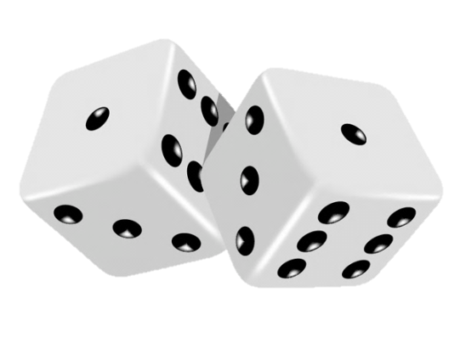
A Widespread Problem
$500,000,000,000 (500 billion) a year in United States (More than combined expenses of Medicare & Medicaid)
1963 Lotteries were banned in every state. Now most states have lotteries.
Storeowners in CA reported decline in grocery sales equivalent to the sale of lotteries tickets where stores sold tickets.
75% of all high school students have gambled.

Slide 6
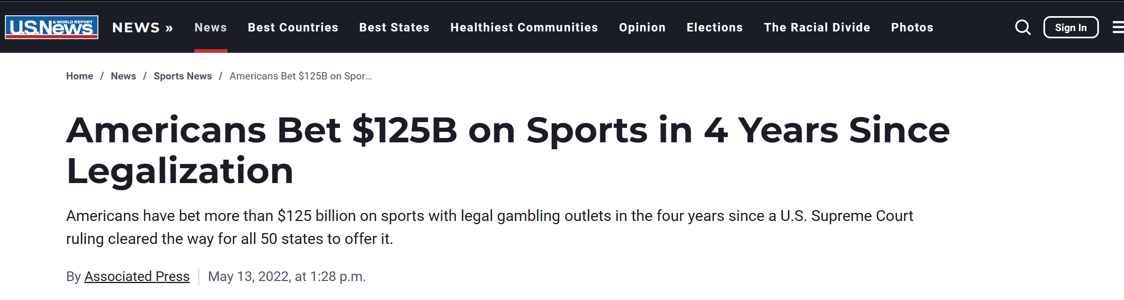

Slide 7
The amount bet in sports gambling varies depending on the location and the event.
In February 2023, bettors in Arizona wagered $609 million on sporting events, including on mobile apps and in person at sportsbook facilities and off-track betting locations¹.
According to a UN report, the amount wagered on illicit betting markets has been pegged somewhere in the ballpark of between $340 billion and $1.7 trillion annually²

Slide 8

Not A New Problem
Greeks in Homer’s time used knucklebones of sheep and goats and used them as dice.
Gambling boards found in Crete date back to 1800 -1900 BC
Babylon - headless arrows were used for making wagers.
“The ancient Egyptians played atep, a game of guessing the number of upheld fingers. The classical Greeks are known to have played with astragals, the forerunner of modern dice, and Jews in biblical Israel gambled by throwing dice. The Romans were reportedly obsessed with gaming and bet heavily on gladiatorial fights and chariot races. The Roman historian Tacitus noted that the ancient Germans gambled not only wealth but liberty as well” (Grolier).

Slide 9
Is it a Sin to Gamble?
What is Gambling?

Slide 10
What is Gambling?
“To bet money on the outcome of a game, contest, or other event” (AHD, p. 546)
“Gambling is the wagering of money or other valuables on the outcome of a game or other event” (Grolier Multimedia Ency.)
“Gambling is betting on the outcome of a future event. Gamblers usually bet money or something else of value as a stake on the outcome they predict. When the outcome is settled, the winner collects the loser’s stakes” (World Book Ency.)

Slide 11
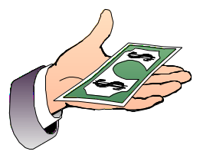


1
Event
(uncertain)
Stake / Wager
Money or anything of value
Agreed upon before
2
3
Gambler # 1
(Winner)
Gambler # 2
(Loser)

Slide 12
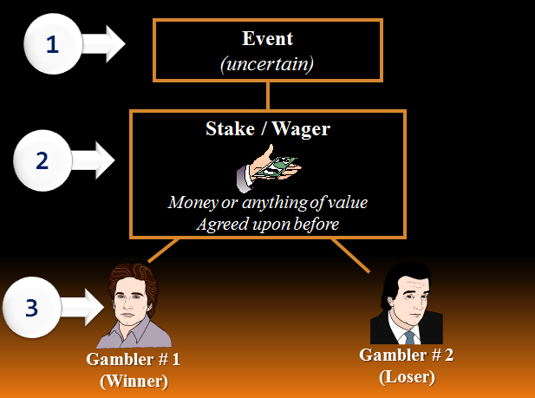
Card Game
Ball Game
Horse / Dog Race
Roll of Dice
Drawing of ticket
Matching numbers
Bet
Price of ticket

Slide 13
What is Gambling?
Gambling
Is Not:
Risk
Insurance
Farming
Stocks
Business
Prizes

Slide 14
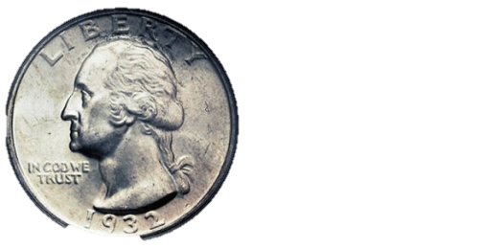
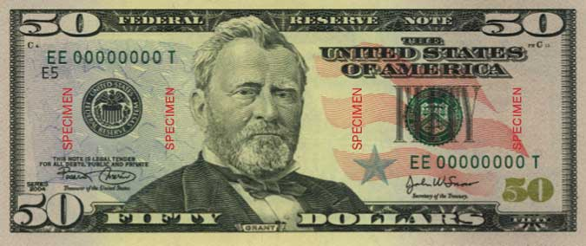

What is Gambling?
Not Determined by Size or Degree
“Gambling, for the compulsive gambler is defined as follows: Any betting or wagering, for self or others, whether for money or not, no matter how slight or insignificant, where the outcome is uncertain or depends upon chance or ‘skill’ constitutes gambling.”
(Gambler’s Anon. Web page)

Slide 15
Is it a Sin to Gamble?
What is Gambling?
Different Forms

Slide 16
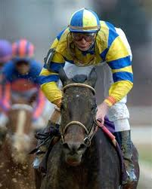
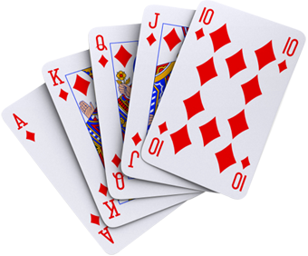
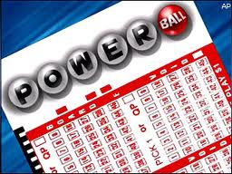
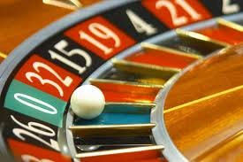
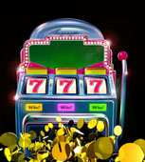
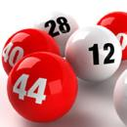
Different Forms
Cards (Poker)
Horse race
Dog race
Lottery
Bingo
Raffle tickets
Slot machines
Roulette
Pitching / Matching coins
Betting on sports
Buying chances – games at fair

Slide 17
Is it a Sin to Gamble?
What is Gambling?
Different Forms
It Violates Bible Principles

Slide 18
Luke 7:18-22
18 Then the disciples of John reported to him concerning all these things.
19 And John, calling two of his disciples to him, sent them to Jesus, saying, "Are You the Coming One, or do we look for another?"
20 When the men had come to Him, they said, "John the Baptist has sent us to You, saying, 'Are You the Coming One, or do we look for another?' "
21 And that very hour He cured many of infirmities, afflictions, and evil spirits; and to many blind He gave sight.
22 Then Jesus answered and said to them, "Go and tell John the things you have seen and heard: that the blind see, the lame walk, the lepers are cleansed, the deaf hear, the dead are raised, the poor have the gospel preached to them.
No Direct
Statement
Rather
Evidence
From
Which To
Draw
Conclusion
Question: “Are you coming one?”
Response: Worked Miracles!
Conclusion: He is the coming one!

Slide 19
It Violates Bible Principles
Addictive

Slide 20

www.gamblersanonymous.org
isomain@gamblersanonymous.org

Slide 21

Crime it breeds to support the addiction
1-2% of the population are compulsive gamblers
“For many of these problems gamblers, the source of their trouble is the lottery. Of the 40,000 calls to the Council on Compulsive Gambling’s national hotline in 1996, fully 52% were from adults addicted to playing the lottery” (Theft by Consent, p. 15)

Slide 22
Addiction Is Wrong
Not to be under the power of any
(1 Cor. 6:12)
Violates
Self Control
(2 Pet. 1:5)

Slide 23
It Violates Bible Principles
Addictive
Covetousness
Inordinate desire for gain
Wants gain without giving or work
Seeks to win at expense of others
Willing for others to loose – so I can gain
Col. 3:5
1 Tim. 6:10

Slide 24
It Violates Bible Principles
Addictive
Covetousness
Violates Principle of Love
Unloving toward those with whom wager
If able – take all at loser’s expense
Is stealing with consent (ill: dueling)
Golden rule (Matt. 7:12)
Love (Matt. 22:39)

Slide 25
It Violates Bible Principles
Addictive
Covetousness
Violates Principle of Love
Violates Stewardship

Slide 26
Stewardship
We are to be good stewards
  Luke 12:42
  1 Pet. 4:10
  1 Cor. 4:2
Gambling is poor stewardship
  Would want your money manager to handle your money that way?
  Odds in state lottery are 1 in 12-14 million (by comparison – chances of struck by lightening 1 in 1.9 million)

Slide 27
It Violates Bible Principles
Addictive
Covetousness
Violates Principle of Love
Violates Stewardship
Violates Legitimate Means of Transfer

Slide 28
Legitimate Means of Transfer
Labor
  Money paid & earned for effort extended
  Eph. 4:28; 2 Cor. 11:8; 2 Thess. 3:10; Luke 10:7
  Gambling doesn’t involve gain by labor

Slide 29
Legitimate Means of Transfer
Labor
Exchange
  A commodity is exchanged for something of value (money or other goods)
  Matt. 13:44, 45; Lk 22:36; Acts 4:32-37; 16:14
  Stocks & Insurance fit here
  Gambling doesn’t involve exchange

Slide 30
Legitimate Means of Transfer
Labor
Exchange
Love / Gift
  Money or something of value given without any expectation of any return
  Help needy (Eph. 4:28; Acts 2, 4, 6, 11)
  Inheritance (Num. 27:1-11; Deut. 21:15-17)
  Gift (Eph. 4:28; Matt. 2:11)
  Prizes fit here

Slide 31
Is it a Sin to Gamble?
What is Gambling?
Different Forms
It Violates Bible Principles
It Breeds Other Sins

Slide 32
It Breeds Other Sins
“…by their fruits ye shall know them”
(Matt. 7:20).
Suicide
General Crime -in
Gambling Areas
To Support
Gambling
General population - 1.1%
Members of Gamblers Anon. - 13%
Check forgery, Prostitution, Tax Evasion, Embezzlement, Illegal Drugs, Drunkenness,
Robberies, and Credit Card Forgery

Slide 33
Is it a Sin to Gamble?
What is Gambling?
Different Forms
It Violates Bible Principles
It Breeds Other Sins

